Slide 1
Quantum Masters Presentation
Weeks 4 & 5
Alex - Ashkan - Elena - Esther - Eva - Lucy

Slide 2
Complex Numbers
The general formula for a complex number is a + bi where b and a are real numbers and i is an imaginary number.
i is the solution to i² = -1. Since no real number satisfies this equation i is an imaginary number.
Absolute value is the magnitude of a quantity irrespective of its sign |-3| = |3| = 3 if c is a complex number → |c|² = c ✕ c*
Ashkan

Slide 3
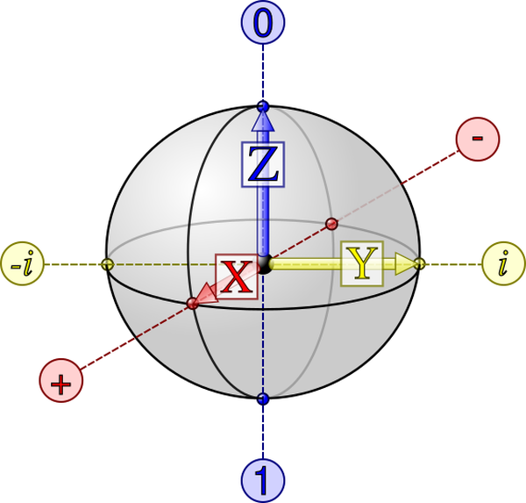
Bloch Sphere
Quantum State is A mathematical entity which provides is the distribution probability of the outcome of a system.
Bloch Sphere is used for visually representing the quantum state of a qubit.
It’s named after physicist Felix Bloch
|+> and |-> are eigenvectors of X gate
Vectors along X are real and vectors along Y imaginary.
Ashkan

Slide 4
The first formula that we used to express the quantum state was the following formula |ѱ> = α|0> + β|1>, where α and β are complex numbers and |α|² ⁺ |β|² = 1.
Then we converted that to |Ѱ> = a|0> + e^{iφ}b|1>, where a and b are real numbers, and it is easier to have one complex number(i) rather than two(α and β).
Using e^{iφ} = Cos(φ) + i Sin(φ) and |e^{iφ}|² = 1 we reach the conclusion that a² + b² = 1.
Since a² + b² = 1 and Sin² x + Cos² x = 1, writing a and b in terms of Sin θ and Cos θ we get, a = Cos θ/2 and b = Sin θ/2
Combining all these reach the final formula
|Ѱ> = Cos θ/2 |0> + e^{iφ} Sin θ/2 |1> for two angles θ and φ. Knowing that e^{iφ} = Cos(φ) + i Sin(φ). Ashkan

Slide 5
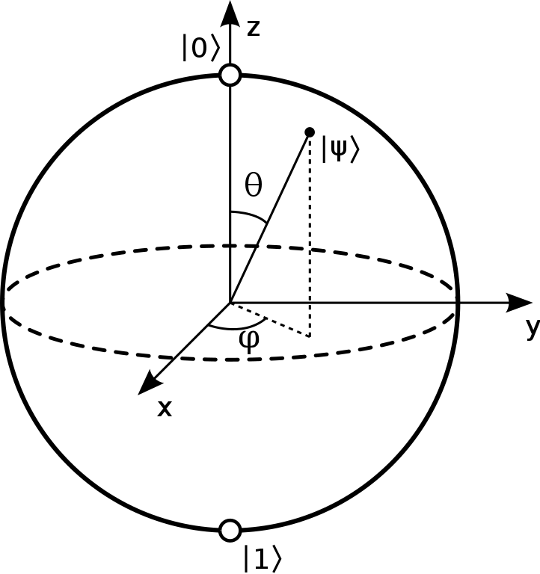
In order to represent a qubit state geometrically we use the general formula |Ѱ> = Cos θ/2 |0> + e^{iφ} Sin θ/2 |1> for two angles θ and φ // e^{iφ} = Cos (φ) + i Sin (φ) // 0<=φ<=pi
Here θ is the degree that starts from the vertical line (z) and moves towards the xy-plane.
Also, φ is the angle that starts at the horizontal line (X) and moves towards line (y).
Using these two degrees, the qubit state can be graphed.
Ashkan

Slide 6
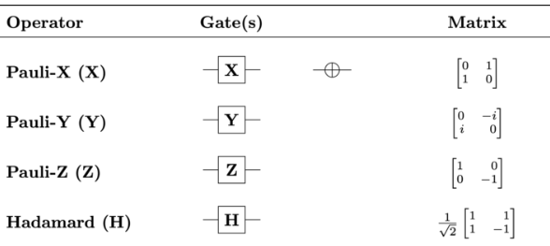
Pauli and Hadamard Gates
The X, Y, and Z gates perform rotations of π radians in the Bloch sphere about the X, Y, and Z axes, respectively. The H gate performs a rotation of π radians about the Bloch vector [1, 0, 1].

Slide 7
Measurement and Wave Function Collapse
Measuring a qubit in a given basis collapses the wave function of the qubit to an eigenstate of the basis
If a_{n} is an eigenstate and 𝜓 is a quantum state, then the probability of obtaining a_{n} when measuring 𝜓 is equal to
Qiskit only allows for measurement in the Z-basis

Slide 8
Stern-Gerlach Experiment
Quantum spin: discovered by physicists Otto Stern and Walther Gerlach in 1922
Quantum spin was demonstrated in Stern-Gerlach Experiment
Neutral particles are sent through a varying magnetic field
It was expected that the particles’ spin would produce a range of deflections depending on field strength
However, it was found that each particle was deflected up or down by a fixed amount (it was quantized)
Think of Z-gate and X-gate as magnetic fields oriented in different directions
Measuring Z then X can change the state of the qubit to an eigenstate in bases
You can also put in an eigenstate into its respective “box” and get the same value back
Elena

Slide 9
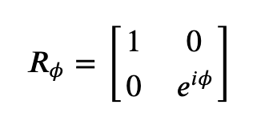
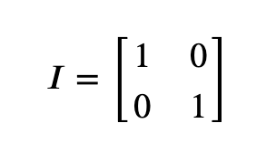
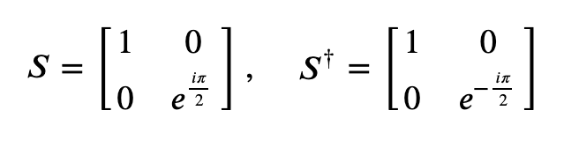
RΦ Gate
RΦ gate rotates angle Φ about the z-axis
Matrix:
Special cases of RΦ gate: I, S, T-gates
I-gate (“Identity gate”) - basically does nothing
Matrix:
S-gate: 𝜙=𝜋/2
Quarter turn around the Bloch sphere
S†-gate is RΦ-gate with 𝜙=−𝜋/2
Matrices:
Elena

Slide 10

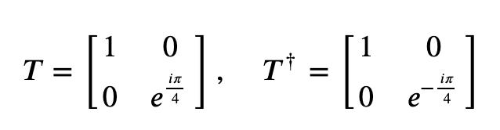

RΦ Gate
S-Gate
Name is due to two applied S-gates have same effect as one Z-gate
T-gate
RΦ-gate with 𝜙=𝜋/4
Matrices:
Also known as
Elena

Slide 11

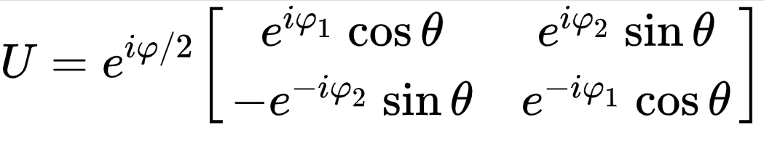
General Unitary Gates
A unitary matrix is a matrix whose elements are pairs of conjugate complex numbers. They are forms of a complex square matrix. The sum of probabilities of all outcomes of any event always equals 1.
Determinant
Esther

Slide 12
Intro to Multi-Qubit Gates
A single bit has two possible states, and a qubit state has two complex amplitudes. Two bits have four possible states: 00 01 10 11
Here is a calculation for probability: p(|00⟩)=|⟨00|a⟩|2=|a00|2
We store 4 complex amplitudes in a 4D-vector
(|00⟩)=|⟨00|a⟩|^2=|00|^2|a⟩=a00|00⟩+a01|01⟩+a10|10⟩+a11|11⟩
Esther

Slide 13
Quantum Algorithms with Eva and Lucy

Slide 14
Agenda:
Phase Kickback: widely used in algorithm design and is the framework to understanding Shor’s algorithm, Quantum Phase Estimation, etc.
Quantum Fourier Transform: Discrete Fourier Transform over wavefunction amplitudes.
Application: Quantum Phase Estimation
Application: Shor’s Algorithm

Slide 15
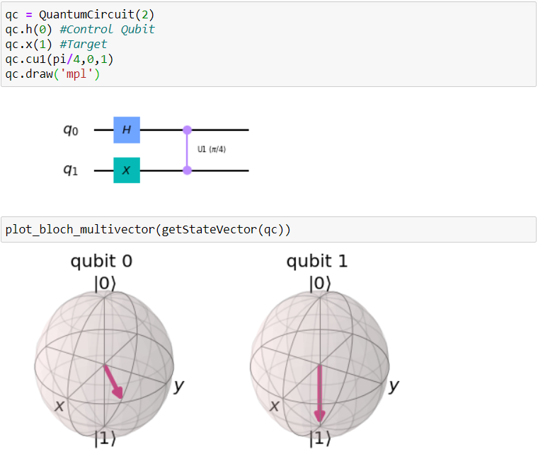
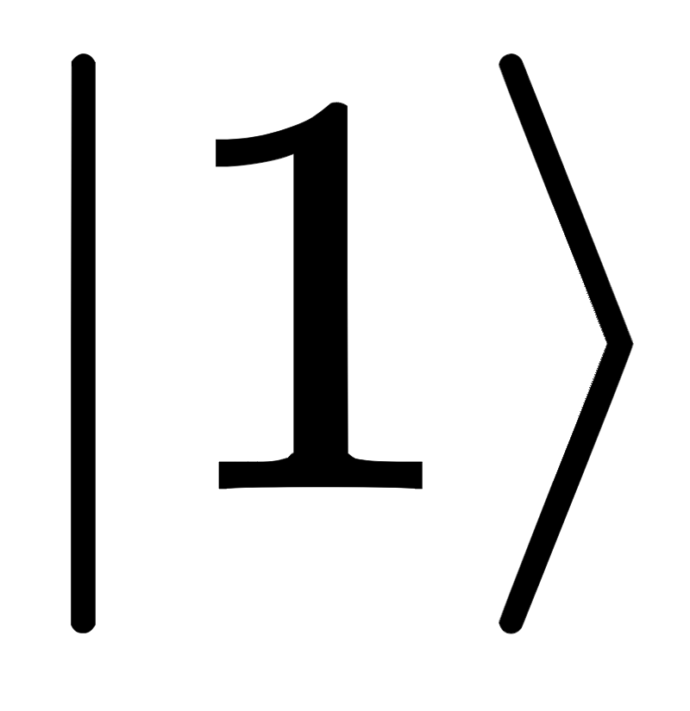
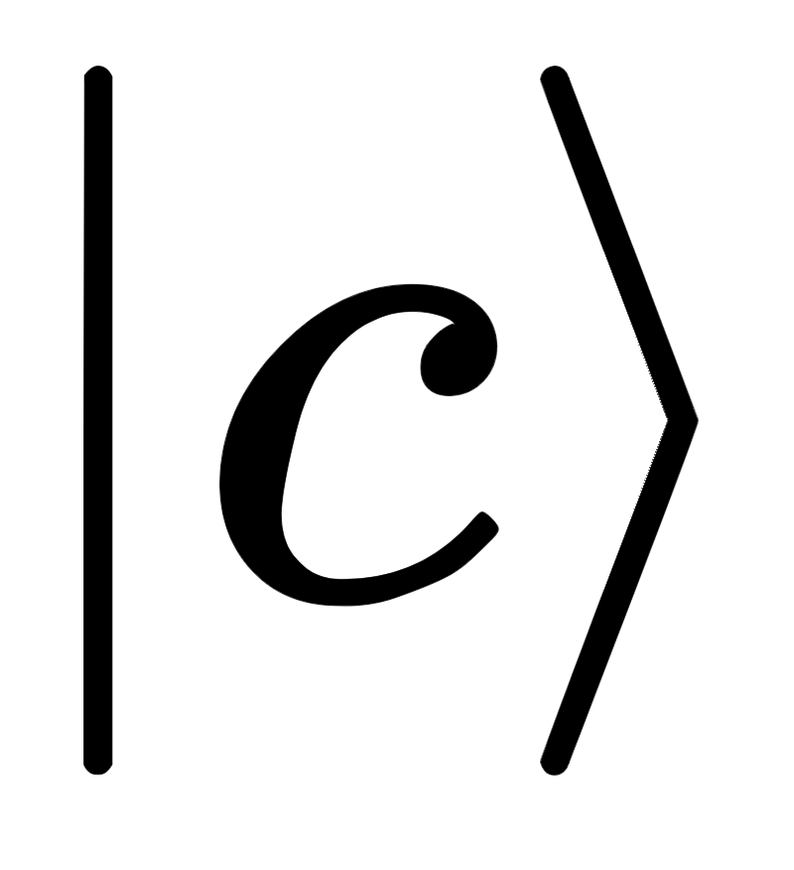
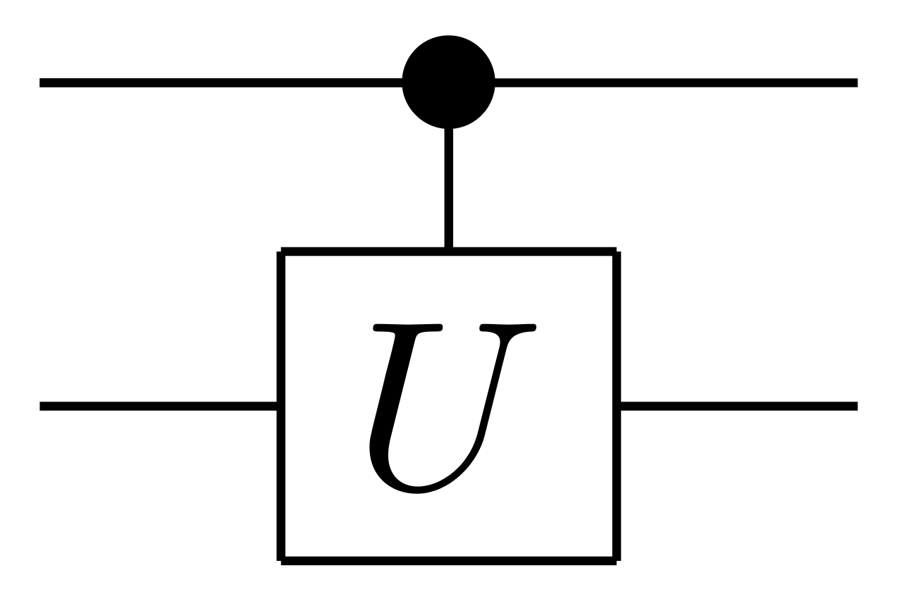
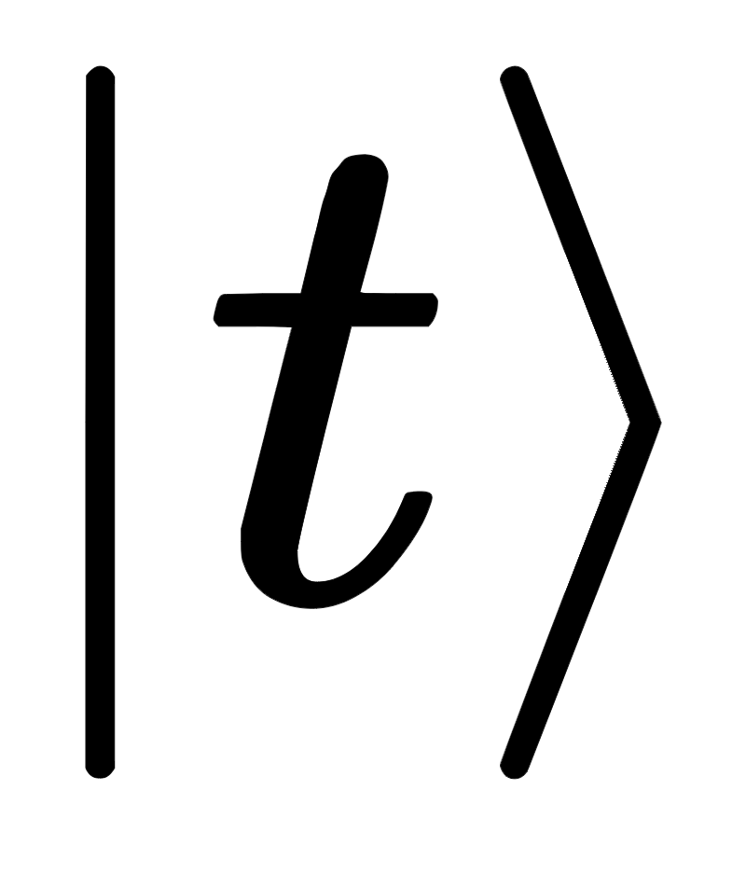
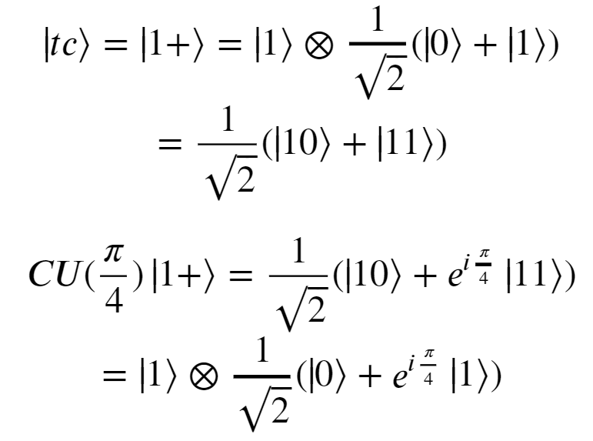
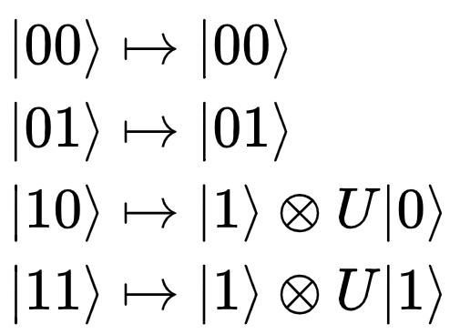
Phase Kickback
Target
Recall: Controlled operations require 2 or more qubits.
How they work: If the control qubit is , then do the operation on the target qubit, otherwise don’t.
Notes:
In the example, we have applied an equal superposition to the first 2 qubits which are our control qubits while the last qubit is our target qubit. In order to see the effect of phase kickback, we initialize the target qubit in the 1-state. Then, we apply the controlled-U operation to both control qubits with the last qubit as their target. We see on the Bloch Sphere that the target qubit remains in the 1-state
CU1 is just a CONTROLLED rotation about Z or R_{phi} as Alex explained previously.

Slide 16
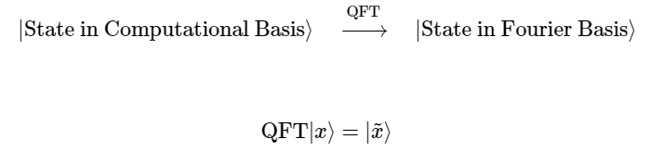
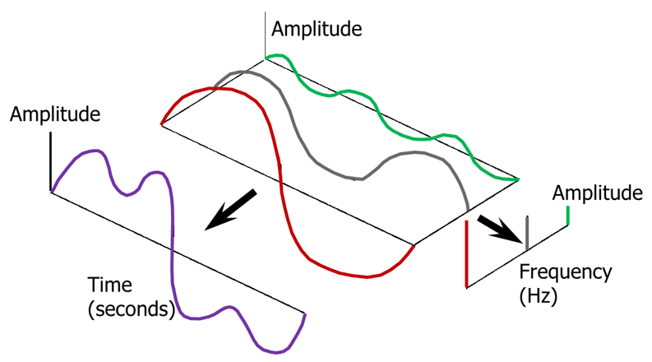
Quantum Fourier Transform - Intuition
Analogous to the Fourier Transform.
Notes:
Image: https://community.sw.siemens.com/s/article/what-is-the-fourier-transform
GIF: https://qiskit.org/textbook/ch-algorithms/quantum-fourier-transform.html
The Fourier Transform is widely used in classical computing specifically in areas of signal processing
Signals include things like sound, images and even scientific measurements)
Signal processing is a field in engineering that tries to analyze these signals to improve transmission, storage, or detection.
The whole concept behind FT is that if you are adding different waves together, you will obtain some resultant wave and with FT you can find out what the significant frequencies making up the resultant wave are, and these graphs are simpler to analyze.
IDEA: You are going from this time-domain or perspective into a frequency perspective
The Quantum Version is the same idea except now, we are dealing with quantum states!!
We have learned about Bases and how when you measure a qubit will always be one of the basis states.
We have also learned that applying transformations or matrices allows us to look at our qubits in a different perspective!
So in these GIFS, we have 4 qubits which can encode up to the number 15 in decimal. As the numbers increase, the qubits change and there is a period associated with the change (the period is just how long it takes to go from 0 to 1). In the second graphic, this is showing the fourier basis, where the rotations represent the frequency with which the qubits go from 0 to 1.
The point is to show that this is exactly analogous to what we are doing with the waves on the left.

Slide 17
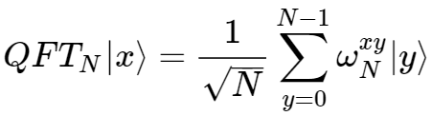

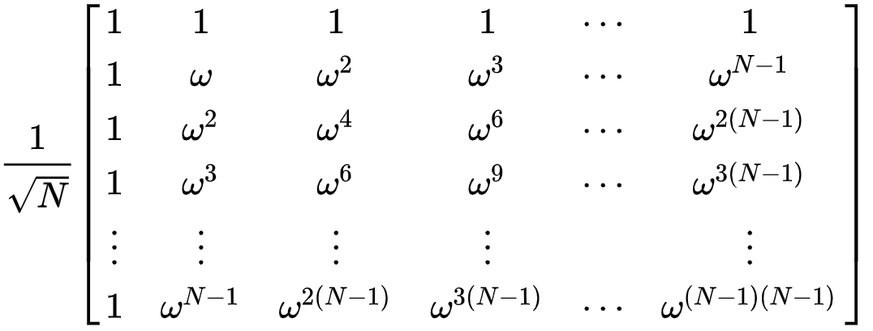
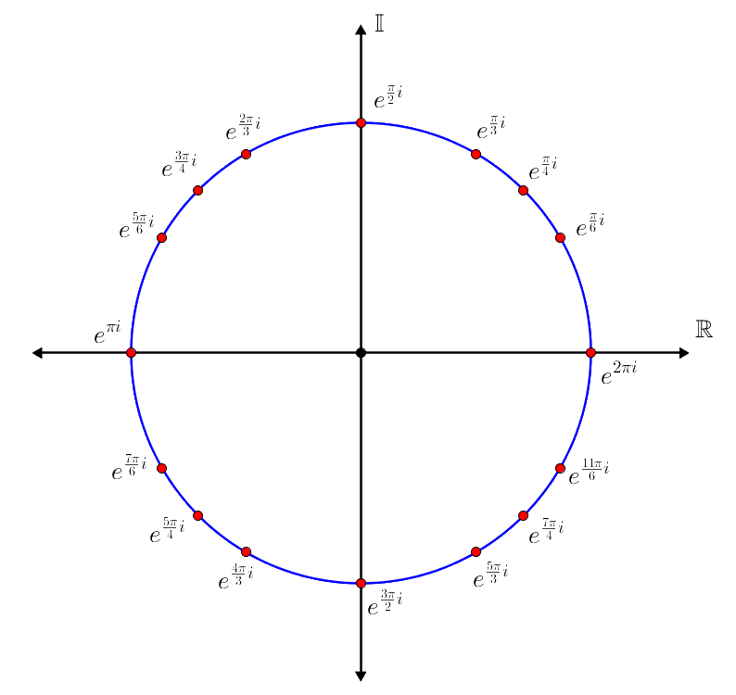
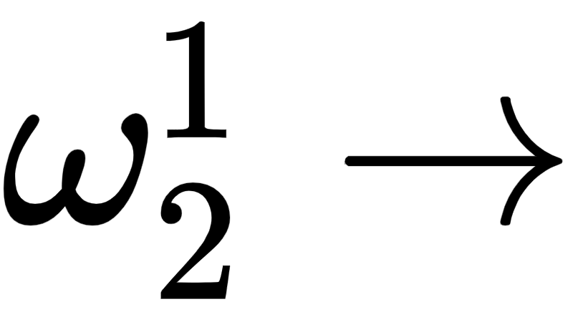
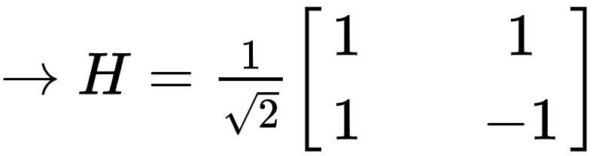
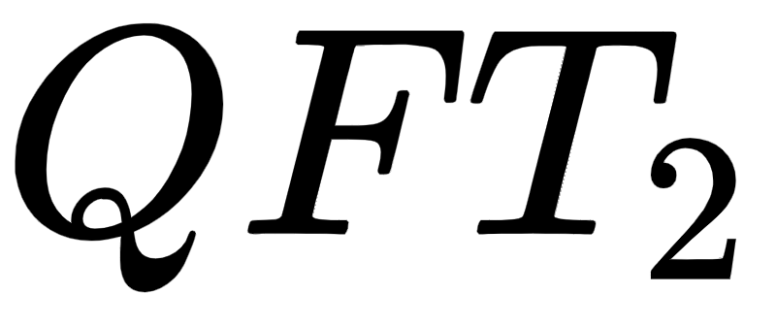
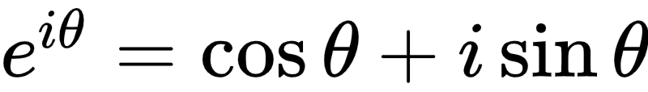
WHERE
N-th roots of Unity
For 1-qubit: N = 2 so we will have a 2x2 matrix
Recall Euler’s Formula:
Notes:
Equations from QISKIT Textbook
Image: https://brilliant.org/wiki/roots-of-unity/
As I said, QFT is just a matrix or transformation! In this case this transformation happens to be via rotations so here I reference the n-th roots of unity to show that all the Quantum Fourier transform is doing is representing the original qubit state in terms of rotations around the familiar unit circle!
As an example we can figure out what the QFT is for 1 qubit very easily. We know that N = 2, so our matric will be 2x2 and we have to figure out what omega^1. In this case, that is just -1 so when we plug this in we obtain the familiar Hadamard gate!

Slide 18
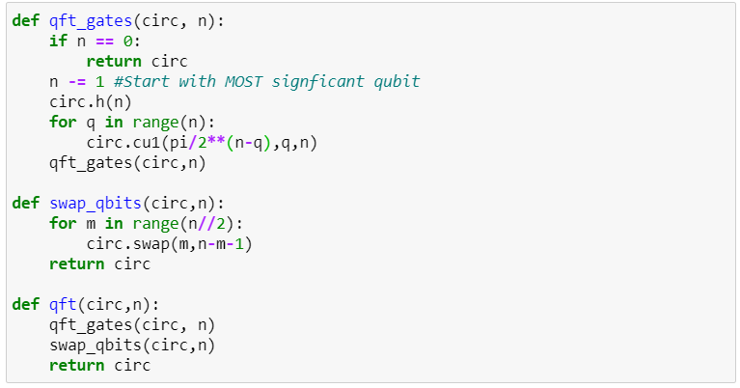
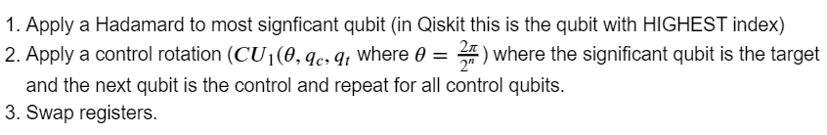
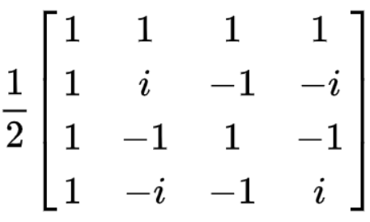
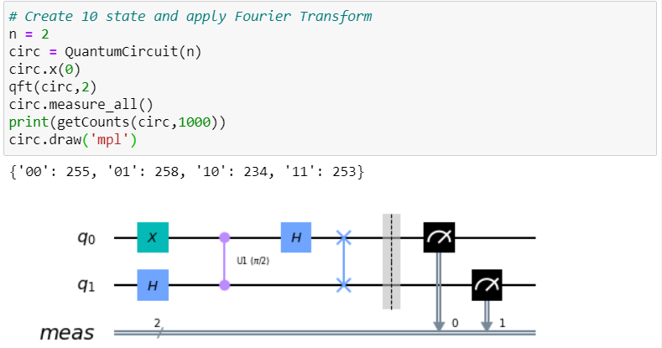
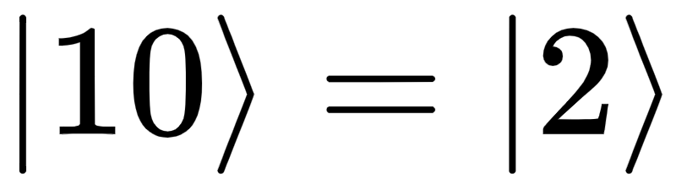
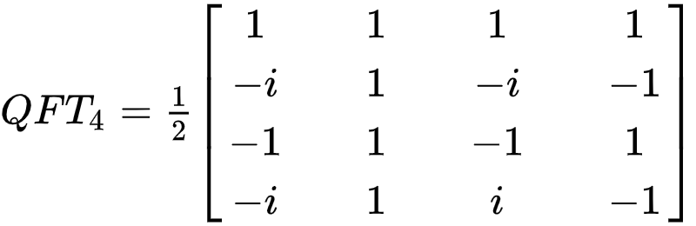
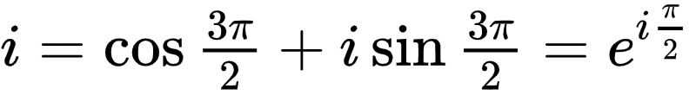
STEPS:
N = 4
Target
Notes:
We swap registers because the order of the qubits is reversed in the output state. Note that it makes sense that we get this fully mixed state because we have changed from the computational basis into this Fourier basis! Our measurement apparatus is fixed in the computational or Z-basis..

Slide 19


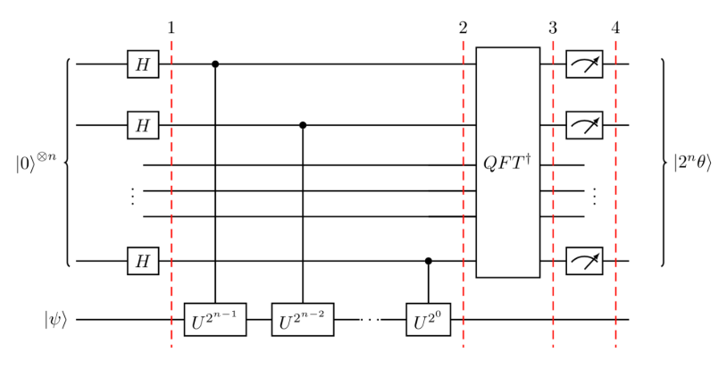
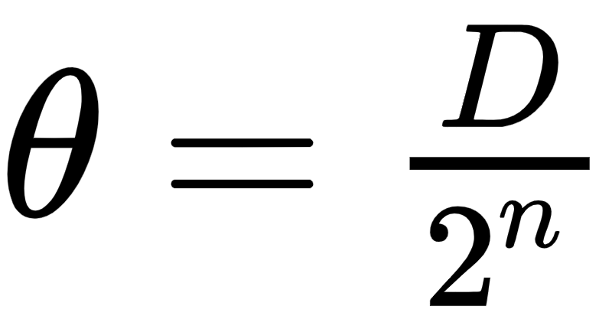
Quantum Phase Estimation
Eigenvalue
Problem: Given Find
𝜃 is encoded as a number between 0 to 2^{n} in the Fourier Basis
So whatever the measurement result is, we convert to decimal number, D, and:
PHASE KICKBACK!
“Counting qubits”
Target: Eigenvector of U
Notes:
The problem in Quantum Phase Estimation is that if we have applied some Unitary gate or Rotation to a given state and we want to know what that was, again we cannot just measure and obtain our result because global phases are NOT observable. We have to cleverly kick back the phase into the Fourier Basis, and then apply a inverse Fourier transform to get back to the computational basis and measure. Because of the phase kickback, we have encoded our phase in this clever way \ket{2^n \theta}
In the first part, all that is happening is the phase of the psi is being KICKED BACK into all those qubits, resulting in a state that is IN THE FOURIER basis.
We perform inverse QFT in order to get back into the computational basis and measure our cleverly encoded phase.

Slide 20
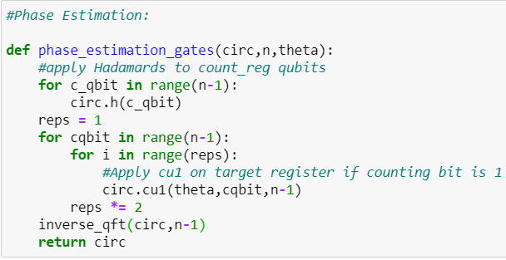
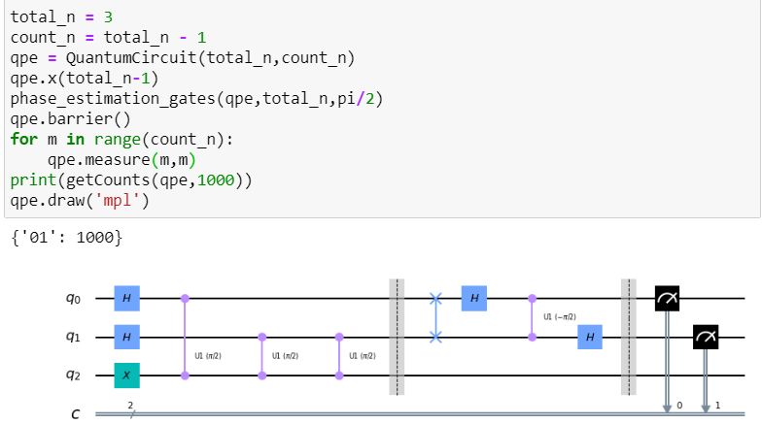
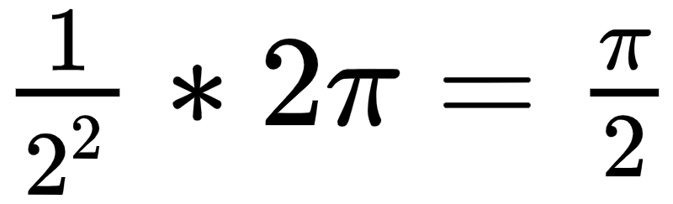
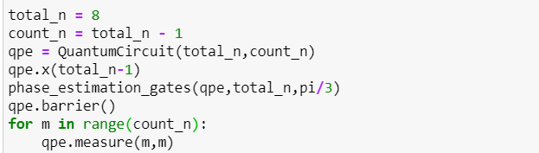
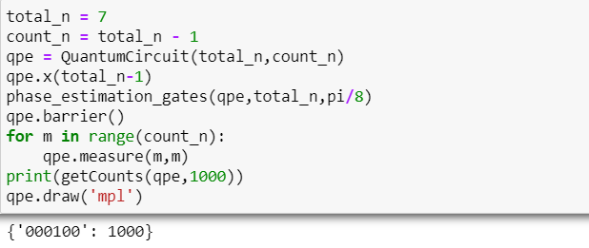
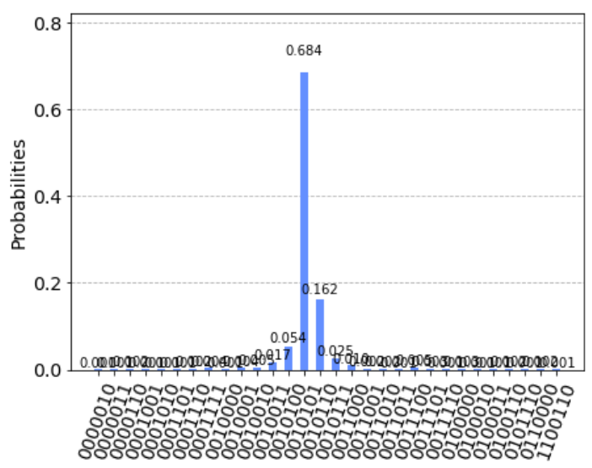
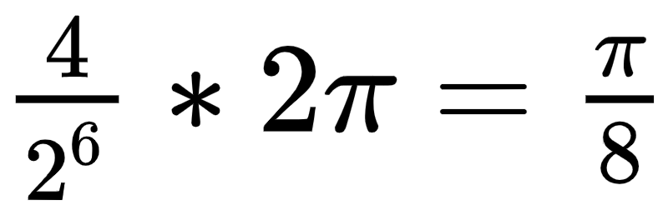
The lower bound is off by ~ 0.5%, and the upper bound is off by ~ 1%
Notes:
So this first function encapsulates the general algorithm:
We apply Hadamards to the counting qubits and then we control the target qubit psi with these counting/control qubits and this generates the phase kickback that we talked about. Then, we apply an inverse QFT to get back to the computational basis and then we can measure and obtain our results.
To which then, we convert to Decimal / 2^n and then multiply by 2*pi to discover our original phase.
Note here that if we try to approximate phases that can’t be written in terms of D/2^n (for example when you do pi/3, you can only obtain an estimation)
If we increase the number of counting qubits, we will hone in on the actual phase… THIS IS WHY ITS CALLED PHASE ESTIMATION when the phase is arbitrary.

Slide 21
Shor’s: what’s it good for?
“Crown Jewel” of quantum algorithms
Shor’s algorithm factors a number into its prime factors
RSA encryption relies on prime factorization being difficult: superpolynomial time
Shor’s algorithm runs in polynomial time -- almost exponentially faster

Slide 22
Shor’s Algorithm
Factoring algorithm for N=pq where p,q are prime
Pick an { a } such that a is coprime with N , i.e. gcd(a,N) =1
Find the smallest { r } such that a^{r} = 1 mod N
This is the “period” of the function
If r is even:
Let x = a^{r/2} mod N, check x+1 ≠ 0 mod N
Then p,q = gcd(x+1, N), gcd(x-1, N)
Then we are done
If r is odd: pick a different a and do it again

Slide 23
An example with 15
Pick a = 13, 13 is coprime with 15
Calculate 13^{x} mod 15 for x = 0, 1, 2, …
1, 13, 4, 7, 1, 13, 4, 7, …
r = 4, since function repeats every 4 numbers
r = 4 is even
x = 13^{r/2} mod N = 13² mod N = 4 ≠ 0
Then p , q = gcd( 4+1, 15 ), gcd( 4-1, 15 )
p = 5, q = 3

Slide 24
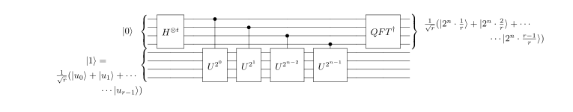
Quantum Circuit Implementation of Shor
Quantum speed up is in step 2, finding r
Since r is like the period of the modular exponentiation, we can use QPE and QFT

