Slide 1
Quantum Masters - Week 5
More on Quantum Algorithms
Lucy and Eva
Goal: To understand more advanced quantum algorithms and figure out a way to solve linear ODEs using Qiskit our project.

Slide 2
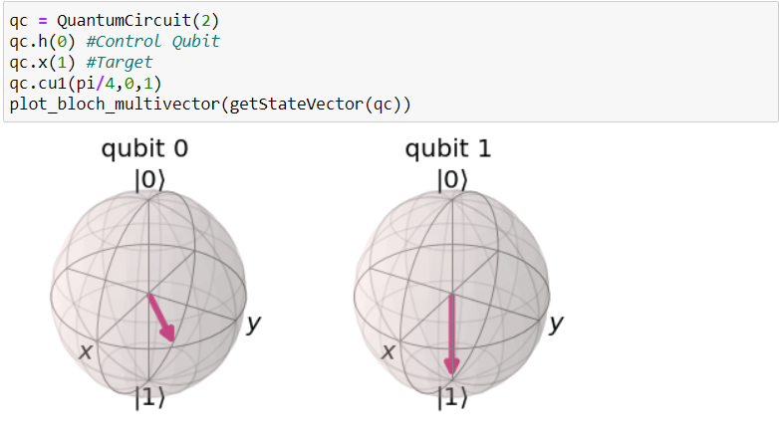
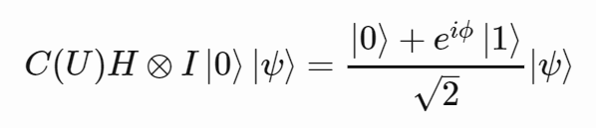
Phase Kickback
Occurs when there is a global phase on the target qubit which then CHANGES the relative phase of the control qubit
Target
Control
Notes:
Global phase is not measurable but RELATIVE phase is measurable.

Slide 3
The Quantum Fourier Basis + Transform
Analogous the classical fourier transform over amplitudes of a wavefunction
Used in quantum algorithms: QPhase Estimation, Shor’s
|0> |+>
|1> |->
For 1 qubit, QFT is just the H gate!
Notes:
Fourier basis is also known as “the frequency domain”

Slide 4
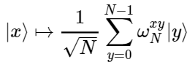


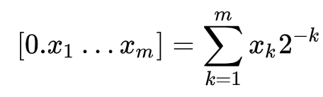

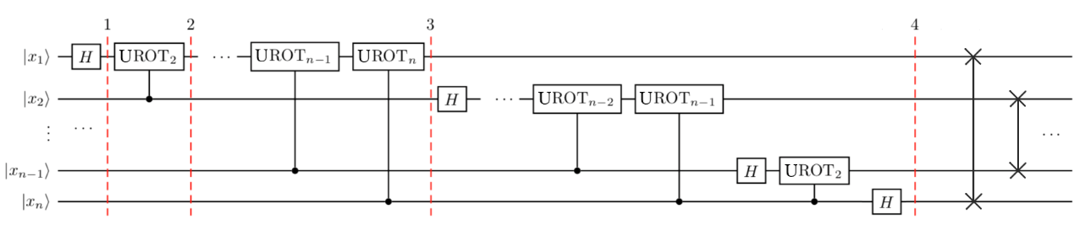
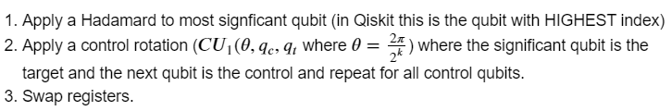
Quantum Fourier Transform
IDEA:
HOW?
Notes:
We swap registers because the order of the qubits is reversed in the output state.

Slide 5
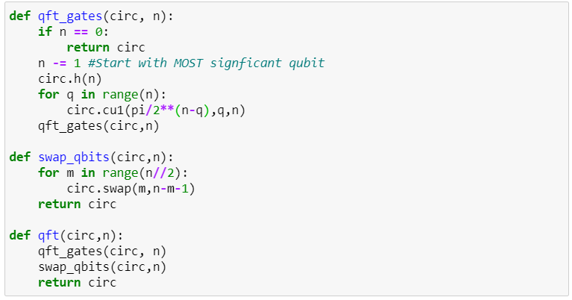
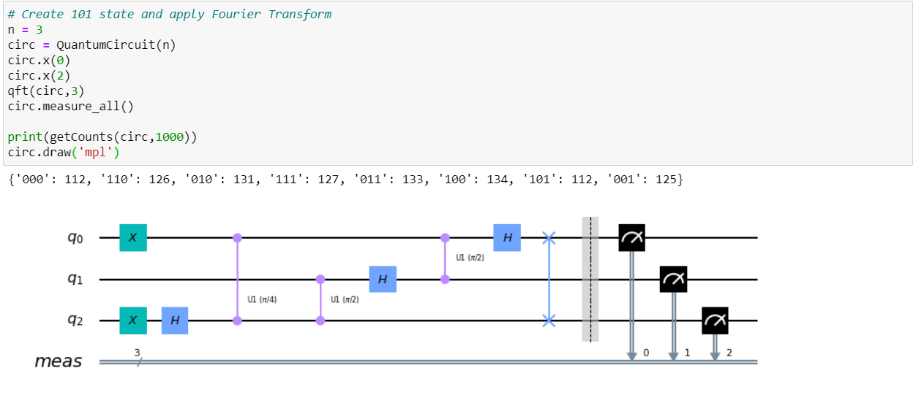
Notes:
We do n - 1 because the indexes start from 0.
We do (n-q) because we want to start with the MOST SIGNIFICANT qubit

Slide 6

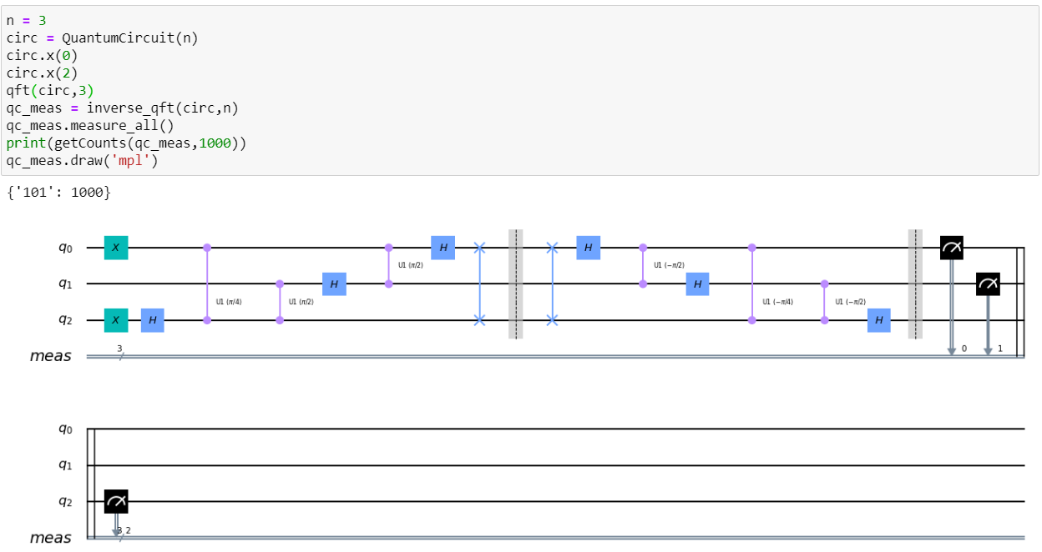
QFT to go from Z basis to Fourier basis
Our state

Slide 7


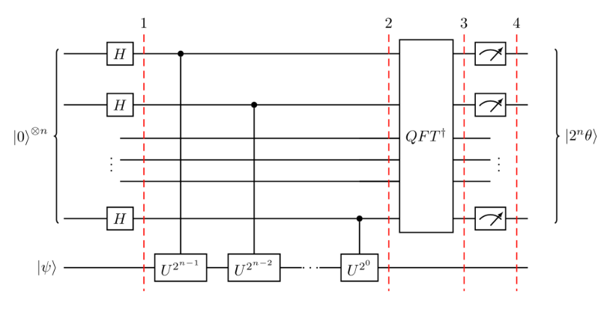
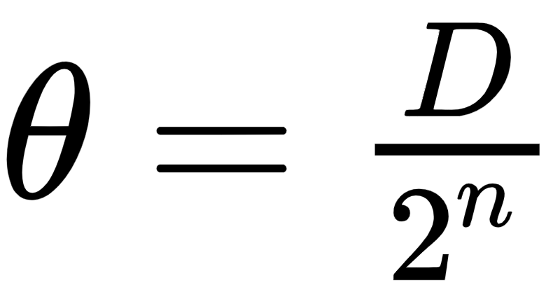
Quantum Phase Estimation
PHASE KICKBACK!
Eigenvalue
Problem: Given Find
𝜃 is encoded as a number between 0 to 2^{n} in the Fourier Basis
So whatever the measurement result is, we convert to decimal number, D, and:
“Counting qubits”
Eigenvector of U
Notes:
You have this state psi that you are applying some arbitrary phase to via applying a unitary operator. You want to ‘KICK BACK’ the phase onto the counting qubits (They are control qubits for CU1 operation) so that you can estimate it because you can’t just measure psi and figure out the phase! That phase is GLOBAL. You need to create a relative phase in order to be able to measure the original phase.

Slide 8
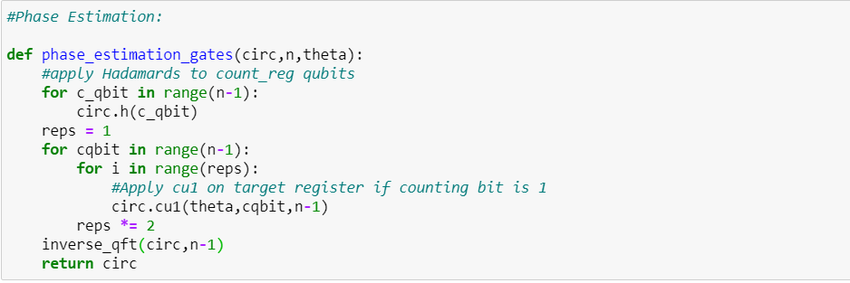
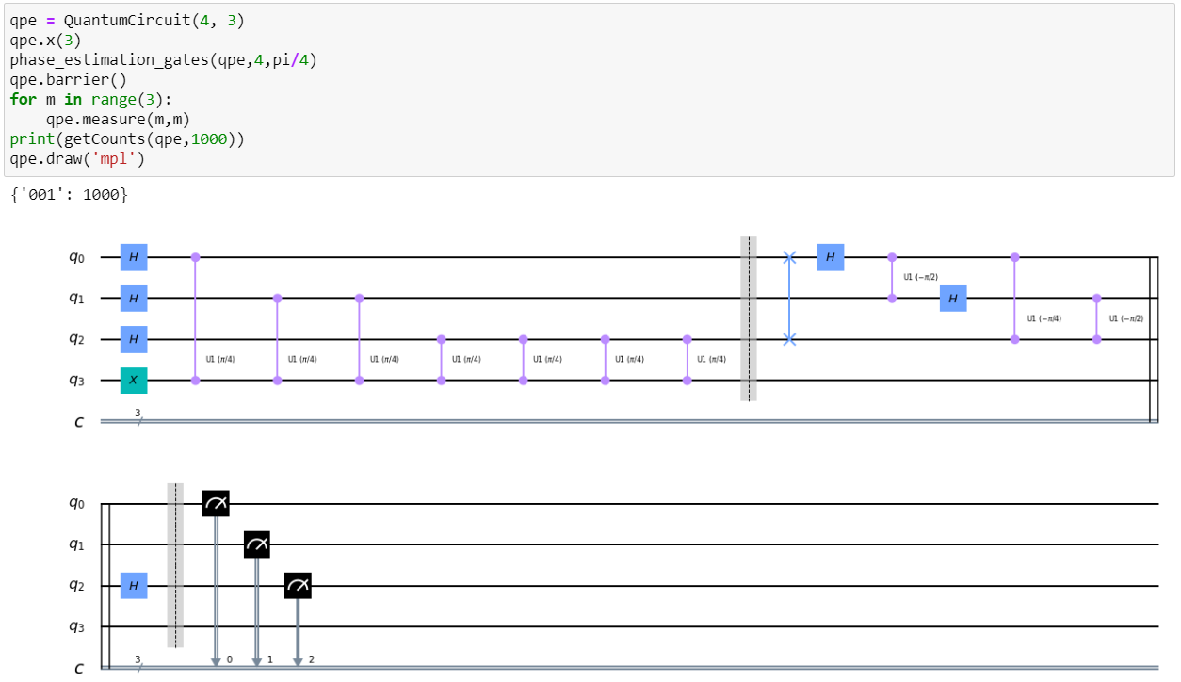
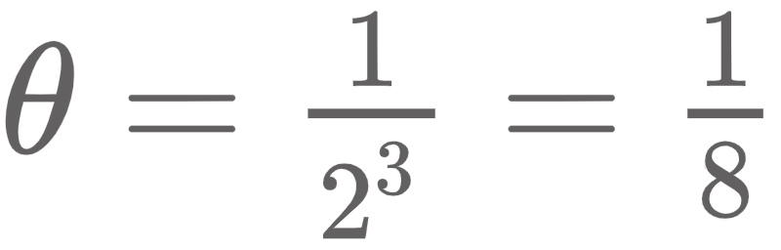
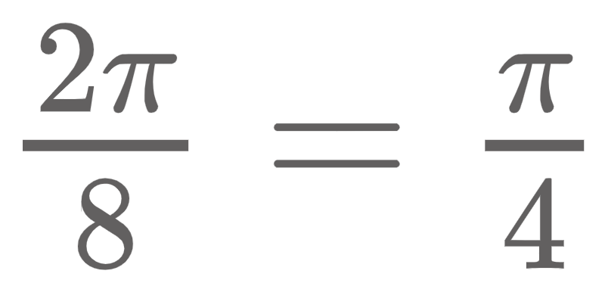
001 → 1 in decimal
So:
Thus our phase is:

Slide 9
Shor’s Algorithm
Factoring algorithm for N=pq where p,q are prime
Pick an { a } such that a is coprime with N , i.e. gcd(a,N) =1
Find the smallest { r } such that a^{r} = 1 mod N
This is the “period” of the function
If r is even
Let x = a^{r/2} mod N, check x+1 ≠ 0 mod N
Then p,q = gcd(x+1, N), gcd(x-1, N)
Then we are done
If r is odd: pick a different a and do it again

Slide 10
An example with 15
Pick a = 13
Calculate 13^{x} mod 15 for x = 0, 1, 2, …
1, 13, 4, 7, 1, 13, 4, 7, …
r = 4, since function repeats every 4 numbers
r = 4 is even
x = 13^{r/2} mod N = 13² mod N = 4 ≠ 0
Then p , q = gcd( 4+1, 15 ), gcd( 4-1, 15 )
p = 5, q = 3

Slide 11
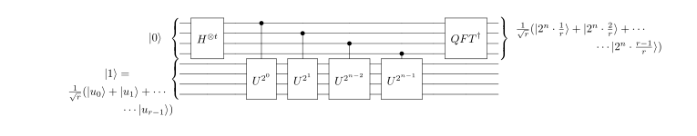
Quantum Circuit Implementation of Shor
Quantum speed up is in step 2, finding r
Since r is like the period of the modular exponentiation, we can use QPE and QFT

Slide 12

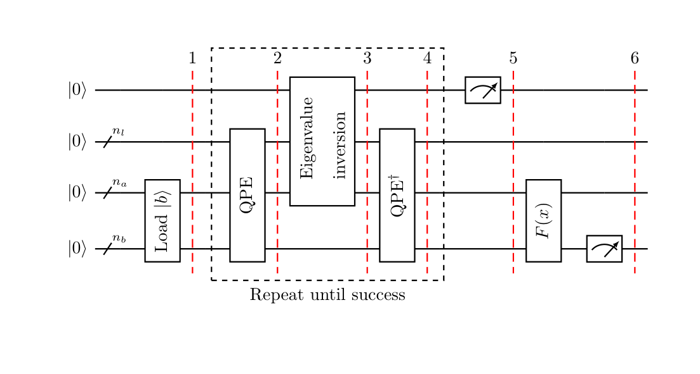

Exploring how to solve Differential Equations
Use of HHL algorithm?
HHL solves linear systems of equations
Rewrite b in eigenbasis of A
Take inverse of A

Slide 13



Lie- trotter Formula Approach
If b = 0, then we have an analogy with Hamiltonian evolution and we can express the vector x in the basis of A:
Use phase estimation to determine the eigenvalue if the state is an eigenvector, otherwise based on the max eigenvalue, ADJUST amplitude by:
Problem: This scales exponentially in the time interval we simulate the ODE

