Slide 1
Assembly Tutor MVP (Name still in progress)
Shabaz Badshah
Wednesday December 13, 2017
CSC398

Slide 2
Currently an MVP
(minimum viable product)
pre-alpha build

Slide 3
Objective
Practice MIPS assembly and binary operations through quizzing

Slide 4
Why?
Learn Android
Learn by doing
Emphasize that computers are just 0s and 1s
Help other students
I’ve always wanted to make an educational app

Slide 5
What does it do right now?
Convert binary to decimal
Convert decimal to binary
Add binary
Compute the MIPS command
Convert MIPS command to 32-bit machine code
Type the MIPS command
Current features list

Slide 6
Planning
Is there something like this on the store? (how original is this idea)
Gamification
Who is the audience
Asking professors
UI
Color

Slide 7
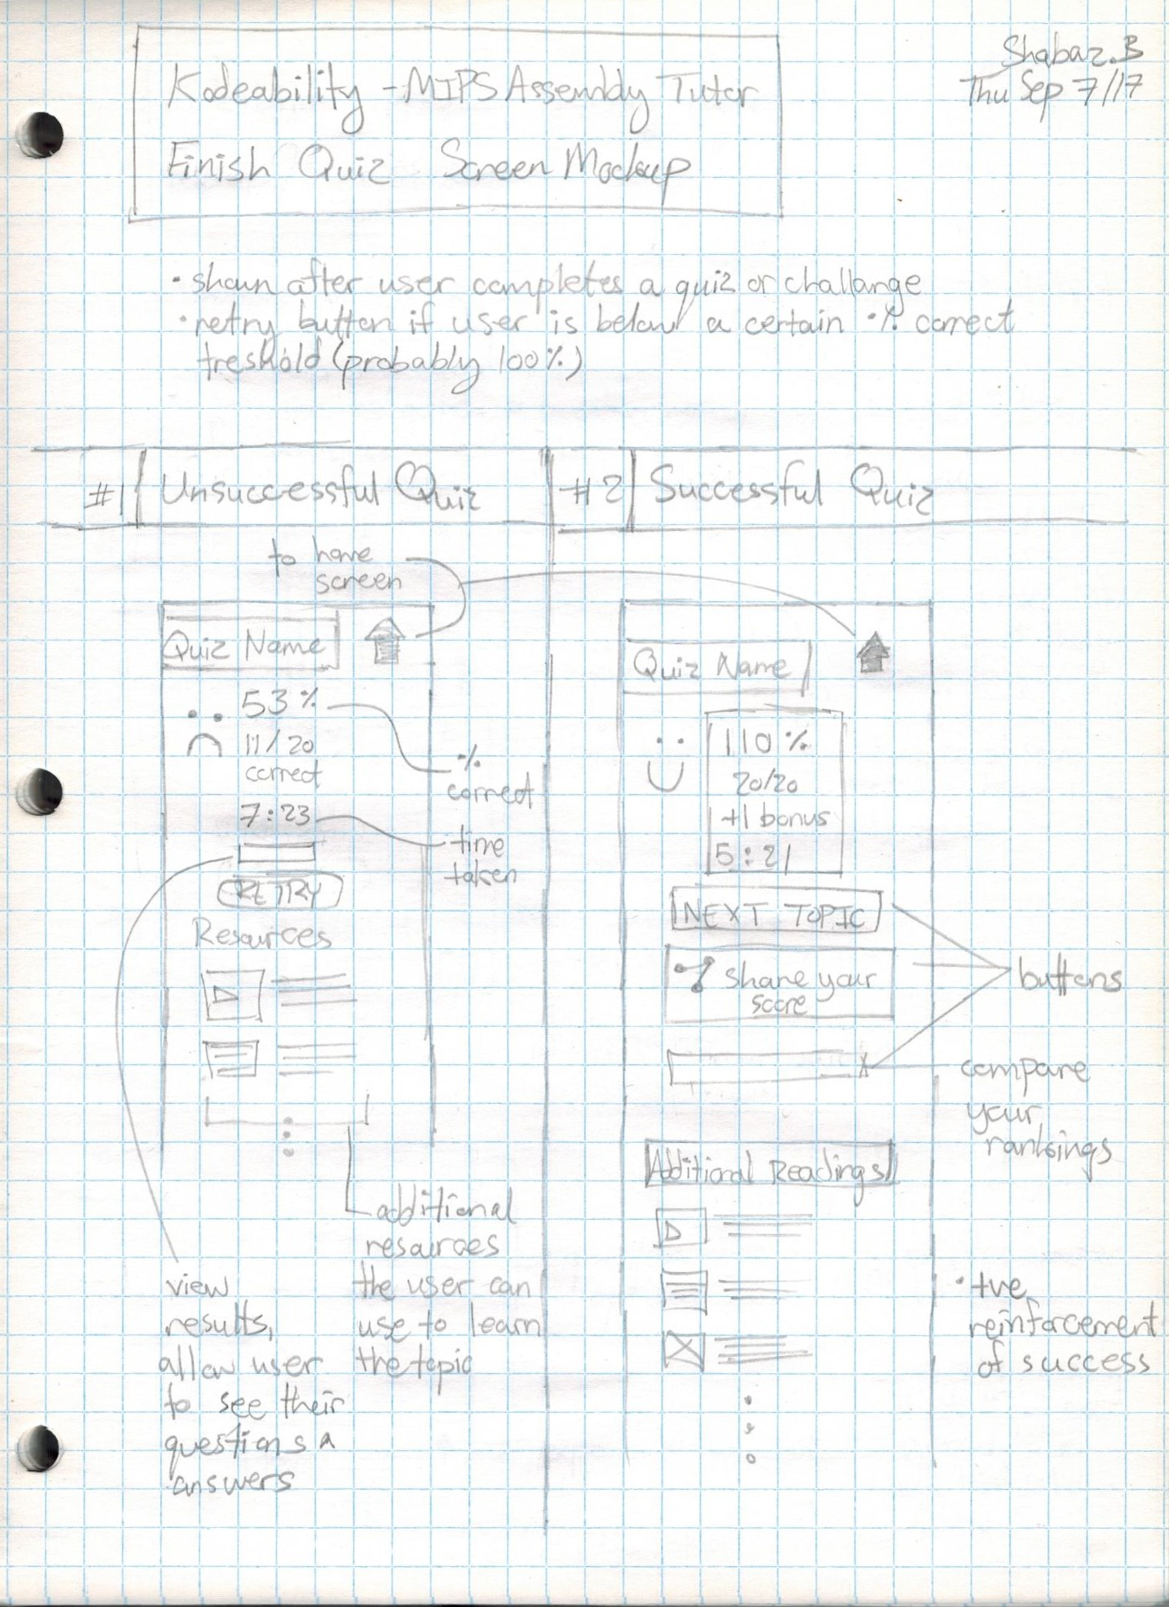
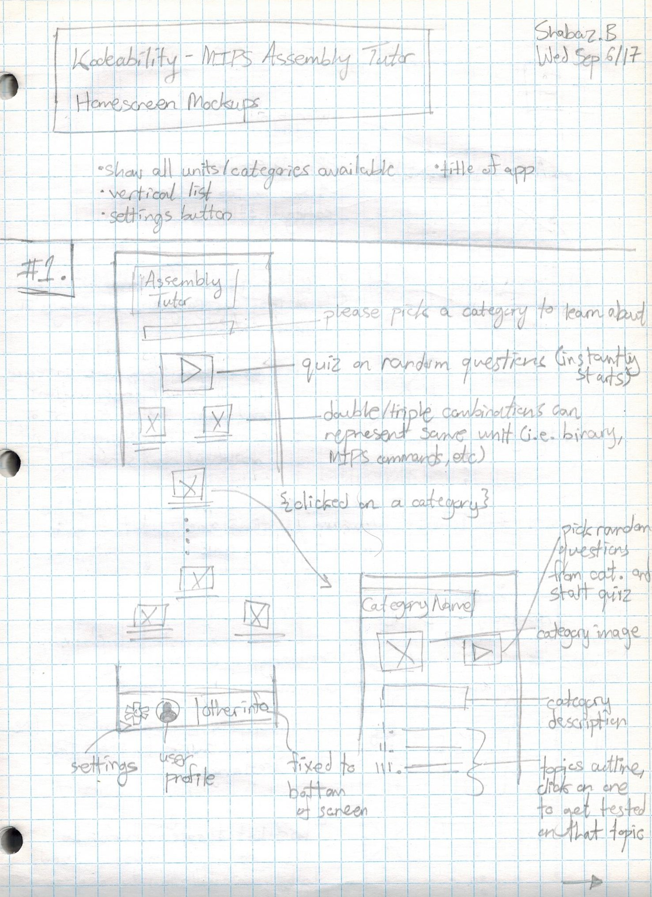
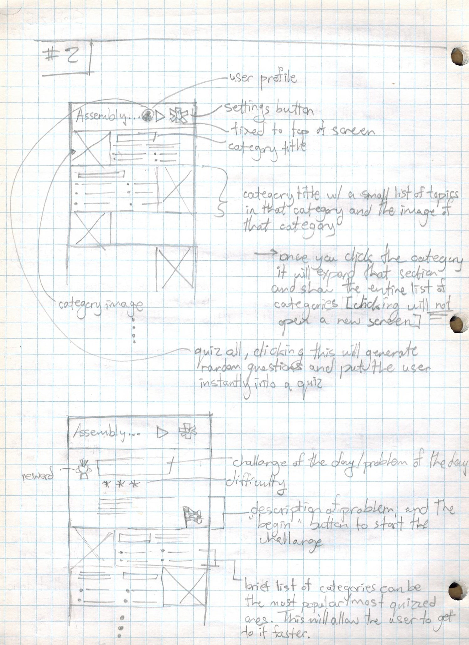

Slide 8
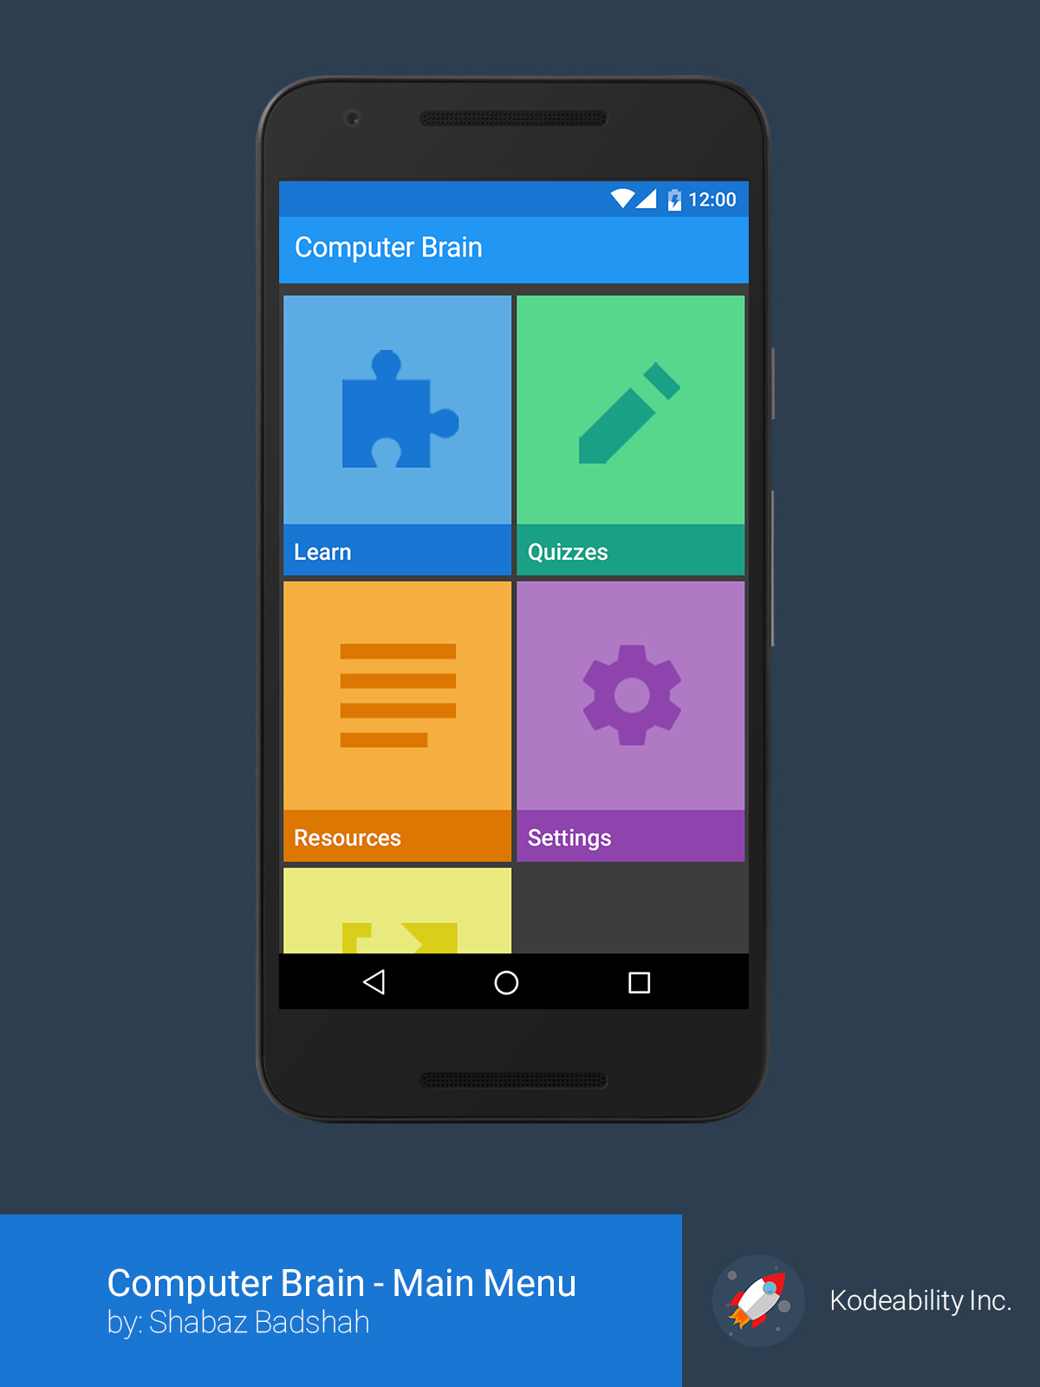
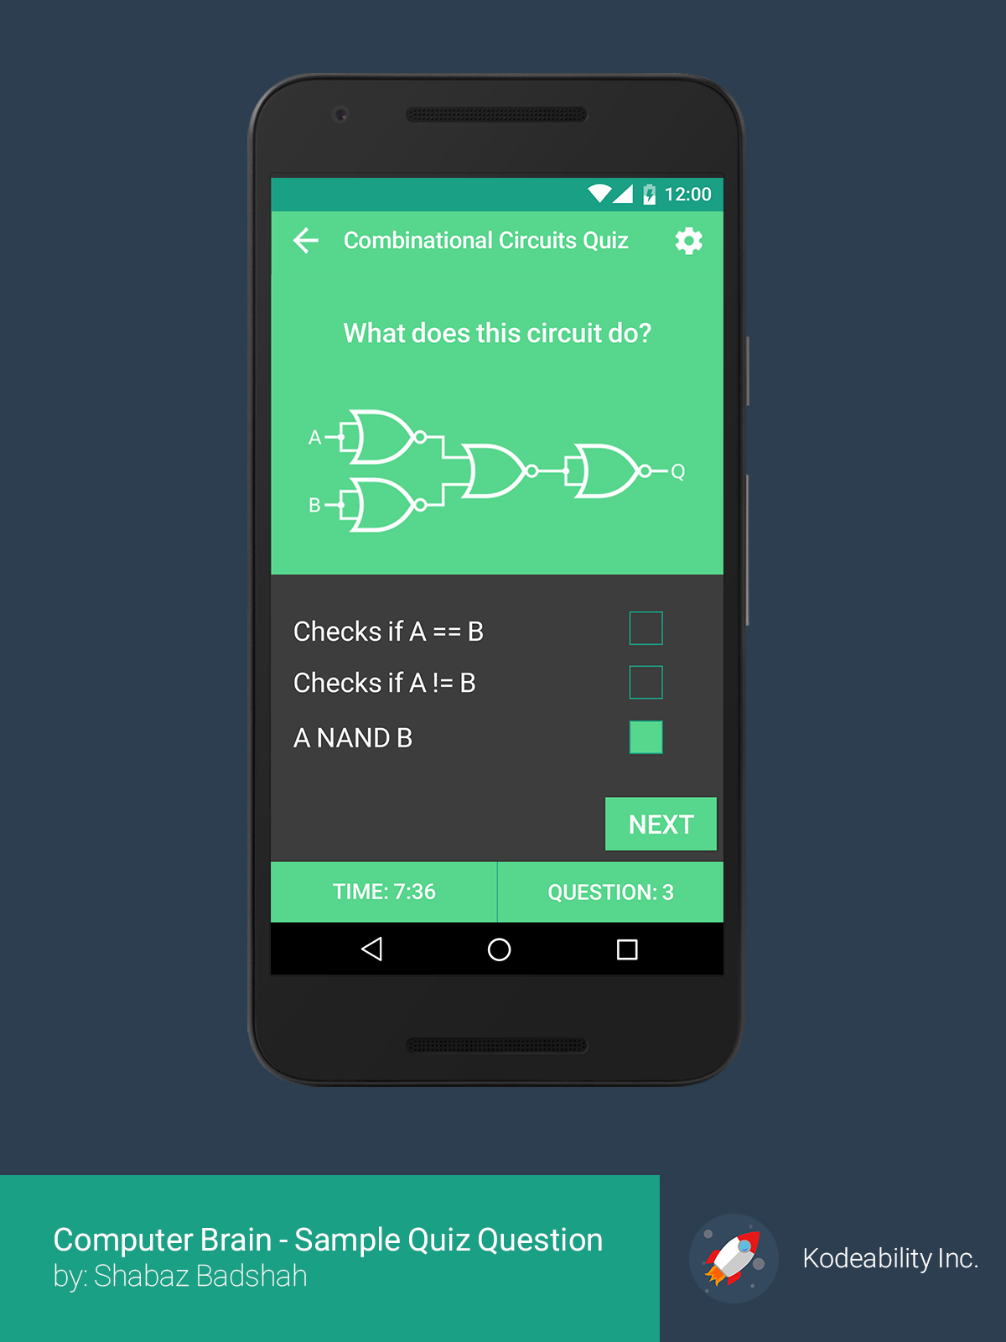
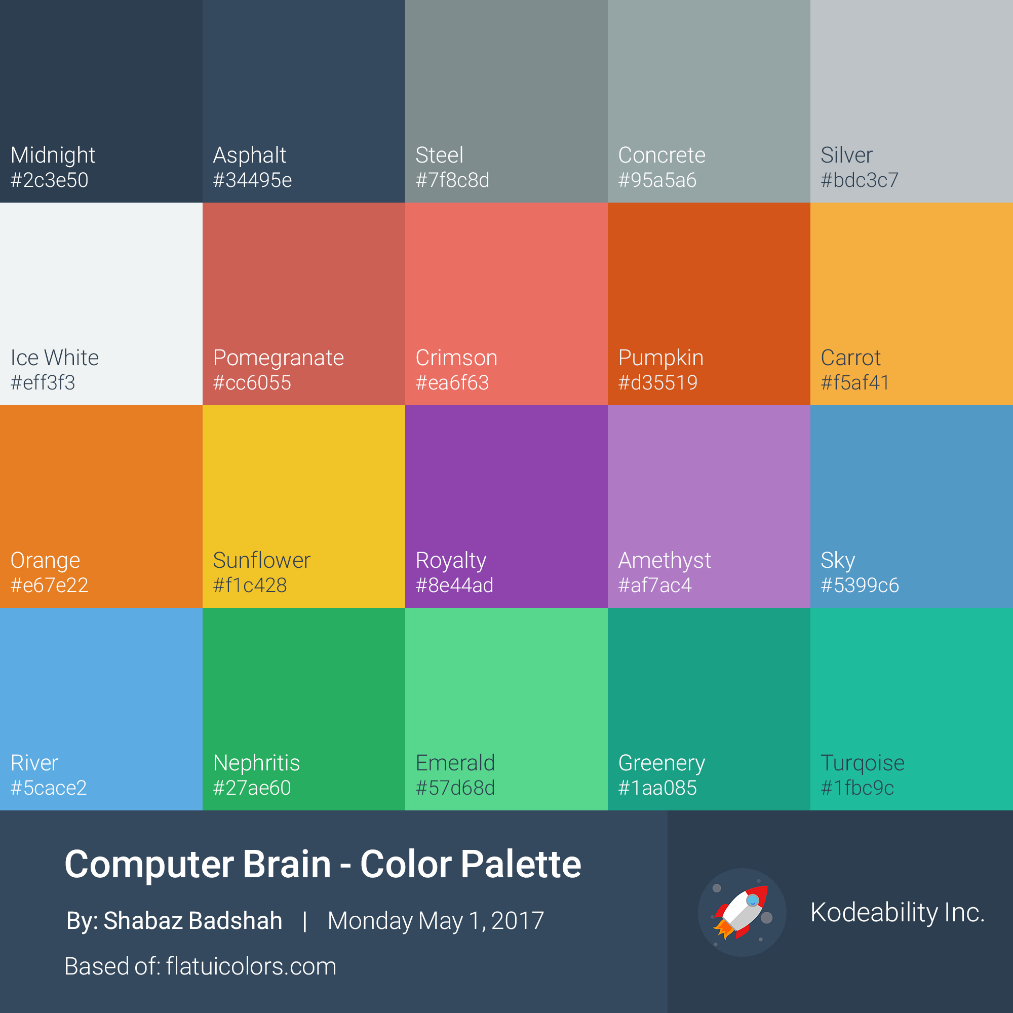

Slide 9
Development
Time to actually learn Android
Quite daunting (massive API)
Utilize everything I’ve learned
Algorithm
Design Patterns
Operating Systems

Slide 10
What was Development Like
Work in 1 week sprints
Kept a personal development log
Kept weekly meeting logs
Git for VC
Android Studio for development
The Android developers guide and source code are basically my friends now
What did I do

Slide 11
What was one major problem that I had?
Spent about 3 weeks on the generator
Algorithm problem (how do you generate questions)
Operating system problem
Design pattern problem
SOL: Design pattern
Question Generator

Slide 12
What did I learn
Android (I still have a lot to learn)
Industry level software development (VC, weekly meetings, logs, design patterns, etc.)
Meeting deadlines and requirements
Building a product from start to finish
Take problems, break them down into the smallest chunks you can, solve

Slide 13
What do I want it to do in the future?
More modules
Use research to determine “best” exercises to implement
Polish up current exercises
Implement a full MIPS compiler
Include leaderboards, and a “1 vs 1” multiplayer component
Get an actual designer?

Slide 14
Do you want to make an Android App?
3 basics things you need to know (event handlers, activity life cycle, UI)
Android studio is the go to IDE
Make sure you use VC
Know your design patterns

Slide 15
Special Thanks
Larry Zhang

Slide 16
DEMO

