Slide 1
E-commerce Project
RentPay

Slide 2
Motivation
Champions Trophy Match
Projector on Rent

Slide 3
Business Type
Business
Customer
Customer
Customer

Slide 4

Domain Name
RentPay.com.pk

Slide 5
Business Plan
RentPay is a platform to rent different products, be it furniture, party accessories or electronics or even camping gear. Once a user logs on to the site, they can browse different products and compare the prices (Rent vs Buy), their delivery times etc. After selecting the item, users have to make security deposit and pay for the item. The product is checked for defects before it is delivered to the customer so that there is no confusion in case of accidental damage to the product.

Slide 6
Products
Products will be classified into two categories
A: Small Products - Delivery time: 2-4 hours
B: Large Products - Delivery time: 24-48 hours

Slide 7
Security Deposit
Security Deposit: Its a collateral that is to be held with RentPay in case of damages to the product. Deposit will be dispatched 7 days after the product has been returned and checked thoroughly. Percentage of security deposit 10%

Slide 8
Internal Model
Internal ModelRentPay aims to bring vendors on board/portal for renting their products. To maintain quality of service RentPay riders (Partner riders) will pick-up the products and deliver it to the customers

Slide 9
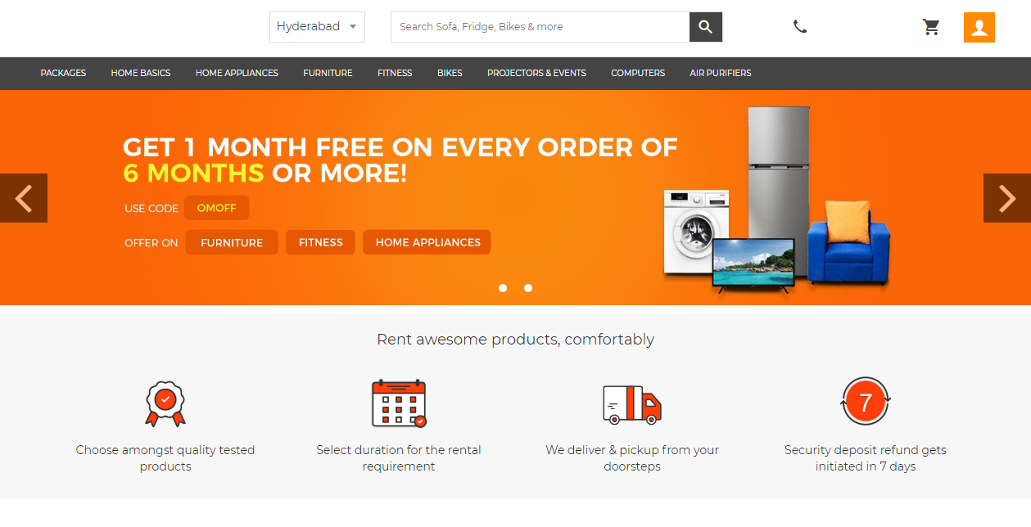

Slide 10
Revenue Model
Our business model relies on the mark-up we charge on the rates we get from our vendors. This start-up in future will pave way for more business partnerships (even in the service category)
Business to Customer
Customer to Customer

Slide 11
Competitive Landscape
Offline Retailers
Independent Users (OLX)

Slide 12
Online Marketing
On-page SEO
Newsletter Mailchimp: Personalized Recommendations
PPC Campaigns: Google Adwords
Social Media: Facebook and Instagram (Paid promotions)
Off-page SEO campaigns: Backlinks
PR Releases
Paid Advert Space
Facebook Adverts
Referral Campaigns

Slide 13
Offline marketing
Flyers
Car stickers
BTL Activities (Sponsored by Retailers)

Slide 14
Order Fulfillment
Partnership with Bykea
Delivery by Businesses

Slide 15
Technical Plan
Type of website: E-Commerce website
CMS used: Wordpress
Plugin: WooCommerce Rental
Hosting: Hostwinds Dedicated Hosting

Slide 16
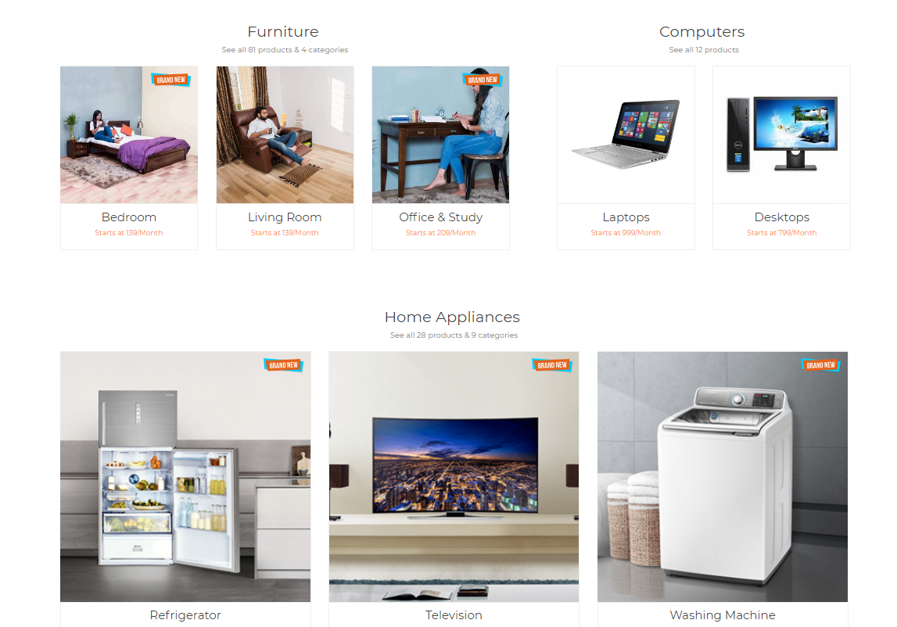

Slide 17
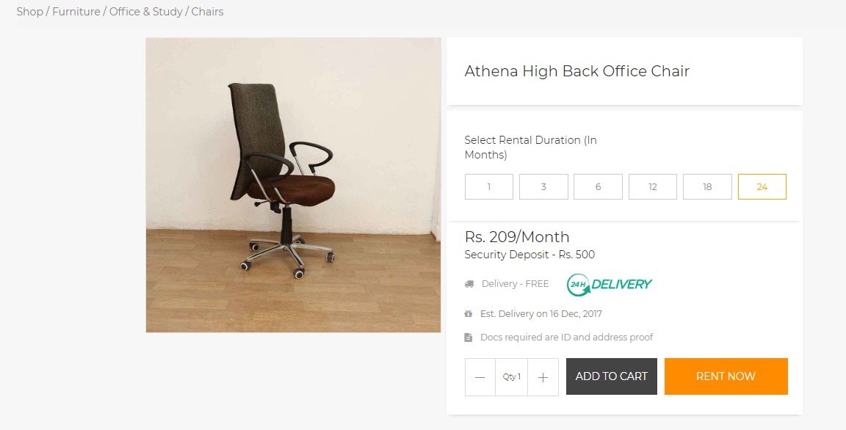

Slide 18
