Slide 1
Traffic Controlling System DLD-Special Assignment 21BEC006

Slide 2
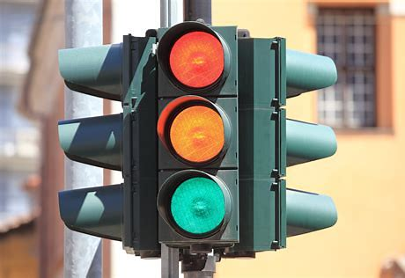
AIM
Design a Traffic Controller System Using Verilog HDL.

Slide 3
INTRODUCTION
The design code for the traffic light controller using a finite state machine .
The input signals are Clock(clk) and reset(rst), while the output signals are north(nl), south(sl), east(el), west(wl).
001 stands for green light, 010 stands for yellow light, and 100 stands for red light in the output signal.
When the reset signal is activated, the design will enter the north state and begin producing output when the reset signal is turned off.
Green light will be on for eight clock cycles and Yellow light will be on for four clock cycles.
The design will begin with the north, then move to the south, then east, and ultimately west, and so on.

Slide 4
STAGES-1
first the state is defined to north i.e, green when clock is zero then to change the
state from north to south by first shifting to north_y i.e shifting to yellow then
the transitions takes place to south
STAGES-2
in this if the state is north_y then convert it into south i.e, green and if it is not
in north_y state then first convert it into north_y i.e, yellow

Slide 5
STAGES-3
in this if the state is south then convert into south_y i.e, yellow and if it is not in
state south then first it is converted into south state
STAGES-4
in this if the state is south_y then convert into east i.e, yellow and if it is not
south_y then it is converted into south_y

Slide 6
STAGES-5
in this if it is east then it is converted into east_y i.e, yellow and if it is not in
state east then first it is converted into east state
STAGES-6
in this if it is east_y then it is converted to west and then from west_y i.e,
yellow it is again converted to north i.e, green

Slide 7
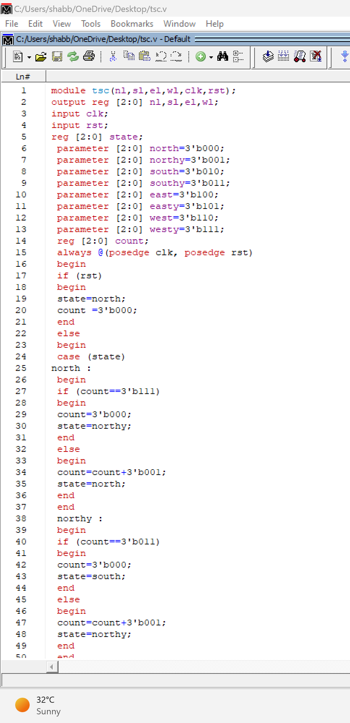
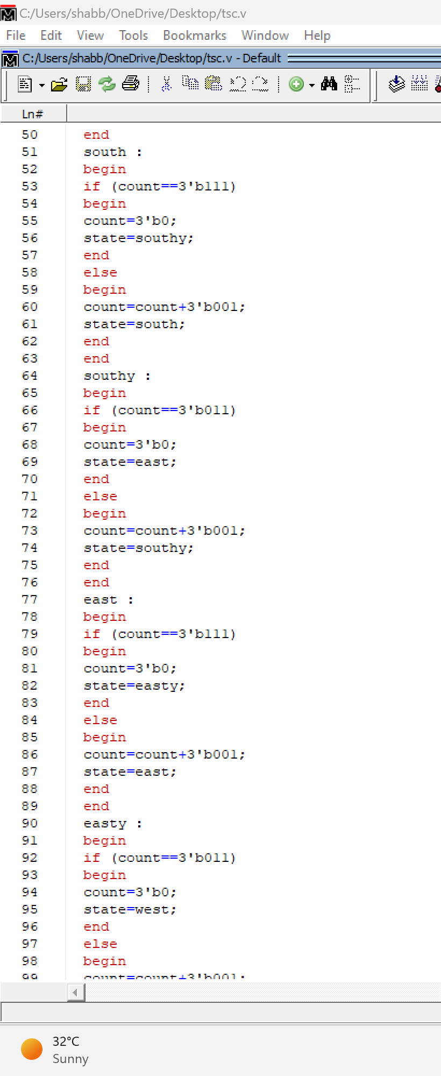

Slide 8
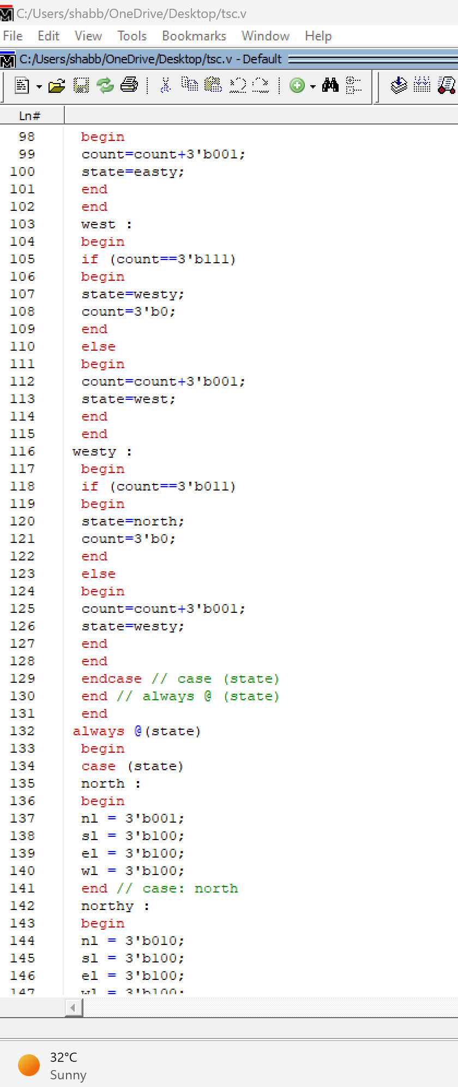
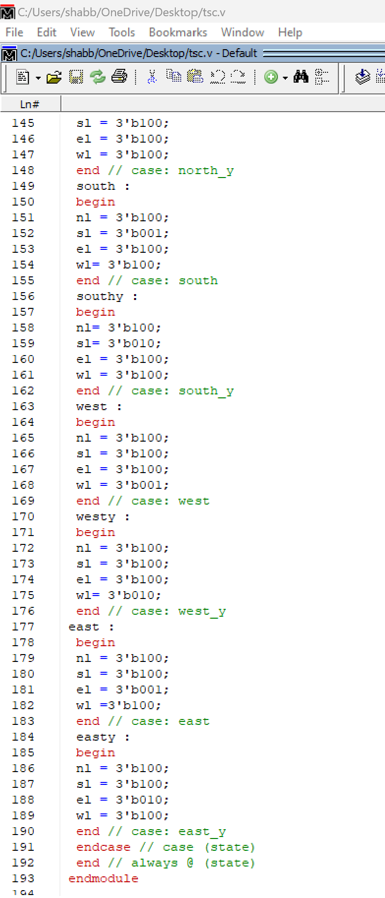

Slide 9
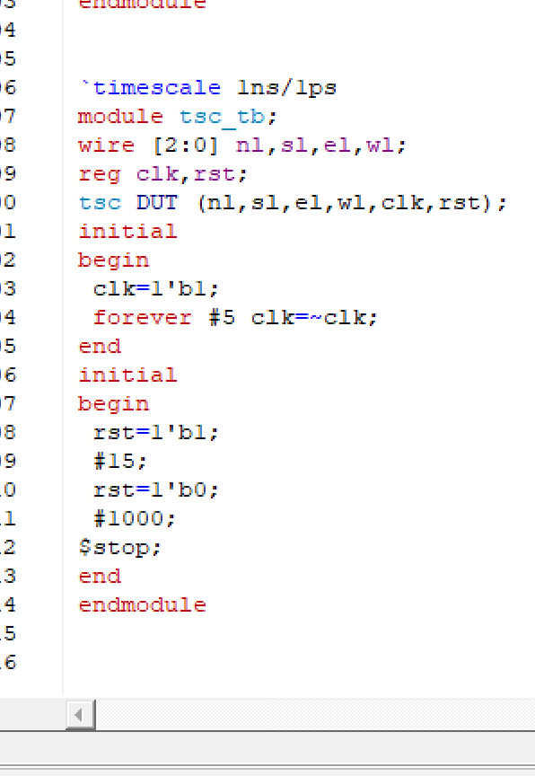
TESTBENCH CODE

Slide 10
CONCLUSION
The Traffic Light is an important agent in preventing road accident. Thus, Designing and Implementing traffic light controller is a task itself. With this Experiment a person can see that just using the given cases we can branch out implementing state diagram, state table and the Verilog code easily.

Slide 11
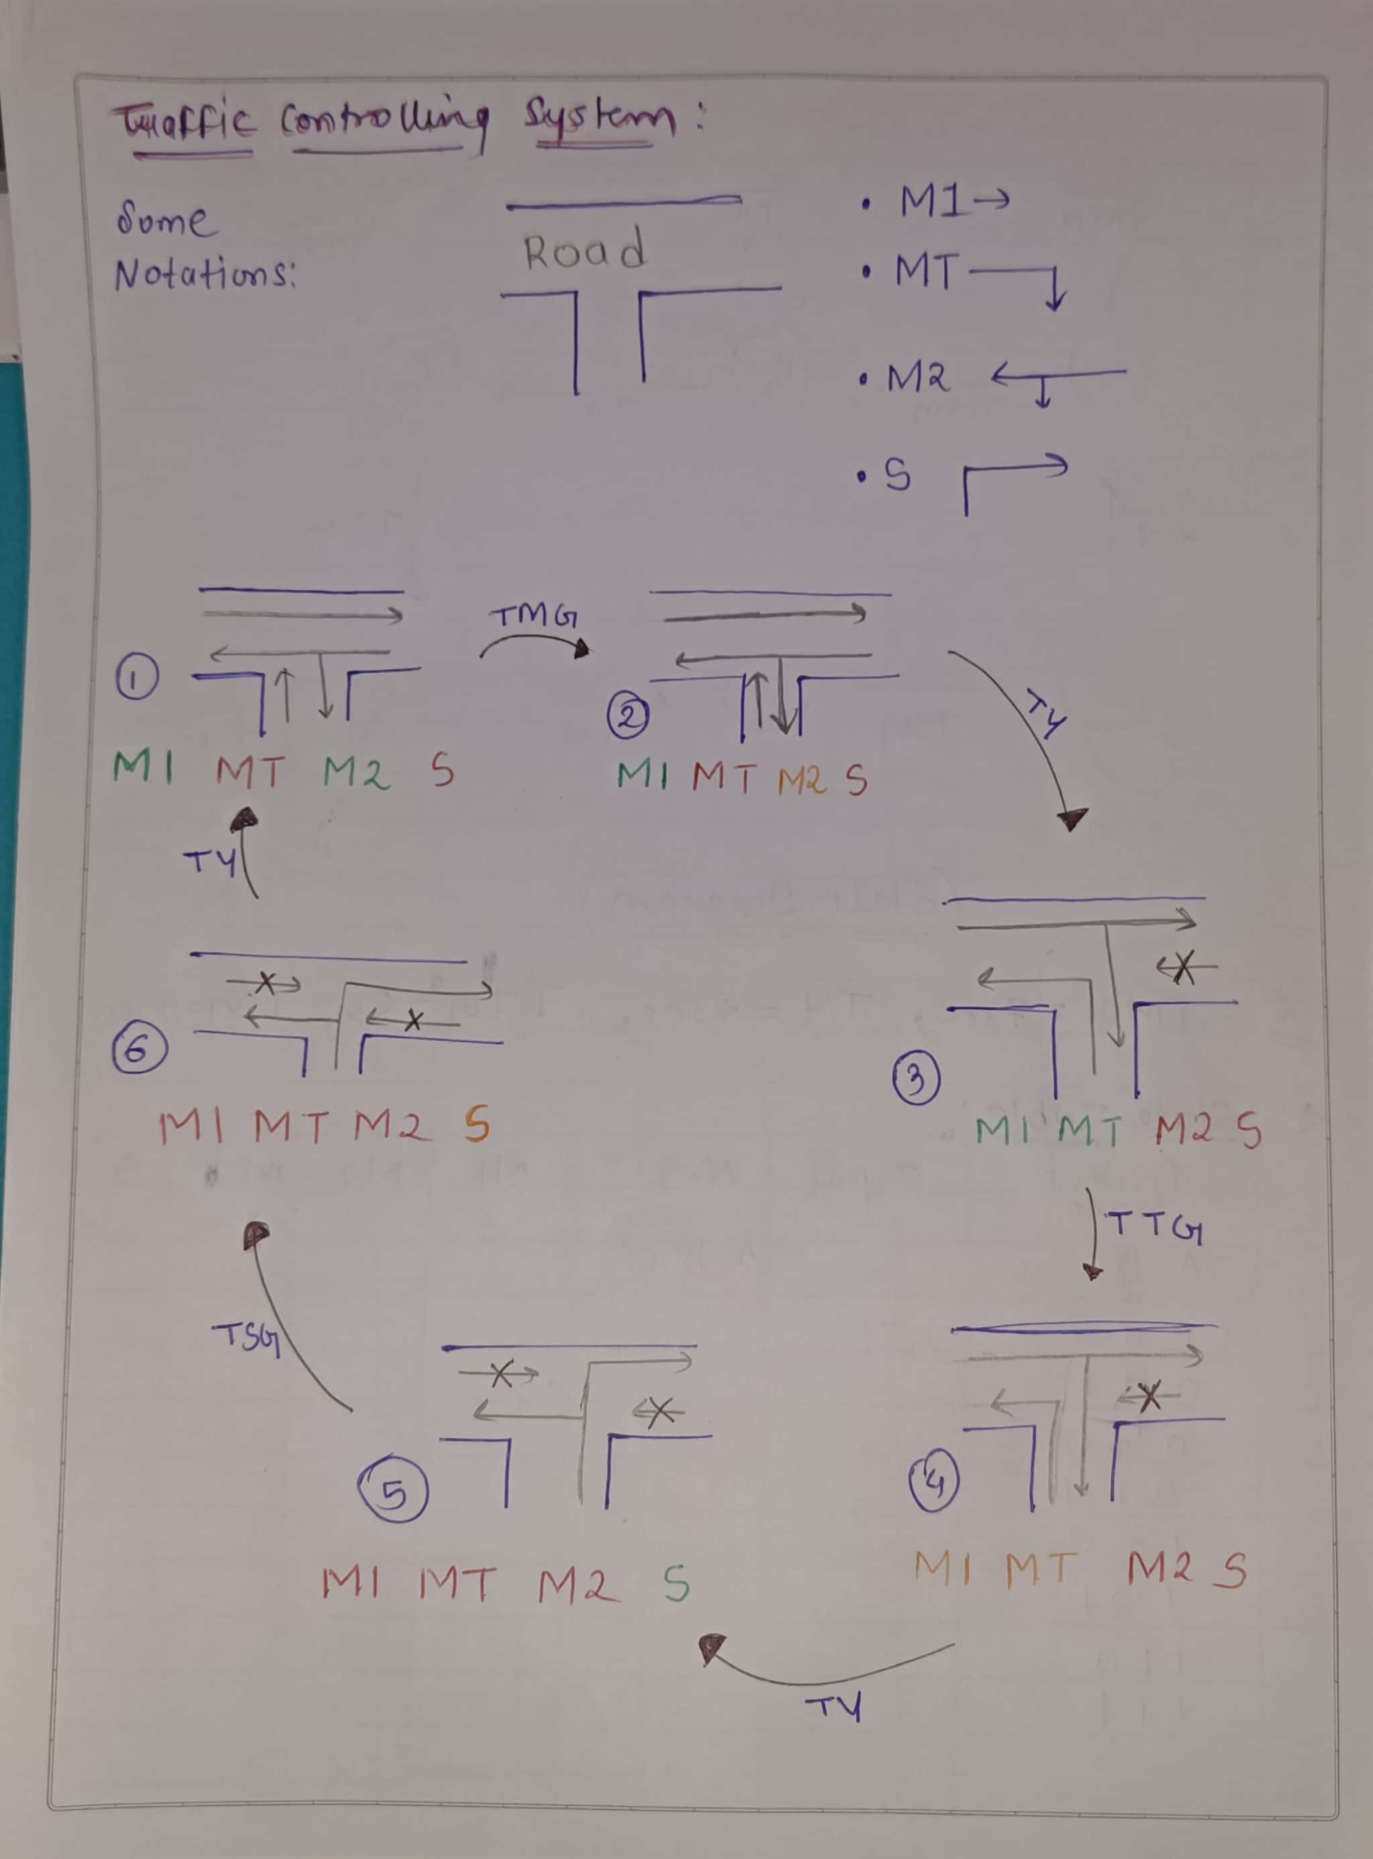
EXAMPLE FOR T-INTERSECTION ROAD

Slide 12
Notation | Name
M1 | Main Road
MT | Main Turn
M2 | Main Road
S | Side Turn
TMG | Time Taken to change from State 1 to 2 | 7 Seconds
TY | Time Taken to change from State 1 to 2 | 2 Seconds
TTG | Time Taken to change from State 1 to 2 | 5 Seconds
TSG | Time Taken to change from State 1 to 2 | 3 Seconds

Slide 13
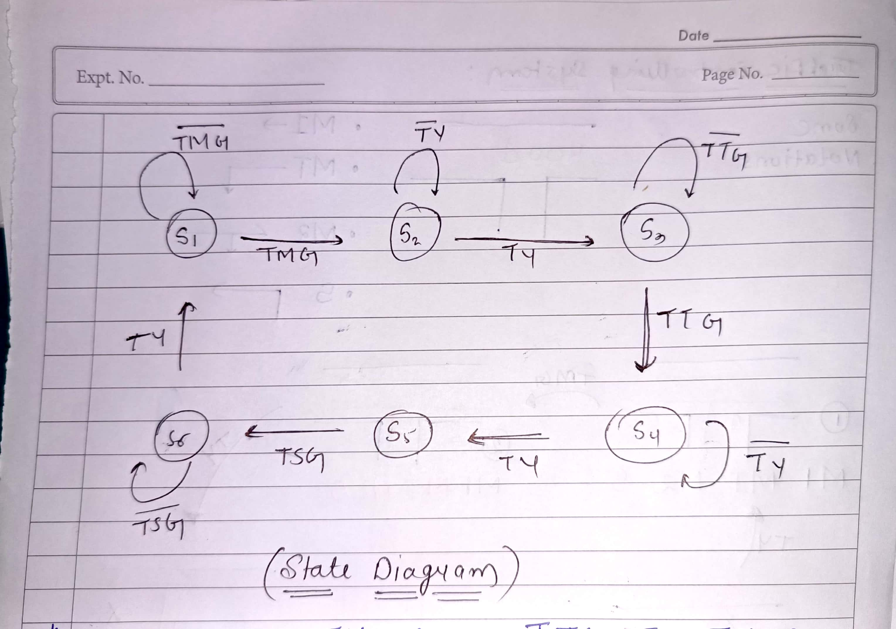
State Diagram
There are 6 states

Slide 14
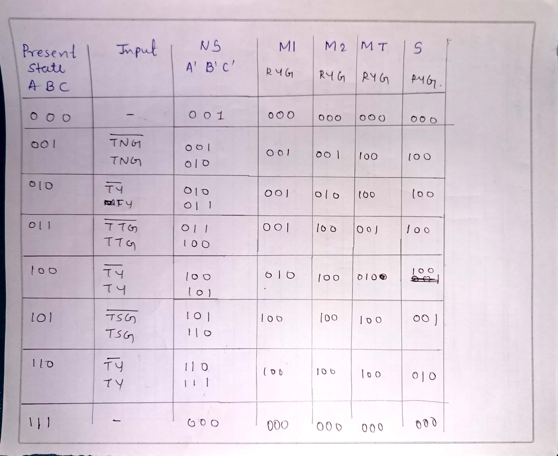
State Table

Slide 15
THANKYOU 21BEC006

