Slide 1
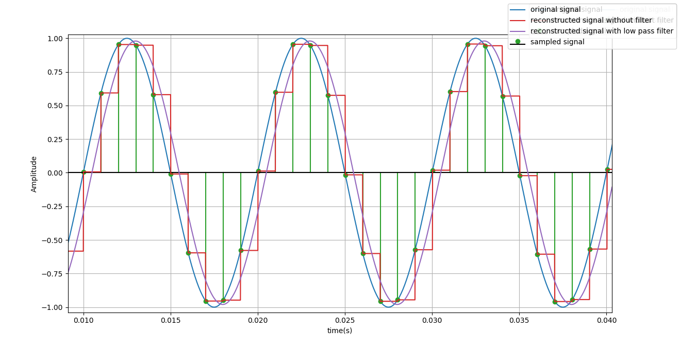
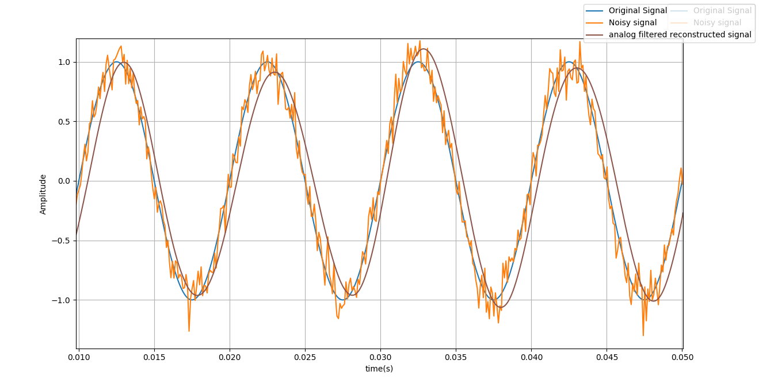
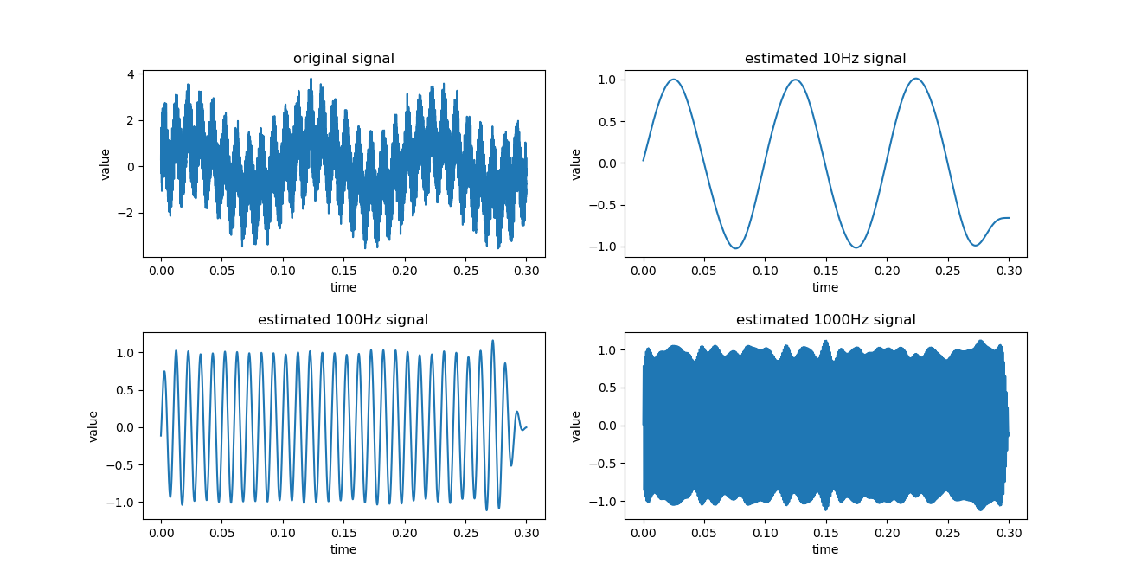
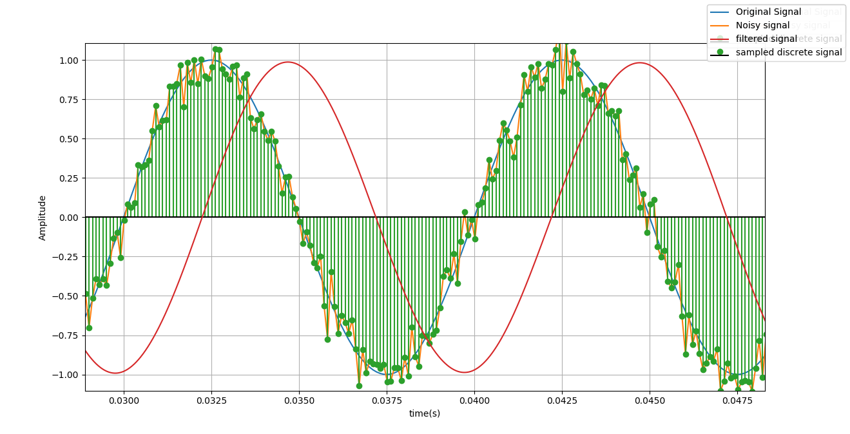
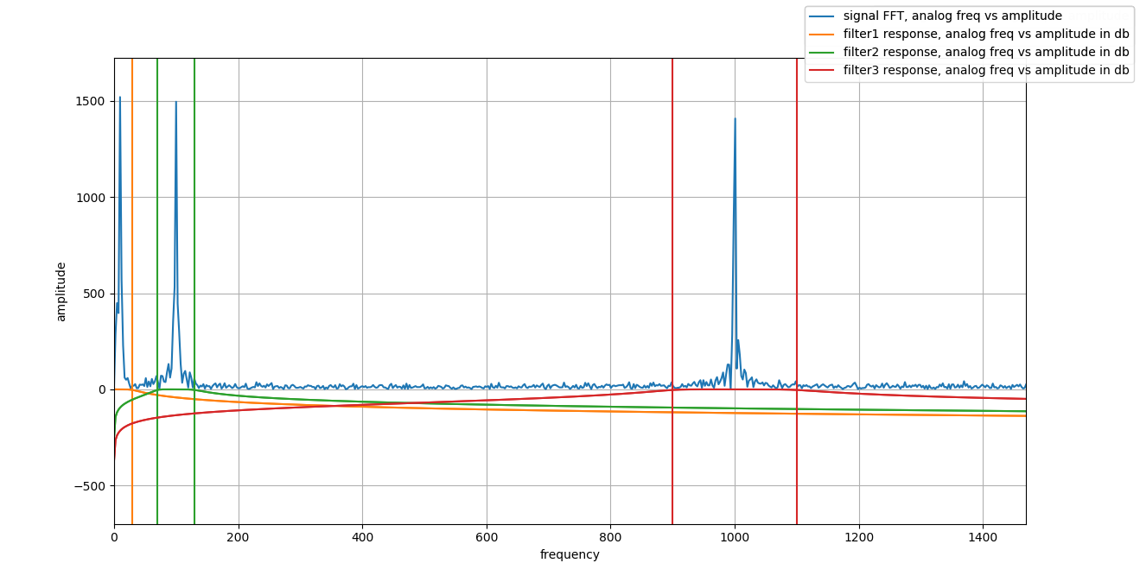
Signal Processing with Python
By: Abhishek Agrawal

Slide 2
Signal Processing Flow:
Analog Signal
Sampling
Digital Signal Processing
Reconstruction
Visualisation
Function Generator
Analog to Digital Converter (ADC)
DSP
Microcontroller
Digital to Analog Converter (DAC)
Oscilloscope

Slide 3
Signal Utility:
Collection of basic tools for creating, sampling and visualising signals.
Signal is class with 2 variables, time on x-axis and value on y-axis.
Function Generator:
sinWaveformGenerate
pulseWaveformGenerate
triangularWaveformGenerate
Add noise
Oscilloscope:
addWaveform
addFrequencyResponse
createSubplots
addToSubplot
Sampler:
sampleSignal
Reconstructor:
reconstructSignal

Slide 4
Scripts Overview:
signalUtility.py
Common Code (library) for creating, sampling, reconstructing and visualising signals
Adding noise to signals
Plotting frequency response
Plotting Subplots
Chapter1.py
Get familiar with Signal Utility tools
Chapter2.py
Filter noisy signal using Low Pass filter in time domain
Chapter3.py
Separate signals of 3 different frequency from noisy mixture using band pass filters in time domain.
Chapter4.py
FFT of Signals.
Chapter5.py
Filter noisy signal using Low Pass filter in frequency domain.
Chapter6.py
Separate signals of 3 different frequency from noisy mixture using band pass filters in frequency domain.

Slide 5
Chapter 1:
Analog Signal
ADC
Sampled Signal
No Digital Signal Processing
DAC
Reconstructed Signal
LPF
Reconstructed Signal after LPF

Slide 6
Filters:
Low Pass Filter: Filters signal in range of frequencies 0-Fc
Band Pass Filter: Filters signal in range of frequencies Fc1-Fc2
High Pass Filters: : Filters signal in range of frequencies Fc – infinity ( Fs/2)
Time domain filtering: Convolution of sampled signal with filter kernel
Frequency domain filtering:
FFT Of Signal
Frequency response of Filter
Inverse FFT of FFT Of Signal * Frequency response of Filter

Slide 7
Chapter 2:
Analog Signal
ADC
Sampled Signal
OUTPUT
Reconstructed Signal
LPF
Reconstructed Signal after LPF
Filtered Signal
DAC
Digital Signal processing
Low Pass filter of 200Hz

Slide 8
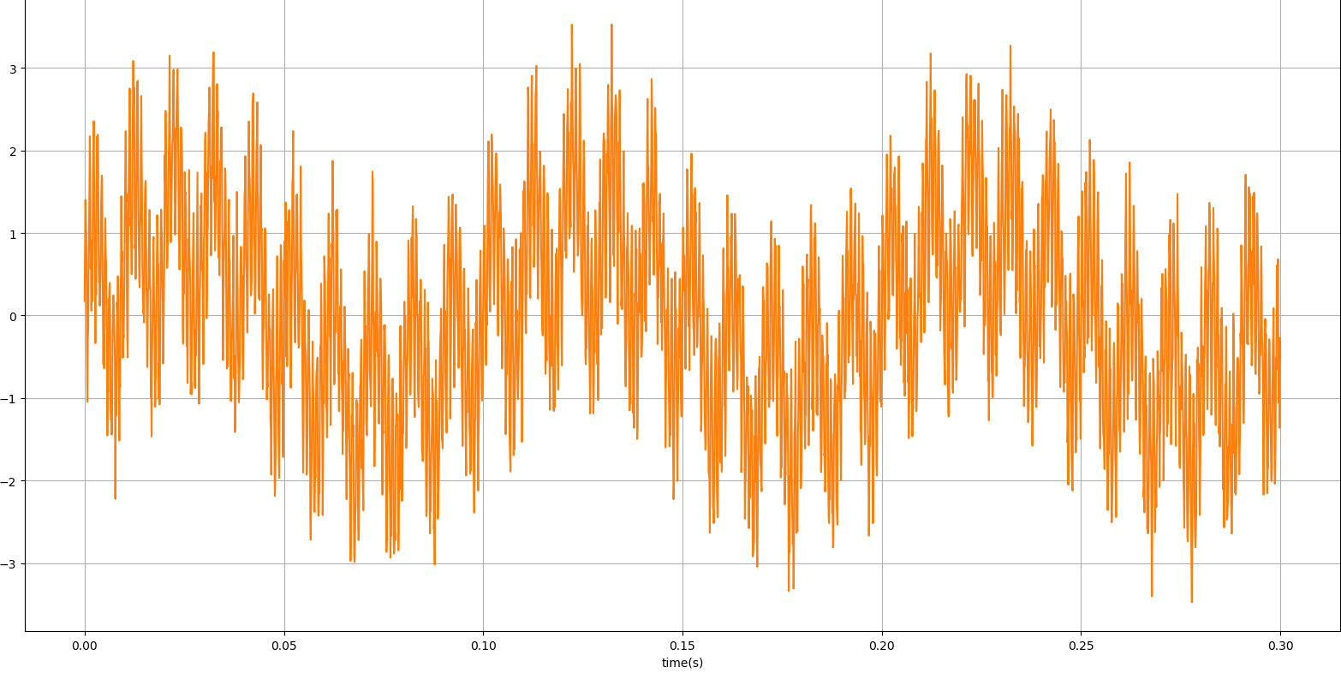
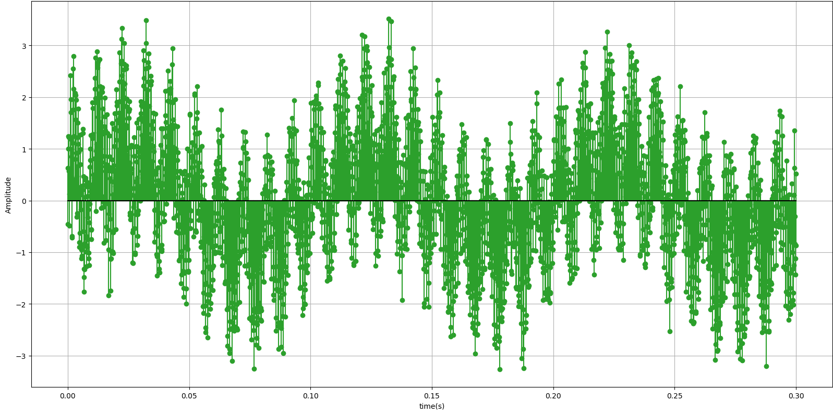
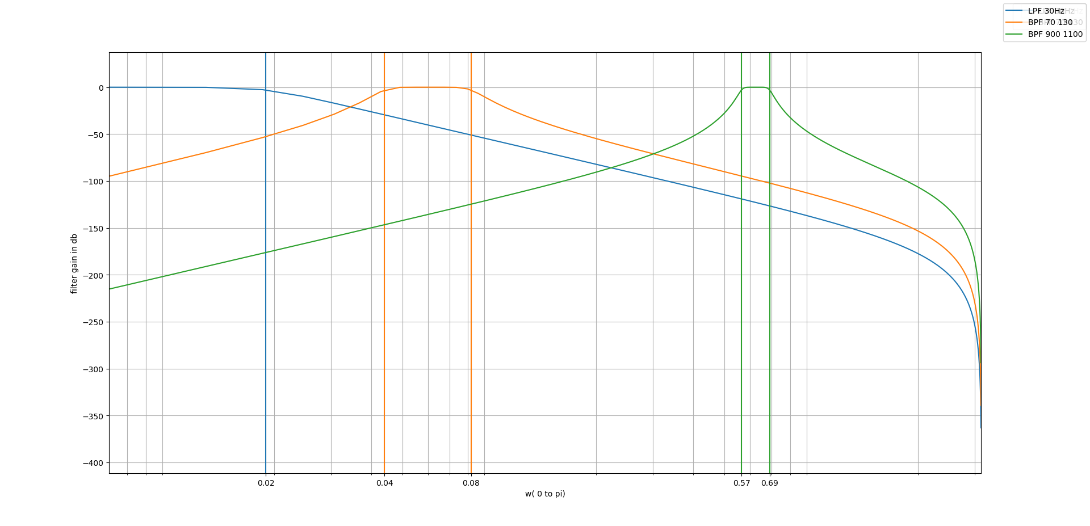
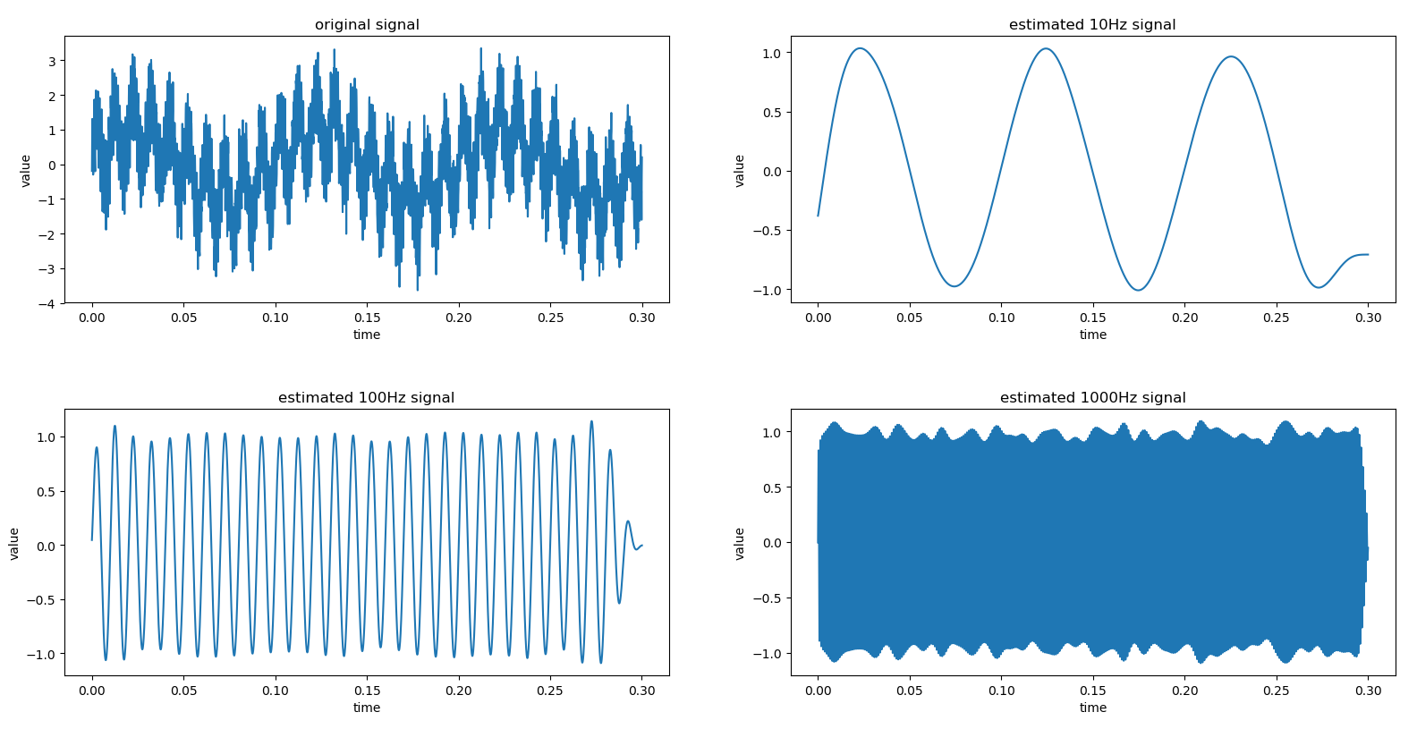
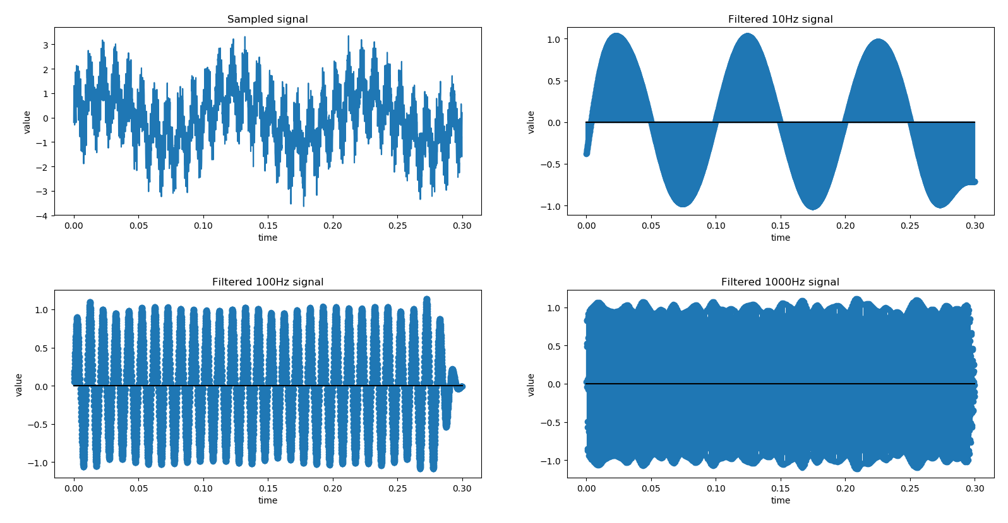
Chapter 3:
ADC
Input
Mixture of 10, 100 and 1000Hz Sin waveforms with noise
Sampling by 10,000 Hz
Digital Signal Processing
Filtering by 30 Hz LPF, 70-130 Hz BPF and 900-1100 Hz BPF
Output
DAC + LPF
DAC output LPF with 200Hz Analog filter
Output of DSP

Slide 9
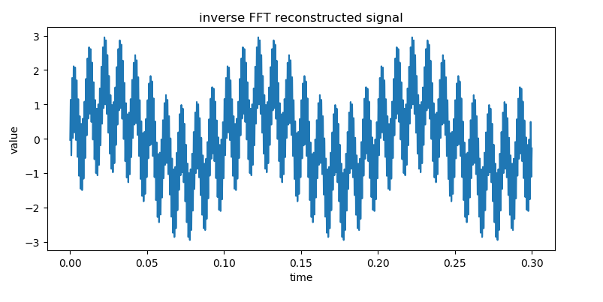
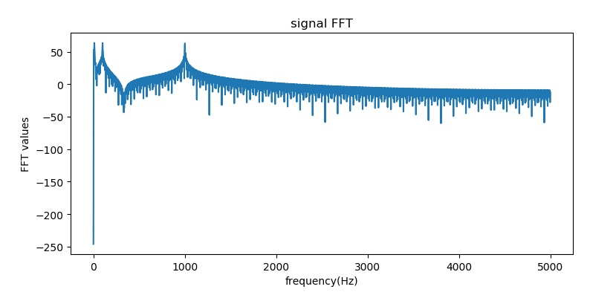
Chapter 4:
ADC
Sampling by 10,000 Hz
Mixture of 10, 100 and 1000Hz Sin waveforms with noise
Input
DAC + LPF
DAC output LPF with 200Hz Analog filter
Digital Signal Processing, FFT of Sampled signal

Slide 10
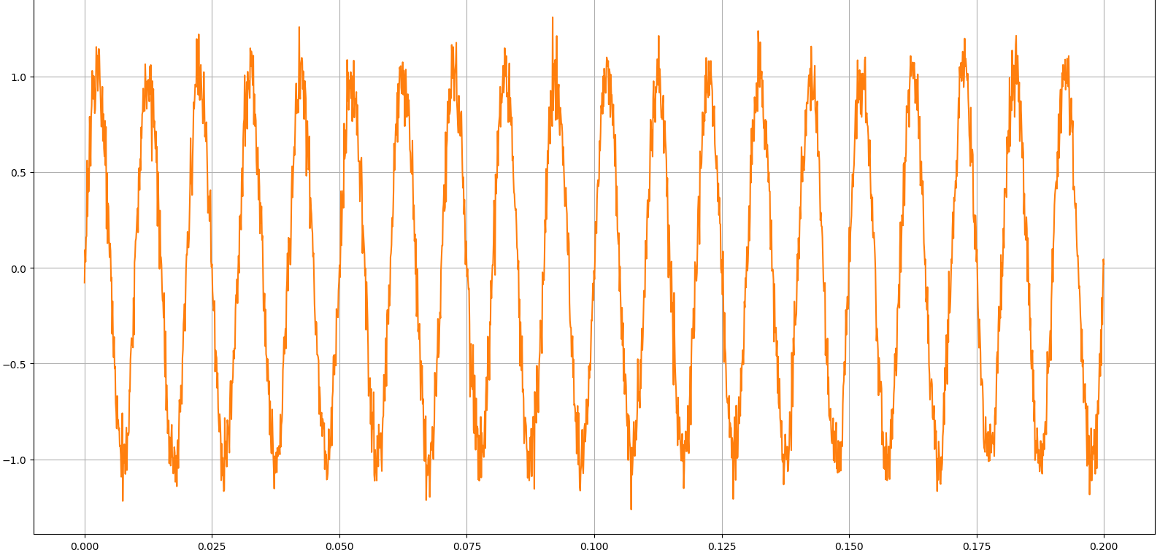
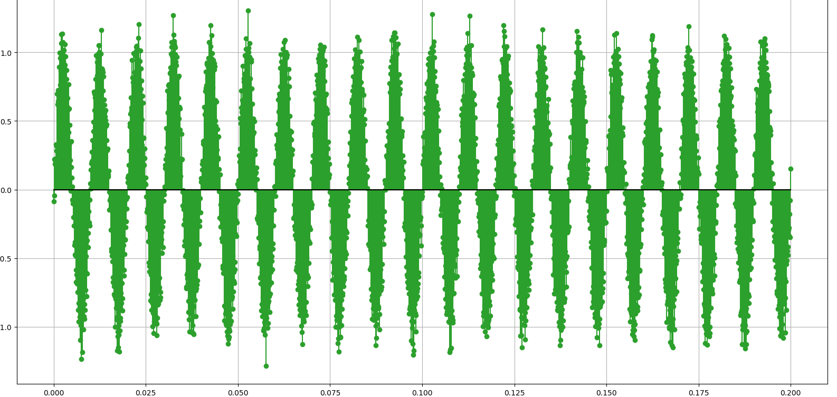
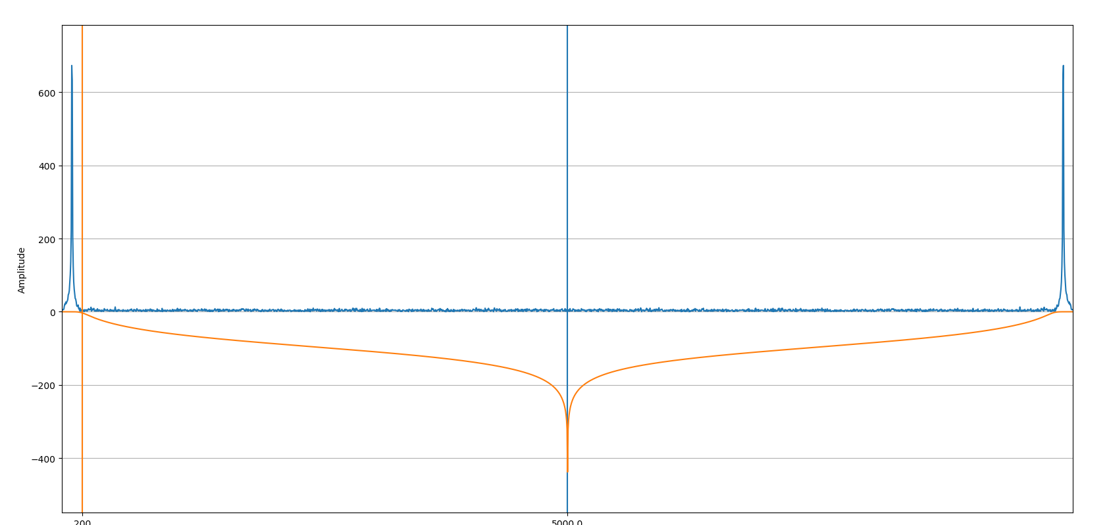
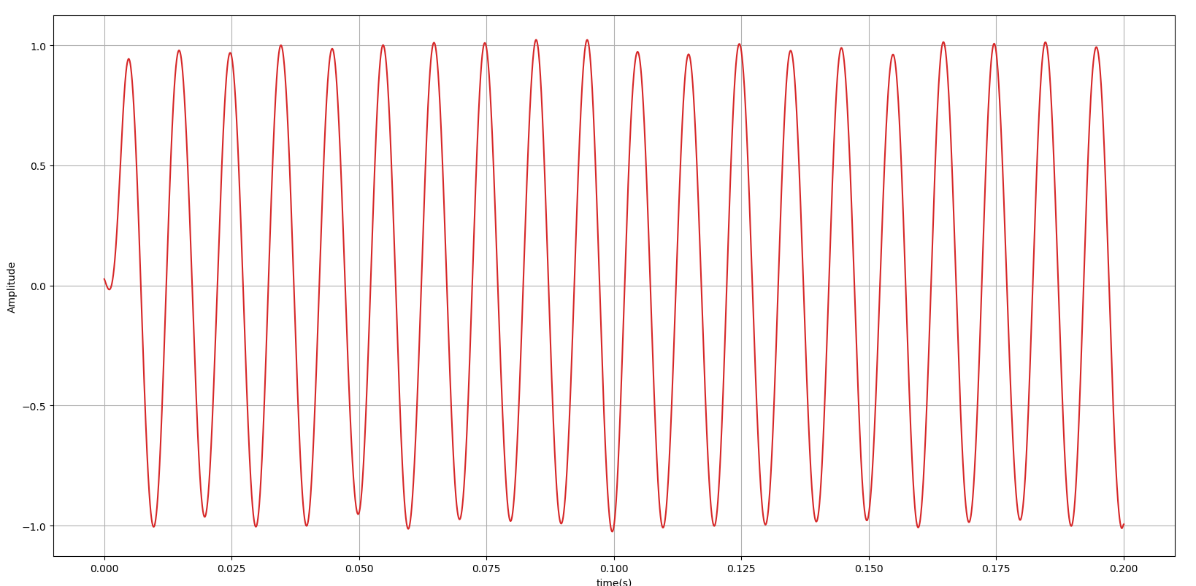
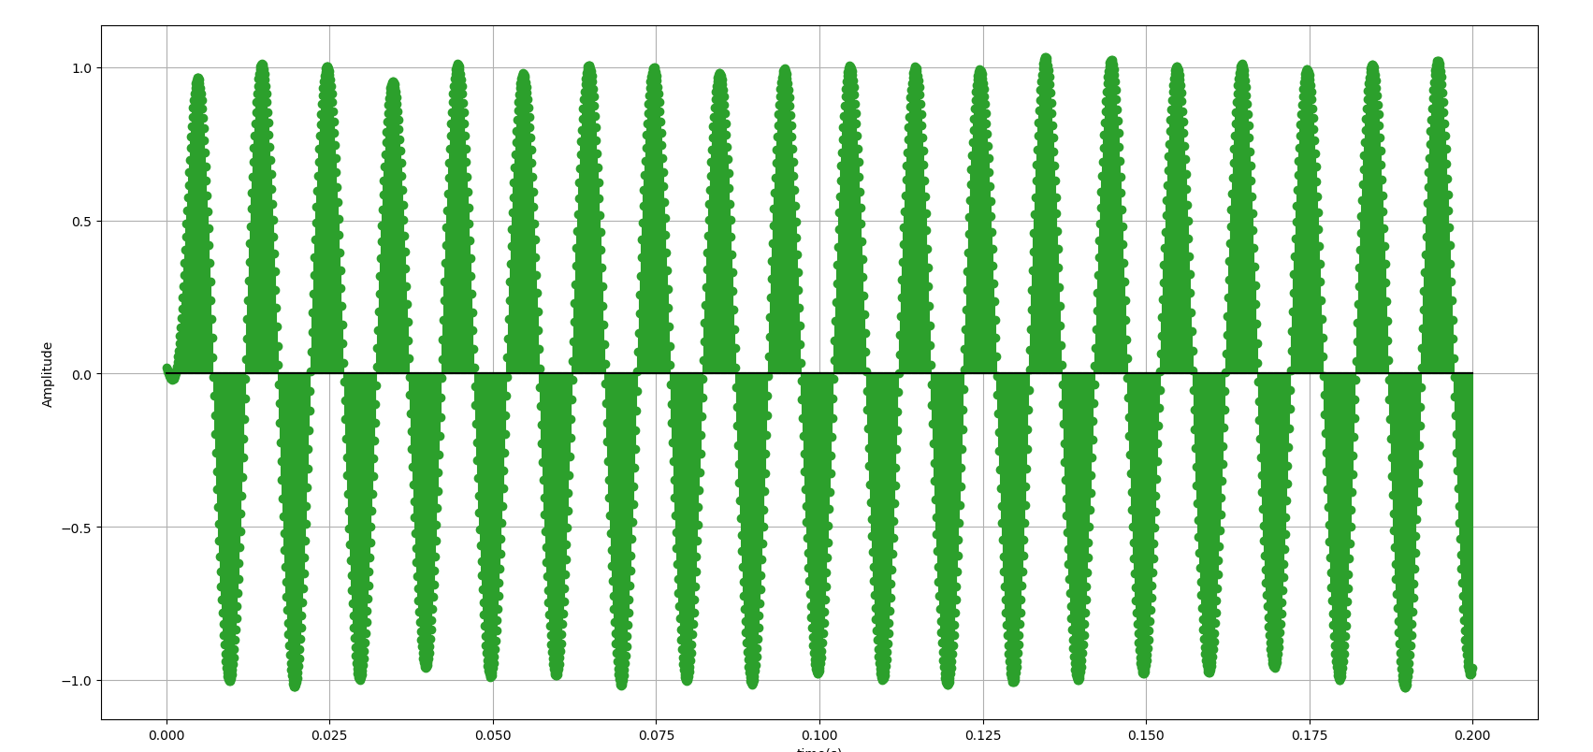
Chapter 5:
ADC
Input
Mixture of 100 Hz Sin waveforms with noise
Sampling by 10,000 Hz
Digital Signal Processing, FFT of signal and
Filtering by 200 Hz in Frequency domain
Output
DAC + LPF
DAC output LPF with 200Hz Analog filter
Output of DSP, Filtered Discrete Signal

Slide 11
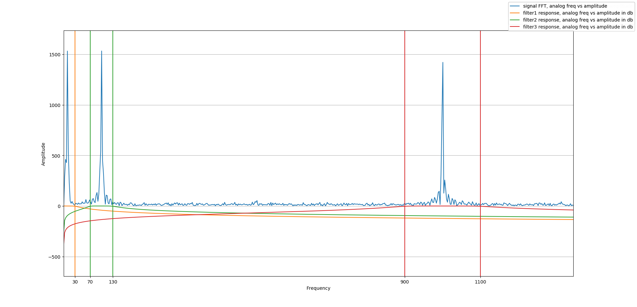
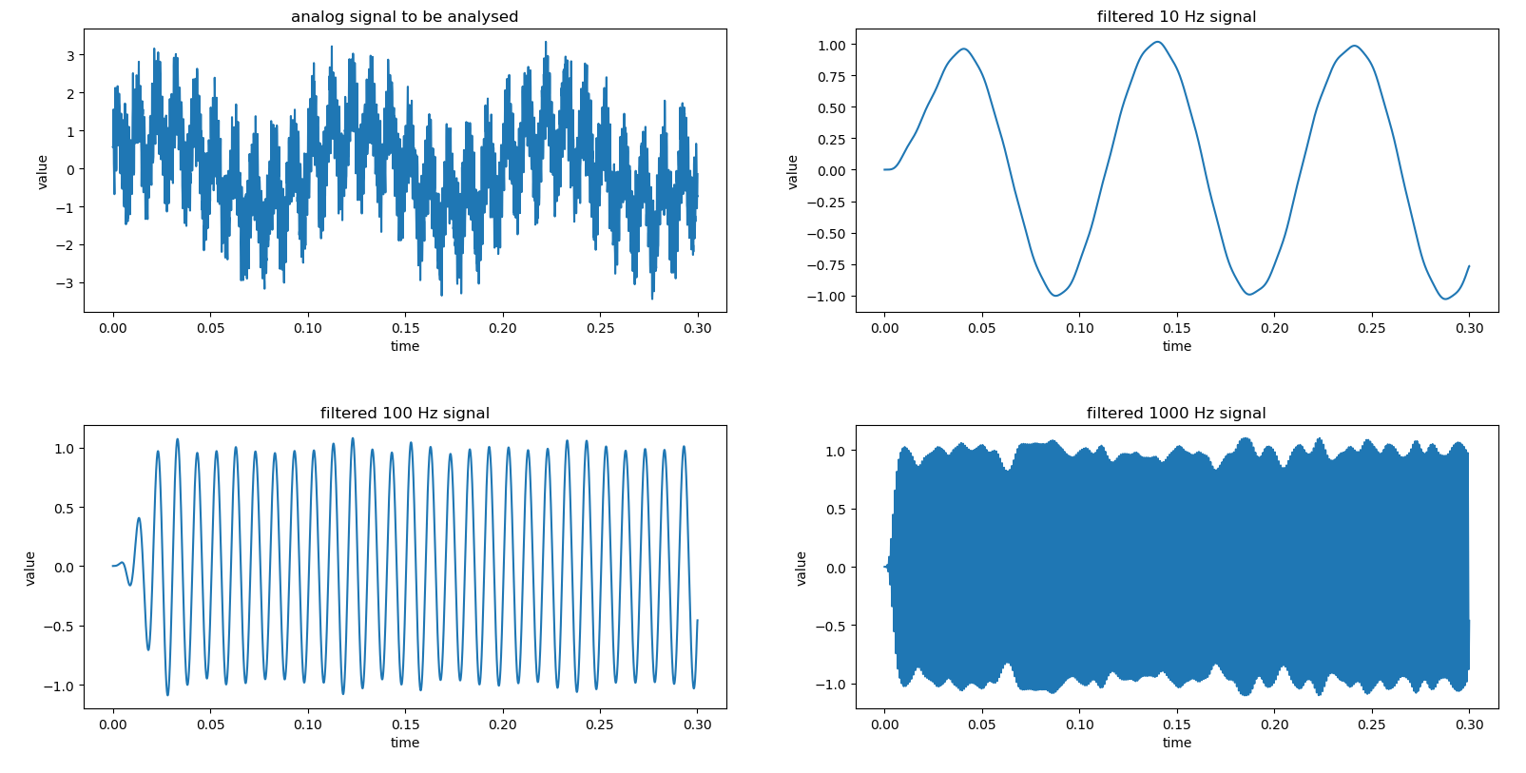
Chapter 6:
ADC
Input
Mixture of 10, 100 and 1000Hz Sin waveforms with noise
Sampling by 10,000 Hz
Digital Signal Processing
Filtering by 30 Hz LPF, 70-130 Hz BPF and 900-1100 Hz BPF
Output
DAC + LPF
DAC output LPF with 200Hz Analog filter
Output of DSP

Slide 12
Thanks

