Slide 1
FinGuard AI
Bank Customer Churn Prediction
A neural network with a local Streamlit application
Shabbir Mhowwala
Notes:
Introduce the project as a college demonstration of supervised binary classification and local deployment. Customer churn means leaving the bank. Source: README.md and app.py in https://github.com/ShabbirMhowwala/Bank-Churn-Rate-Predictor. The deck describes the model trained on 23 October 2026.

Slide 2
Problem and objective
Customer churn
A customer stops using the bank’s services.
Project objective
Estimate exit risk from customer attributes and show it in a simple local application.
Target: Exited = 1 for exited, 0 for stayed.
02
Notes:
Explain why early identification can help a retention team prioritize review. The project does not prove that contacting a customer prevents churn. The dataset provides no specific future time horizon. Sources: README.md; data/bank_customer_churn.csv.

Slide 3
Technology stack
Area | Technology and role
Model | TensorFlow / Keras: training and inference
Data | Pandas / NumPy: tables and numeric arrays
Preprocessing | scikit-learn: scaling, encoding, splits, metrics
Interface | Streamlit with HTML/CSS and UI extensions
Visuals | Plotly, Matplotlib, and Seaborn
Storage | CSV data, Joblib objects, and an HDF5 model
Python 3.12, TensorFlow 2.18, Keras 3.14.1, scikit-learn 1.9.0.
03
Notes:
Python is the application language. Keras provides the model interface on TensorFlow. Streamlit supplies the web interface and Python server. The project uses no Flask/Django service, SQL database, or external inference API. Sources: requirements.txt; requirements-local-lock.txt; components/; utils/.

Slide 4
Dataset overview
10,000
customer records
20.37%
historical churn rate
04
Notes:
The CSV has 10,000 rows, 14 columns, and no missing values. It includes France, Germany, and Spain. The source provenance and monetary currency are not documented in the repository. Class imbalance means a high accuracy can be misleading. Sources: data/bank_customer_churn.csv; local_verification.json.

Slide 5
Ten customer inputs
Profile and relationship
Banking and engagement
Credit score
Country
Gender
Age
Years with the bank
Account balance
Number of products
Credit card status
Active membership
Estimated salary
Row number, customer ID, and surname are excluded from the model.
05
Notes:
Explain each field using the sample CSV. Identifiers do not enter the network. Geography and gender are categorical. The other eight original inputs are numeric or binary. Sources: data/sample_customers.csv; utils/preprocessing.py; pages/2_Predict.py.

Slide 6
Feature engineering and preprocessing
Engineered feature | Meaning
BalanceSalaryRatio | Balance divided by salary
CreditScoreAgeRatio | Credit score divided by age
BalancePerProduct | Balance divided by product count
TenureByAge | Tenure divided by age
IsHighValueInactive | Above-median balance and inactive membership
13 scaled numeric features + 5 encoded category values
Final input to the network: 18 numbers per customer.
06
Notes:
Five engineered features join the ten raw inputs. Zero salary, product count, and tenure are replaced with one in their respective ratios. StandardScaler learns numeric means and standard deviations. OneHotEncoder creates three country and two gender columns. Prediction must reuse exactly these transformations. The high-value flag uses the reference dataset median, 97,198.54. Source: utils/preprocessing.py; utils/app_data.py; local_verification.json.

Slide 7
Neural network architecture
Stage | Configuration
Input | 18 numeric values
Hidden layer 1 | 64 neurons, ReLU, batch normalization
Regularization | Dropout 0.25
Hidden layer 2 | 32 neurons, ReLU, dropout 0.20
Hidden layer 3 | 16 neurons, ReLU
Output | 1 neuron, sigmoid
4,097 total model parameters.
07
Notes:
Dense layers learn weighted combinations of inputs. ReLU introduces nonlinearity. Batch normalization stabilizes intermediate activations. Dropout acts during training, while sigmoid maps the final value into the interval zero to one. Total parameters are 4,097 including batch-normalization state. Sources: train_model.py build_model(); local_verification.json.

Slide 8
Training parameters
Parameter | Value
Optimizer | Adam
Learning rate | 0.001
Loss | Binary cross-entropy
Batch size | 64
Maximum epochs | 45
Actual epochs in included run | 32
Class imbalance handling | Balanced class weights
08
Notes:
A batch contains 64 examples. An epoch is a full pass over the training examples. Adam minimizes binary cross-entropy using a learning rate of 0.001. Class weights increase the contribution of the minority churn class. The script fixes the split seed but does not fully seed network initialization or training. Sources: train_model.py; local_training.log.

Slide 9
Data split and early stopping
Subset | Customers | Purpose
Training | 6,800 | Update network weights
Validation | 1,200 | Choose when to stop
Test | 2,000 | Evaluate the saved model
Stratified test split with random state 42
Stop after 8 epochs without better validation AUC.
Restore the weights with the best validation AUC.
09
Notes:
The script reserves 20% for test with stratify=y and random_state=42. Keras takes 15% of the remaining 8,000 examples for validation. It monitors val_auc in max mode, patience eight, and restores best weights. The current preprocessing order has leakage limitations described on slide 17. Source: train_model.py.

Slide 10
Learning over 32 epochs
Early stopping selects the best validation-AUC weights.
10
Notes:
The chart uses the recorded epoch metrics from local_training.log, not invented values. Validation AUC guides early stopping. The final restored weights can come from an earlier epoch than the last one. Avoid interpreting training/validation similarity as proof of generalization because the preprocessing split needs improvement. Sources: local_training.log; train_model.py.

Slide 11
Verified test performance
0.859
ROC AUC
Always-stayed baseline: 79.65% accuracy, but 0% churn recall.
11
Notes:
Scores come from the reloaded local model on 2,000 test records. Accuracy is overall correctness. Precision measures how many churn alerts are correct. Recall measures how many actual churners the model catches. AUC measures ranking across thresholds. The always-stayed baseline achieves 79.65% accuracy and zero churn recall. Sources: local_verification.json; models/test_predictions.csv.

Slide 12
What the errors mean
Actual / predicted | Stayed | Exited
Stayed | 1,239 | 354
Exited | 98 | 309
309 of 407 churn cases detected
98 missed churners and 354 false alarms
12
Notes:
The test set contains 1,593 stayed and 407 exited customers. True negatives=1,239, false positives=354, false negatives=98, true positives=309. Precision=309/(309+354), recall=309/(309+98). The binary decision threshold is 0.50. Business costs of outreach and missed churn would guide threshold selection. Sources: models/test_predictions.csv; local_verification.json.

Slide 13
Prediction and risk categories
Display category | Exit-risk score
Stable | Below 0.35
Watchlist | 0.35 to below 0.65
High Risk | 0.65 and above
The app reuses the saved model and preprocessor.
Suggested actions follow rules. Scores are uncalibrated estimates.
Evaluation threshold: 0.50. Display bands use 0.35 and 0.65.
13
Notes:
A form submission becomes a one-row DataFrame. Feature engineering uses the reference dataset median, then the saved scaler and encoder transform the inputs. The saved ANN returns a score. The evaluation threshold is 0.50, while display categories use 0.35 and 0.65. A score is neither a confidence guarantee nor an accuracy percentage. The explanation/action text is hand-written logic. Sources: utils/app_data.py; pages/2_Predict.py.

Slide 14
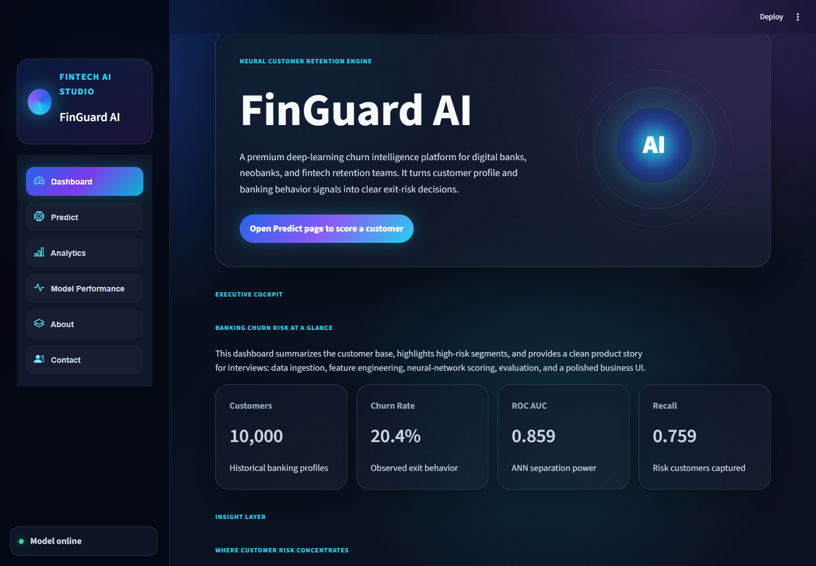
Application dashboard
Historical customer overview
Customer count and churn rate
Saved model metrics
Country and product analysis
14
Notes:
Show the screenshot, then switch to the live demo if available. Explain that the dataset count and churn rate describe historical customers. AUC and recall come from the saved test results. Analytics filters operate on the CSV and do not fetch live bank records. Source: assets/local_dashboard.png; app.py; pages/3_Analytics.py.

Slide 15
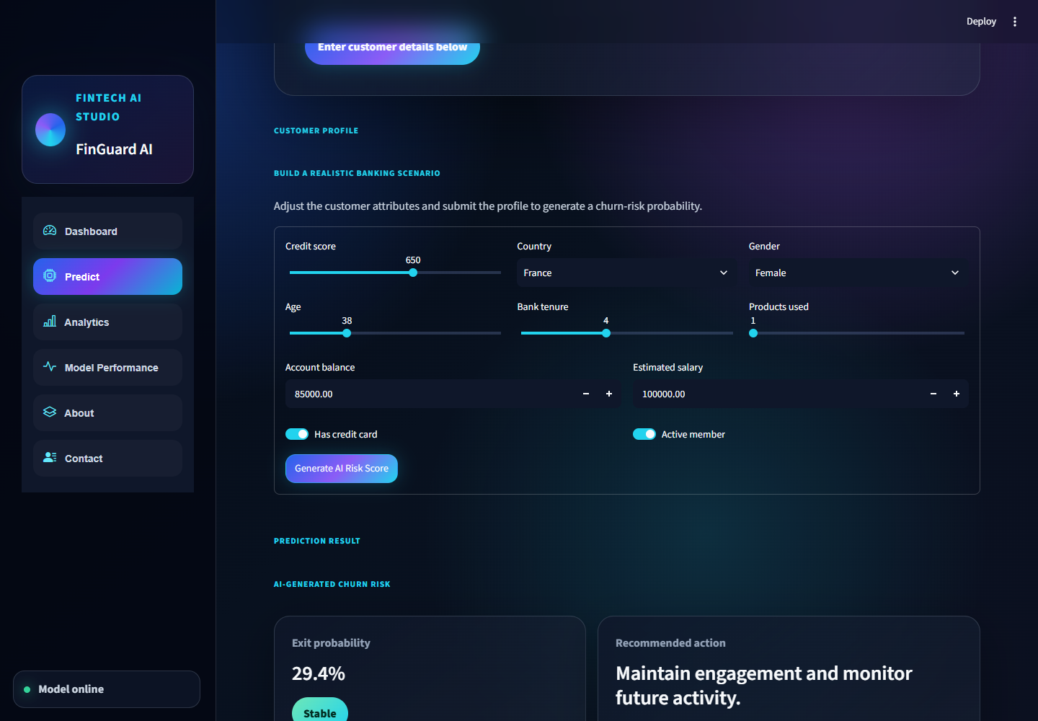
Live prediction demonstration
1. Enter a customer profile
2. Generate the risk score
3. Discuss the score and category
Default profile: 29.4%, Stable
15
Notes:
The screenshot shows the default input profile with a 29.4% score and Stable category. Enter all values from sample_customers.csv for exact examples: row 2 produces 98.72% High Risk and row 3 produces 7.57% Stable for this included saved model. Changing one input does not guarantee a specific direction of score change. Sources: assets/local_prediction.png; data/sample_customers.csv; local_verification.json.

Slide 16
Local deployment on Windows
Setting | Value
Runtime | Python 3.12 in a virtual environment
Server | Streamlit 1.66.1 on the local computer
Address and port | 127.0.0.1 : 8501
Start / stop | Run_Project.bat / Stop_Project.bat
Inference files | Saved model, preprocessor, and reference CSV
D:\Bank-Churn-Rate-Predictor
Core prediction works offline after installation.
16
Notes:
The project is installed in D:\Bank-Churn-Rate-Predictor. Its .venv uses the existing Python 3.12 installation. Install from requirements-local-lock.txt to match the tested Windows package set. Run_Project.bat launches the server and browser. Keep its window open or use Stop_Project.bat to stop. Models remain on disk after restart. No retraining or external inference API is needed for everyday use. Sources: Run_Project.bat; Stop_Project.ps1; .streamlit/config.toml; LOCAL_SETUP.md.

Slide 17
Limitations and next steps
Validation
Split raw data before learning preprocessing statistics.
False alarms
Tune thresholds and calibrate probabilities.
Model choice
Compare logistic regression and tree-based models.
Explanations
Add model-specific analysis beyond rules and correlations.
Current median uses all data; scaler fitting also includes validation rows.
17
Notes:
Current preprocessing leakage: the high-value median uses the full dataset before train/test splitting, and preprocessing fits on all development rows before the validation split. Split raw records first and learn statistics on training only. The current churn precision is 46.61%. Compare logistic regression and tree-based models. Tune thresholds and calibrate probabilities using independent data. Rules and correlations do not explain neural decisions. The app is an educational prototype. Sources: train_model.py; utils/app_data.py; PROJECT_GUIDE.md.

Slide 18
Project summary
An end-to-end classification application
Historical data, engineered features, and a trained ANN
Saved artifacts support repeatable local predictions
Recall and false alarms explain the tradeoff
Questions
github.com/ShabbirMhowwala/Bank-Churn-Rate-Predictor
18
Notes:
Close by summarizing the implemented system rather than overstating prediction quality. It demonstrates the full workflow from labeled CSV data to preprocessing, model training, evaluation, and a local browser app. The included model catches about 76% of churn cases with about 47% precision. Invite questions about preprocessing, dropout, sigmoid, class imbalance, or local deployment. Sources: README.md; PROJECT_GUIDE.md; local_verification.json.

