Slide 1
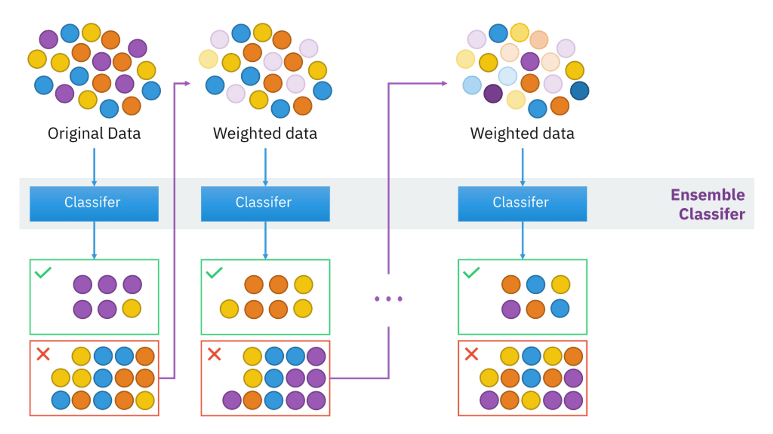
Ada Boost Algorithm
*
AdaBoost is a versatile algorithm. It processes data by combining weak learners, such as decision trees. Each tree in the algorithm focuses heavily on correcting the errors of the previous tree.
*
It uses a weight-based boosting method. Here, 'weight' means the algorithm assigns an importance to each data point. If a tree makes an error on a data point, the weight for that specific data point is increased. This ensures that the next tree pays more attention to that data point, thus correcting the error. This process ultimately leads to better overall results.

Slide 2
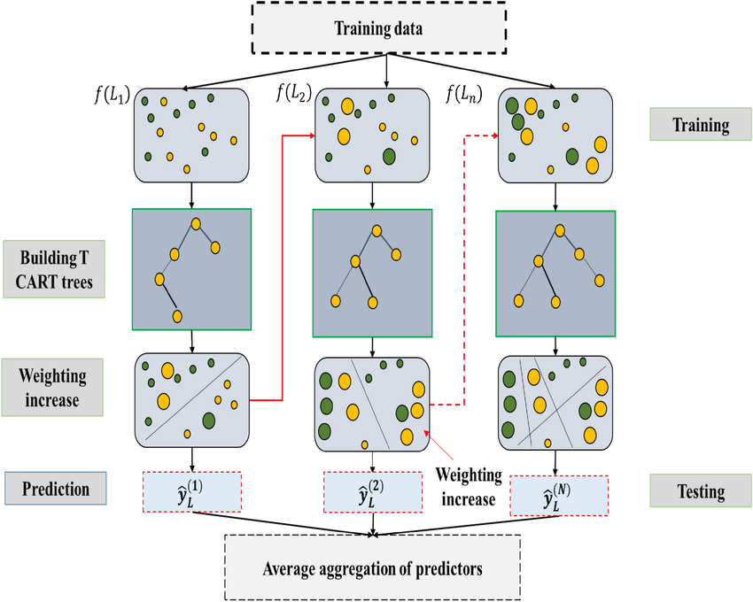
XG Boosting Algorithm
*
XG Boosting is a powerful gradient boosting algorithm. It combines decision trees to provide accurate predictions.
*
Gradient boosting framework is about building a new model to reduce mistakes in an existing model and adding it to the existing model.

Slide 3
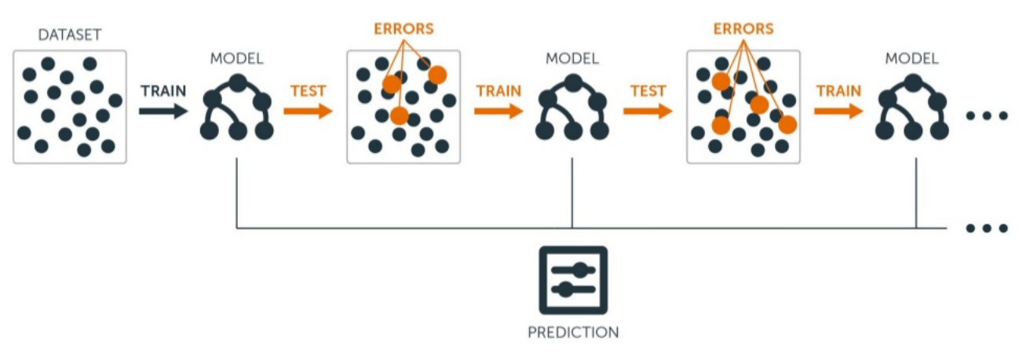
LG Boosting Algorithm (LGBM)
*
Light Gradient Boosting Machine, like other boosting algorithms, is built by combining decision trees. The subsequent trees correct the errors made by the previous trees.
*
It is very efficient and fast for large and high-dimensional datasets, but for small datasets, it might sometimes overfit.

