Slide 1

PQC Message System
Enhanced Post-Quantum Cryptography Suite
Team No: 36
Shabesh V K (23039177205210138)
Nathan J (2303917720521095)
Naveen S J (2303917720521096)
Project Guide
Dr. R. Jenice Aroma
22 October 2026
1
22IT790 - Final Project Review

Slide 2
Problem Statement
Need
Secure messaging needs a practical migration path because sufficiently capable quantum computers could threaten conventional public-key cryptography.
Project Objectives
Integrate post-quantum and classical algorithms into a usable web-messaging workflow.
Combine key establishment, authenticated encryption and signatures in a modular security layer.
Evaluate prototype functionality, sender-side cryptographic processing and deployment constraints.
22 October 2026
2
22IT790 - Final Project Review

Slide 3
Literature Survey
Paper / standard details
Title, author, venue and year
Observations
[1] R. Bavdekar et al. (2022)
Post Quantum Cryptography: Techniques, Challenges, Standardization, and Directions for Future Research
arXiv:2202.02826
Surveys quantum threats, PQC families and standardization challenges; guides the comparison of candidate cryptographic algorithms.
[2] R. Niederhagen and M. Waidner (2017)
Practical Post-Quantum Cryptography
Fraunhofer SIT white paper
Discusses migration, compatibility and secure implementation, supporting a phased hybrid transition strategy.
[3] F. Borges, P. R. Reis and D. Pereira (2020)
A Comparison of Security and Its Performance for Key Agreements in Post-Quantum Cryptography
IEEE Access
Compares security levels, key sizes and execution times, highlighting the need for multi-criteria cryptographic evaluation.
22 October 2026
3
22IT790 - Final Project Review

Slide 4
Literature Survey
Paper / standard details
Title, author, venue and year
Observations
[4] C. Paquin, D. Stebila and G. Tamvada (2020)
Benchmarking Post-quantum Cryptography in TLS
PQCrypto 2020, LNCS 12100
Studies the effects of network latency and packet loss on PQC handshakes; primitive timings alone do not represent overall protocol latency.
[5] NIST (2024), FIPS 203
Module-Lattice-Based Key-Encapsulation Mechanism Standard
Specifies ML-KEM, including ML-KEM-768; provides a standards reference for key-establishment and receiver-side decapsulation work.
[6] NIST (2024), FIPS 204
Module-Lattice-Based Digital Signature Standard
Specifies ML-DSA signing and verification; provides a standards reference for planned receiver-side authentication validation.
22 October 2026
4
22IT790 - Final Project Review

Slide 5
Stakeholder Analysis
Stakeholder
Role / interest
Expected needs
Military personnel
Operate secure messaging tools
Reliable communication and simple adoption
Government agencies
Exchange sensitive information
Interoperability and long-term confidentiality
Security teams
Assess hybrid cryptographic controls
Test environments and review evidence
Application teams
Integrate APIs and cryptographic modules
Clear interfaces and upgrade flexibility
Legal / compliance teams
Review applicable security standards
Traceable requirements and documentation
22 October 2026
5
22IT790 - Final Project Review

Slide 6
Innovation in Proposal
Integrated hybrid messaging design
Combines Kyber768 and ECDH-P384 for sender-side hybrid key establishment.
Encrypts messages using AES-256-GCM and generates hybrid digital signatures.
Supports registration, login, messaging and encrypted-message storage.
Modular interface, API, cryptographic and storage layers simplify future upgrades.
Research dissemination
Prepared the ICDCN 2027 poster manuscript “A Crypto-Agile Hybrid Framework for Post-Quantum Secure Messaging” to present the system design and migration approach.
22 October 2026
6
22IT790 - Final Project Review
Notes:
The contribution is the integration of established cryptographic components in an extensible messaging prototype. It is not a claim of a new cryptographic primitive or a proof that the combined construction is secure. Full receiver decapsulation, signature verification and stronger key handling remain necessary. Source: supplied final presentation, objectives, architecture, algorithm, validation and constraints slides.

Slide 7
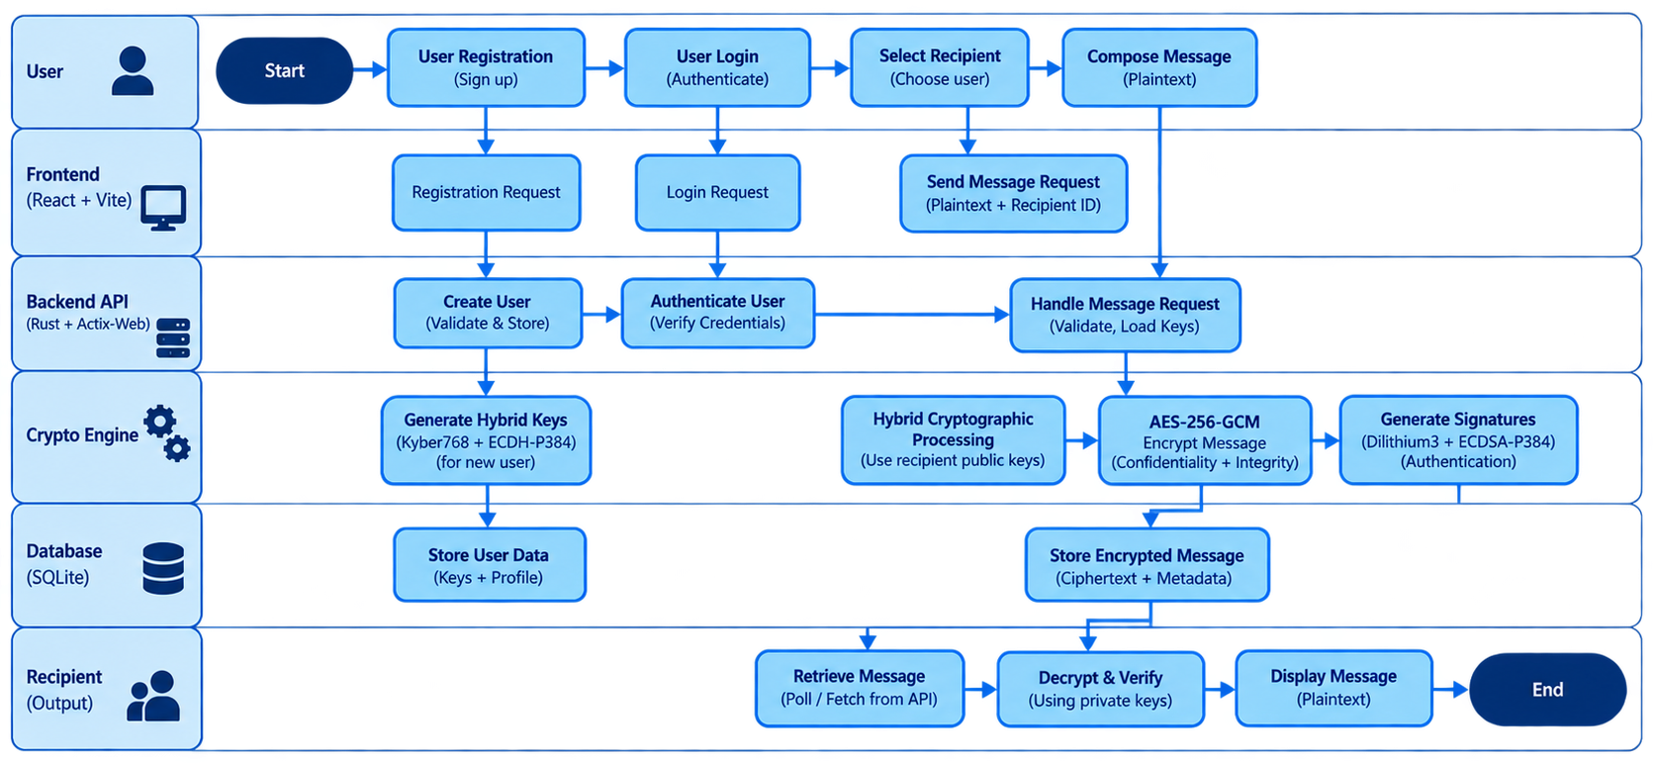
System Architecture
Detailed prototype: receiver-side decrypt/verify is planned; complete end-to-end validation remains pending.
22 October 2026
7
22IT790 - Final Project Review

Slide 8
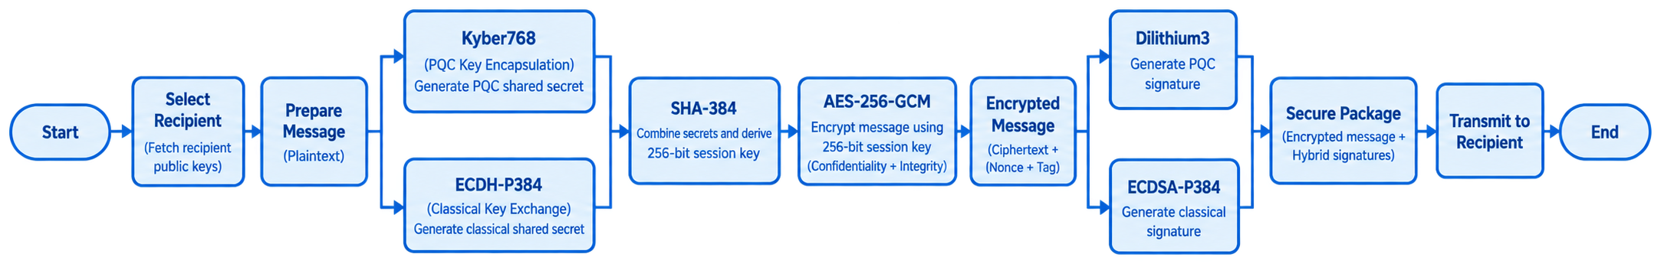
Hybrid Cryptographic Algorithm
Sender-side hybrid key establishment, authenticated encryption and signing
Kyber768 and ECDH-P384 contribute to the 256-bit session key used by AES-256-GCM.
Dilithium3 and ECDSA-P384 generate the sender-side authentication signatures.
22 October 2026
8
22IT790 - Final Project Review

Slide 9
Technical Specifications
Component
Implementation
Purpose
PQC Key Establishment
Kyber768
Post-quantum component of hybrid key setup
Classical Key Exchange
ECDH-P384
Classical shared-secret contribution
Key Derivation
SHA-384 → 256-bit
Symmetric session-key derivation
Message Encryption
AES-256-GCM
Confidentiality and integrity protection
PQC Signature
Dilithium3
Sender-side post-quantum authentication
Classical Signature
ECDSA-P384
Sender-side classical authentication
22 October 2026
9
22IT790 - Final Project Review

Slide 10
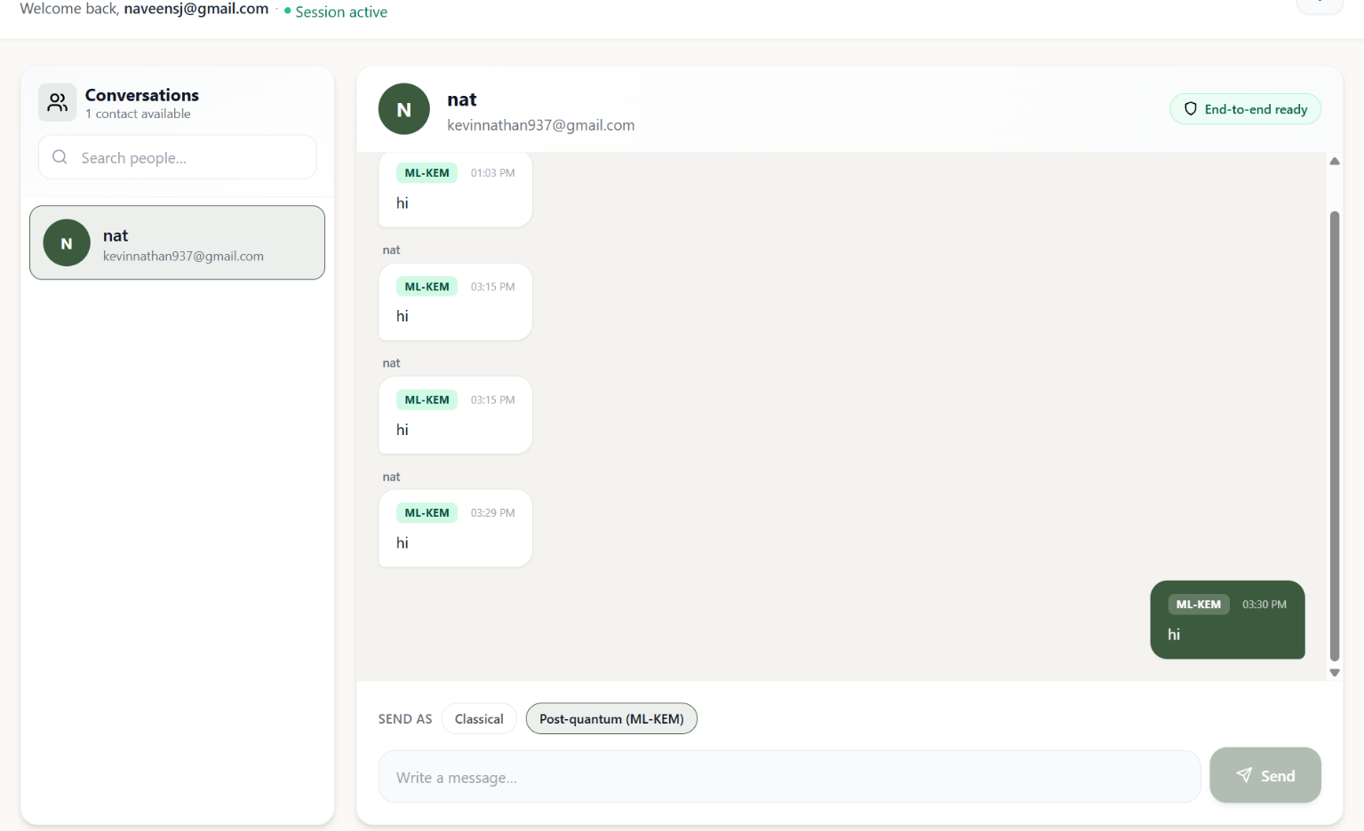
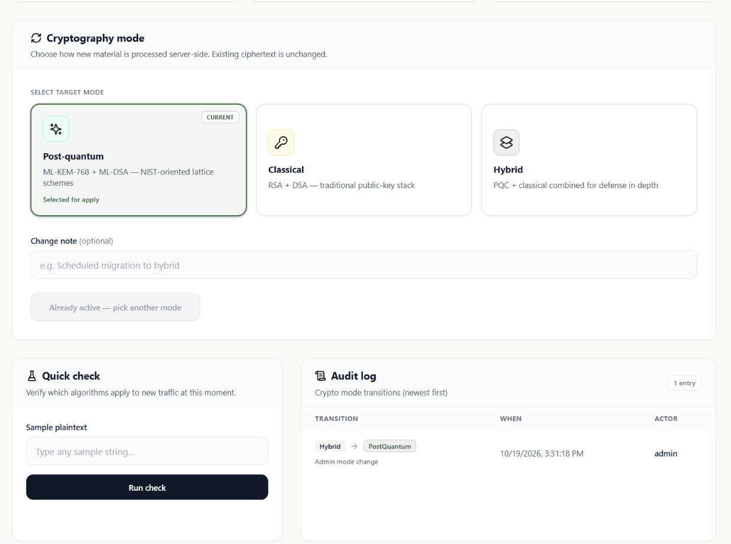
Interpretations & Final Results
Secure Messaging Workflow
Cryptographic Mode & Audit
Two-way messages displayed with ML-KEM labels and a selectable send mode.
Post-quantum, classical and hybrid choices; the mode transition is recorded in the audit log.
22 October 2026
10
22IT790 - Final Project Review
Notes:
2

Slide 11
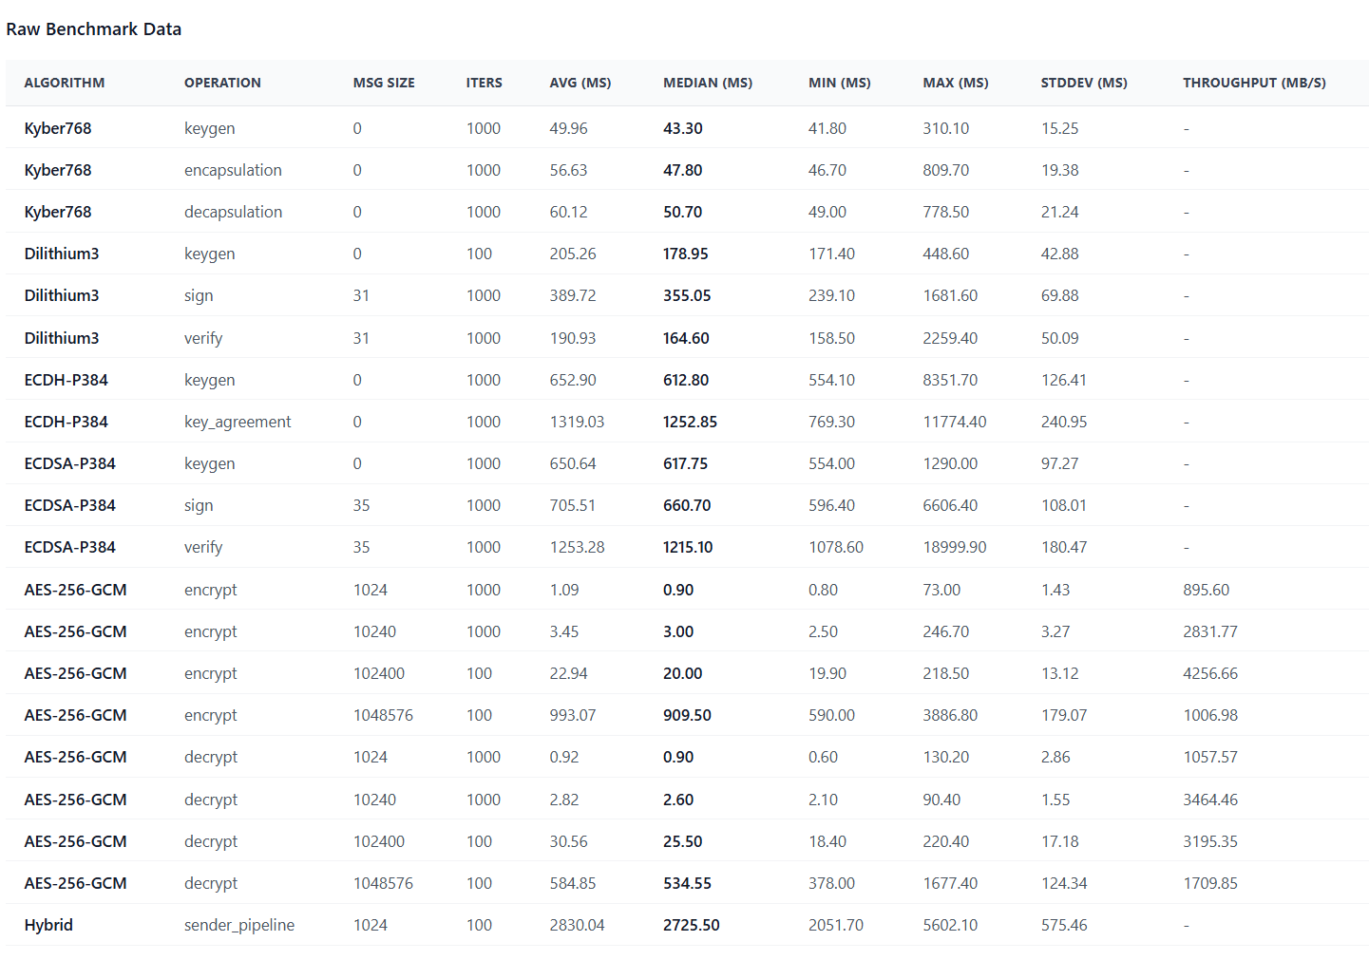
Interpretations & Final Results
Raw Benchmark Data
22 October 2026
11
22IT790 - Final Project Review
Notes:
2

Slide 12
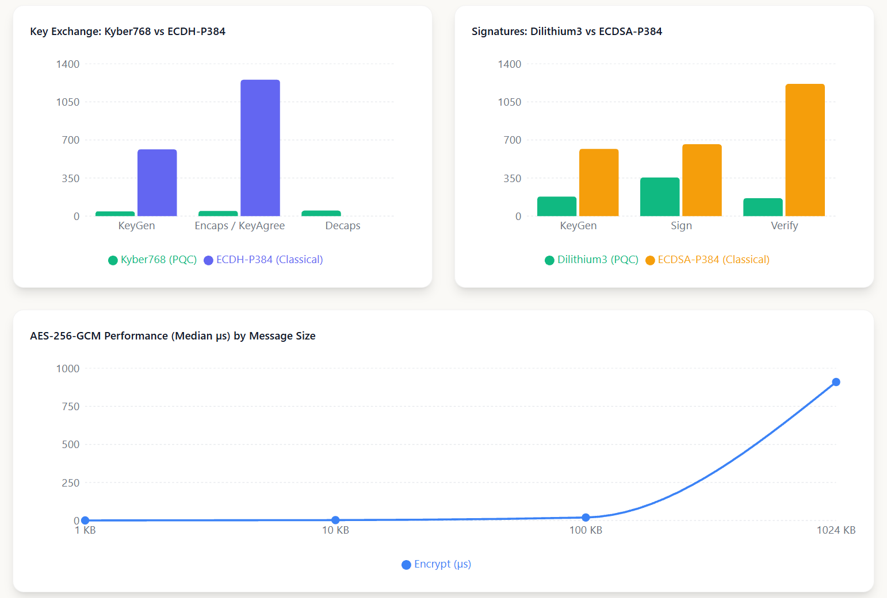
Interpretations & Final Results
Cryptographic Performance Comparison
22 October 2026
12
22IT790 - Final Project Review
Notes:
2

Slide 13
Feasibility & Validation
Feasibility
Validation
User registration, login and messaging are integrated in the prototype.
Functional registration and messaging workflows have been demonstrated.
Sender-side hybrid key establishment, encryption and signatures are implemented.
Sender-side hybrid cryptographic processing has been tested.
Ciphertext and message metadata are stored using SQLite.
Receiver-side PQC decapsulation and signature verification remain pending.
Local/LAN deployment is supported using Docker.
Complete end-to-end security validation is still pending.
22 October 2026
13
22IT790 - Final Project Review
Notes:
2

Slide 14
SDG Relevance & Cost
SDG 9
Cost Effectiveness
Industry, Innovation and Infrastructure
Open-source tools: No proprietary software licence fees for the prototype framework and libraries.
Supports resilient digital infrastructure by demonstrating a practical migration path using hybrid post-quantum cryptography.
Existing hardware: Runs on general-purpose computers without specialized cryptographic accelerators.
SDG 16
Peace, Justice and Strong Institutions
Local deployment: Docker/LAN demonstrations avoid recurring public-cloud hosting charges.
Relates to confidentiality and privacy in sensitive institutional communication.
22 October 2026
14
22IT790 - Final Project Review
Notes:
The SDG mapping describes project relevance, not a measured social impact. The open-source stack, standard-PC operation, local hosting and modular design support a qualitative cost-effectiveness argument. Actual expenditure, rupee savings, hosting prices and operating budgets were not supplied, so no financial total is asserted.
SDG sources:
https://sdgs.un.org/goals/goal9
https://sdgs.un.org/goals/goal16
Project evidence: supplied final presentation, feasibility, SDG and technology stack slides.

Slide 15
Conclusion & Future Work
Conclusion
Built QuMail using React, Rust/Actix-Web, SQLite and Docker for encrypted messaging.
Combined Kyber768 + ECDH-P384 key establishment with AES-256-GCM message protection.
Added Dilithium3 + ECDSA-P384 signatures and tested sender-side cryptographic processing.
Prepared an ICDCN 2027 poster manuscript describing the crypto-agile hybrid framework.
Demonstrated sender-side processing; complete receiver-side verification remains pending.
Future Work
Complete receiver-side decapsulation, signature verification and end-to-end security testing.
Introduce Zero-Trust authentication and least-privilege access controls.
Optimize performance, scalability and deployment readiness.
22 October 2026
15
22IT790 - Final Project Review
Notes:
2

Slide 16
References
[1]
R. Bavdekar et al., “Post Quantum Cryptography: Techniques, Challenges, Standardization, and Directions for Future Research,” arXiv:2202.02826, 2022.
[5]
NIST, “Module-Lattice-Based Key-Encapsulation Mechanism Standard,” FIPS 203, 2024. doi:10.6028/NIST.FIPS.203.
[2]
R. Niederhagen and M. Waidner, “Practical Post-Quantum Cryptography,” Fraunhofer SIT white paper, 2017.
[6]
NIST, “Module-Lattice-Based Digital Signature Standard,” FIPS 204, 2024. doi:10.6028/NIST.FIPS.204.
[3]
F. Borges, P. R. Reis and D. Pereira, “A Comparison of Security and Its Performance for Key Agreements in Post-Quantum Cryptography,” IEEE Access, 2020. DOI: 10.1109/ACCESS.2020.3013250.
[7]
NIST Computer Security Resource Center, “Post-Quantum Cryptography” project, csrc.nist.gov/projects/post-quantum-cryptography.
[4]
C. Paquin, D. Stebila and G. Tamvada, “Benchmarking Post-quantum Cryptography in TLS,” PQCrypto 2020, LNCS 12100, pp. 72–91.
[8]
Indian Patent Office, Public Search portal, iprsearch.ipindia.gov.in (prior-art search resource).
22 October 2026
16
22IT790 - Final Project Review
Notes:
10

