Slide 1
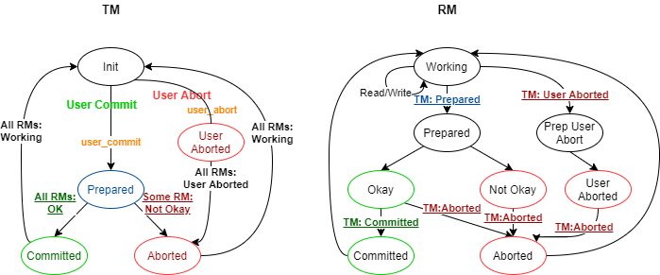
1st Refinement: Abstract Commit (AC) Protocol
Transaction Manager
TM state
Key Manager
RM state
Status (Init, Prepared, etc.)
Sequence Number (last session number used by the client)
Status (Working, Prepared, Okay, etc.) Local Key Version List Local Key Fingerprint
Notes:
Non-local guards that look into other components’ local state

Slide 2
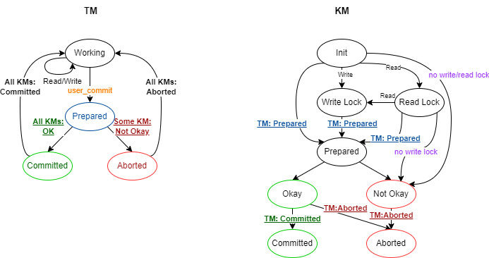
1st Refinement: 2PC + 2PL (version 1)
Lockreleased
No lock to release
Lock acquired
Lock not available
Read Lock
Write Lock
No Lock
Lock released
No lock to release
Transaction Manager
TM state
Key Manager
KM state
Status Sequence Number (last sqn of client) View (of client on the kv-store)
Status Local Key Version List Local Key Fingerprint
Notes:
Non-local guards that look into other components’ local state

Slide 3
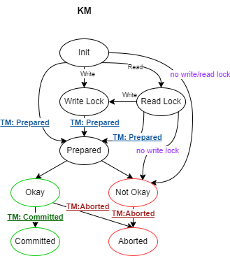
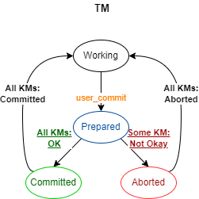
1st Refinement: 2PL + 2PC (version 2)
Transaction Manager
TM state
Key Manager
KM state
Status Sequence Number (last sqn of client) View (of client on the kv-store)
Status Local Key Version List Local Key Fingerprint
Notes:
Non-local guards that look into other components’ local state

