Slide 1
Fitness buddy
CAPSTONE PROJECT
Presented By:
Shabnam Yasmin Ahmed St Joseph’s University, Bengaluru M.Sc. Computer Science

Slide 2
OUTLINE
Problem Statement
Technology used
Wow factor
End users
Result
Conclusion
Git-hub Link
Future scope
IBM Certifications

Slide 3
Problem Statement
In today’s fast-paced world, many individuals struggle to maintain a healthy lifestyle due to lack of personalized guidance, time constraints, and inconsistent motivation. Traditional fitness solutions often require expensive subscriptions, in-person consultations, or rigid schedules that don't adapt to personal preferences or daily routines.
There is a growing need for an accessible, friendly, and intelligent virtual assistant that can provide on-demand fitness advice, healthy lifestyle suggestions, and basic nutrition guidance—all tailored to individual needs and available at any time.
Fitness Buddy aims to solve this problem by offering a conversational, AI-powered health and fitness coach that can: Recommend home workouts and routines based on user input. • Provide motivational tips and daily fitness inspiration. • Suggest simple, nutritious meal ideas. • Encourage habit-building and consistency.

Slide 4
Technology used
IBM cloud lite services
IBM Granite model
LLMs RAG (Retrieval- Augmented Generation)
NLP Cloud Computing

Slide 5
IBM cloud services used
IBM Cloud watsonx.ai Studio
IBM Cloud watsonx.ai Runtime
IBM Cloud Agent Lab
IBM Granite foundation model
IBM Cloud Object Storage
Lite Plans

Slide 6
Wow factors
Hybrid Knowledge System: The agent dynamically combines information from two distinct sources:
its private, curated knowledge base (our fitness/recipe file) and real-time data from the internet via external tools
(like Google Search).
Rapid Development Cycle: A sophisticated, deployable AI assistant was created using a low-code visual
interface (Agent Lab) in a very short amount of time, without requiring deep programming expertise.
Context-Aware Conversational Flow: The agent can handle natural conversation, understand user intent,
and provide relevant, contextual advice, creating a user-friendly coaching experience.
Cost-Effective Prototyping: The entire end-to-end solution, from development to deployment, was built on
free "Lite" tier services, making advanced AI development highly accessible.

Slide 7
System Approach
The project followed a structured, multi-stage approach:
Data Preparation: Sourced raw exercise and nutrition data from Kaggle. This data was then cleaned,
filtered for relevance (e.g., bodyweight exercises, healthy recipes), and formatted into a structured knowledge
base document.
Environment Setup: A new project was created in IBM watsonx.ai, and essential services like
Cloud Object Storage and the Watson.ai Runtime was configured and associated.
3. Agent Configuration: Within the watsonx Agent Lab, a foundation model was selected as the core
of the agent.
Knowledge Grounding (RAG): The prepared knowledge base document was uploaded and vectorized,
making its content searchable and retrievable by the agent.
Deployment: The fully configured agent was deployed as a scalable, online AI service within an
IBM Cloud Deployment Space, making it available via a secure API endpoint.

Slide 8
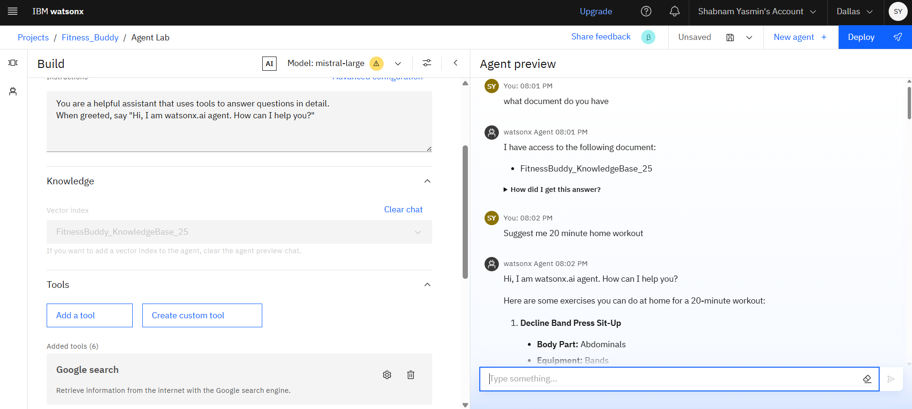
Result

Slide 9
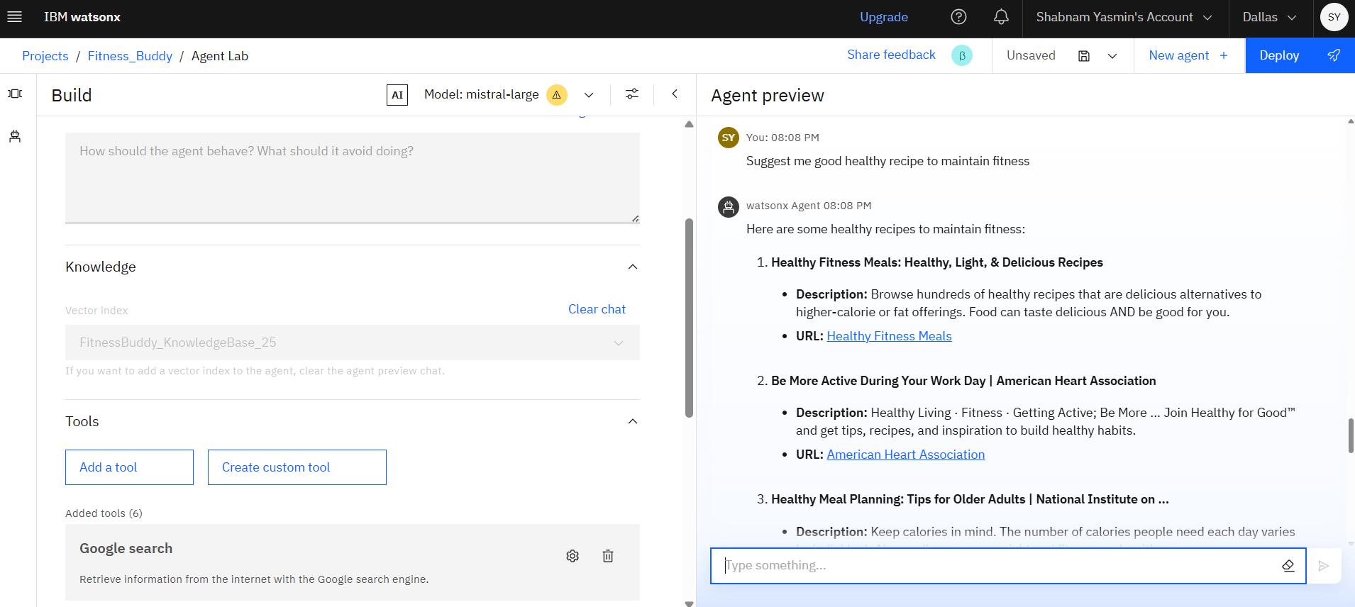
Result

Slide 10
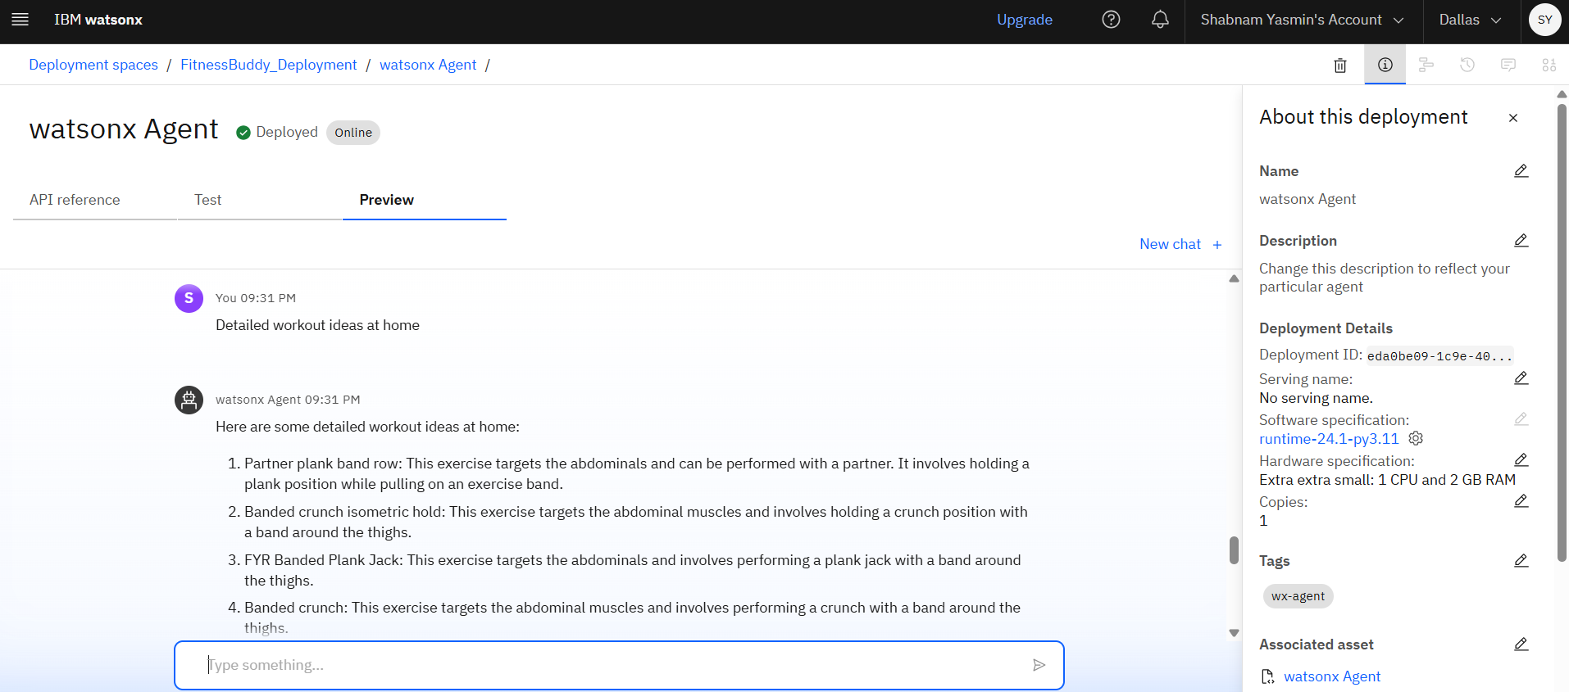
Result deployed ai agent

Slide 11
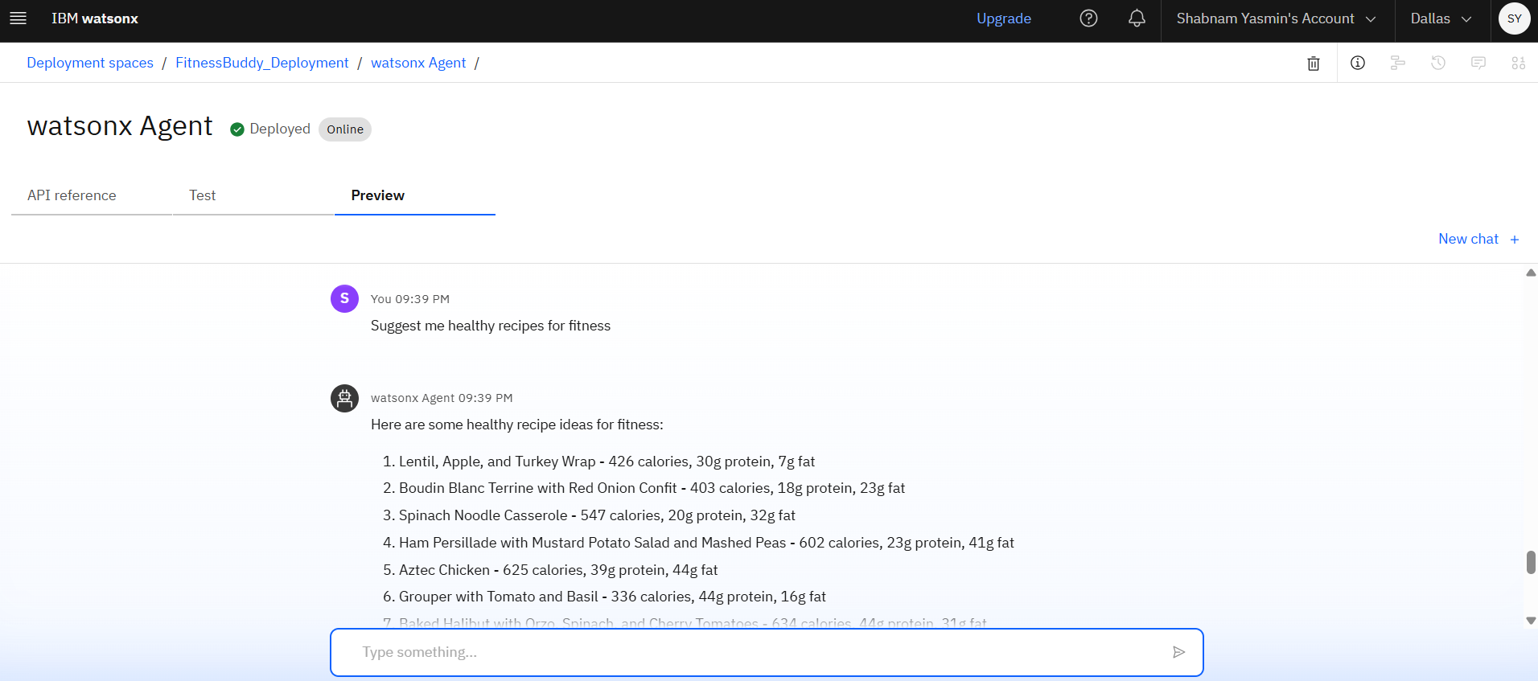
Result deployed ai agent

Slide 12
End users
The primary end users for the FitnessBuddy agent include:
Fitness Beginners: Individuals who are new to working out and healthy eating and need simple, trustworthy guidance.
Busy Professionals: People with tight schedules who need quick, on-demand workout routines and meal ideas that they can access anytime, anywhere.
Budget-Conscious Individuals: Users seeking personalized fitness advice without the financial commitment of a human personal trainer or expensive apps.

Slide 13
Conclusion
The FitnessBuddy project successfully demonstrates the power and accessibility of IBM watsonx.ai for creating specialized, conversational AI agents. By leveraging a Retrieval-Augmented Generation (RAG) approach combined with external tools, we developed an intelligent coach capable of providing accurate, contextual, and personalized fitness and nutrition advice. This project validates that a sophisticated and valuable AI tool can be rapidly prototyped and deployed on the IBM Cloud platform with minimal resources.

Slide 14
Github link
GitHub Link: https://github.com/ShabnamY/FitnessBuddy-Agentic_AI.git
(Have added the Jupyter Notebook file in the above GitHub Link)

Slide 15
Future scope
The FitnessBuddy agent provides a strong foundation that can be expanded in several ways:
Front-End Integration: To develop a user-friendly mobile or web application that connects to the deployed agent's API for a seamless user experience.
Enhanced Personalization: To implement user profiles to track fitness goals, workout history, dietary preferences, and progress over time, enabling the agent to provide truly individualized long-term coaching.
Expanded Knowledge Base: To regularly update the knowledge base with a wider variety of workouts, specialized diet plans (e.g., vegan, keto), and the latest fitness research.
Multi-modal Capabilities: To add the ability for users to upload images of meals for calorie estimation or videos of their exercises for form correction analysis.
Proactive Engagement: To integrate push notifications to proactively send workout reminders, motivational messages, and healthy habit tips to users.

Slide 16
References
Data Sources (from Kaggle)
Mega Gym Dataset
Recipe & Nutrition Dataset

Slide 17
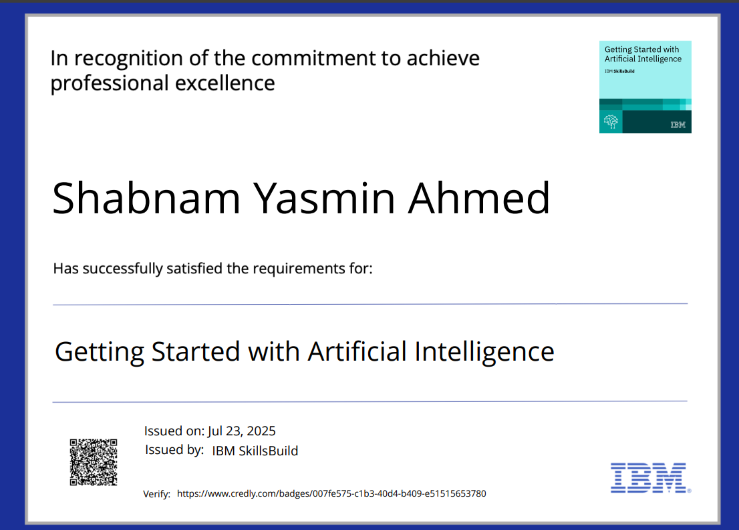
IBM Certifications- getting started with AI

Slide 18
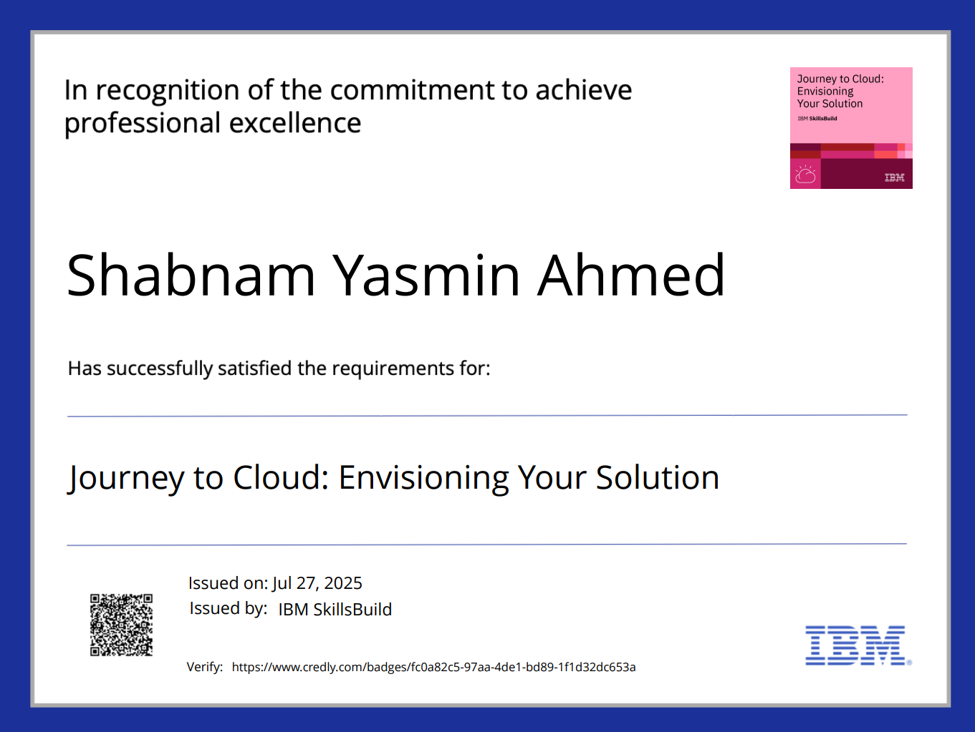
IBM Certifications- Journey to Cloud

Slide 19
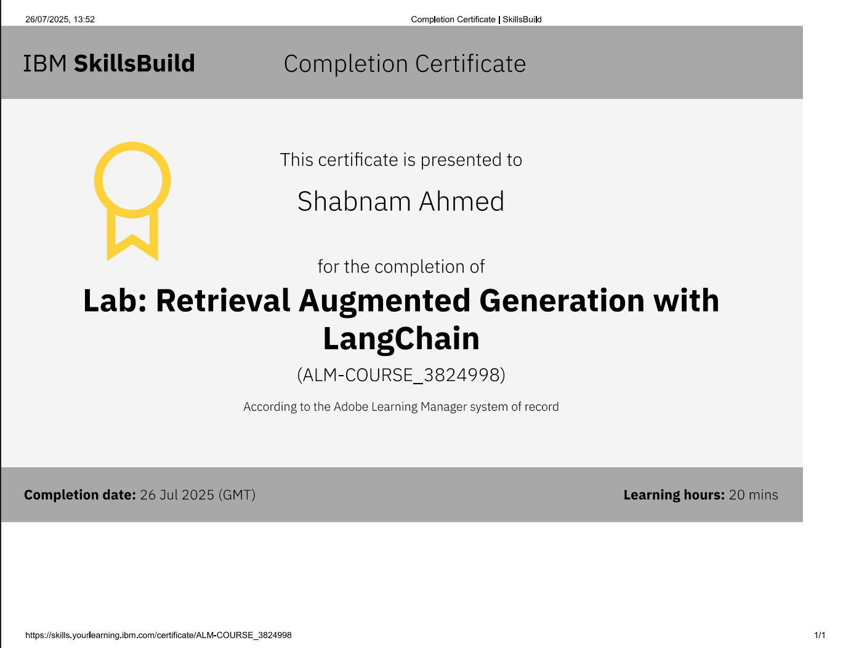
IBM Certifications- RAG Lab

Slide 20
THANK YOU

