Slide 1
Two major paradigms of recommender systems :
collaborative
content based methods
Various methods of collaborative filtering,
user-user,
item-item
Matrix factorization

Slide 2
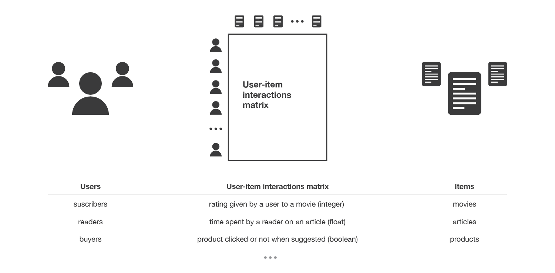
Collaborative filtering methods:
Collaborative methods for recommender systems are methods that are based solely on the past interactions recorded between users and items in order to produce new recommendations. These interactions are stored in the so-called “user-item interactions matrix”.

Slide 3
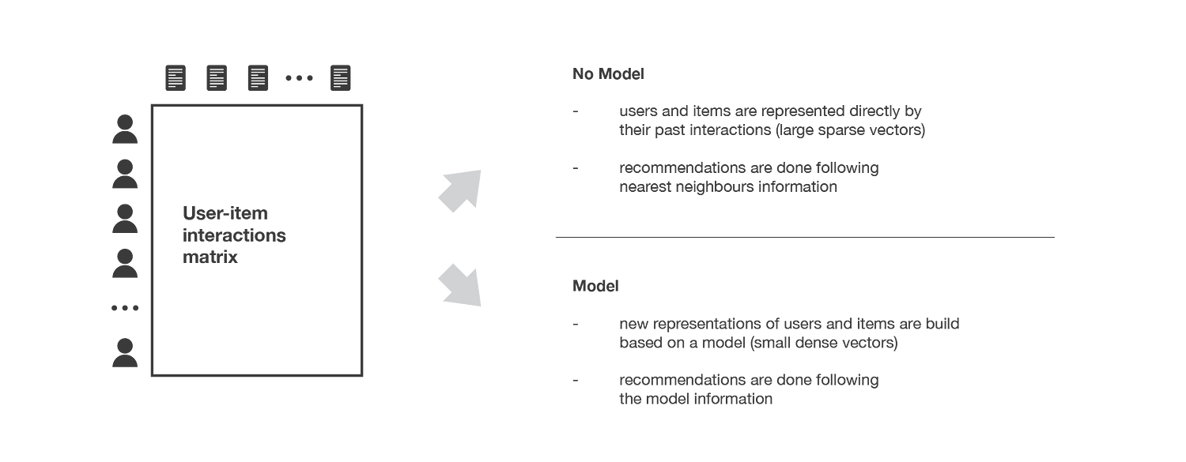
Collaborative filtering methods:
The main idea that rules collaborative methods is that these past user-item interactions are sufficient to detect similar users and/or similar items and make predictions based on these estimated proximities.
Collaborative filtering algorithms:
memory based
model based approaches.
Memory based approaches: directly works with values of recorded interactions, assuming no model, and are essentially based on nearest neighbors search (for example, find the closest users from a user of interest and suggest the most popular items among these neighbors).
Model based approaches: assume an underlying “generative” model that explains the user-item interactions and try to discover it in order to make new predictions.

Slide 4
Collaborative filtering methods: Pros and Cons
Pros
They require no information about users or items and, so, they can be used in many situations.
The more users interact with items the more new recommendations become accurate: for a fixed set of users and items, new interactions recorded over time bring new information and make the system more and more effective.
Cons
If not enough rating exists, very spare matrix, the system becomes ineffective.
However, as it only consider past interactions to make recommendations, collaborative filtering suffer from the “cold start problem”: it is impossible to recommend anything to new users or to recommend a new item to any users and many users or items have too few interactions to be efficiently handled.
Solution: 1) Recommending random items to new users or new items to random users (random strategy),
2)recommending popular items to new users or new items to most active users (maximum expectation strategy),
3)recommending a set of various items to new users or a new item to a set of various users (exploratory strategy)
4) using a non collaborative method for the early life of the user or the item.
Gray sheep: two disconnected clusters of users, some users falls somewhere in between on the boarder
Black sheep: users who are aways from the two types of users.

