Slide 1

Enhancing LLM Responses: The RAG Approach vs. Isolated LLMs
Understanding how language models work and how we can enhance them using Langchain

Slide 2
What are LLMs?
LLMs like GPT-3 (OpenAI) are pre-trained models that generate text based on patterns in vast amounts of data.
They understand and generate human-like text but have limitations such as outdated information.
Example: OpenAI GPT-3, GPT-4, Meta Ilama, google PaLM

Slide 3
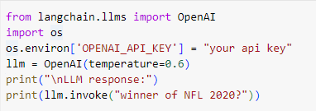
LLM Example in Action

Slide 4
Langchain Tool: Enhancing LLM Capabilities
Langchain Tools:
Langchain Tools are interfaces that LLM can use to interact with the world.
Tools allows models to access real-time information, APIs, or databases.
How it Works:
Langchain integrates with tools like Wikipedia, Google Search, etc.
The LLM retrieves data through Langchain and processes it for enhanced answers.
Why Use Langchain tools?
Overcomes outdated data issues in LLMs.
Improves accuracy with real-time knowledge.

Slide 5
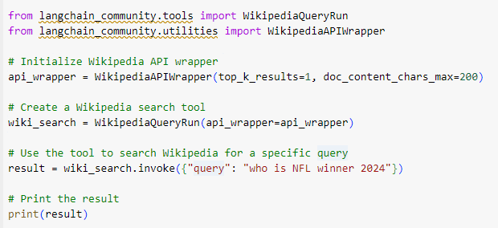
Langchain Tool - Wikipedia Search Example

Slide 6
What is RAG?
RAG combines both retrieval tools and generative models.
The LLM retrieves information from external sources, verifies it, and generates a response.

Slide 7
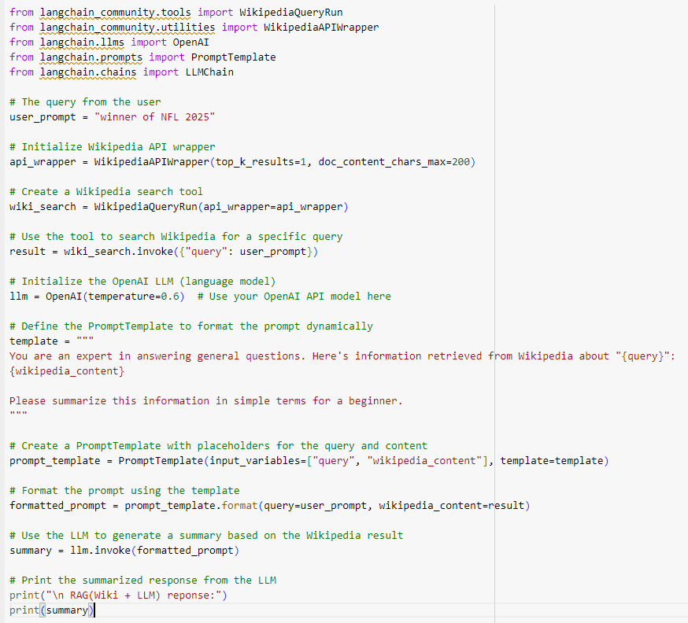
RAG Example with Wikipedia and LLM

