Slide 1
BLE Hand visualization
By: Shabrya Lott
lotts2@unlv.nevada.edu

Slide 2
Aim & Accomplishments
Aim
To measure human hand movements by monitoring and storing accelerometer/gyro data.
Accomplishments
Learned how to capture data from IMU sensor (6 DOF- MPU 6050)
Learned how to calibrate and display collected data in a visual manner
Learned how to make device wireless by using a Bluetooth module (HC-06).

Slide 3
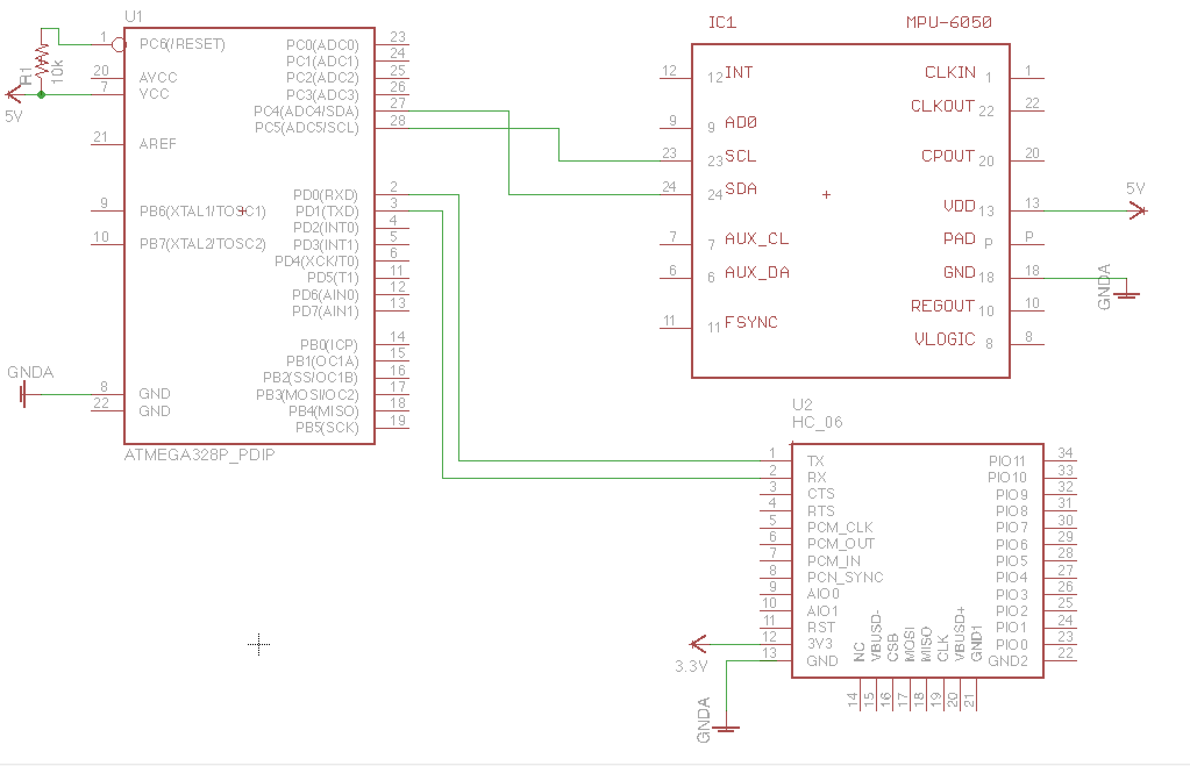
Schematics

Slide 4
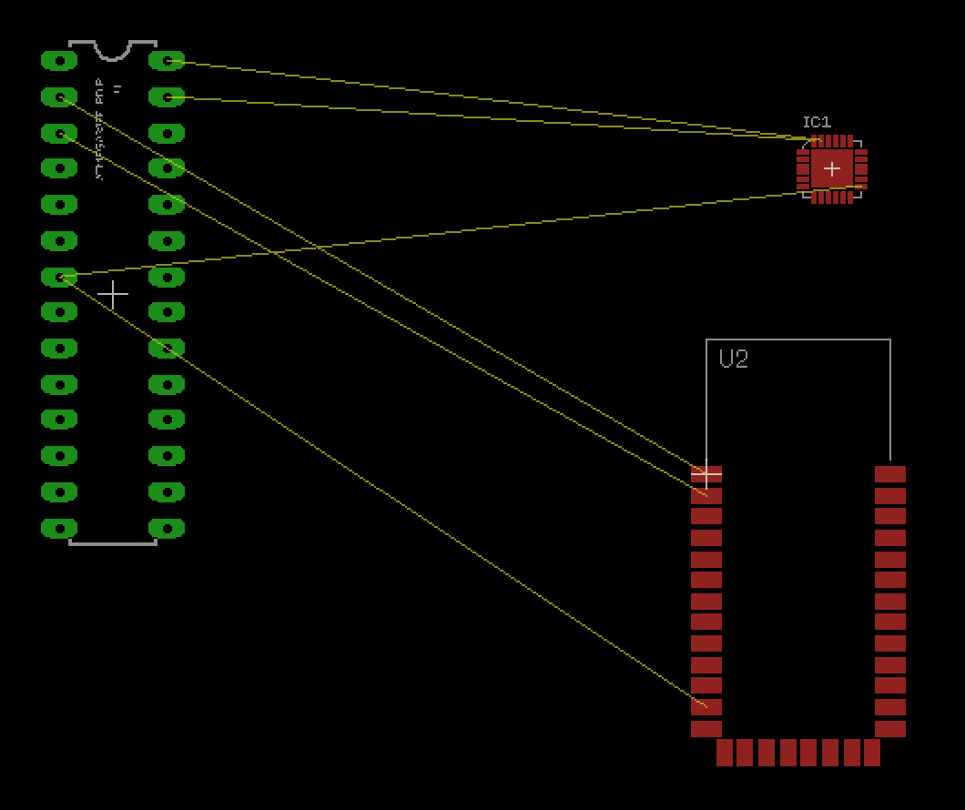
PCB Layout

Slide 5
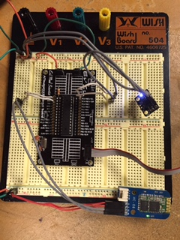
Breadboard

Slide 6
Design Stages
Components
ATmega328p – Micro-controller unit
MPU 6050 – 6 DOF Gyro/Accelerometer
HC-06 – Bluetooth Module
Ellipsis- Android Tablet used to Display Sensor data
Interfaces
Inter-Integrated Circuit communication (I2C): MPU-6050 to Atmega328p
Universal Asynchronous Receiver/Transmitter (UART) + Bluetooth: Atmega328p to Android device
Visualization
The data is displayed on Android Application, “Bluetooth Terminal/Graphics”.

Slide 7
Code Development
Initialization
Interfaces
UART - set baud rate, make asynchronous , enable transmitter
I2C- init TWI clock
MPU-6050 sensor
check if device is accessible
set appropriate registers for a start condition
find average raw values for calibration
Data Collection
Read raw values of the X, Y, Z axis of the sensor
Convert values to actual measurements by subtracting calibration value and dividing by the MSB
Visualization
Turn data into a printable string
Special Format for Application: “EValue1, Value2, Value3… \n”
Changed data type of values for easier visualization on graph

Slide 8
Video Demonstration
YouTube Video:
https://youtu.be/_NsUO8qaSoY

