Slide 1
Complete Mips Processor
By: Shabrya Lott & Melissa Cordova

Slide 2
goal
To design a multicycle MIPS processor that can decode and execute a given set of 27 instructions.

Slide 3
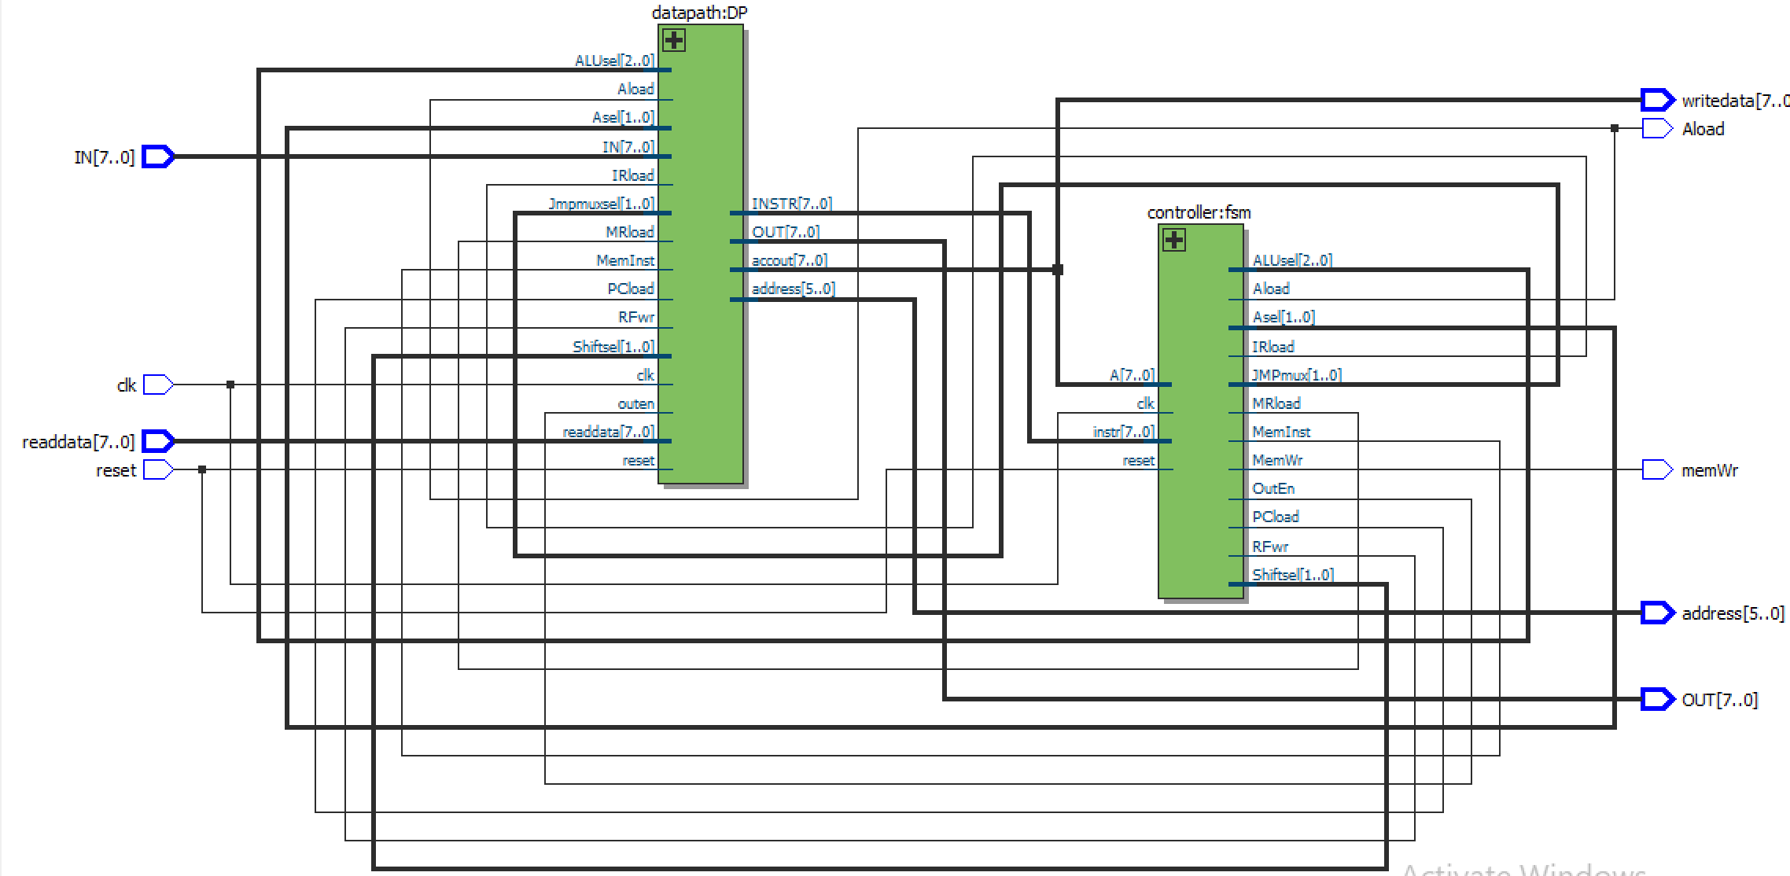
CPU
Control Unit: FSM that determines what signals to send to the datapath.
Datapath: combinational components that perform micro-operations and move data to and from registers.

Slide 4
Control Unit Design
FSM has 29 states = Fetch + Decode+ 27 distinct states
Most of the instructions require 3 cycles
1st Cycle: Fetch
2nd Cycle: Decode
3rd Cycle: Execute
Instructions that that are two bytes long take an extra cycle (4 cycles)

Slide 5
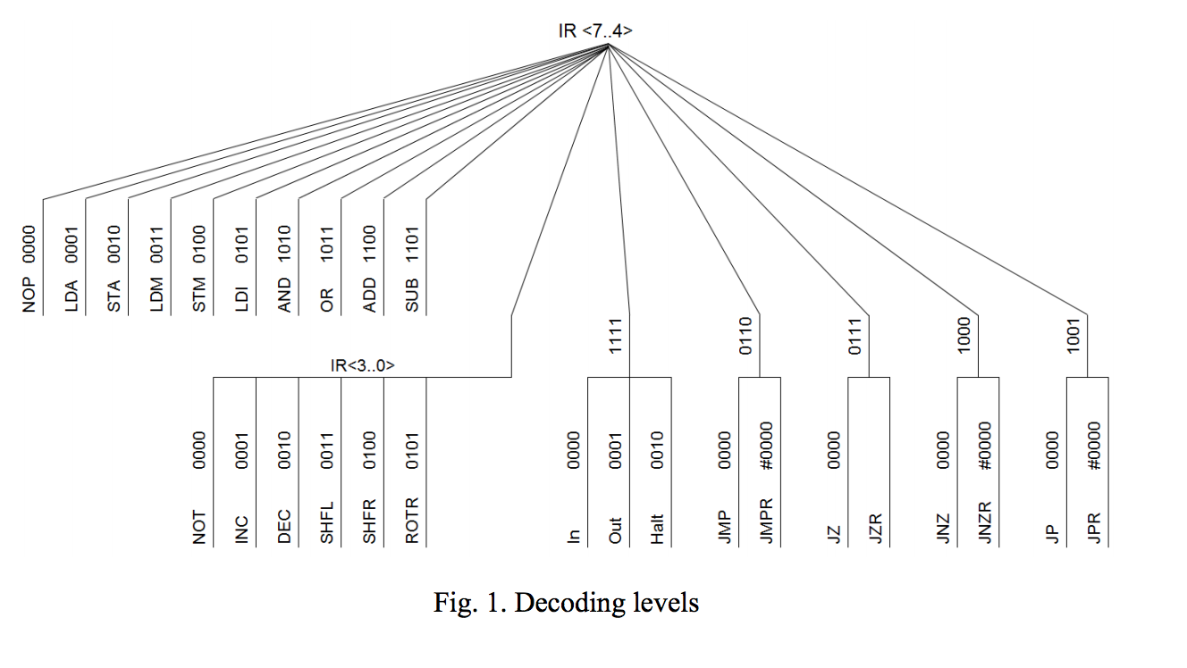
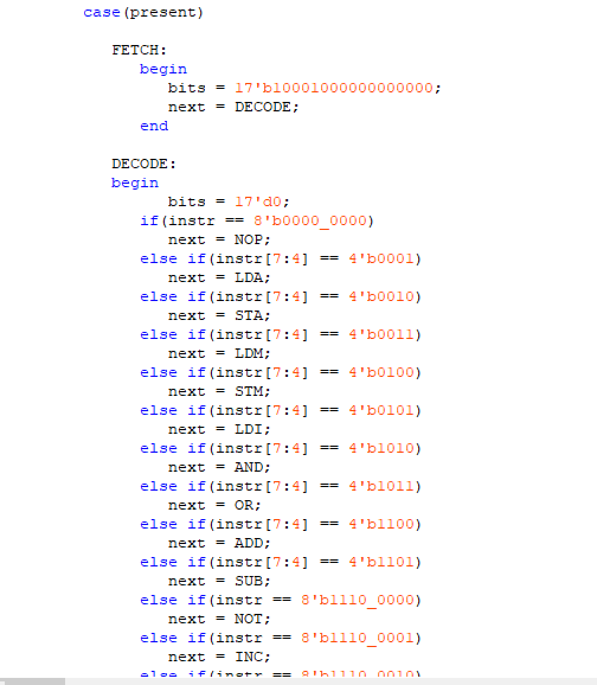
Control Unit Design

Slide 6
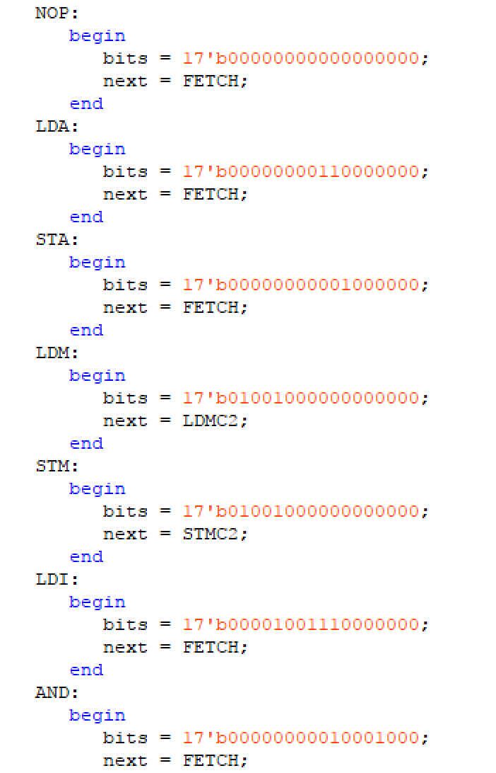
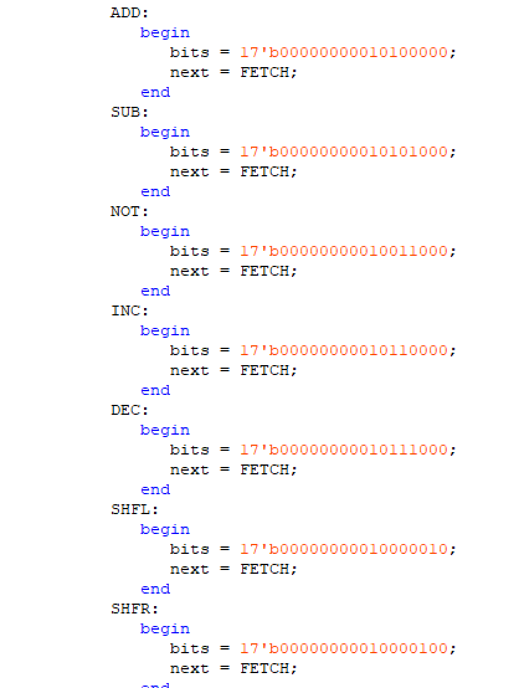
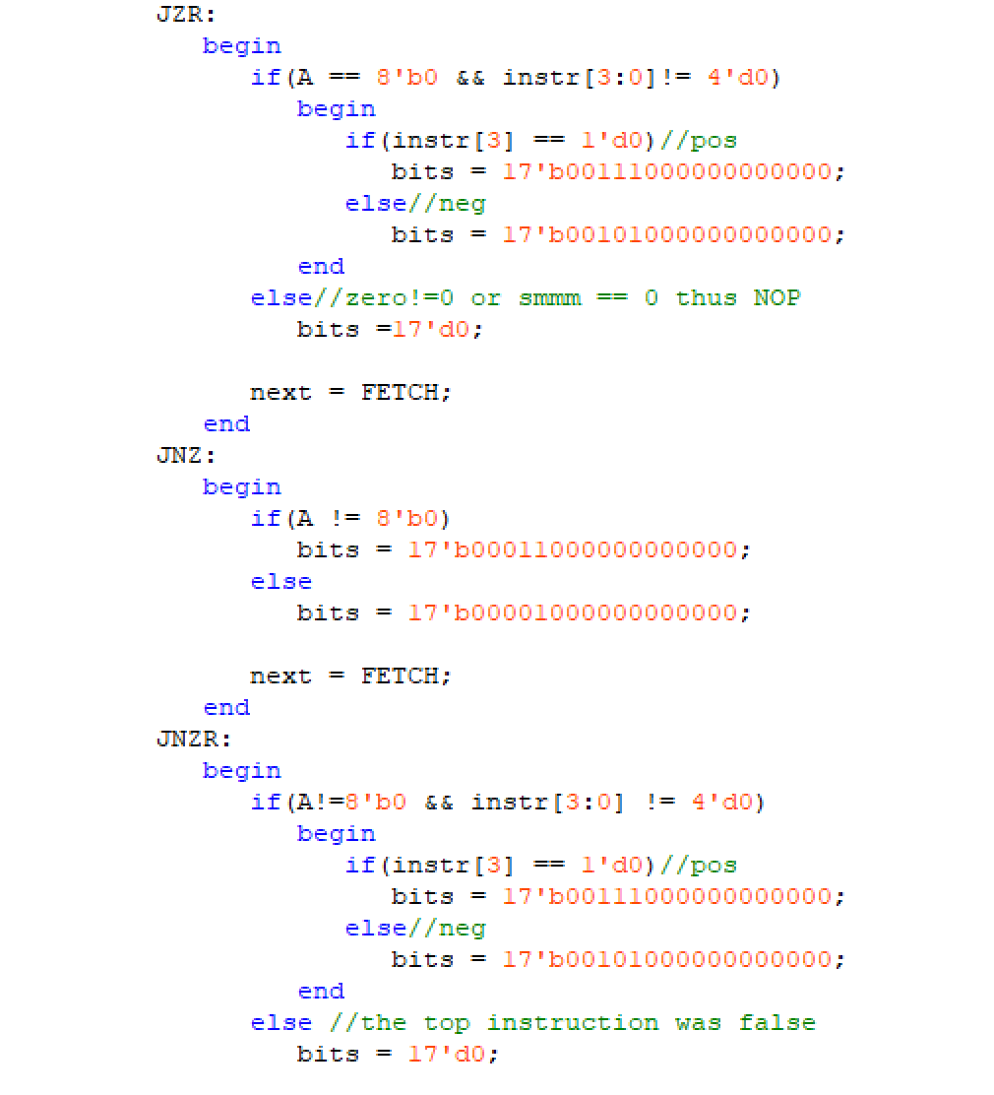
Control Unit Design

Slide 7
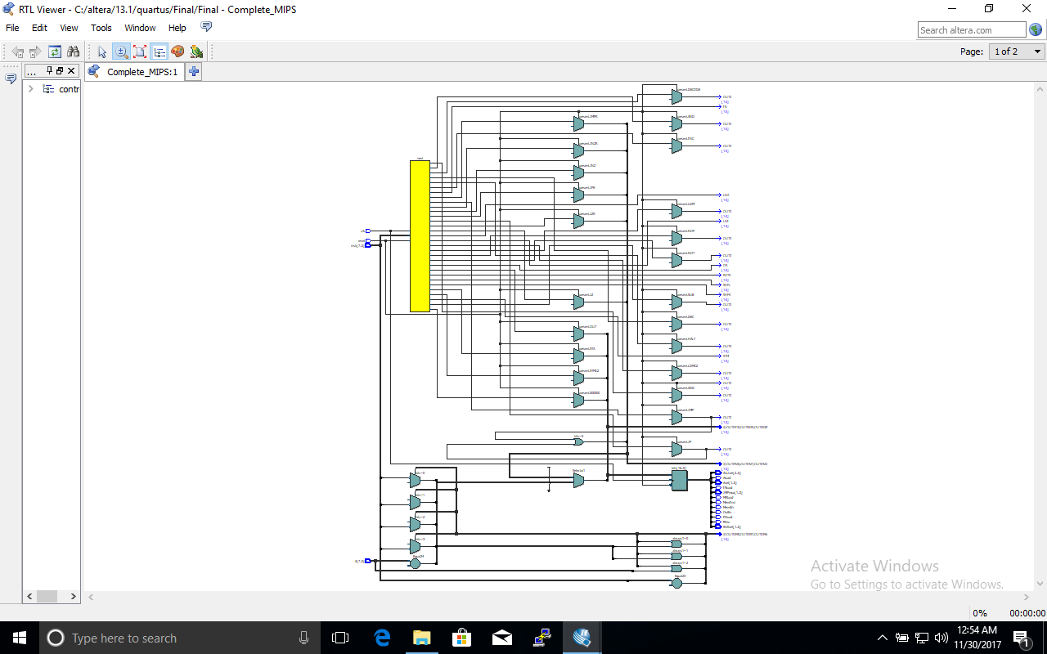
CU RTL VIEWER

Slide 8
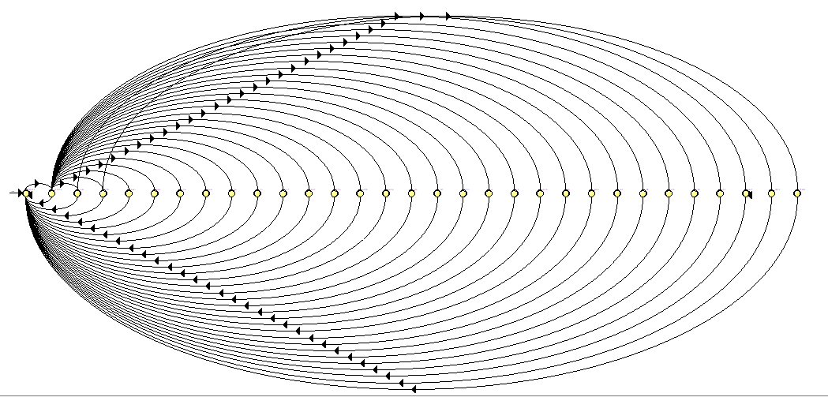
State Graph

Slide 9
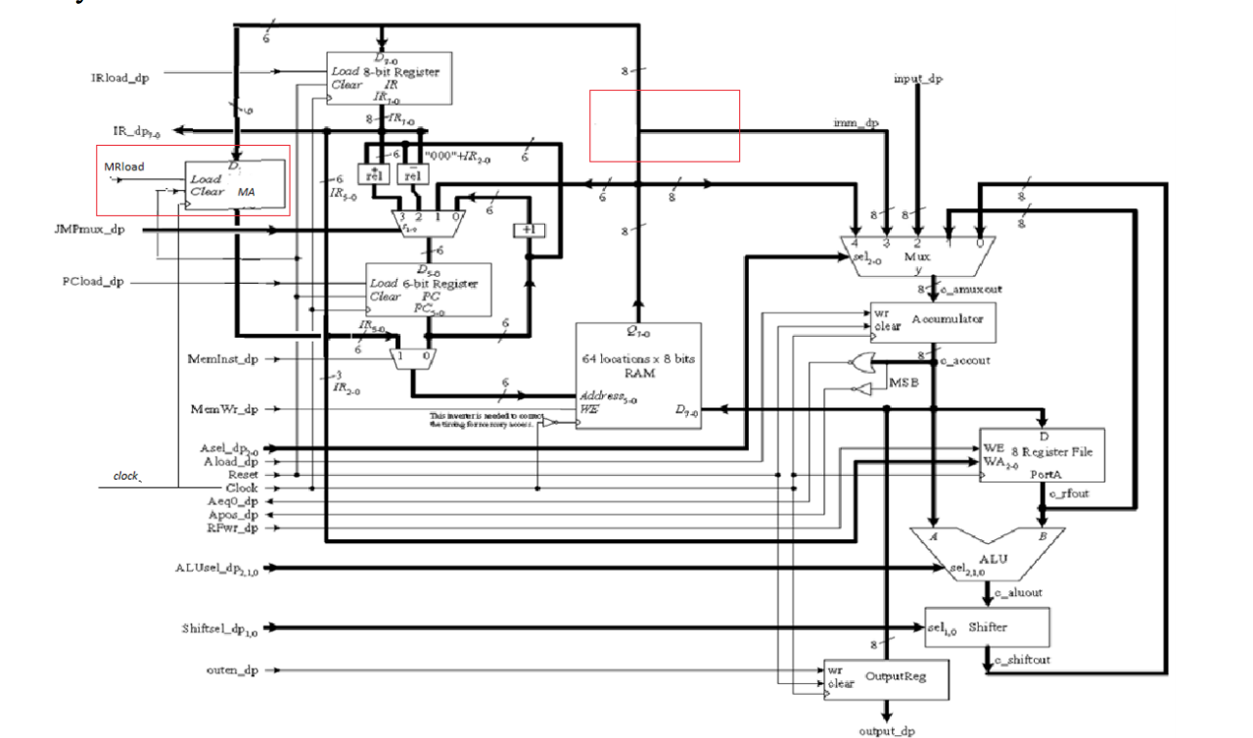
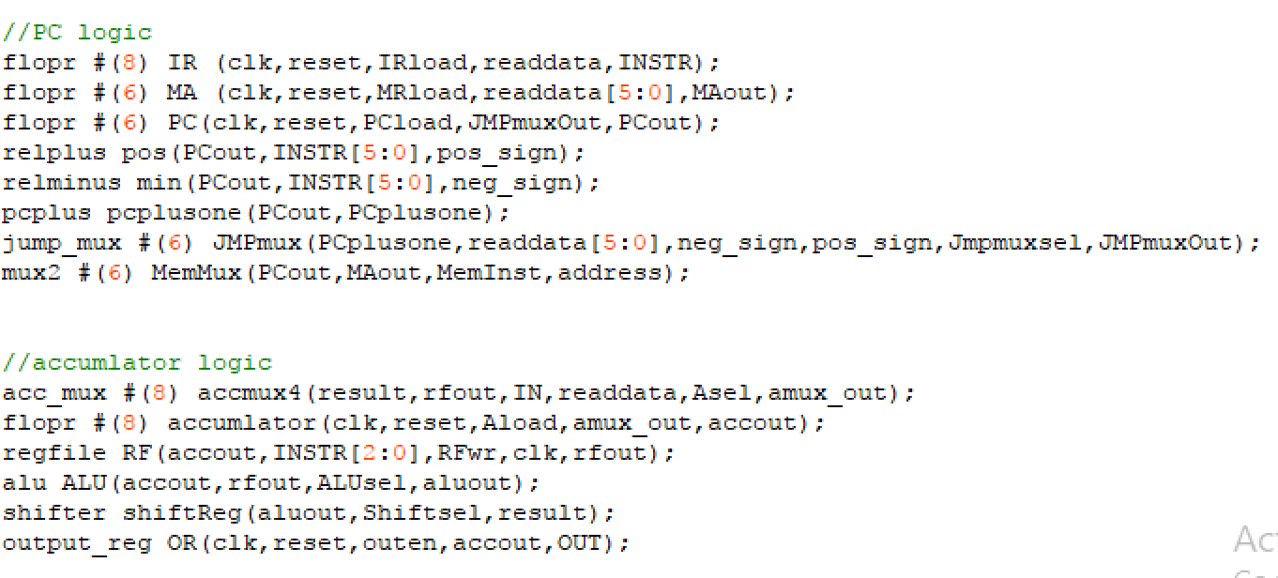
DataPath Design

Slide 10
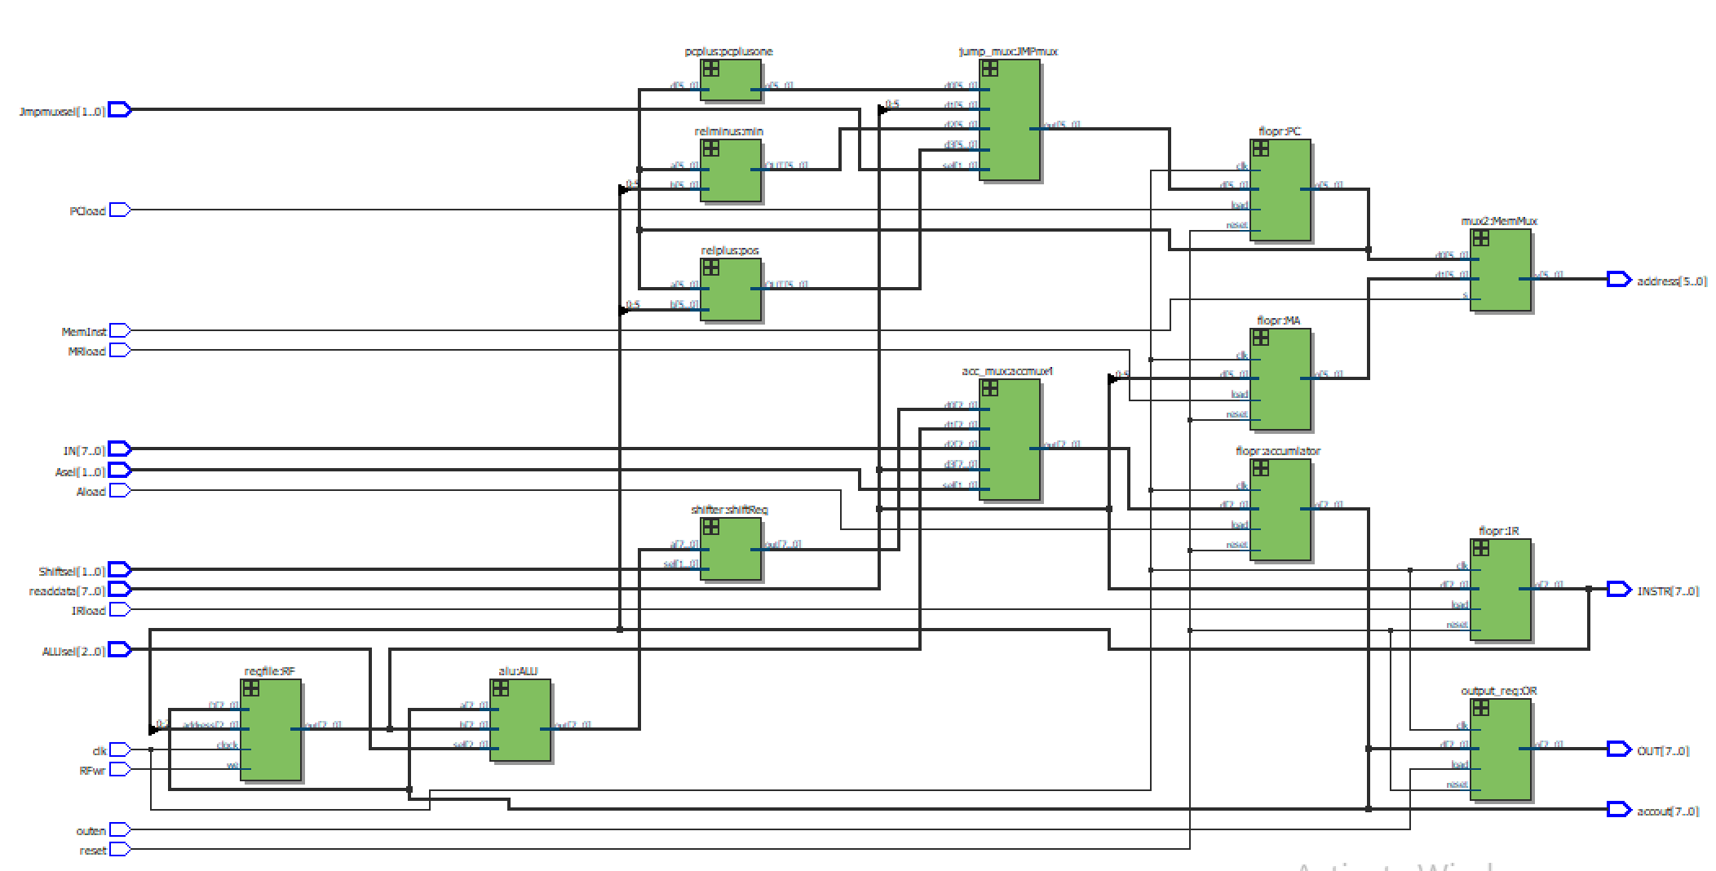
DP RTL Viewer

Slide 11
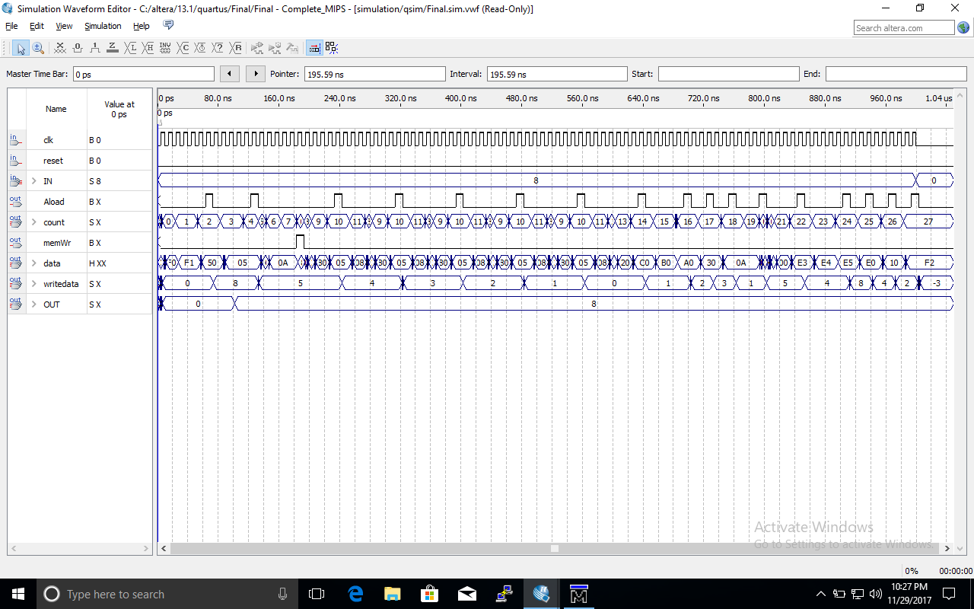
Waveform
000000: In A //A <- 8
000001: Out A //Output A
000010: LDI A, 5 //A <- 5
000100: STM 001010, A //M[10] <- A = 5
000110: DEC A //A<- A -1
000111: JNZ 000101 //PC<-000101 if A != 0
001001: INC A //A <- 1
001010: STA 0, A //Reg[0]<- 1
001011: ADD A, 0 //A<- A + R[0] = 2
001111: OR A, 0 //A<- A or R[0] = 3
010000: AND A,0 //A <- A and R[0] = 1
010001: LDM A, 0 //A<- M[10] = 5
010011: SUB A,0 //A<- A – R[0] = 4
010100: NOP //no operation
010101: SHFL A //A=<- A << 1 = 8
010110: SHFR A //A=<- A >> 1 = 4
010111: ROTR A //A<- 2 (Rotate A right)
011000: NOT A //A <- NOT A = -3
011001: HALT //Halt execution

Slide 12
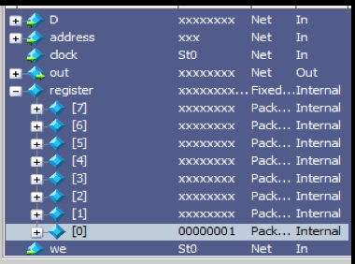
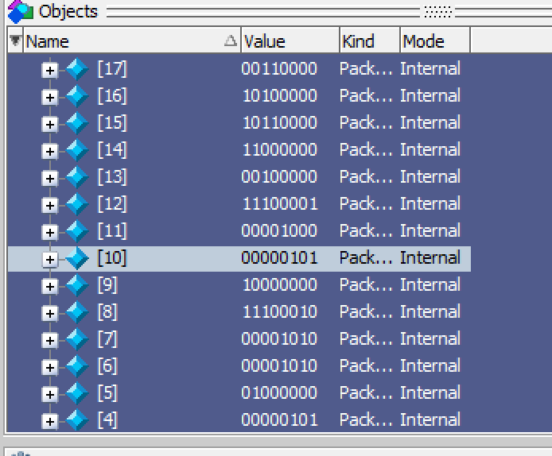
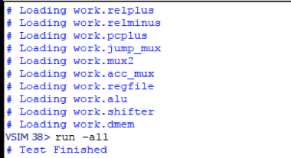
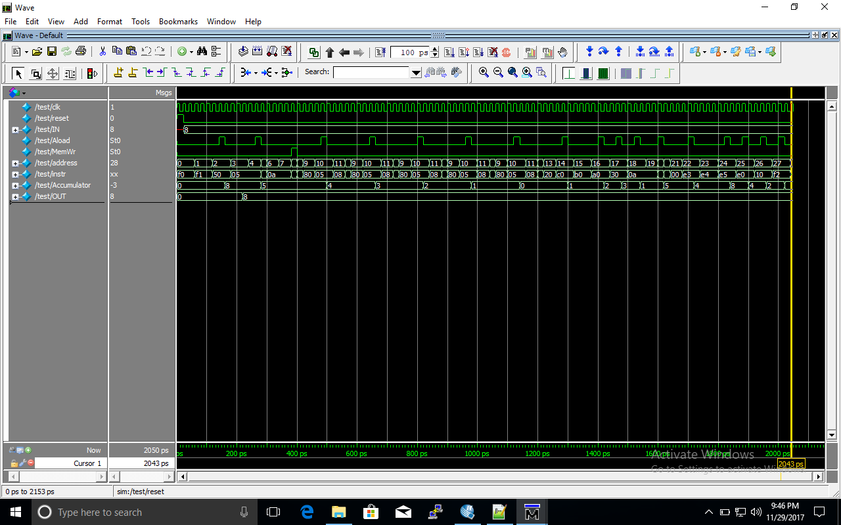
MODELSIM Simulation

Slide 13
ENCOUNTERED PROBLEMS & Solutions
Problem 1: Originally, the processor was not outputting the correct results when a two byte instruction was being executed.
Solution 1: We guessed that these instructions required a delay to keep the 2nd byte longer so we placed the 2nd bytes twice in the memory file.
Problem 2: After, 20 instructions were executed it would no longer output results
Solution 2: We guessed that this was due to delay issues so we created two memory files that shows different instructions can be executed.

