Slide 1
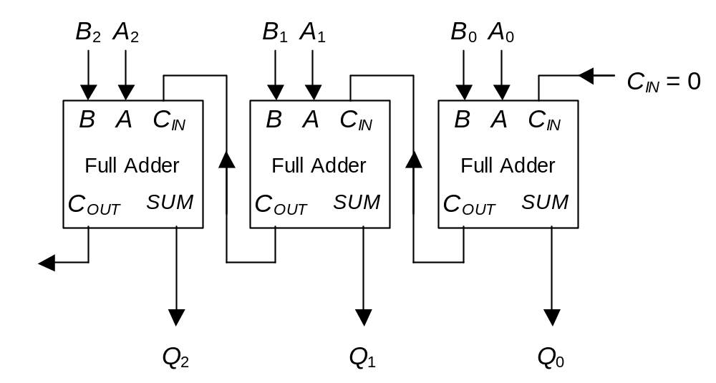
Parallel Adder Recap
To add two n-bit numbers together, n full-adders should be cascaded.
Each full-adder represents a column in the long addition.
The carry signals ‘ripple’ through the adder from right to left.

Slide 2
Propagation Delay
All logic gates take a non-zero time delay to respond to a change in input.
This is the propagation delay of the gate, typically measured in tens of nanoseconds.
1
0
X
X
Y
1
0
Y
time

Slide 3
Carry Ripple
A and B inputs change, corresponding changes to C_{IN} inputs ‘ripple’ through the circuit.
B
2
A
2
B
1
A
1
B
0
A
0
C
IN
= 0
B
A
C
IN
B
A
C
IN
B
A
C
IN
Full Adder
Full Adder
Full Adder
t = 0, A & B change
C
OUT
SUM
C
OUT
SUM
C
OUT
SUM
t = 30 ns, Adder 0 outputs respond
t = 60 ns, Adder 1 outputs respond
Q
2
Q
1
Q
0
t = 90 ns, Adder 2 outputs respond

Slide 4

Carry-Look-Ahead
The accumulated delay in large parallel adders can be prohibitively large.
Example : 16 bits using 30 ns full-adders :
Solution : Generate the carry-input signals directly from the A and B inputs rather than using the ripple arrangement.

Slide 5

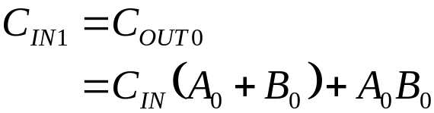
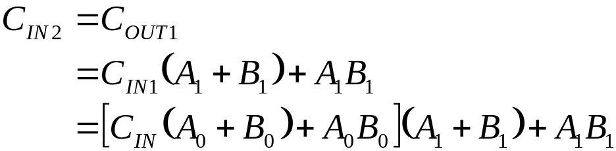
Designing a Carry-Look-Ahead Circuit
B₂ A₂
B₁ A₁
B₀ A₀
C_{IN}
Carry-look-ahead logic
B A C_{IN}
B A C_{IN}
B A C_{IN}
C_{OUT} SUM
C_{OUT} SUM
C_{OUT} SUM
Q₂
Q₁
Q₀

Slide 6
Practical Carry-Look-Ahead Adder
The complexity of each C_{IN} term increases with each stage.
To limit the number of gates required, a compromise between carry-look-ahead and ripple carry is often used.
Example : 8-bit adder using two four bit adders with carry-look-ahead.
A₀₋₃ B₀₋₃ C_{IN}
4-bit adder
C_{OUT} S₀₋₃
A₀₋₃ B₀₋₃ C_{IN}
4-bit adder
C_{OUT} S₀₋₃

Slide 7
Overflow
What happens when an N-bit adder adds two numbers whose sum is greater than or equal to 2^{N} ?
Answer: Overflow.
Example: 6+4 using a three-bit adder.
(6)₁₀ = (110)₂ and (4)₁₀ = (100)₂
1 1 0
1 0 0
0 1 0 (C_{OUT} = 1)
+

Slide 8




Modulo-2^{N} Arithmetic
In fact, the addition is correct if you are using modulo-2^{N} arithmetic.
This means the output is the remainder from dividing the actual answer by 2^{N}.
An N-bit adder automatically uses modulo-2^{N} arithmetic.
Example : 3-bits -> modulo-8 arithmetic

Slide 9
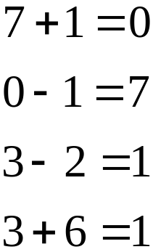
Using Modulo-2^{N} Arithmetic
Conventional arithmetic
-
+
0
1
2
3
4
5
6
7
Modulo-8 arithmetic
Example Sums
7
0
6
1
-
+
5
2
4
3
Subtracting 2 is equivalent to adding 6
Subtracting x is equivalent to adding 8-x

Slide 10

Two’s Complement
Using N bits, subtracting x is equivalent to adding 2^{N}-x.
This implies that the number –x should be represented as 2^{N}-x.
NB. To avoid ambiguity, when using signed binary numbers, the range of possible values is:
3 bit example:
Binary Digits | 000 | 001 | 010 | 011 | 100 | 101 | 110 | 111
Unsigned Decimal | 0 | 1 | 2 | 3 | 4 | 5 | 6 | 7
Signed Decimal | 0 | 1 | 2 | 3 | -4 | -3 | -2 | -1

Slide 11
Signed Arithmetic
Binary arithmetic rules are exactly the same.
Now, however, overflow occurs when the answer is bigger than 3 or less than -4
111
000
Example: 3 - 1
-1
0
(3)₁₀ = (011)₂
(-1)₁₀ = (111)₂
110
001
-2
1
-
+
+
1
0 1 1
1 1 1
1 1 0 (carry bits)
0 1 0 (sum bits)
-3
2
101
010
-4
3
100
011

Slide 12
Signed and Unsigned Numbers
All arithmetic operations can be performed in the same way regardless of whether the inputs are signed or unsigned.
You must know whether a number is signed or unsigned to make sense of the answer.

Slide 13

Two’s Complement Conversion
A quick way of converting x to 2^{N}-x is to complement all the bits and add one.
Why does this work ?
Eg. N = 8 and x = (45)₁₀ = (00101101)₂
1 1 1 1 1 1 1 1 (2^{N}-1 = 255)
0 0 1 0 1 1 0 1 (45)
1 1 0 1 0 0 1 0 (difference, each bit is complemented)
-
+
0 0 0 0 0 0 0 1
1 1 0 1 0 0 1 1 (211 = 256 – 45)

Slide 14
A Binary Subtraction Circuit
To calculate A-B, all the bits in B must be complemented and an extra one added using C_{IN}
B
2
A
2
B
1
A
1
B
0
A
0
C
IN
= 1
B
A
C
IN
B
A
C
IN
B
A
C
IN
Full Adder
Full Adder
Full Adder
C
OUT
SUM
C
OUT
SUM
C
OUT
SUM
Q
2
Q
1
Q
0

Slide 15
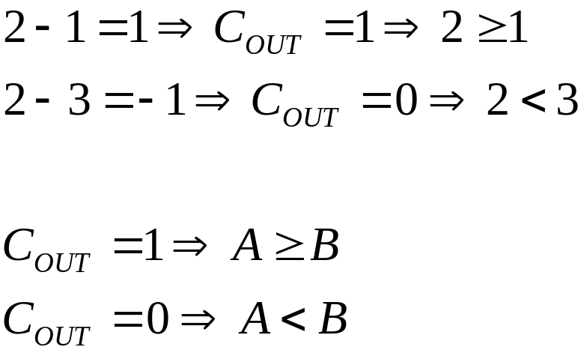
Comparison
Whenever the result of an addition passes zero, a C_{OUT} signal is generated.
This can be used to compare unsigned numbers.
C_{OUT} generated
7
0
6
1
+
5
2
4
3

Slide 16
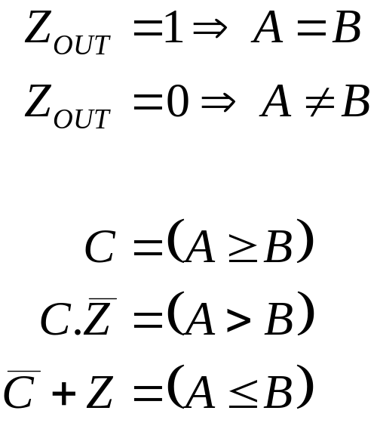
Zero Flag
NORing the result bits together tests whether all the bits are low – i.e. the result is zero.
The resulting signal (or flag) is high only when A = B.

Slide 17
Summary
Carry-Look-Ahead
  The speed of the parallel adder can be greatly improved using carry-look ahead logic.
Subtraction
  An adder can be simply modified to perform subtraction and/or comparison.
Next Time
  Circuits that can either add or subtract… and more.

