Slide 1

PAINDICATOR
Map Your Pain
A clinical decision-support system for digital pain mapping & dermatome analysis
Amit Bezalel · Shachar Guttman | Biomedical Engineering, Tel Aviv University
Supervisor: Prof. Mickey Scheinowitz · In collaboration with Loewenstein Rehabilitation Medical Center (Clalit Health Services)

Slide 2
THE PROBLEM
Pain is everywhere — and barely documented
Pain is a top reason people see a doctor — yet one of the worst-documented clinical signals.
• Recorded as free text or a felt-tip drawing on a paper body chart
• Subjective & unstructured — no numbers to compute
• Not comparable over time — pain care is about change, and we throw it away
• Loses anatomical precision — a flat sketch doesn't point to a spinal level
The clinician's real job — localizing pain to a spinal nerve level — is done from memory and a 2D picture.
TODAY
✎ paper drawing
“lower back, radiating down the leg”
→ subjective → not measurable → not trackable
PAINDICATOR · Tel Aviv University × Loewenstein (Clalit)
2

Slide 3
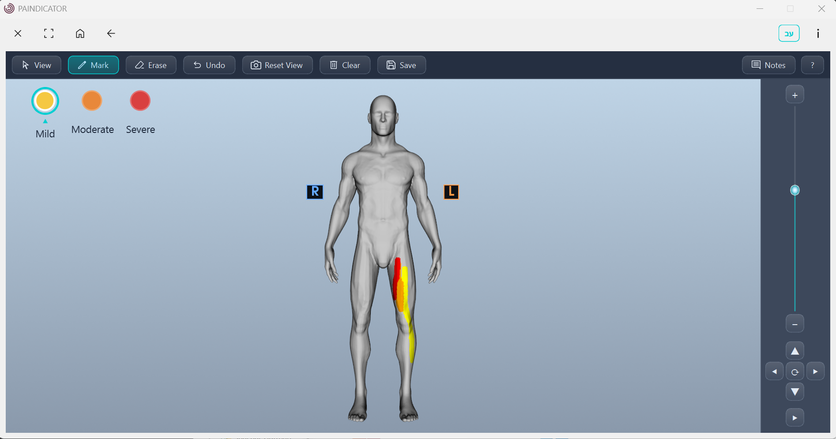
THE INSIGHT
Paint pain on a 3D body — every point is a nerve
What if the patient painted their pain onto an interactive 3D model?
• Three intensity levels — mild / moderate / severe
• Every vertex is mapped to a dermatome (the skin of one spinal nerve root)
• So painting isn't a picture — it becomes anatomical data, automatically
Subjective report → quantitative, anatomical signal
PAINDICATOR · Tel Aviv University × Loewenstein (Clalit)
3

Slide 4
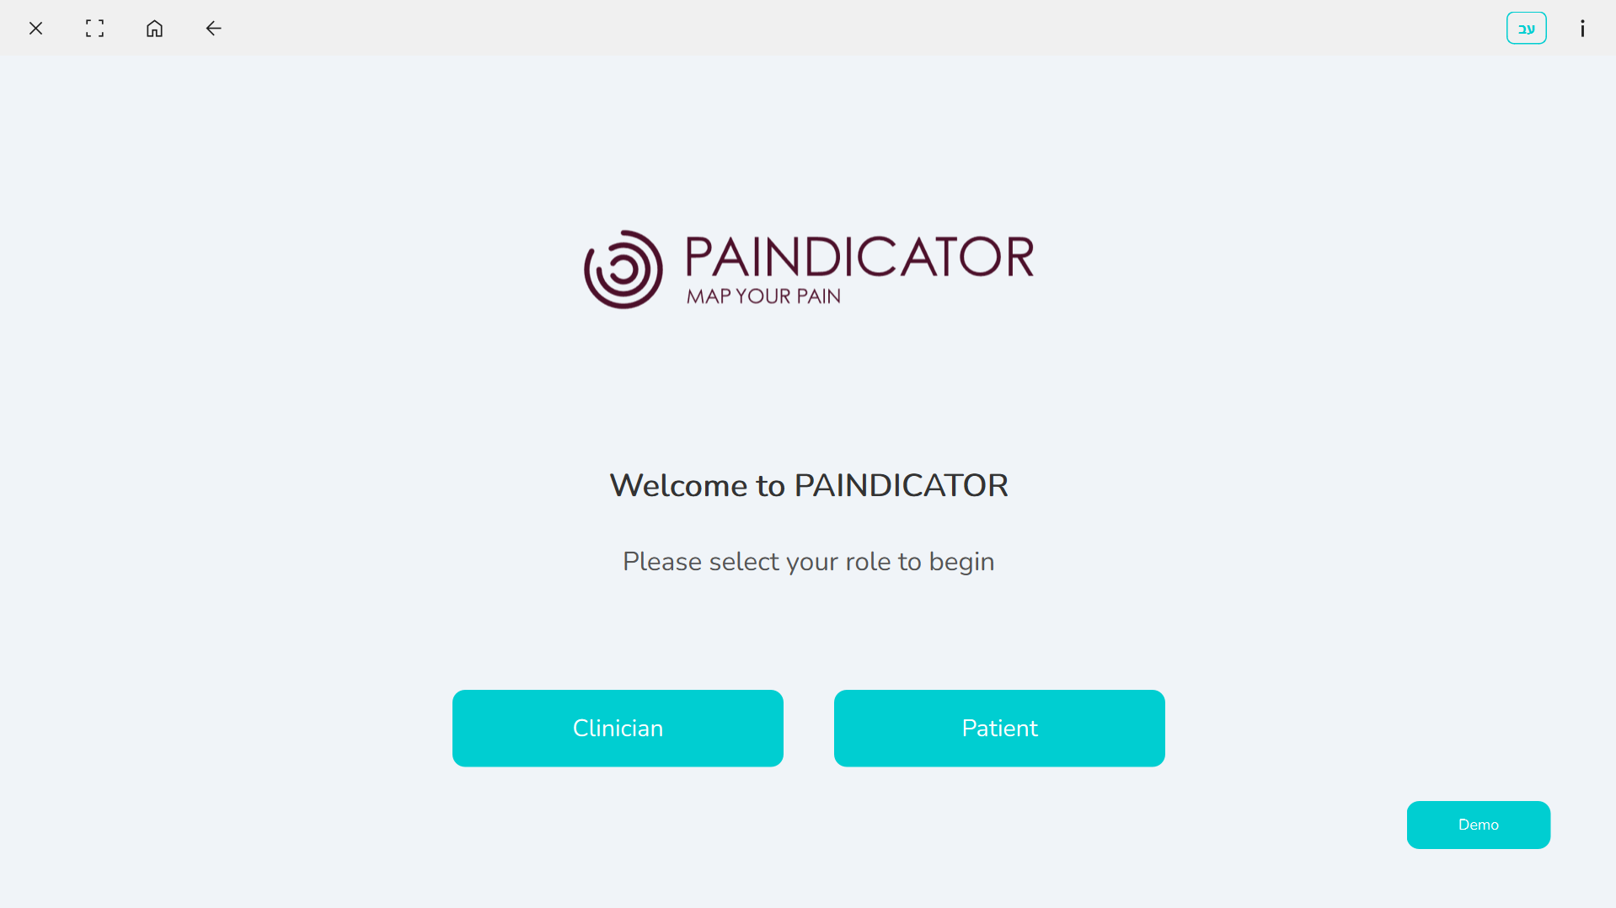
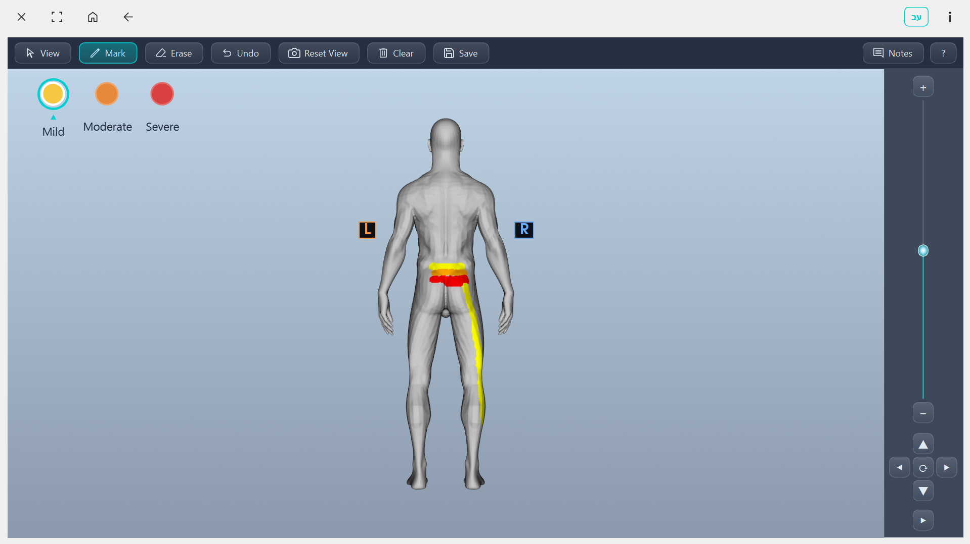
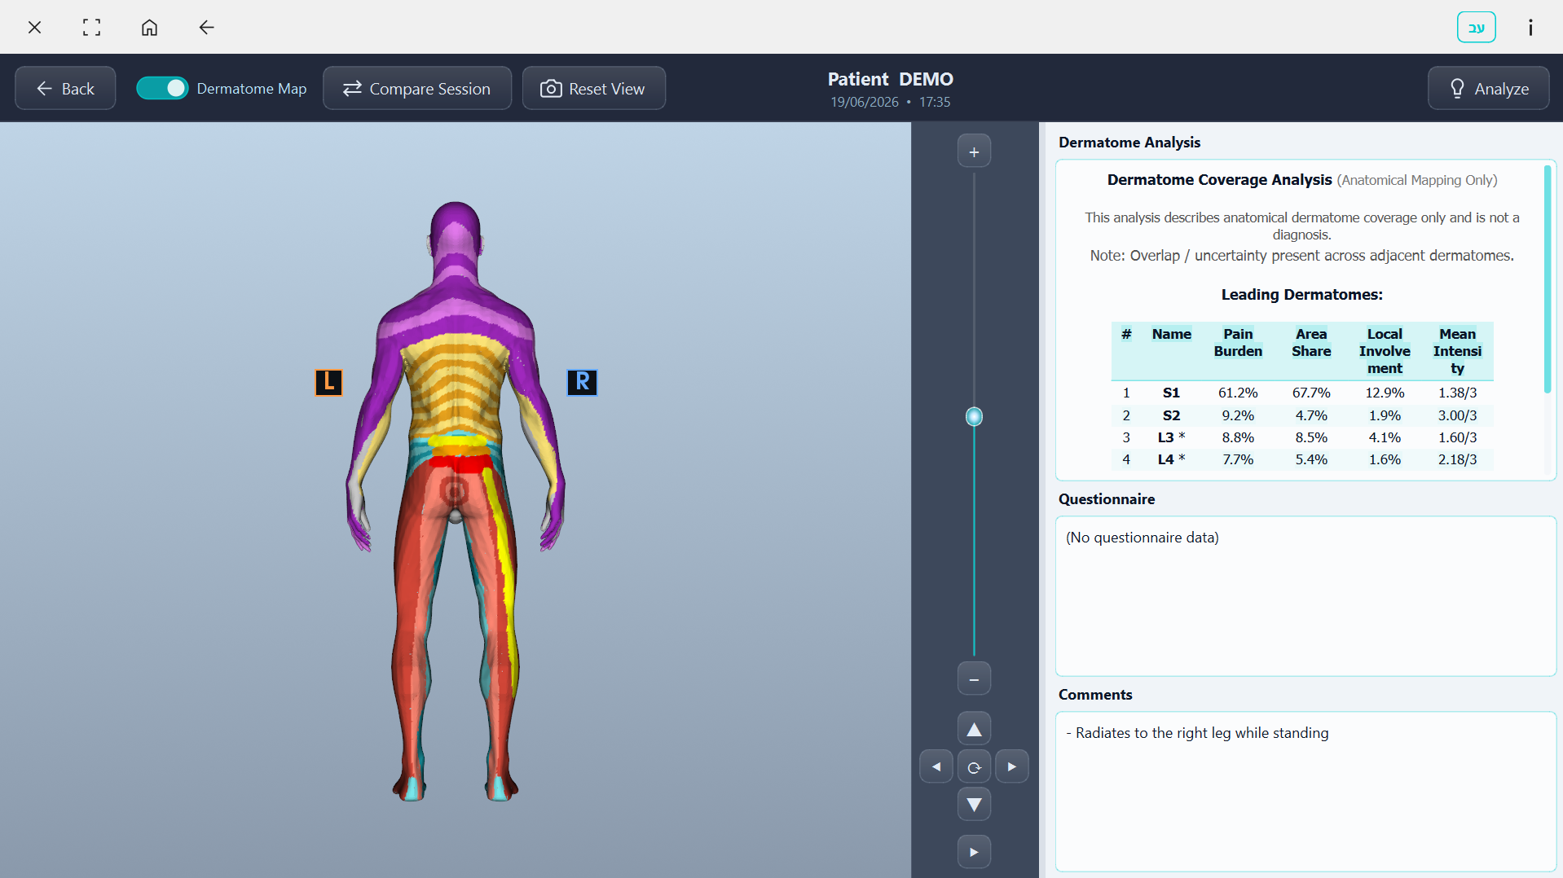
SEE IT WORK
From patient drawing to clinician analysis
1 · Guided entry
2 · Paint the front
3 · Rotate & paint the back
4 · Clinician analysis
Live demo optional — these captured screens are the fallback flow.
PAINDICATOR · Tel Aviv University × Loewenstein (Clalit)
4

Slide 5
HOW IT WORKS
From paint to ranked, per-nerve metrics
1
Patient paints
per-vertex levels 0–3 on the 3D model
2
Dermatome lookup
1 byte / vertex map → C1–S5 (31 dermatomes)
3
Coverage engine
pure math · no graphics · fully testable
4
Ranked output
per-dermatome metrics + clinician panel + saved JSON
PAINDICATOR · Tel Aviv University × Loewenstein (Clalit)
5

Slide 6
CLINICAL VALUE
Quantitative dermatome analytics
Metric | What it tells the clinician
Weighted pain burden | this nerve level's share of total pain → ranks the dominant level
Pain area share | large mild area vs small intense area
Local involvement | how much of the nerve zone is affected
Mean local intensity | average severity where painted (1–3)
Segmental spread | narrow = single level · wide = central/multifocal
Overlap flag | adjacent levels near-equal → radiculopathy ambiguity
“L5–S1 distribution, 78% burden in L5, sharp 3/3 → consistent with L5–S1 disc herniation.”
PAINDICATOR · Tel Aviv University × Loewenstein (Clalit)
6

Slide 7
CLINICAL + TECHNICAL
Explainable decision support
A rule-based analyzer correlates the dermatome pattern with the questionnaire:
• Localizing patterns — e.g. L5–S1 sciatica, C6–C7 disc, femoral nerve (L2–L4)
• Symptom phenotyping — burning+tingling → neuropathic; Valsalva-positive → disc
• Widespread (≥7 levels) → central sensitization / fibromyalgia
Every line is a readable rule a clinician can audit & override — explainable, not a black box.
RED FLAGS surfaced
• Cauda equina (S3–S4–S5 / bladder–bowel) → urgent referral
• Severe unilateral thoracic band → herpes zoster (pre-rash)
• Fever + spine pain → discitis / epidural abscess
• Multi-level cervical/thoracic → myelopathy
Decision support — descriptive only. Not a diagnosis; not a substitute for clinical judgment.
PAINDICATOR · Tel Aviv University × Loewenstein (Clalit)
7

Slide 8
ENGINEERING
A real, robust application
~5,600 lines of Python · clean ownership split: rendering / interaction / analytics core
• PyQt6 UI + VTK 3D pipeline (lazy init, crash-safe lifecycle)
• Per-vertex radius brush with normal gating — can't paint through the body
• Gap-free fast strokes + true per-stroke undo + erase
• Tablet-first: stylus pressure, two-finger pinch / pan / rotate, gesture guide
• Bilingual English / Hebrew with full RTL
• Ships as a standalone, offline Windows EXE (PyInstaller)
STACK
Python 3.11
PyQt6 6.10
VTK 9.5.2
NumPy 2.3.5
Pillow 12.0
PyInstaller 6.17
2 models · 31 dermatomes · 12 screens
PAINDICATOR · Tel Aviv University × Loewenstein (Clalit)
8

Slide 9
REAL-WORLD IMPACT
Built with a clinical partner
Co-developed with Loewenstein Rehabilitation Medical Center (Clalit Health Services) around a real documentation problem.
Where it helps:
• Pain clinics
• Neurology
• Orthopedics & spine
• Physical medicine & rehabilitation
Sessions are saved and comparable over time — we finally measure how pain changes.
PARTNERS
Tel Aviv University
Biomedical Engineering
Loewenstein Rehabilitation Medical Center
Clalit Health Services
PAINDICATOR · Tel Aviv University × Loewenstein (Clalit)
9

Slide 10
VISION
Where it goes next
1
2
3
4
Visual heatmap
color the body by computed pain burden — at a glance
Longitudinal metrics
numeric change-over-time from the multi-session overlay
ML pattern recognition
rules become the labeled foundation + safety net
Regulatory path
position as decision support; explore CE / device class
PAINDICATOR · Tel Aviv University × Loewenstein (Clalit)
10

Slide 11
WHY WE WIN
Five reasons to back PAINDICATOR
1
Genuine novelty
quantitative pain → nerve mapping, ranked burden + overlap flag
2
Real clinical partner
co-developed with Loewenstein / Clalit
3
Finished & deployable
offline tablet app — works today, end to end
4
Explainable & private
auditable rules; local data; no cloud
5
Solid engineering
~5,600 LOC · 2 models · 31 dermatomes
PAINDICATOR · Tel Aviv University × Loewenstein (Clalit)
11

Slide 12
Thank you
Amit Bezalel · Shachar Guttman — Biomedical Engineering, Tel Aviv University
We'd love your questions.
PAINDICATOR is a research / decision-support tool. Its analysis is a descriptive summary of recorded data — not a diagnosis, and not a substitute for clinical judgment, physical examination, or imaging.

