Slide 1
פרוייקט סיום
Perennation can be done in Hebrew or English
Suggested format is Power point (but this is a suggestion only)
Both students should present
Presentation time is 15 minutes + 5 minutes for questions.
Presentation should include:
Title and names
Description of the project
What is the problem and what is the solution?
Technical details (do not go into code level, block diagram/ flow charts are enough)
Anything else you think is interesting (problems, challenges, future work, …)
I will ask questions during after the presentation – so be prepared😊
Tip – present in a Why, What, how order
(Why we did the project, what you did, how you did it)

Slide 2
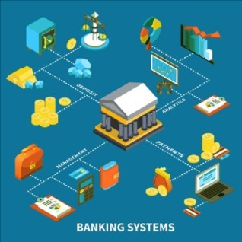
Secure Banking Transaction System
By: Shachar Markovich
Naor Maman
Tzuf Newfeld

Slide 3


Today:
About the Project
The Problem
Our Solution
Technical details
Future Work
Demonstration & Code
Notes:
[נאור אומר]
הנה הדברים שמצפים לנו היום:
על קצה המזלג - הסבר קצר על מה זה Container ומה זה Docker
לאחר מכן נדבר על הסביבה שיצרנו – ממה היא מורכבת ומה היא דורשת.
ובסוף נקנח עם הצצה לקוד והדגמה בלייב.
בואו נתחיל!

Slide 4
About the Project
Template text

Slide 5
The Problem
Template text

Slide 6
Our Solution
Template text

Slide 7
Technical details
Template text

Slide 8
Future Work
Template text

Slide 9
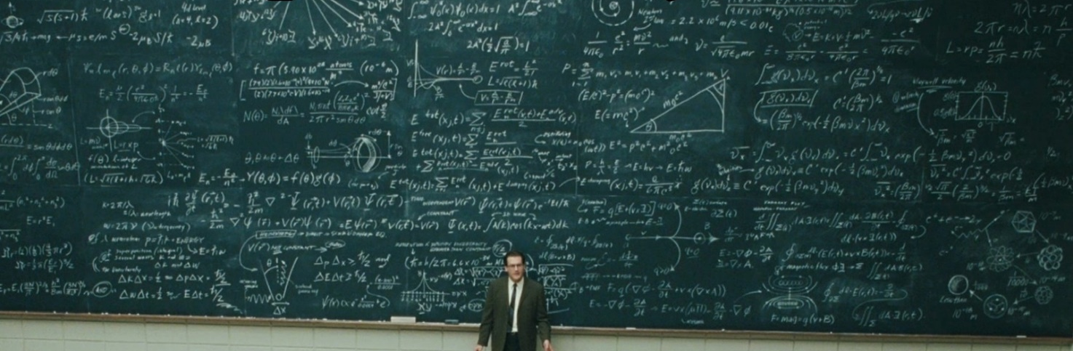
Questions?

Slide 10

Notes:
https://github.com/ShacharMarkovich/Automatic-Isolation-and-Analysis-Environment

