Slide 1

Livin - Youth-Driven Pet & Plant Care Platform
Peer-to-Peer App Connecting Owners and Young Helpers
Benny Giorno
Shachar Shoshani
Final Project Presentation

Slide 2

Project Description: What is Livin?
Social & Location-Based Care
A dynamic app connecting users for temporary pet, plant, and even stray animal care needs.
Connecting Generations
Specifically designed to link pet and plant owners with responsible young helpers (ages ~15 to college students).
Flexible Job Requests
Owners can easily post care requests for when they're away on vacation or during busy periods.
Local Opportunities for Youth
Helpers discover local, short-term care jobs, offering valuable experience and income.

Slide 3

Project Goals: Why Livin?
Easy & Safe Care
Provide owners with a trusted platform to find reliable help for their beloved pets and plants.
Flexible Opportunities
Offer teenagers and students flexible paid (or volunteer) work opportunities close to their homes.
Reduced Stress
Alleviate owners' concerns about their pets and plants when they are away or busy.
Community Building
Foster stronger local community ties through shared responsibility for pet and plant welfare.

Slide 4





Livin's Innovation: What Makes Us Unique?
Unified Care Platform
Combines pets, plants, and even stray animal care in one seamless application.
Youth-Centric Model
Empowers young helpers as the primary care providers, fostering responsibility and skill development.
Intuitive Matching
Features a "dating app"-inspired flow: initial match, temporary 24-hour chat, and final confirmation.
Robust Trust System
Includes comprehensive ratings, reviews, reporting, and admin moderation for enhanced safety and reliability.

Slide 5

Brief Literature Review: Supporting Our Vision
Gig Work & Youth Development
Alshebami (2025): Gig economy participation aids youth in skill-building, income generation, and community engagement.
"Green Care" Benefits
Galardi et al. (2021): Highlights the psychological and social benefits of combining animal and plant care activities.
Youth in the Gig Economy
World Bank (2023): Over 50% of online gig workers are under 30, valuing flexibility above all else.
Conclusion
Research strongly supports a youth-driven, local, care-based gig platform like Livin, addressing modern needs.

Slide 6
Competitor Review: Identifying the Gap
Pet Care Apps (e.g., Rover, Wag!)
Plant Care Apps (e.g., Planta)
Livin's Unique Position
Pros: Geolocation, reviews, secure payments
Pros: Reminders, AI diagnosis, care guides
Combines pets + plants
Focus on youth helpers
Cons: Mostly adult sitters, no plant care, not youth-focused
Cons: No marketplace for human sitters or temporary care
Features staged trust-building mechanisms
No existing app offers this holistic solution

Slide 7
Functional Requirements: Bringing Livin to Life
Universal User Features
Owner Job Management
Helper Job Search
Secure registration, login, profile management, and essential notifications for all users.
Post detailed job requests (pets/plants, services, time, location, payment) and manage applications.
Helpers can efficiently search and filter jobs by distance, care type, time, and apply with ease.
Matching & Communication
Admin Oversight
Initial matching, 24-hour temporary chat, mutual confirmation, and integrated reviews.
Comprehensive tools for viewing reports, moderating content and users, and accessing usage statistics.

Slide 8


Non-Functional Requirements: Ensuring a Robust Platform
Performance
Typical actions like search and chat response within ~2 seconds.
Availability & Reliability
Targeting 99% uptime with persistent storage for all critical user and job data.
Security & Privacy
HTTPS, hashed passwords, access control, and privacy by hiding exact addresses until match.
Usability
Mobile-first design, max 3 taps for main flows, and clear validation messages.
Scalability & Compatibility
Backend and database designed for growth, responsive web, and future native app support.

Slide 9
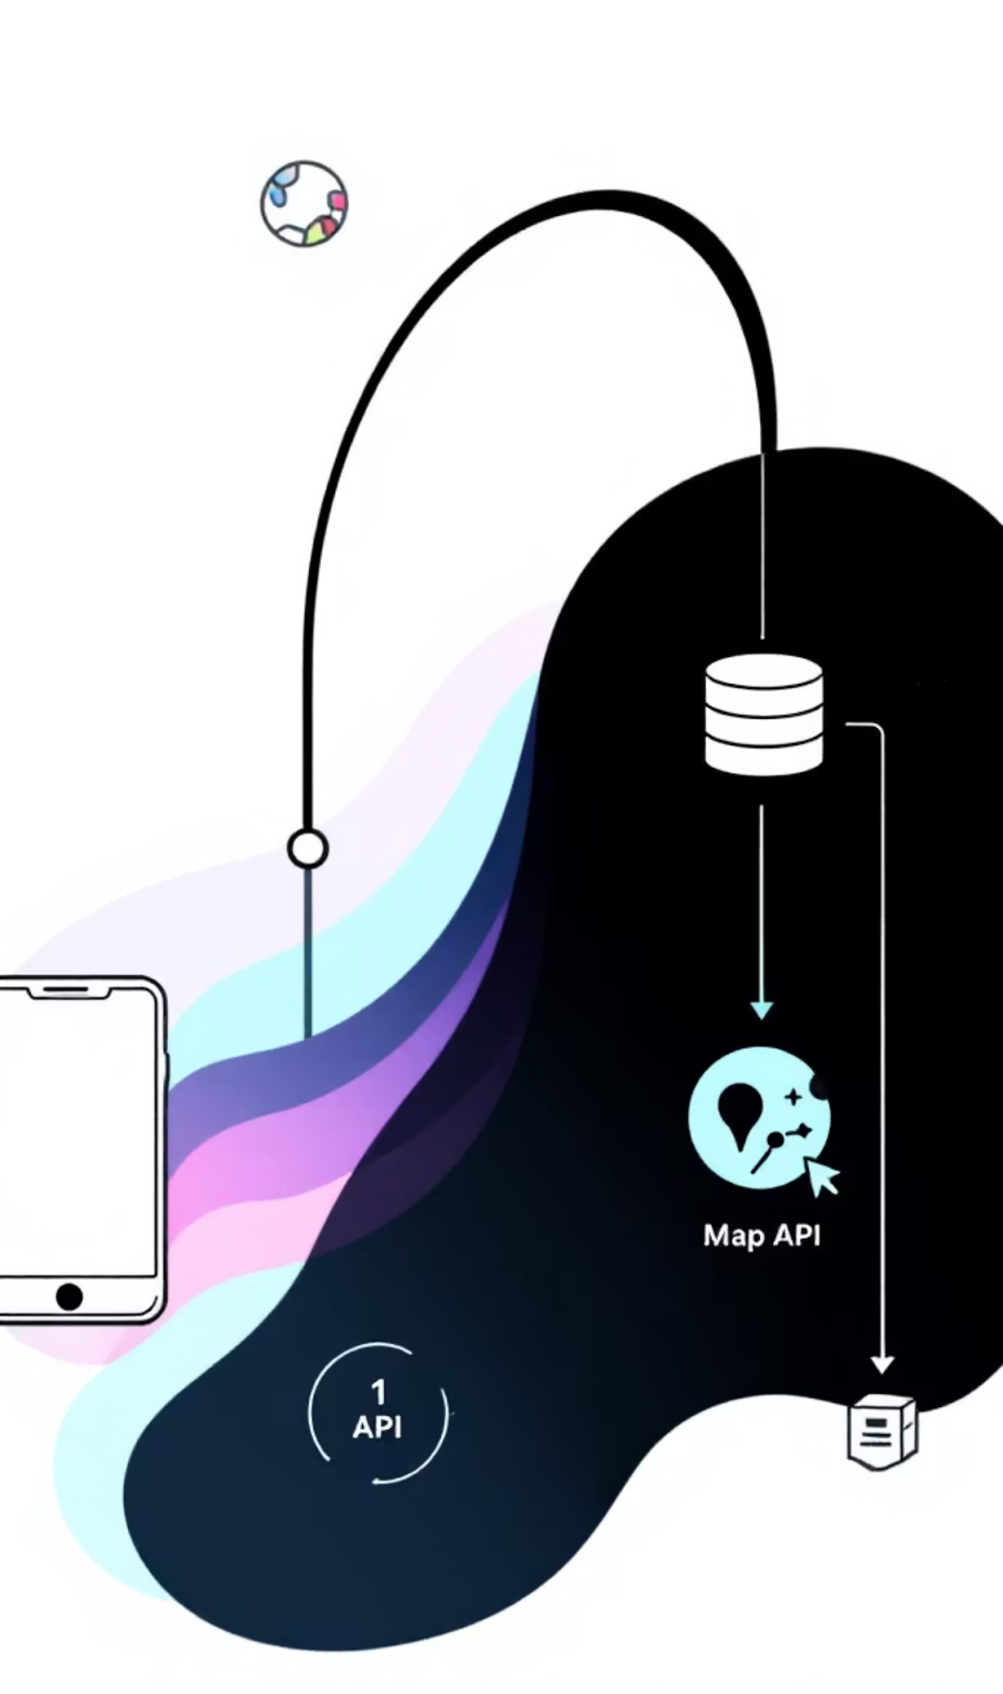

Main System Design: Architecture Overview
Chat & Notifications
Client
Real-time messages & alerts
Web & mobile interfaces
Matching Engine
Client-Server Architecture
Backend
Pairing logic and rules
RESTful API core services
Job Management
User Management
Postings & workflows
Authentication & profiles
Client-Server Model
Core Components
Key Integrations
Web/mobile client interfaces with a robust backend via RESTful APIs for all core functionalities.
User, Job, and Matching Engines, along with Chat & Notifications and Admin Dashboard for comprehensive control.
Seamless integration with Map APIs (Google Maps/OpenStreetMap) and dedicated image storage solutions.

Slide 10

Summary: Livin' Towards a Connected Future
Bridging Gaps
Livin seamlessly connects owners and young helpers for reliable pet and plant care.
Innovative Blend
A unique platform combining gig economy, green care principles, and youth participation.
Solid Foundation
Built upon clear functional and non-functional requirements, with a scalable architecture for growth.
Next Steps
Focus on UI prototyping, implementation, and thorough user testing to bring Livin to life!

