Slide 1

Note: The data and information in this document is reflective of a hypothetical situation and client. This document is to be used for KPMG Virtual Internship purposes only.
Sprocket Central Pty Ltd
Data analytics approach
Shachi Vaidya

Slide 2
Note: The data and information in this document is reflective of a hypothetical situation and client. This document is to be used for KPMG Virtual Internship purposes only.
Agenda
Introduction
Data Exploration
Model Development
Interpretation

Slide 3
Note: The data and information in this document is reflective of a hypothetical situation and client. This document is to be used for KPMG Virtual Internship purposes only.
Introduction
Customer Analysis
Customer analysis allows businesses to identify and segment their target audience effectively. By analysing demographic information, purchasing patterns, and psychographic characteristics, businesses can identify the most valuable customer segments to focus their resources on. This helps optimize marketing efforts and increase the likelihood of attracting and retaining the right customers.

Slide 4
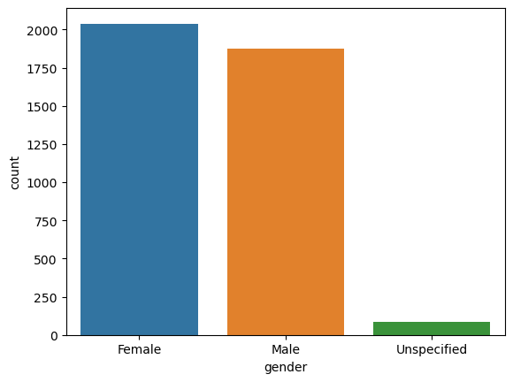
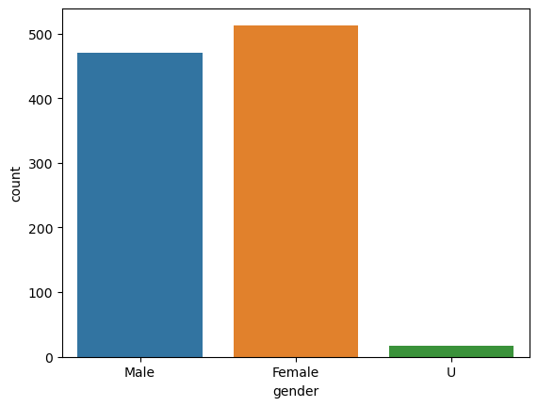
Note: The data and information in this document is reflective of a hypothetical situation and client. This document is to be used for KPMG Virtual Internship purposes only.
Data Exploration
Finding the gender wise potential Customer.
As per the Observation Potential and important customers are Females for both the new and Old customer data .
Old Data
New Data
New Data

Slide 5
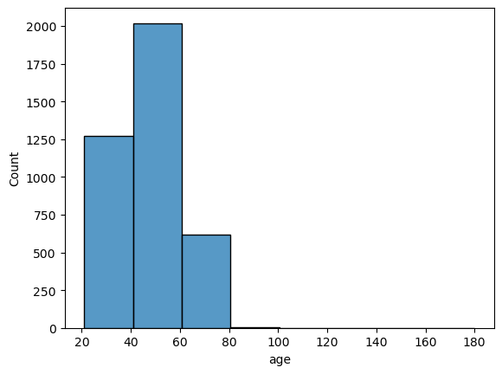
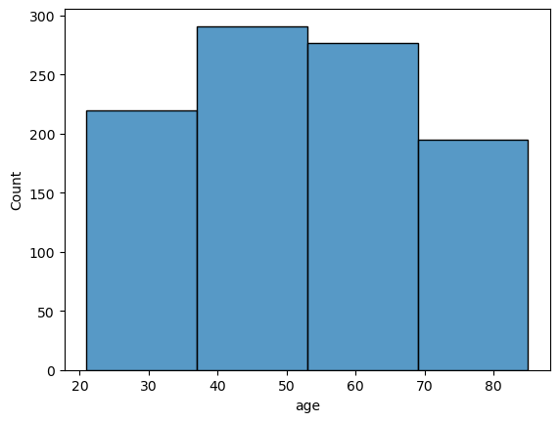
Note: The data and information in this document is reflective of a hypothetical situation and client. This document is to be used for KPMG Virtual Internship purposes only.
Model Development
Age Distribution Analysis.
Old Data
After finding out potential customer we find out that The Targeted Age for the customer is between 35 to 60.
Then the target will be age between 20 to 40.
We see the drop of Customers after the age 60 .
New Data

Slide 6
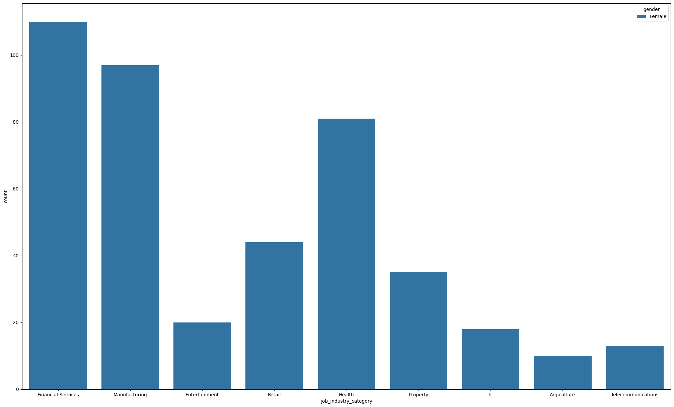
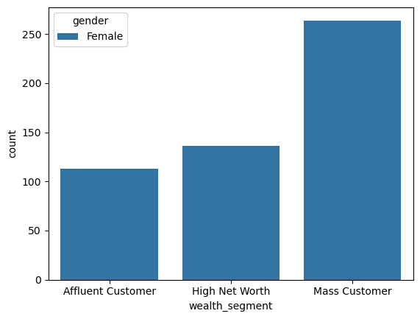
Note: The data and information in this document is reflective of a hypothetical situation and client. This document is to be used for KPMG Virtual Internship purposes only.
Interpretation
Job Industry Category
Most of the Buyers are from Financial Industry and Manufacturing with Mass Customer on this social Class.

Slide 7
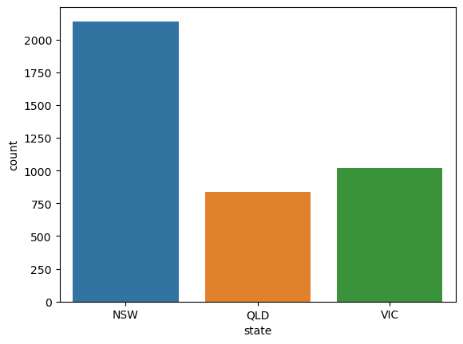
Note: The data and information in this document is reflective of a hypothetical situation and client. This document is to be used for KPMG Virtual Internship purposes only.
Interpretation
State
In summary Our Target customer willk be Females from age 35 to 60 From Finance and Manufacturing industry with mass customer and the targeting city for more sales should be NSW New South Wales.

Slide 8
Note: The data and information in this document is reflective of a hypothetical situation and client. This document is to be used for KPMG Virtual Internship purposes only.
Thank You

