Slide 1
Tutorial (Real example)
The GUI for imaging flow cytometry

Slide 2
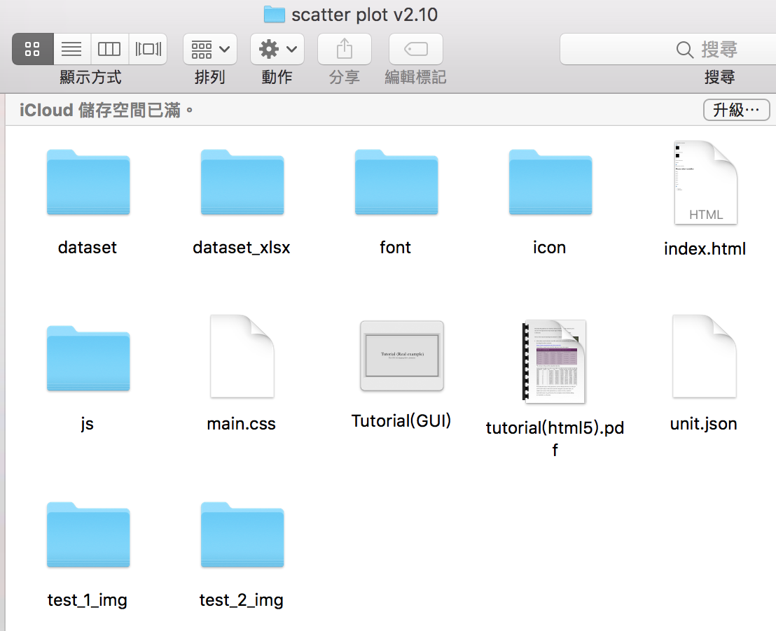
Step 1: Open the folder containing the GUI
Unzip the file: “scatter plot v2.10.zip”

Slide 3
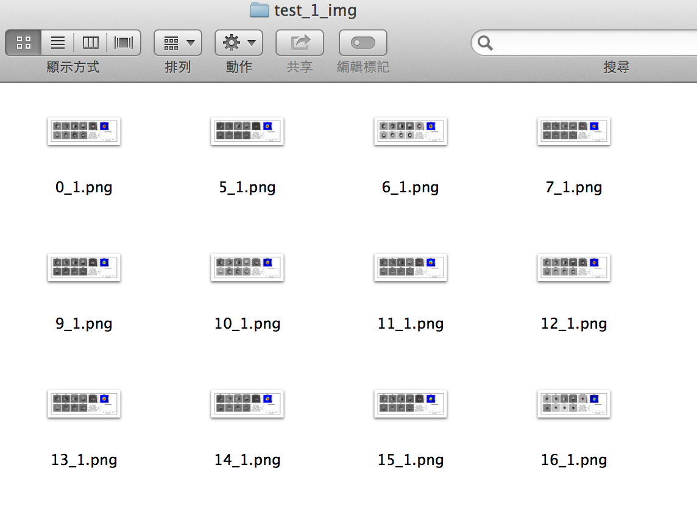
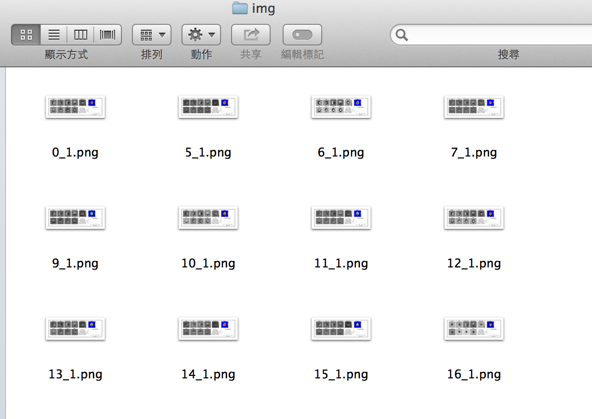
Step 2: Input Data
Copy all the images stored in the folder “test_1_img”
Open the folder “dataset”
Paste all of them into the folder “img”, which is inside the folder “Dataset 1”

Slide 4
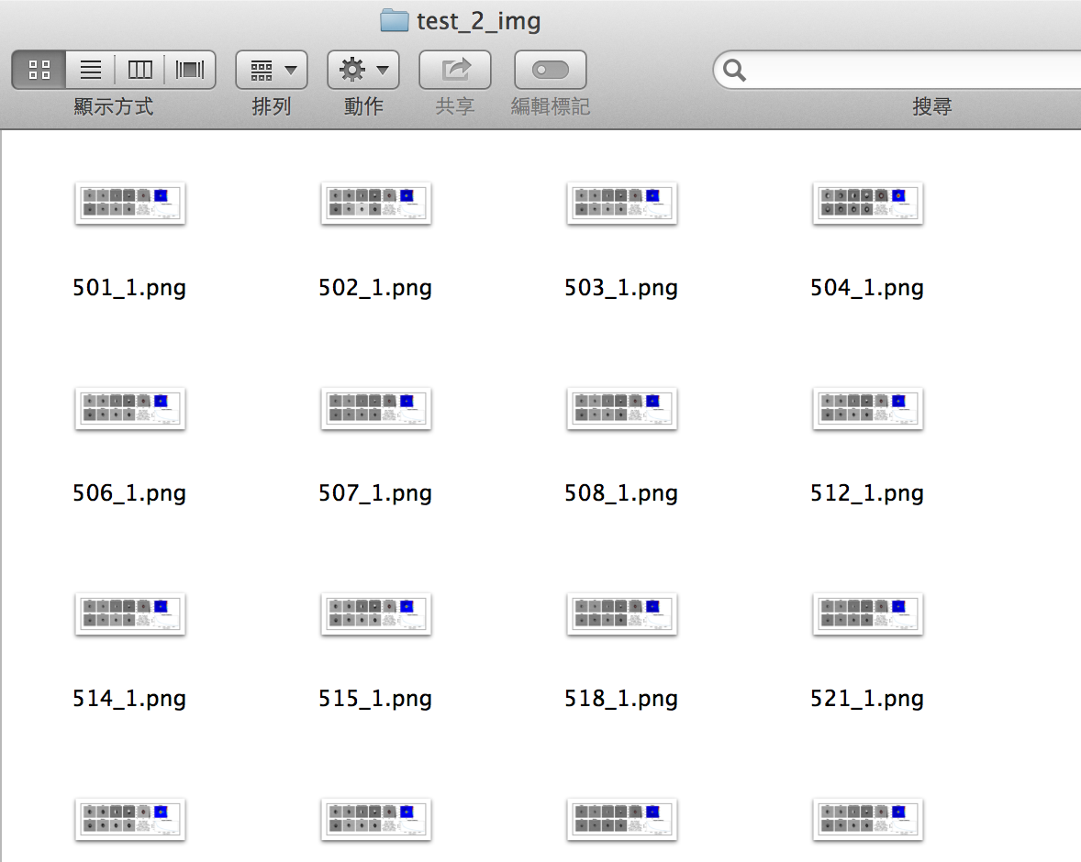
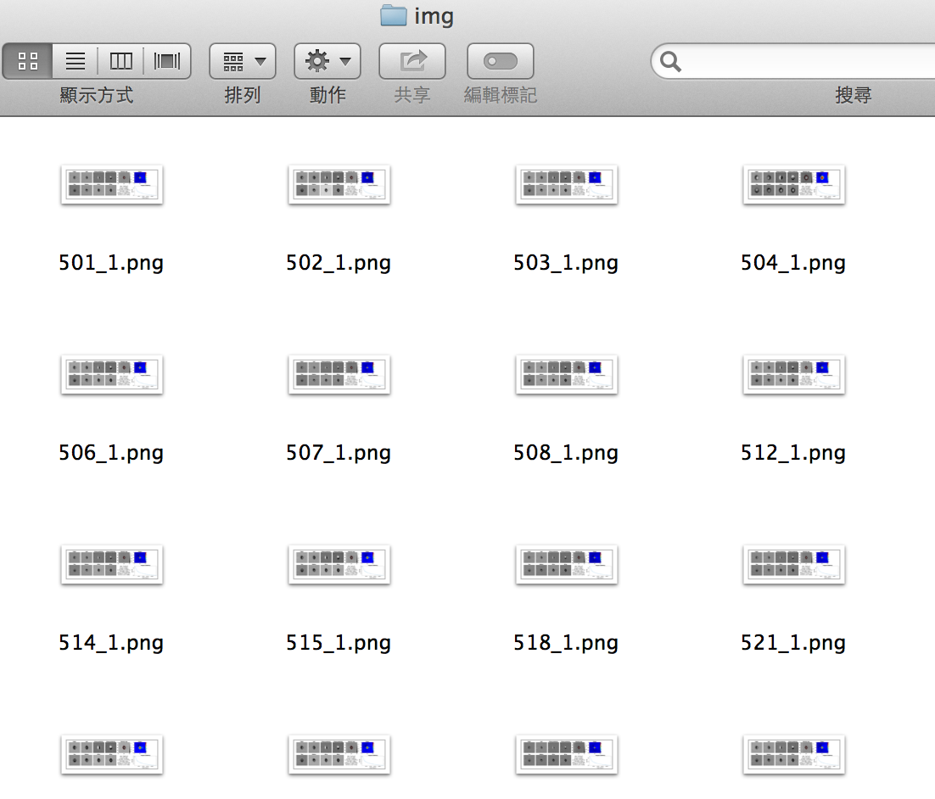
Step 2 (continue):
Copy all the images stored in the folder “test_2_img”
Open the folder “dataset”
Paste all of them into the folder “img”, which is inside the folder “Dataset 2”

Slide 5
Step 2 (continue):
Open “unit.json” by double-clicking it

Slide 6
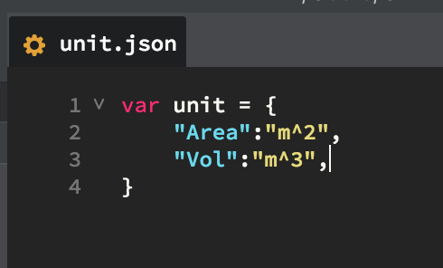
Step 2 (continue):
Type in the units of the corresponding parameters that show up in “parameter1.xlsx” and “parameter2.xlsx”

Slide 7
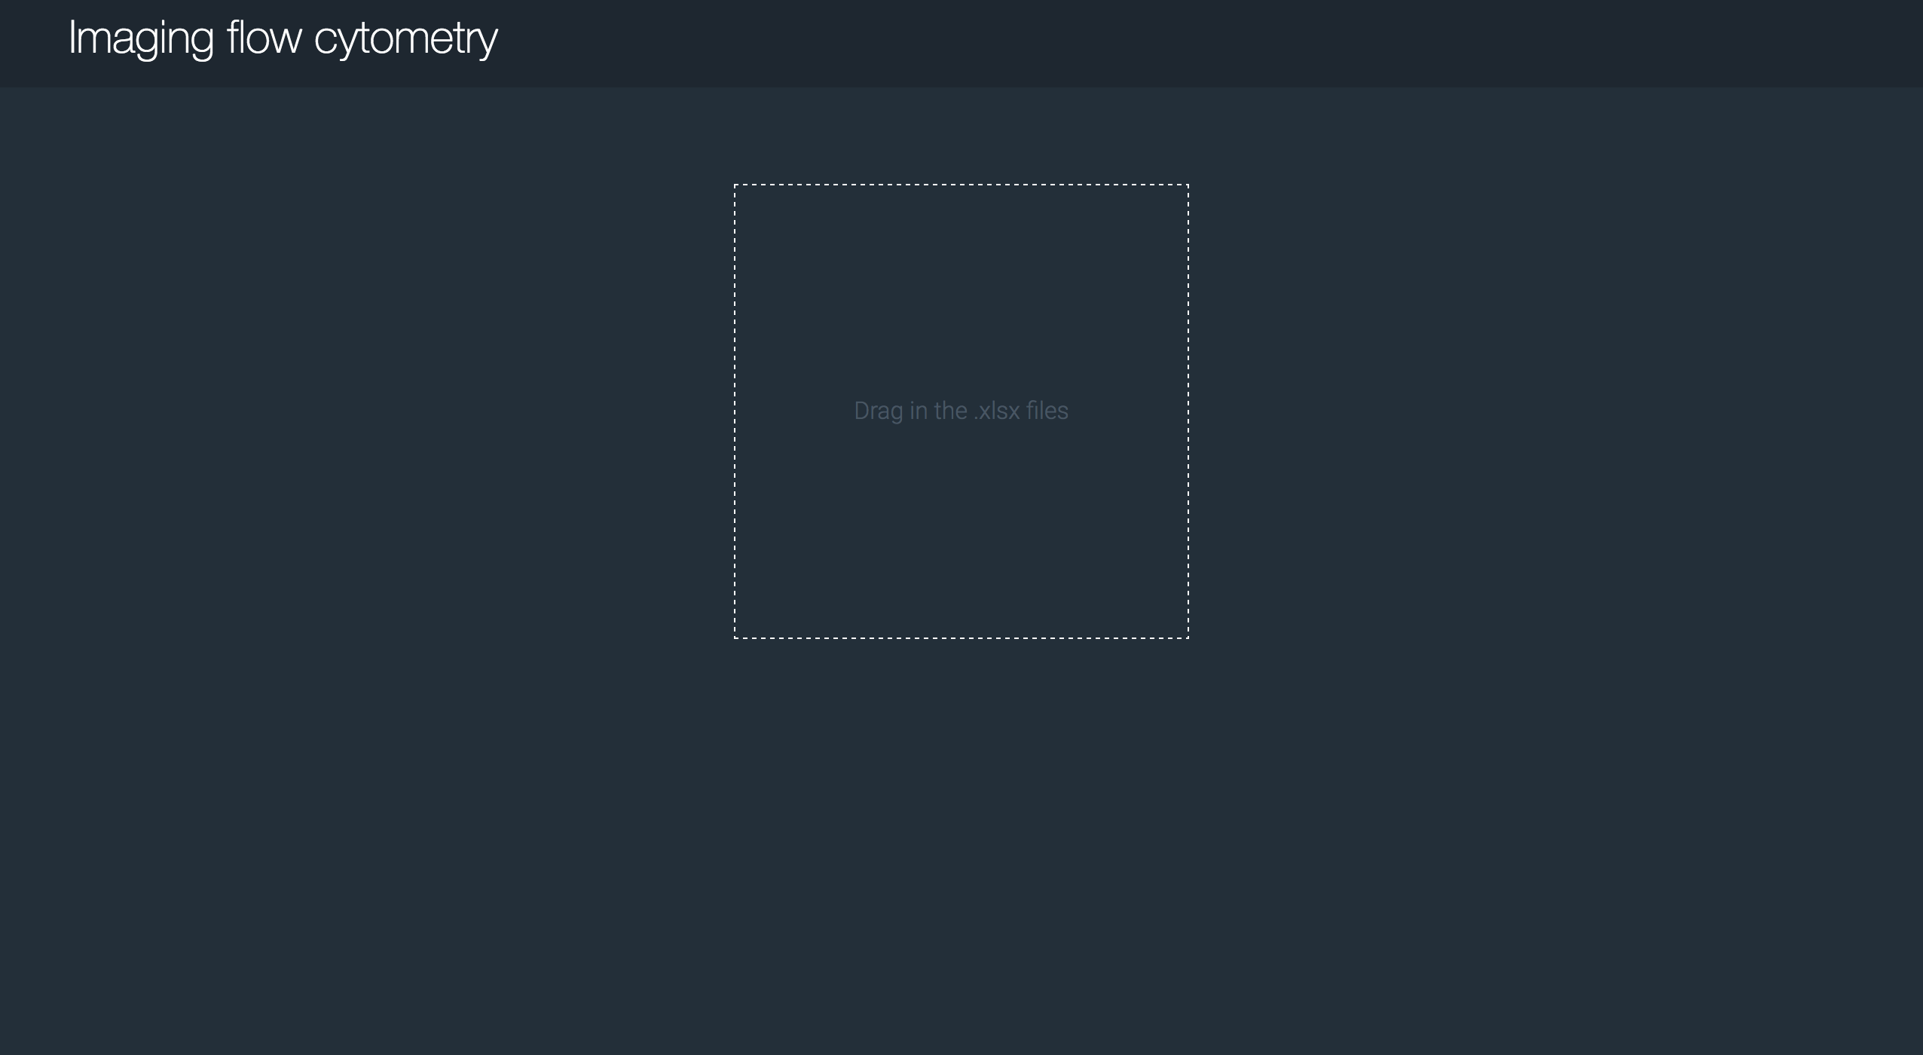
Step 3: Open the GUI
Open “index.html” by double-clicking it

Slide 8
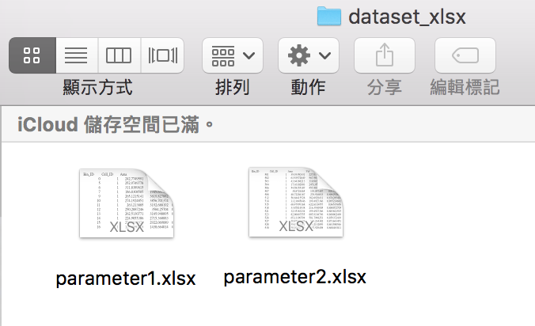
Step 3 (continue):
Drag the files that are stored inside the folder “dataset_xlsx” into the
circled region (in red)

Slide 9
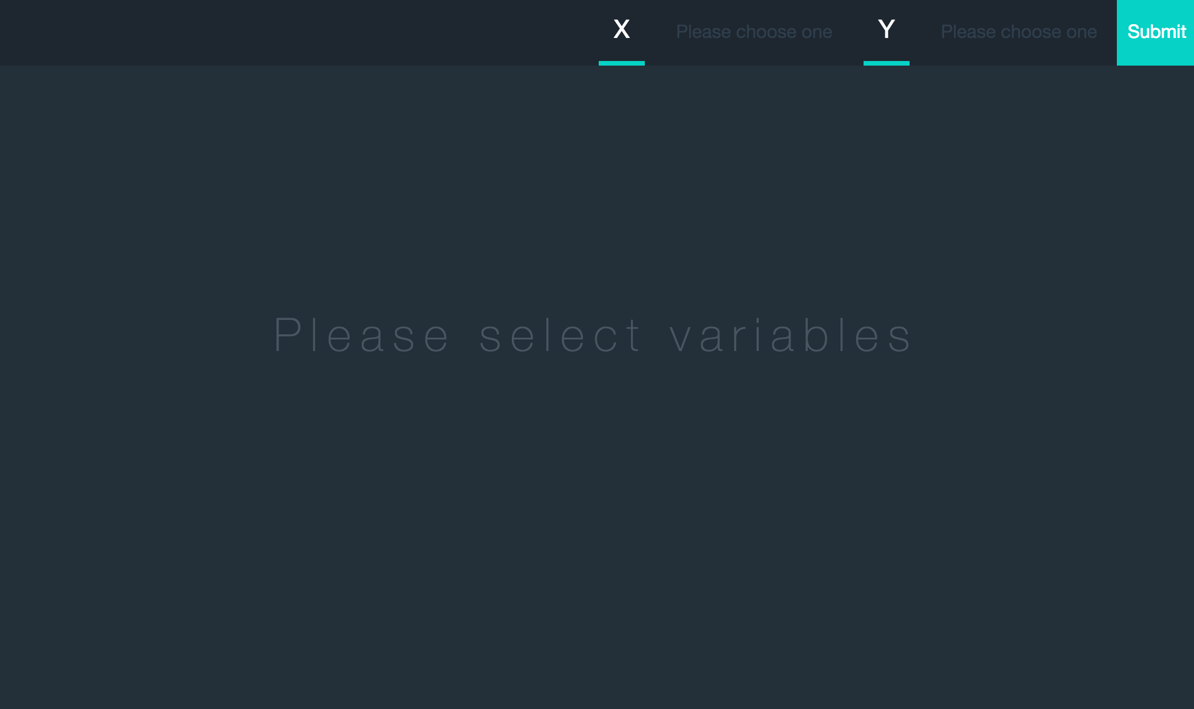
Step 3 (continue):
The interface after the files are dragged in

Slide 10



Step 3 (continue):
Choose a parameter for x-axis from
(Area is chosen for this example):
Choose a parameter for y-axis from
(Vol is chosen for this example):
Click the “Submit” button:

Slide 11
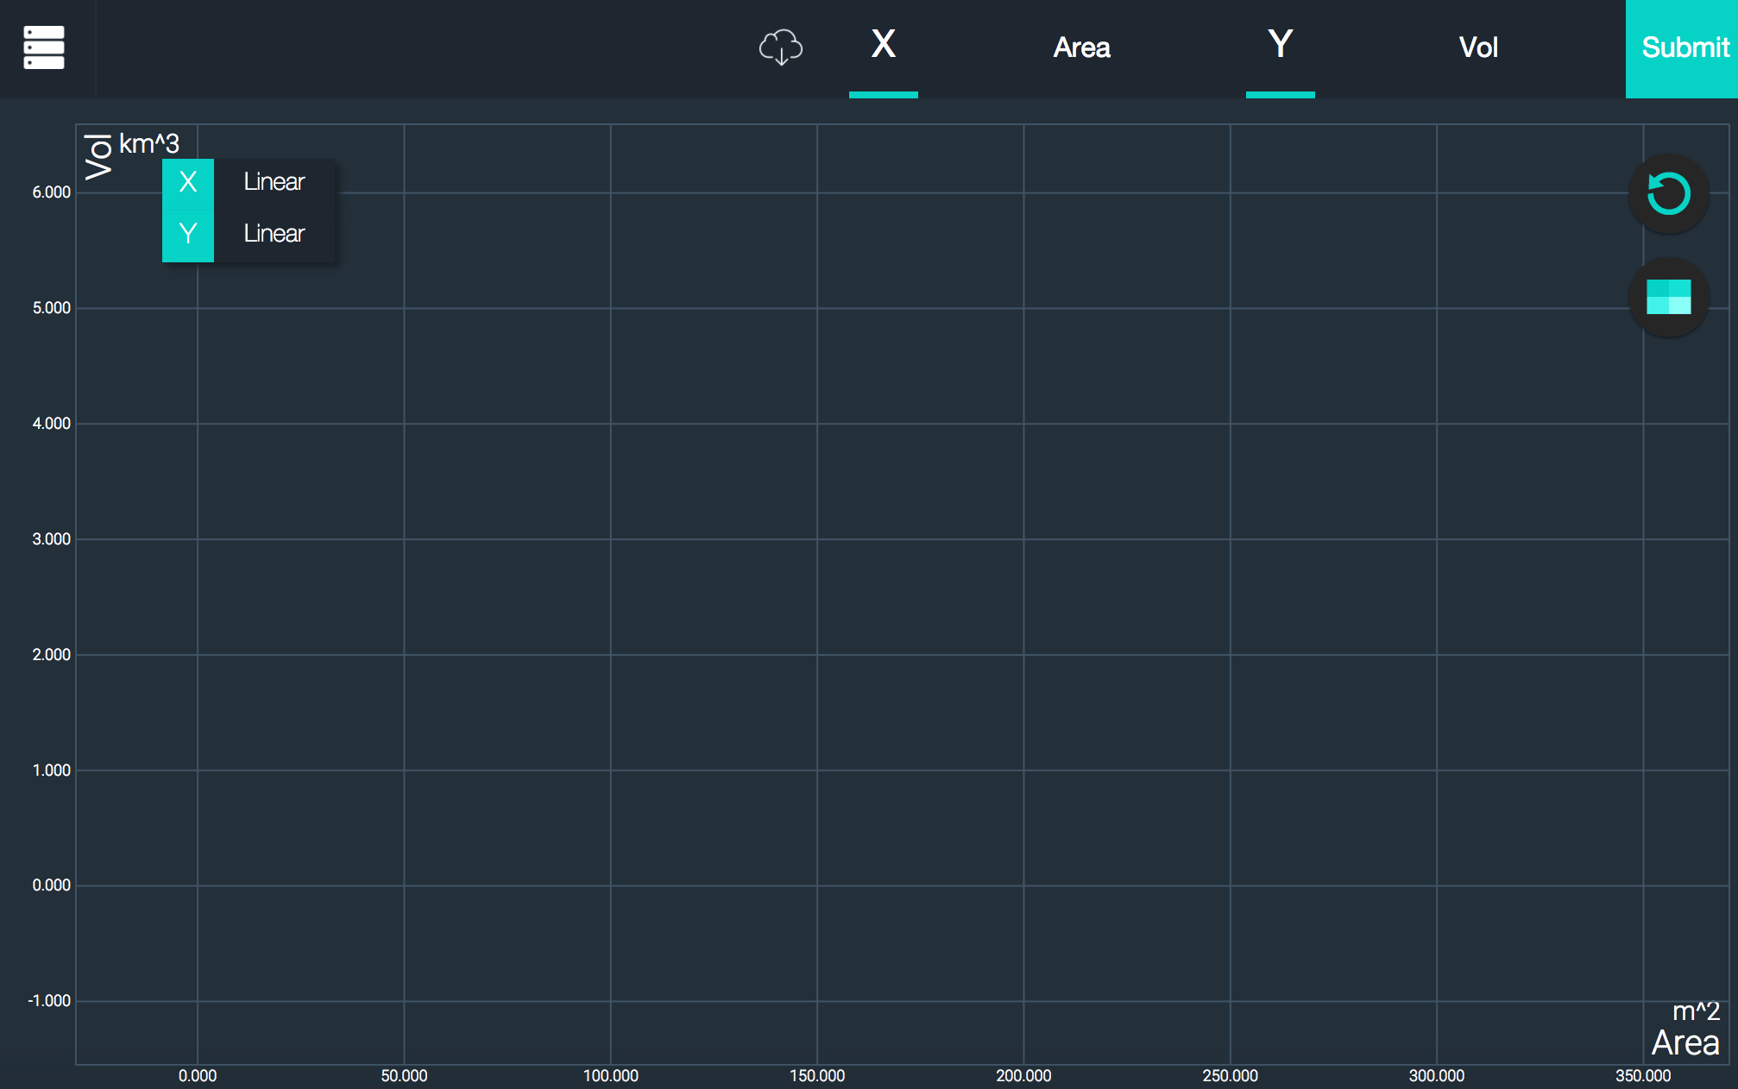
Step 3 (continue):
Click the circled button to choose the dataset to be displayed:

Slide 12
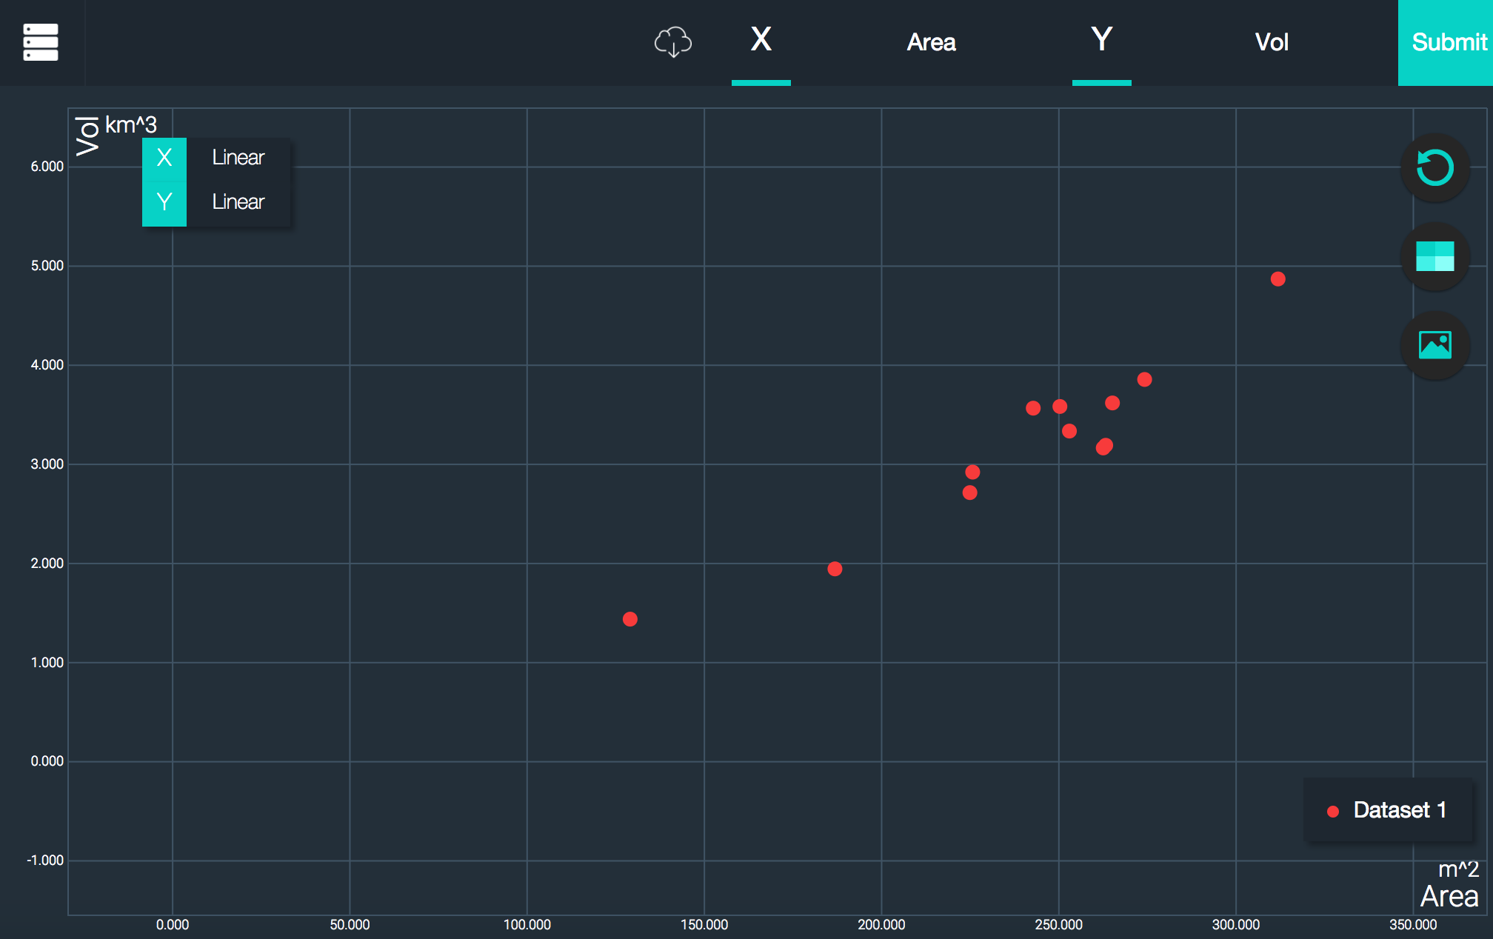
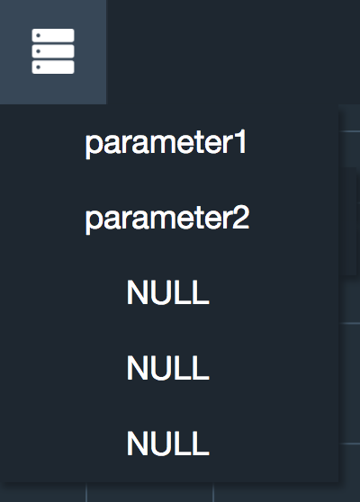
Step 3 (continue):
Click “Dataset 1” to display dataset1

Slide 13
Step 3 (continue):
Click the circled button again to choose the dataset to be displayed:

Slide 14
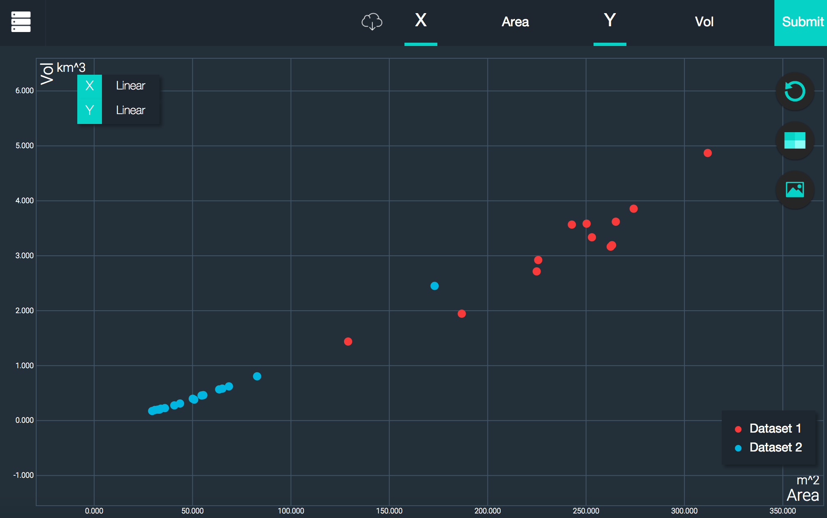
Step 3 (continue):
Click “Dataset 2” to display dataset2

Slide 15
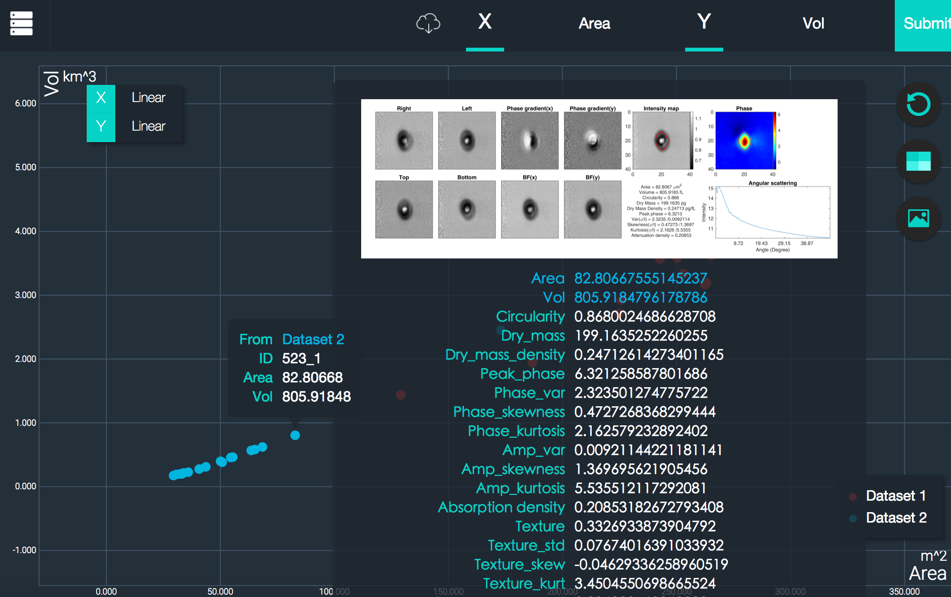
Additional feature: View image and parameters
Move the cursor to one of the points
The corresponding image and also parameters of that point will be displayed in a pop-up window

Slide 16
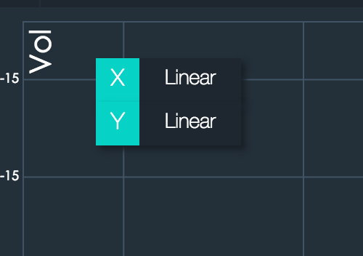
Additional feature: Change scale type
Different scales, including linear scale, log10 scale and log2 scale can be chosen individually for x-axis or y-axis from:

Slide 17
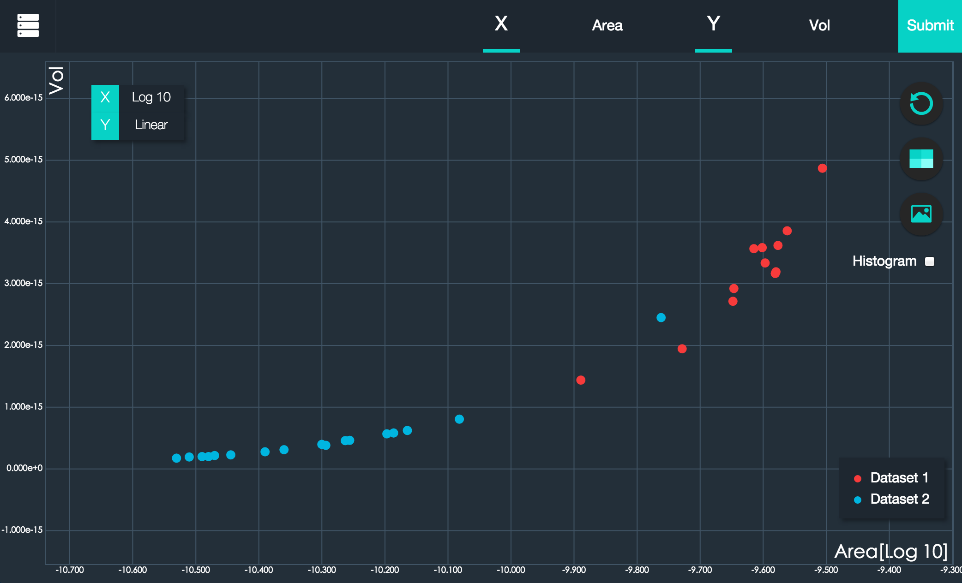
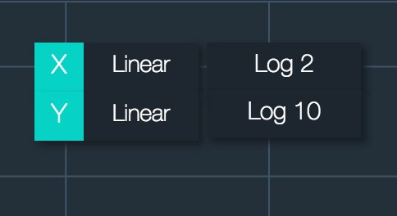
Change scale type (continue):
In this example, move the cursor to the circled region and choose “Log 10” to change the scale of x-axis from linear to log10:

Slide 18
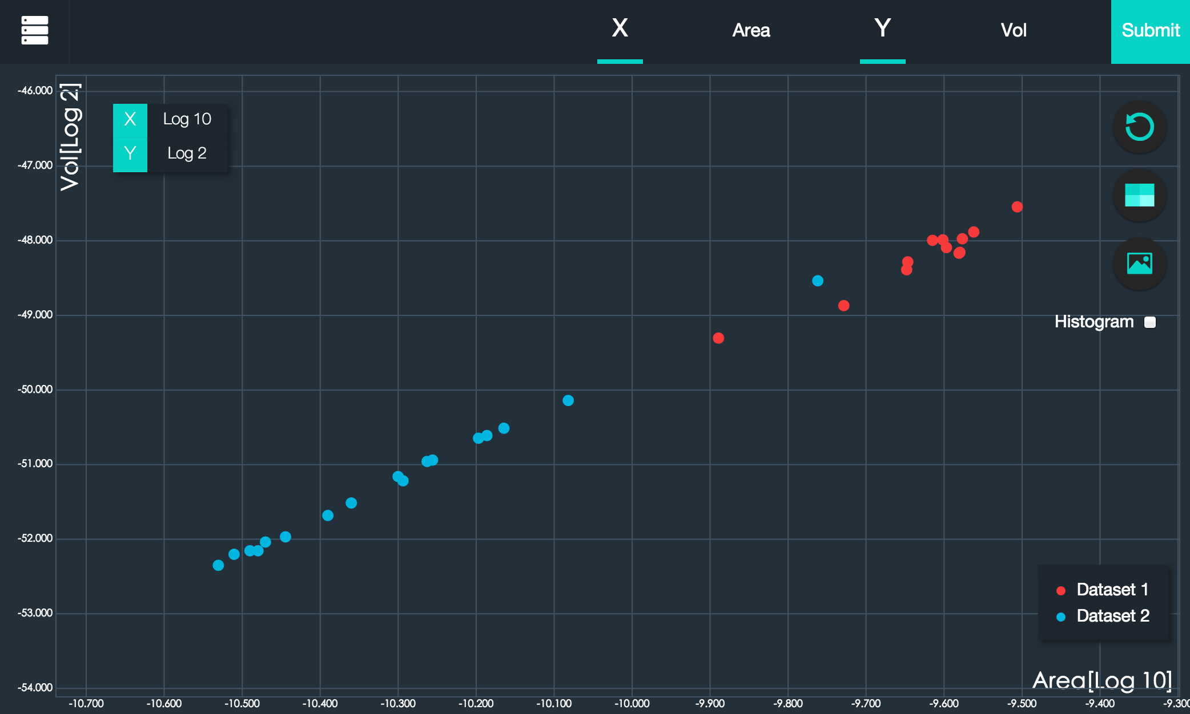
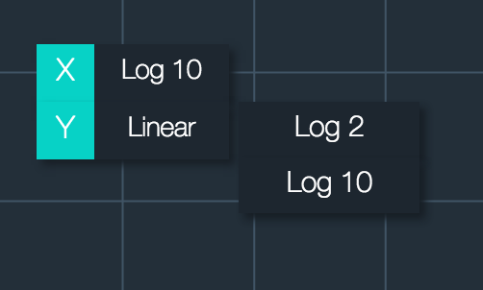
Change scale type (continue):
After that, move the cursor to the circled region and choose “Log 2” to change the scale of y-axis from linear to log2:

Slide 19
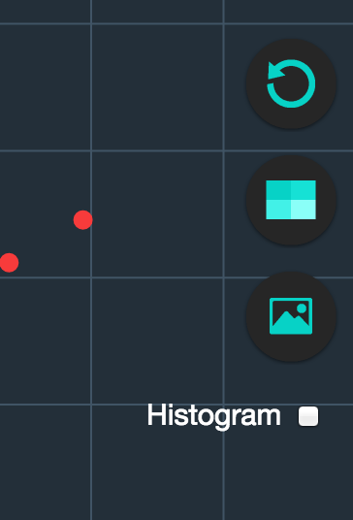
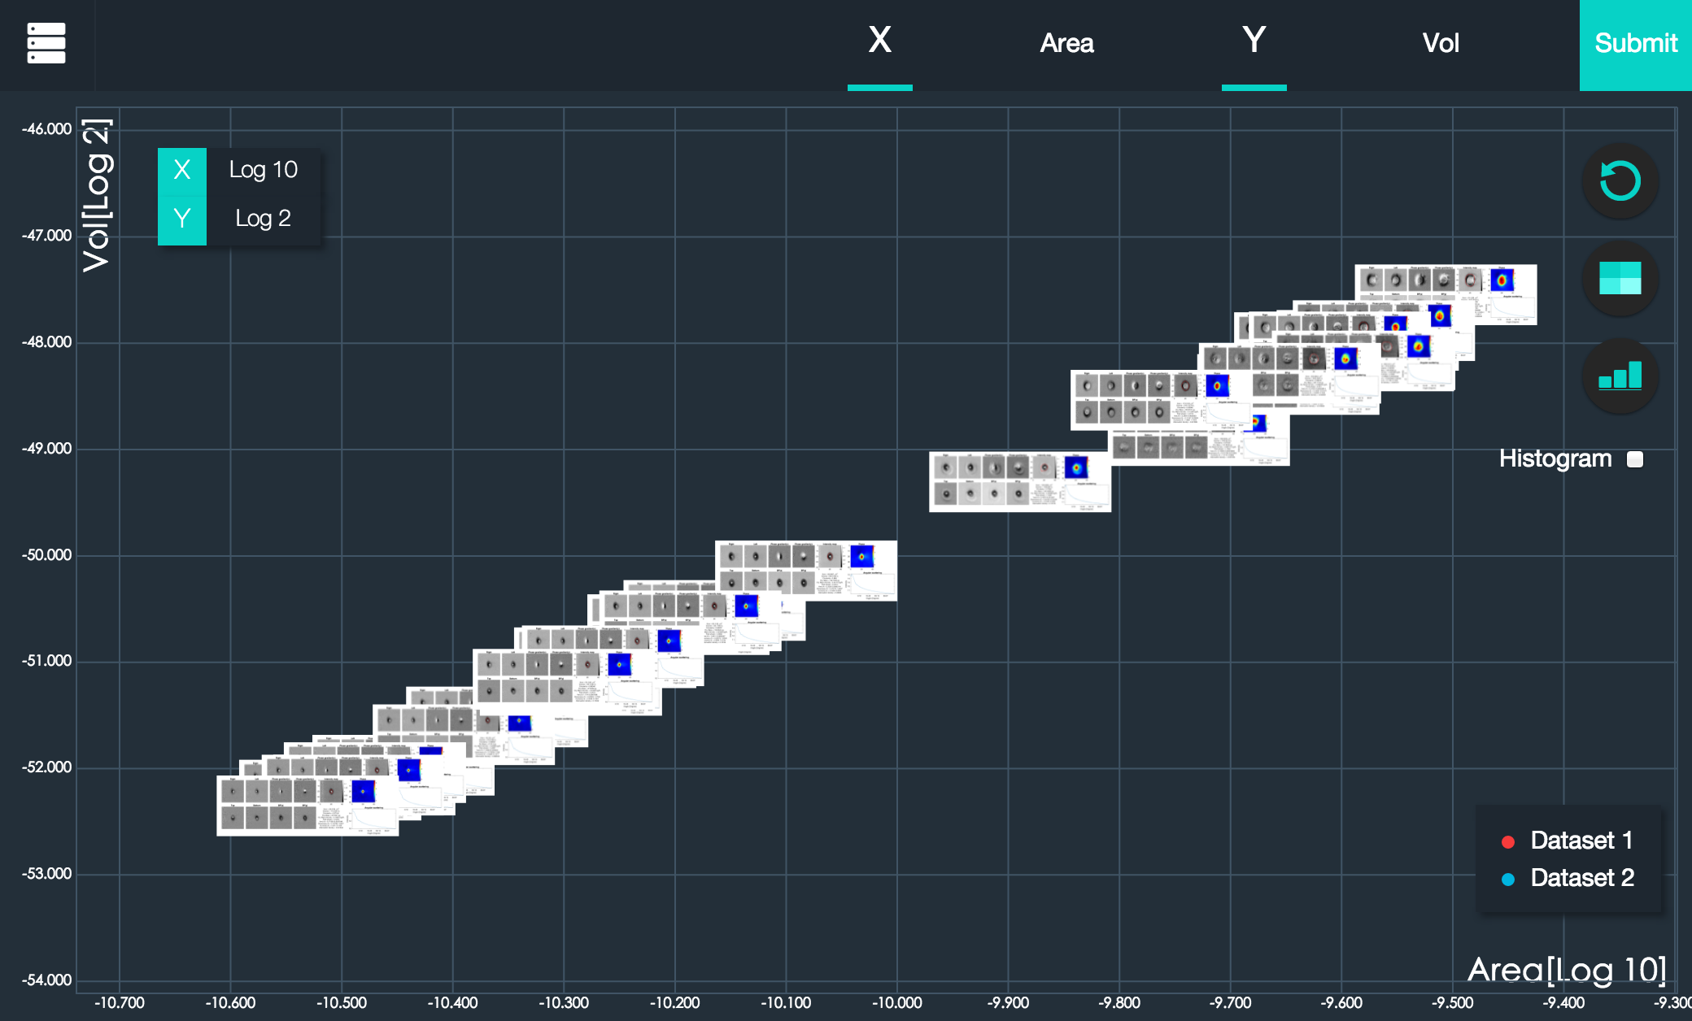
Additional feature: Change points into images
Click the circled button
All the points displayed in the current scatter plot are changed into their corresponding images

Slide 20
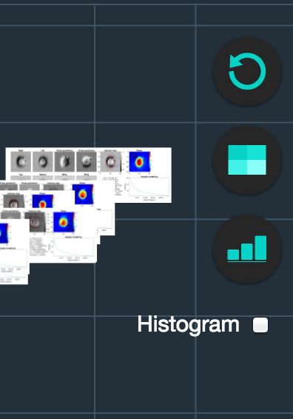
Change points into images (continue):
In order to see the images of a particular group of points, you can zoom into a particular region (by using the scroll wheel of the mouse) to resolve the overlapping images
By clicking the circled button (with a different icon), which is located at the same place, all the images are changed back into points

Slide 21
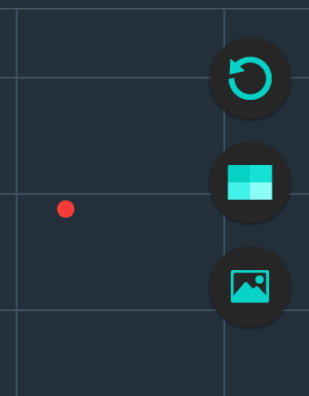
Additional feature: Reset zoom
After zooming into a particular region, you can click the circled button to reset “zoom”, i.e. return to the original “zoom ratio”

Slide 22
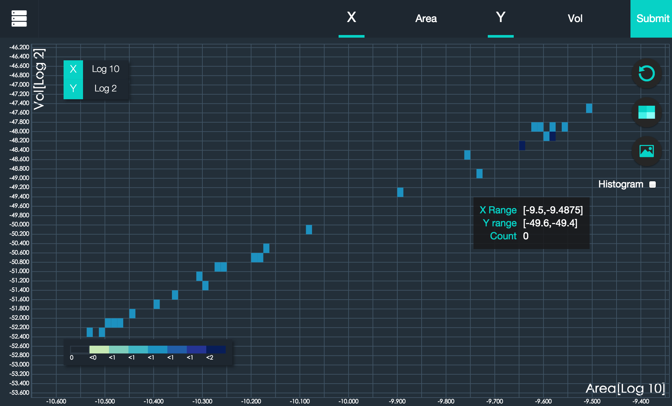
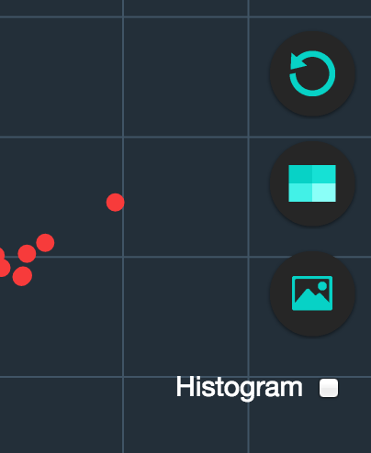
Additional feature: Heat map
Click the circled button to view the heap map

Slide 23
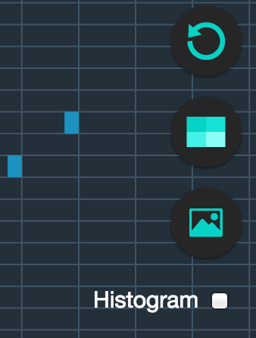
Heat map (continue):
In heat-map mode, you can zoom into a particular region by dragging out a rectangular gate (but not by using the scroll wheel of the computer mouse)
Click the circled button again to return to scatter-plot mode

Slide 24
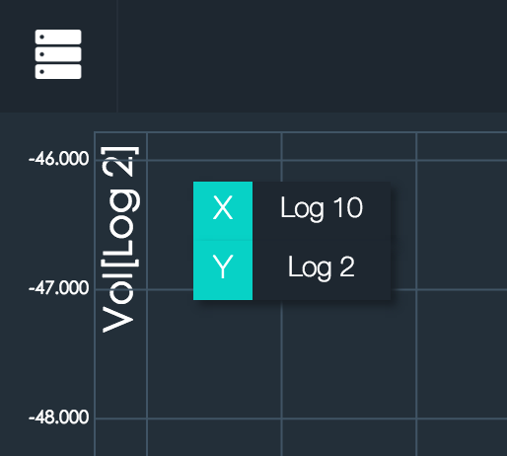
Additional feature: Histogram
In order to display the histograms, only one set of data can be displayed in the current scatter plot
Click the circled button

Slide 25
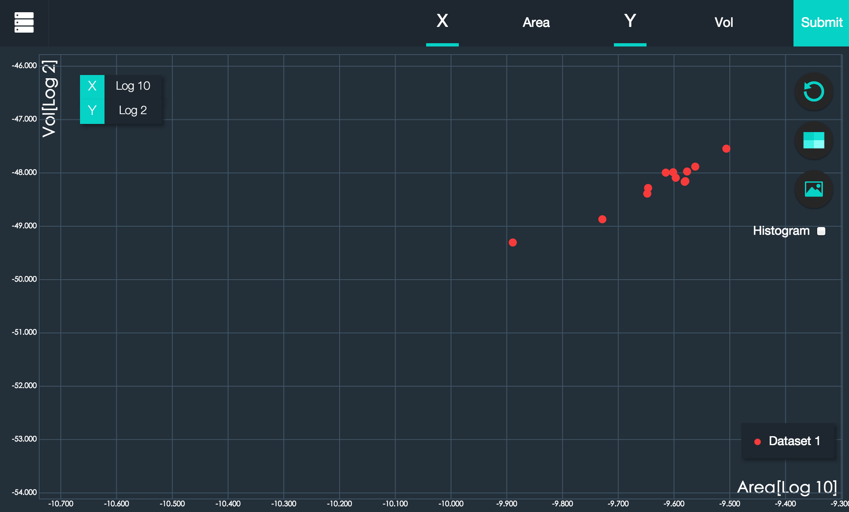
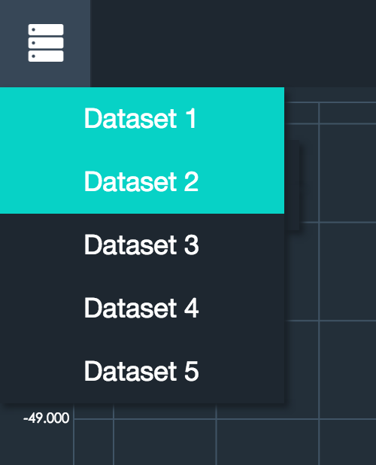
Histogram (continue):
Click “Dataset 2”
Only dataset 1 is displayed in the current scatter plot now

Slide 26
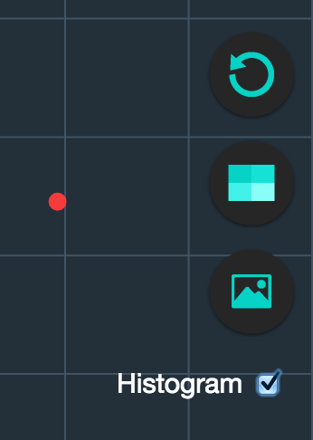
Histogram (continue):
Tick the circled check-box

Slide 27
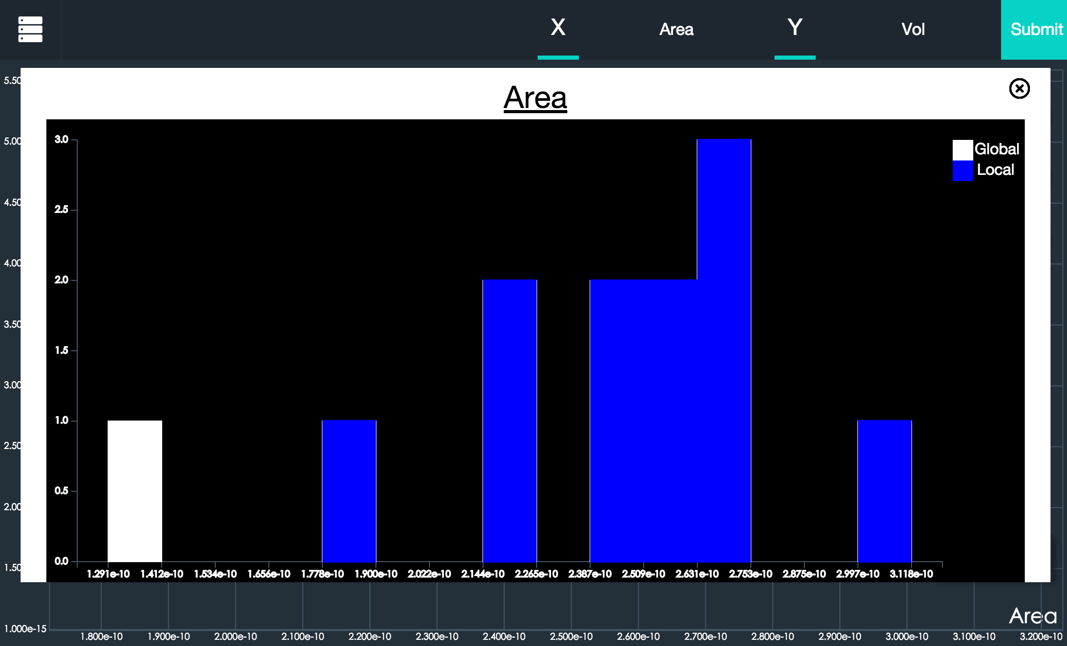
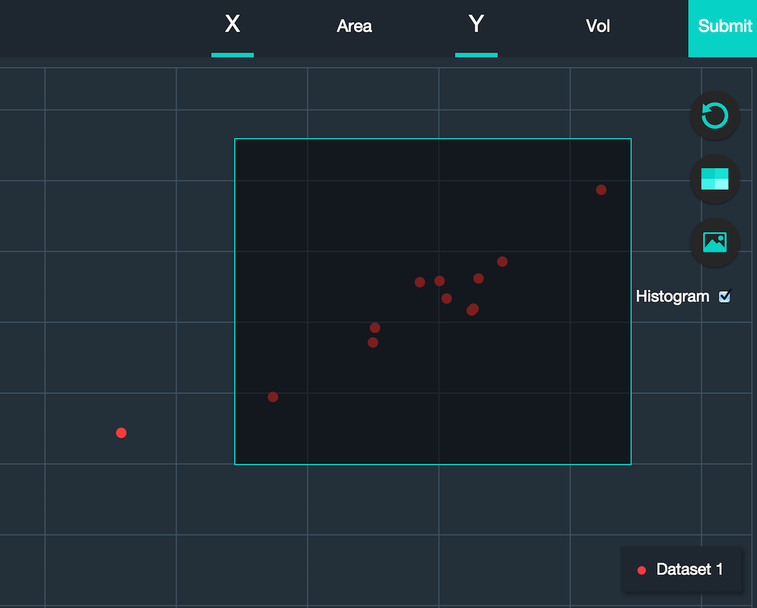
Histogram (continue):
Choose a group of points by dragging out a rectangular gate
Histograms of all the parameters are shown in a pop-up window
View the hidden histograms by using the scroll wheel of mouse

Slide 28
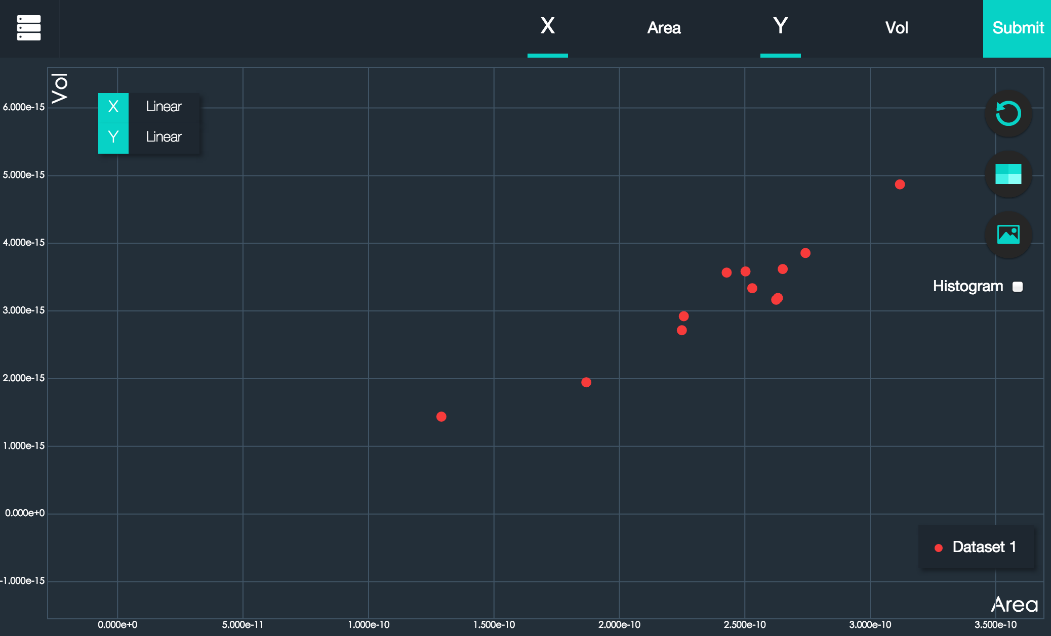
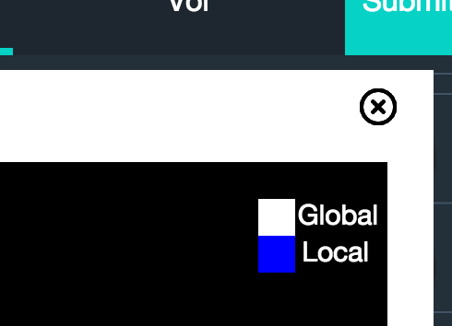
Histogram (continue)
Click the circled button, which is located at the top-right corner of the pop-up window to return to scatter-plot mode

Slide 29
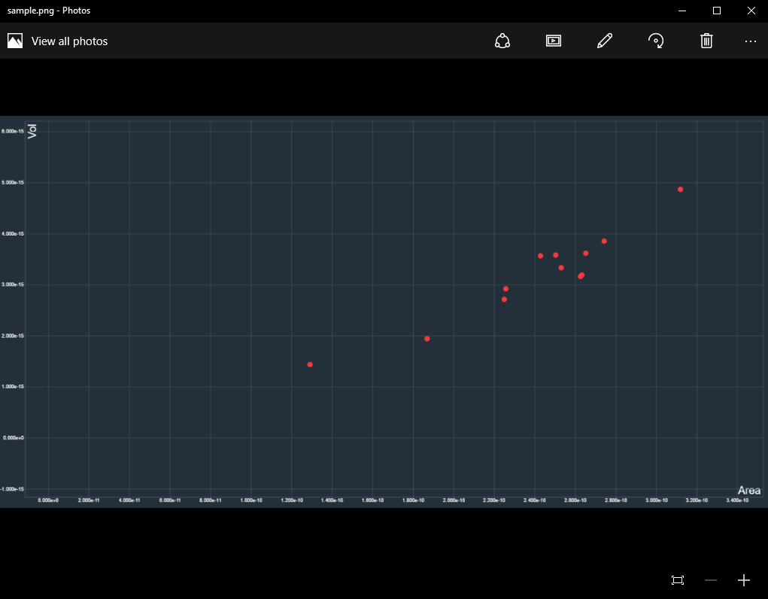
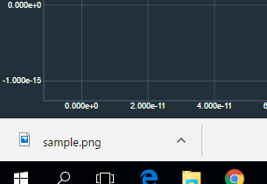
Additional feature: Output scatter plot
Press “Shift + P” to save the current scatter plot

