Slide 1
NephroTwin AI
🩺 HAPPIEST HEALTH DIGITAL TWIN CHALLENGE 2026
EXECUTIVE SUMMARY
Problem : Hypotension during dialysis is patient-specific, and population risk scores miss it.
Solution : A persistent virtual patient that scores risk before connection and shows why.
A personalized dialysis digital twin that predicts intradialytic hypotension and supports safer fluid-removal planning.
Evidence. AUC 0.977 on a synthetic cohort. On real HEMOBP data the hybrid matches the standard model at 0.871, and we report that openly.
Path. Prospective study, then a SaMD pathway, then machine and EHR partnerships.
Predict the risk. Understand the patient. Plan dialysis more safely.
Team ZWEIKERN · Shada Ali Kuzhikattil, Rushdha V
Vel Tech Rangarajan Dr. Sagunthala R&D Institute of Science and Technology, Chennai
Repo: github.com/Shada0/NephroTwin-AI
Demo video: [INSERT YOUTUBE UNLISTED VIDEO LINK HERE]
Pitch deck: [INSERT GOOGLE DRIVE PITCH DECK LINK HERE]
Simulated research prototype: synthetic cohort plus open real-data validation (HEMOBP). Not a medical device.
Notes:
Open with the one-line vision: predict the risk, understand the patient, plan dialysis more safely. Name the team and college. State the disclaimer up front: this is a simulated research prototype, and we report the real-data result honestly later in the deck.

Slide 2



Hypotension during dialysis is patient-specific
🩺 THE CLINICAL PROBLEM
Removal outruns refill
Patients differ
Sessions differ
Dialysis removes fluid gained between sessions. Removing it faster than the body refills it can drop blood pressure mid-treatment.
Refill rate, vascular response and comorbidity vary sharply from one patient to the next.
Fluid gain, heat and gap length change the risk for the same patient from one session to the next.
9.5%
Population scores ignore each patient’s physiology. Our target: the probability of hypotension before the session starts, the reasons behind it, and what-if scenarios for clinicians, never orders.
of 14,638 real HEMOBP sessions had a hypotensive reading
NephroTwin AI · ZWEIKERN · Simulated research prototype, not a medical device
2 / 14
Notes:
IDH is the clinical pain point: fluid removal can outrun the body’s refill. The key insight is variability, both between patients and between sessions, which is why population-level scores fall short. In the open HEMOBP dataset 9.5% of sessions had a hypotensive reading. Our goal is to estimate the risk before the session starts, show why, and let clinicians explore scenarios without issuing orders.

Slide 3

A persistent virtual patient that learns
⚡ THE DIGITAL TWIN SOLUTION
1
2
3
Initialise
Update
Simulate
Estimate refill rate k, BP sensitivity S and fluid-gain rate g from past sessions, with uncertainty. MAP least squares plus a population prior from training patients only.
A scalar Kalman filter fuses home and clinic weights into a fluid-excess state. Each new session re-fits the parameters with a warm start.
Two-compartment ODE (SciPy), BP response and AR(1) noise. Monte Carlo over uncertainty gives P(SBP < 90 mmHg) for the plan and each what-if.
Outcome label (demo definition): any monitored SBP below 90 mmHg.
Prediction timestamp: scheduled connection time. No later data are used.
NephroTwin AI · ZWEIKERN · Simulated research prototype, not a medical device
3 / 14
Notes:
This is a twin, not a renamed classifier: the patient state persists and updates. Initialise from history with MAP least squares and an empirical-Bayes prior learned from training patients only. Update with a Kalman filter that fuses home and clinic weights. Simulate with the two-compartment ODE and Monte Carlo to get the probability of SBP below 90 mmHg, for the planned session and for what-if variants.

Slide 4



Two streams, controlled for leakage
📊 DUAL DATA STREAMS
Stream A · History (EHR)
Stream B · Dynamic signals
Age, sex, diabetes, hypertension, CVD
Baseline BP, dry weight, labs, medications
6 months of sessions: UF, duration, IDWG
Timed BP and HR, prior hypotension events
Daily home weight and BP cuff readings
Wearable HR, HRV, activity, sleep (gaps shown)
Temperature and heat-wave flag
Pre-dialysis vitals
Prediction timestamp
Past sessions only
Tested, not assumed
Only data stamped before the scheduled connection time feed any model.
Twin parameters for session n use sessions before n, never later ones.
Patient-grouped and temporal hold-outs; tests assert outcomes never enter features.
Real HEMOBP data has no wearables, weather or labs. Those streams stay synthetic and are labelled as such.
NephroTwin AI · ZWEIKERN · Simulated research prototype, not a medical device
4 / 14
Notes:
Stream A is the static and historical record; Stream B is dynamic: home weight, cuff BP, wearable signals and weather. BP is a cuff reading, not a wearable measurement. The leakage controls are the credibility point: prediction happens at connection time, twin parameters for session n use only earlier sessions, and automated tests assert that outcome columns never enter the features. Real HEMOBP data has no wearable, weather or lab streams, so those remain synthetic and are labelled.

Slide 5

From two data streams to a pre-session risk
⚡ SYSTEM ARCHITECTURE
Stream A
Physiology engine
Models compared
Historical EHR. Feature extraction uses sessions before the prediction time only.
State. MAP least squares (k, S, g) with shrinkage, plus a Kalman filter for fluid excess.
Population baseline (LR, RF)
Personalized digital twin
Hybrid: standard + twin
Ablation: population params
Fluid. Two-compartment ODE (SciPy).
BP. Blood-volume response with AR(1) noise.
Stream B
Clinician outputs
Risk. Monte Carlo over parameter and state uncertainty, then Platt calibration.
Risk with uncertainty and Green/Amber/Red demo thresholds
What-if simulation
Streamlit dashboard
Sensors and weather. Preprocessing adds missingness flags and 3-day windows.
Prediction timestamp = scheduled connection time
NephroTwin AI · ZWEIKERN · Simulated research prototype, not a medical device
5 / 14
Notes:
Walk left to right. Both streams are preprocessed with leakage controls, then feed the patient-specific state estimation. The engine combines MAP least squares with shrinkage and a Kalman filter, a two-compartment fluid ODE, a BP response with AR(1) noise, and Monte Carlo risk with Platt calibration. We compare four models: population baseline, twin, hybrid, and the ablation with population parameters. Outputs are risk with uncertainty, what-if simulation, and the clinician dashboard.

Slide 6
Strong on synthetic data, honest on real data
📊 EVIDENCE · ROC-AUC, BARS START AT 0.5 (CHANCE)
Synthetic cohort
Real open data (HEMOBP)
120 patients · 36 held-out test patients · 23.5% prevalence
328 patients · 14,638 sessions · 87 test patients · 9.5% hypotension
Personalized twin
0.977
Hybrid (standard + twin)
0.871
Logistic regression
0.949
Logistic regression
0.863
Twin, no personalization
0.879
Personalized twin alone
0.736
+0.028 AUC vs logistic regression (95% CI +0.015 to +0.043). Personalization lifts the twin from 0.879 to 0.977.
Twin, no personalization
0.607
Twin alone: −0.127 vs logistic regression (CI −0.159 to −0.097). Hybrid: +0.008 (CI +0.000 to +0.016), about on par.
Optimistic: the twin’s structure resembles the data generator.
Reported openly: sparse readings (median 6 per session) limit identifiability.
NephroTwin AI · ZWEIKERN · Simulated research prototype, not a medical device
6 / 14
Notes:
Left: on the synthetic cohort the personalized twin reaches 0.977 against 0.949 for logistic regression, a +0.028 difference with a patient-cluster bootstrap CI of +0.015 to +0.043. The ablation with population parameters scores 0.879, so personalization is what adds value. Caveat: the twin’s structure resembles the generator, so this is optimistic and not clinical evidence. Right: on real HEMOBP data the twin alone does NOT beat the standard model, 0.736 against 0.863, because readings are sparse. The hybrid matches the standard model at 0.871. We report this negative result openly. Personalization still helps against the population-parameter twin, 0.607 to 0.736.

Slide 7
13 views and a guided case study
🏥 CLINICIAN DASHBOARD
Unit · 4 views
Patient · 2 views
The “Ravi” case · 7 steps
Project overview, unit overview, patient list, weekly priority list (risk × uncertainty, no treatments assigned)
Twin profile with parameter uncertainty and explanations; pre-session card with the what-if planner
1 Patient overview
2 Dynamic data update
3 Heat-wave scenario
4 Digital twin update
5 Risk flag
6 What-if planner
7 Clinical review
Story · 3 views
Trust · 4 views
Ravi guided demo, historical replay (prediction first, outcome after), simulated daily check-in
Model evaluation, real-data validation, data quality, limitations and safety
Simulated patient, not real clinical data. The 2.8 kg gain by day 3 is a demonstration input.
NephroTwin AI · ZWEIKERN · Simulated research prototype, not a medical device
7 / 14
Notes:
Switch to the live Streamlit app here if possible. The 13 views are grouped into unit, patient, story and trust. The Ravi guided demo walks seven steps: overview, dynamic data update, heat-wave toggle, twin update with a what-changed table, risk flag with explanations, what-if planner with non-directive wording, and a closing clinical-review step. The risk is computed by the twin, not hard-coded. The heat-wave rule is a documented synthetic rule, and the 2.8 kg gain is a demonstration input. Demo video: [Video Link]. Repo: [Repo URL].

Slide 8
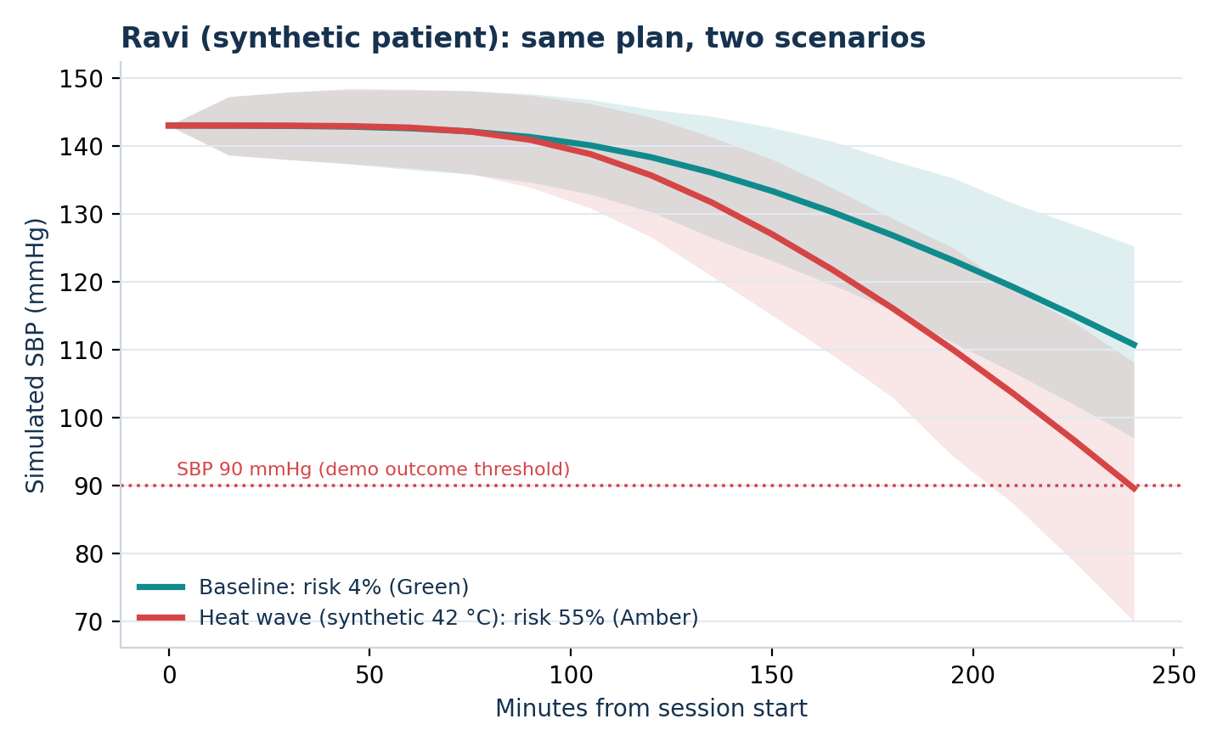
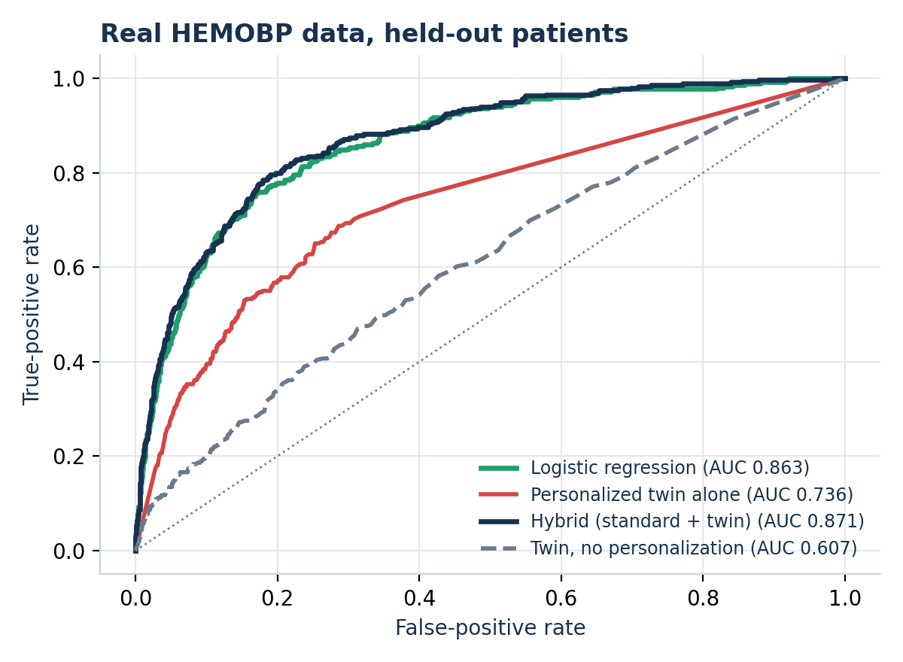
Ravi: 4% baseline risk becomes 55% in a heat wave
🏥 DASHBOARD IN ACTION
Guided demo, step 5. The twin recomputes live: the same plan scores 4% (Green) at baseline and 55% with the synthetic heat-wave input. Shaded band = 10th to 90th percentile. Synthetic patient, demonstration input.
Real-data validation (HEMOBP). The hybrid edges the standard model (0.871 vs 0.863) while adding physiology and what-if simulation; the twin alone trails. We report that openly.
NephroTwin AI · ZWEIKERN · Simulated research prototype, not a medical device
8 / 14
Notes:
Show the live dashboard if possible. Left: Ravi baseline vs heat wave, computed by the twin (4% to 55%). Right: real HEMOBP ROC curves. Be candid that the twin alone trails the standard model on real data and the hybrid is on par.

Slide 9
Value, pricing and ROI for dialysis clinics
💼 BUSINESS VALUE AND CLINIC ECONOMICS
🏥 Value for chains and hospitals
💼 Pricing model
💵 ROI per clinic, per year
PPPM licence. Per-patient-per-month software fee for outpatient dialysis centers: $25 PPPM (US/EU); India tier about $10
+ Avoided acute events × $100
+ Avoided hospitalizations × $4,000
+ Nurse time saved × $25
− Licence: patients × 12 × PPPM
Fewer emergency intradialytic interventions
Shorter nurse intervention times
Fewer early session terminations
Better patient retention and survival
EHR integration fee. Enterprise fee per site for Epic or Cerner connections: $10,000 one-time per site
Planning assumptions, not results. No savings are claimed until the Phase 1 study.
Priced against avoided events: cost per acute event prevented, and per avoided emergency admission.
Targets for the prospective study, not yet demonstrated.
Worked example (illustrative planning model): 100-patient centre, 15,600 sessions a year, 10% needing an acute intervention, 15% target reduction = 234 events avoided. Benefit about $39.8K (events $23.4K + nurse time $4.4K + 3 avoided emergency admissions $12.0K) against a $30.0K licence: net about +$9.8K, benefit-to-cost 1.3x. Cost per acute event prevented (licence ÷ events) is about $128; each avoided emergency admission is valued at $4,000. Break-even needs roughly 10% fewer interventions. All inputs get replaced by Phase 1 measurements.
NephroTwin AI · ZWEIKERN · Simulated research prototype, not a medical device
9 / 14
Notes:
This slide is the business case in one view. The value to chains and hospitals is fewer emergency interventions, shorter nurse intervention time, fewer early terminations and better retention and survival; these are targets we will measure in the prospective study, not results. Pricing is a per-patient-per-month licence for outpatient centers plus an enterprise EHR integration fee. The ROI model is transparent: the bracketed inputs get filled from Phase 1 data and the team’s own cost assumptions, so we do not claim a savings number yet. Fill in the bracketed prices before presenting.

Slide 10
From a $95B+ market to a focused first wedge
📊 MARKET OPPORTUNITY
TAM
TAM · Global dialysis
$95B+
About $95B+ global dialysis market serving 3.8M+ end-stage renal disease patients worldwide.
SAM
SAM · Clinical decision support
~$3.2B
Software and AI decision support in North American and European dialysis clinics, about $3.2B.
SOM
SOM · Initial rollout
~$120M
Top 50 regional outpatient dialysis chains, about $120M addressable.
India lens: about 2.2 lakh new ESRD patients a year (roughly 3.4 crore added dialysis sessions). India-first entry via private chains and district centres.
Global figures: team triangulation of published market-research estimates; verify before external use. India figures: Ministry of Health and Family Welfare, PM National Dialysis Programme guidelines.
NephroTwin AI · ZWEIKERN · Simulated research prototype, not a medical device
10 / 14
Notes:
TAM: the global dialysis market, about $95B+, covering 3.8M+ end-stage renal disease patients. SAM: software and AI clinical decision support in North American and European dialysis clinics, about $3.2B. SOM: our initial rollout to the top 50 regional outpatient dialysis chains, about $120M addressable. These figures are the team’s estimates; add sources for each before presenting externally.

Slide 11
Validate, regulate, then scale
🚀 GO-TO-MARKET AND REGULATORY ROADMAP
PHASE 1 · NEAR TERM · 0 TO 12 MONTHS
PHASE 2 · REGULATORY · 12 TO 30 MONTHS
PHASE 3 · SCALE · 30 TO 48 MONTHS
🔬 Validate
🛡️ Regulate
🏥 Scale
IRB-approved prospective observational study with partner clinics
Continuous BP, medications and UF profiles
Real-world value of continuous monitoring
Clinician usability study
Software as a Medical Device (SaMD) as a clinical decision support tool
FDA 510(k) submission and CE mark pathway
Quality system, clinical validation, calibration monitoring
Integration partnerships with dialysis machine makers, e.g. Fresenius, Baxter
EHR integrations, e.g. Epic, Cerner
Rollout across the top 50 regional chains
Target partners, no agreements yet.
Pathway to confirm with regulatory counsel. India CDSCO pilots run in parallel.
Commercial motion. Pilot with partner clinics, convert to PPPM licences, add EHR integration fees as sites connect.
NephroTwin AI · ZWEIKERN · Simulated research prototype, not a medical device
11 / 14
Notes:
Three phases. Phase 1: an IRB-approved prospective observational study with partner clinics, to validate real-world continuous monitoring with richer data. Phase 2: the regulatory pathway as Software as a Medical Device, a clinical decision support tool, via FDA 510(k) and CE mark; confirm the exact route with regulatory counsel. Phase 3: scale through strategic integration partnerships with dialysis machine manufacturers such as Fresenius and Baxter and EHR providers such as Epic and Cerner; these are target partners, with no agreements in place. Fill in the timeline placeholders.

Slide 12
Twin versus standard ML versus static rules
🩺 COMPETITIVE LANDSCAPE
Static rules
Standard ML
NephroTwin AI
Personalization
None. Fixed thresholds.
Learned from population features.
Per-patient k, S, g, updated every session.
Explainability
Transparent but generic.
Feature contributions.
Physiology parameters and fluid state.
What-if simulation
Not supported.
Re-scores inputs, no physiology.
Simulates duration, UF, gap and heat.
Uncertainty
None.
Probability only.
Parameter and state uncertainty.
Honest edge. On real data the hybrid matches the standard model (0.871 vs 0.863) and adds explainable physiology and what-if simulation.
NephroTwin AI · ZWEIKERN · Simulated research prototype, not a medical device
12 / 14
Notes:
Compare three approaches. Static rules are transparent but generic. Standard machine learning learns from population features and gives a probability, but has no physiology and no mechanistic what-if. NephroTwin keeps a per-patient state, explains with physiology parameters and fluid state, simulates scenarios, and carries uncertainty. Be candid: on real data the hybrid is about on par with the standard model, so our advantage is explainability and simulation, not a large AUC gain. No named competitor products are claimed here; add a competitor row if you have verified information.

Slide 13



Built to inform clinicians, never to instruct them
🛡️ SAFETY, GOVERNANCE AND HONEST REPORTING
Prototype status
Non-directive by design
Honest reporting
A simulated research prototype, not a medical device. Synthetic patients are labelled everywhere. Thresholds are configurable demonstration values.
Planner outputs are simulations marked “Clinical review required” and “Not a treatment recommendation”. No orders for duration, UF, medication or sessions.
On real data the twin alone underperforms. Synthetic wins are not clinical effectiveness, and retrospective simulation cannot show treatment benefit.
Required before any real use
Clinical validation
Regulatory review
Data-protection review
Expert oversight
NephroTwin AI · ZWEIKERN · Simulated research prototype, not a medical device
13 / 14
Notes:
Safety and honesty are part of the product. This is a simulated research prototype and says so everywhere. Planner wording is deliberately non-directive. We state plainly that the twin alone loses to the standard model on real HEMOBP data, that synthetic superiority is not evidence of clinical effectiveness, and that the heat-wave inputs follow a documented synthetic rule. Any real use needs clinical validation, regulatory review, data-protection review and expert oversight.

Slide 14
From a research prototype to a clinical tool
🚀 FUTURE SCOPE AND CALL TO ACTION
Now
Next
Later
Prospective, ethics-approved validation with richer data: medications, continuous BP, UF profiles.
Hierarchical Bayesian pooling and a better observation model for sparse readings. Clinician usability study. Real wearable and weather feeds.
Calibration monitoring, the SaMD submission, and machine and EHR partnerships.
Partner with us
Repo (MIT): github.com/Shada0/NephroTwin-AI
We seek clinic partners for the Phase 1 study, nephrology advisors, and seed funding for the Phase 1 study.
Demo video: [INSERT YOUTUBE UNLISTED VIDEO LINK HERE]
Pitch deck: [INSERT GOOGLE DRIVE PITCH DECK LINK HERE]
Team ZWEIKERN: Shada Ali Kuzhikattil (Lead Architect, AI Engineer) and Rushdha V (Clinical Informatics, UI/UX). Vel Tech Rangarajan Dr. Sagunthala R&D Institute of Science and Technology, Chennai.
NephroTwin AI · ZWEIKERN · Simulated research prototype, not a medical device
14 / 14
Notes:
Close with the roadmap: validate prospectively, improve identifiability with hierarchical Bayesian pooling, run a usability study, then regulate and scale. State the ask clearly: clinic partners for the Phase 1 study, nephrology advisors, and your funding or support request. Fill in the repo and video links and the ask before presenting. Thank the judges.

