Slide 1
India State-Wise Development Analysis A Composite Development Index for Indian States
Power BI Dashboard Project
2023–24 Development Analysis
Prepared By:
Md. Shadab Ali

Slide 2
Project Objective
• Compare development levels across Indian states.
• Build a Composite Development Index using multiple indicators.
• Identify high-performing and low-performing states.
• Analyse the relationship between income and development.
• Provide evidence-based policy recommendations.
20 States
7 Indicators
4 Dashboard Pages

Slide 3
Indicators & Weighting Framework
PCI
(20%)
GSDP (15%)
Literacy (15%)
Life Expectancy (15%)
Female LFPR (10%)
Internet (10%)
Unemployment (15%)
Weighted Development Score Calculation
Overall Development Score
(State Ranking Basis)

Slide 4
Methodology
Reverse
Normalization
(Unemployment)
Data Collection
Min-Max
Normalization
Weighted
Score Calculation
• State-level data was collected for seven development indicators.
• Min-Max Normalization was applied to ensure comparability across different scales.
• Unemployment was reverse-normalized because lower values indicate better performance.
• Weighted scores were calculated using predefined indicator weights.
• The final Development Score was used to rank all states.
Development
Score & Ranking

Slide 5
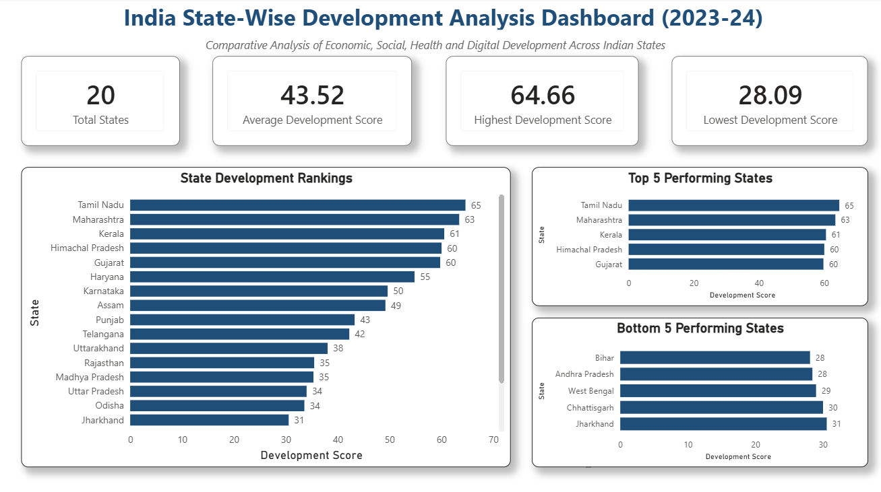
Dashboard Overview
KPI Summary:-
• Total States
• Average Score
• Highest & Lowest Score
Top Performers:-
• Tamil Nadu
• Maharashtra
• Kerala
State Ranking Analysis:-
• Complete ranking of all states
• Comparative performance
Bottom Performers:-
• Bihar
• Andhra Pradesh
• West Bengal

Slide 6
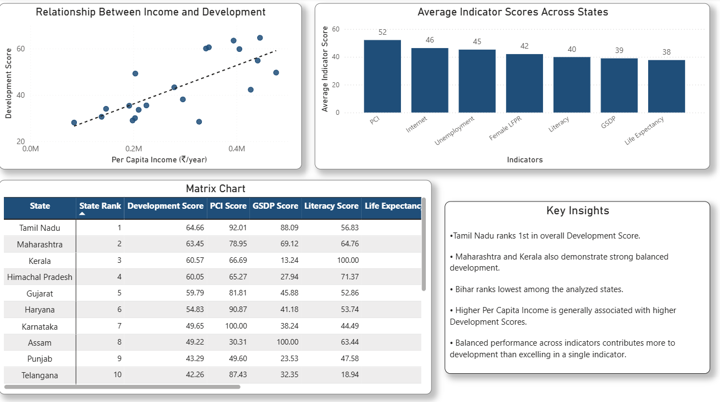
Development Drivers & State Scorecard
Key Analytical Findings:-
• Development Score generally rises with higher Per Capita Income.
• The scatter plot shows a positive association between income and development.
• High-performing states maintain balanced performance across multiple indicators.
• Lower-ranked states lag across several indicators simultaneously.
• Balanced development contributes more to rankings than excellence in a single metric.
Key Observation:-
Income and Development show a positive relationship.

Slide 7
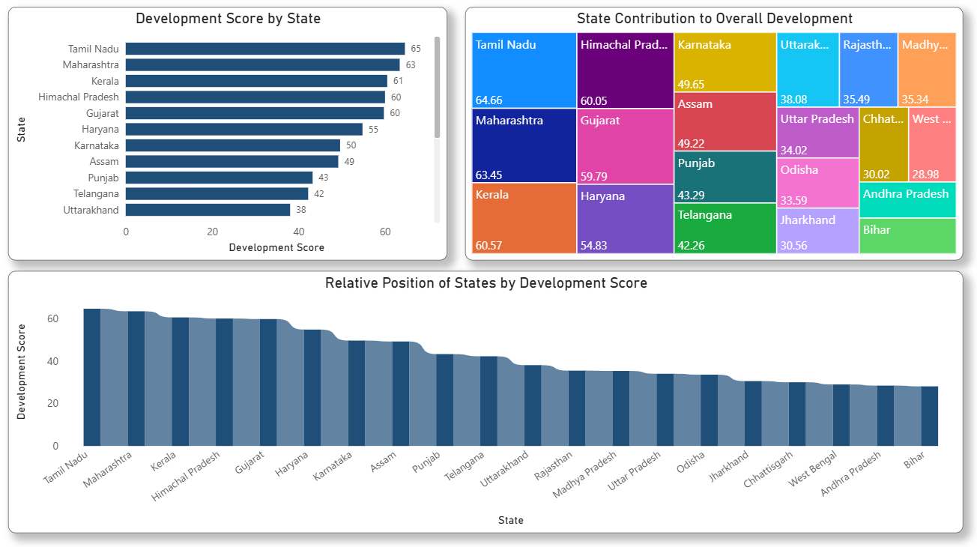
Regional Development Analysis
Regional Insights:-
• Tamil Nadu achieved the highest Development Score among the analyzed states.
• Maharashtra and Kerala also ranked among the strongest performers.
• Bihar recorded the lowest Development Score.
• Development performance varies significantly across states.
• The treemap highlights the relative contribution of states to overall development outcomes.
• The ribbon chart clearly visualizes differences in state rankings.
Top State: Tamil Nadu
Bottom State: Bihar

Slide 8
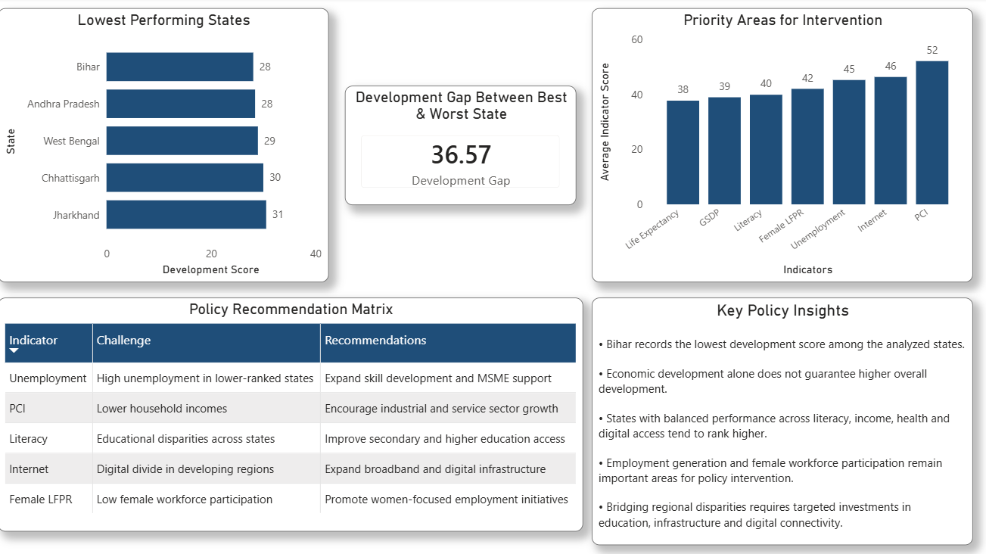
Policy Recommendations & Strategic Priorities
Policy Priorities:-
• Improve education quality and literacy outcomes.
• Strengthen healthcare infrastructure and access.
• Expand digital connectivity and internet penetration.
• Increase female labour force participation.
• Promote employment generation and skill development.
• Encourage balanced growth across economic and social indicators.
Target Outcome:-
Higher Development
Scores & Better
Quality of Life

Slide 9
Major Findings & Key Takeaways
Major Findings:-
• Tamil Nadu achieved the highest Development Score.
• Maharashtra and Kerala consistently ranked among the strongest performers.
• Bihar recorded the lowest Development Score.
• Development performance varies significantly across states.
• Higher Per Capita Income is generally associated with higher Development Scores.
Key Takeaways:-
• Development is multi-dimensional.
• Balanced performance across indicators leads to stronger outcomes.
• Economic growth alone is not sufficient.
• Social and human development indicators remain critical.
• Data-driven analysis can support better policy decisions.
Composite Development Scores provide a holistic view of state-level development.

Slide 10
Limitations of the Study
Data Availability:-
The analysis was limited to the selected indicators and available state-level data.
Weight Assumptions:-
Indicator weights were predefined and may influence final rankings.
Limited Coverage:-
Only 20 states were included in the analysis.
Static Analysis:-
The study reflects a specific time period and does not capture future changes.
Despite these limitations, the framework provides a useful comparative assessment of state-level development.

Slide 11
Conclusion
1.) This project successfully developed a Composite Development Index to compare development performance across Indian states.
2.) The analysis demonstrated that development is multi-dimensional and influenced by economic, educational, health, social, and digital factors.
3.) The Power BI dashboard provides an interactive framework for understanding development disparities and supporting evidence-based policy decisions.
Thank You
Questions & Discussion

