Slide 1
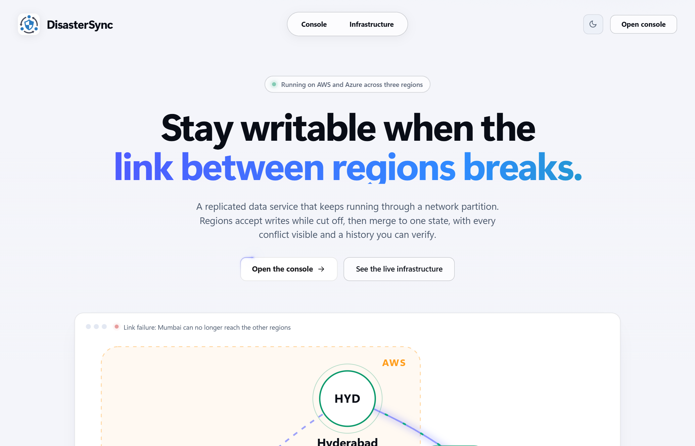
CodeAstra 2.0 · Cloud Computing and Distributed Systems
DisasterSync
Keep writing when the link between regions breaks
Geo-distributed disaster data replication with graceful degradation, running on AWS and Azure.
Live on three regions: Mumbai and Hyderabad (AWS), Singapore (Azure)
Notes:
Open with the one-line problem: a disaster cuts a region off. Our answer: it keeps working, and when the link returns nothing is lost and nothing is silently overwritten. Everything you will see today is running live on AWS Mumbai, AWS Hyderabad and Azure Singapore.

Slide 2
A broken link forces a bad choice
1
2
3
Stop writing
Overwrite silently
Drift apart
Safe, but a region cut off by a disaster cannot record anything when it matters most.
Last write wins. The older edit just disappears and nobody is told.
Regions keep different versions and there is no rule for which one is right.
42.2%
of acknowledged edits silently lost by a last-writer-wins store in our 100-trial failure test. DisasterSync lost none.
Notes:
Every replicated system has to pick one of three outcomes when a link breaks. Two of them are bad for disaster data. The number on this slide is measured: we ran a last-writer-wins baseline through the same failures as our engine, 100 randomised trials each.

Slide 3
Every requirement, running live
✓
Two or more servers, separate databases
Mumbai, Hyderabad (AWS) and Singapore (Azure), each with its own event log
✓
Simulate connection loss, servers stay up
Cut any link from the dashboard; no server is shut down
✓
Local writes during the partition
Every region keeps accepting and storing writes
✓
Replicate on reconnect
Regions pull what they are missing, in order, safely repeatable
✓
Documented conflict resolution
Deterministic rules; every conflict kept, explained and visible
✓
Status dashboard
Mode, sync age, queues, state hash, logs and recovery reports
Notes:
This maps one to one to the six items in the problem statement. We verified all six on local, on Docker, and on the real AWS and Azure deployment.

Slide 4
Three ideas make it safe
01
02
03
Write locally
Pull what is missing
Merge by rule
Each region appends changes to its own tamper-evident log. Nothing waits for the network.
Regions ask peers for the events they have not seen. Order is kept and repeats are harmless.
The same set of events always gives the same state, in any order, on any region.
Append-only, hash-chained events
Version vectors, per-origin order
Hybrid clocks plus documented rules
Wall clocks never decide which edit is newer. Causality does.
Notes:
This is the core. Local write, pull-based sync, deterministic merge. A skewed clock cannot make a stale edit win, because we use version vectors for causality and only use clocks to pick a display value between genuinely concurrent edits. We prove that with a clock-skew scenario in the benchmark.

Slide 5
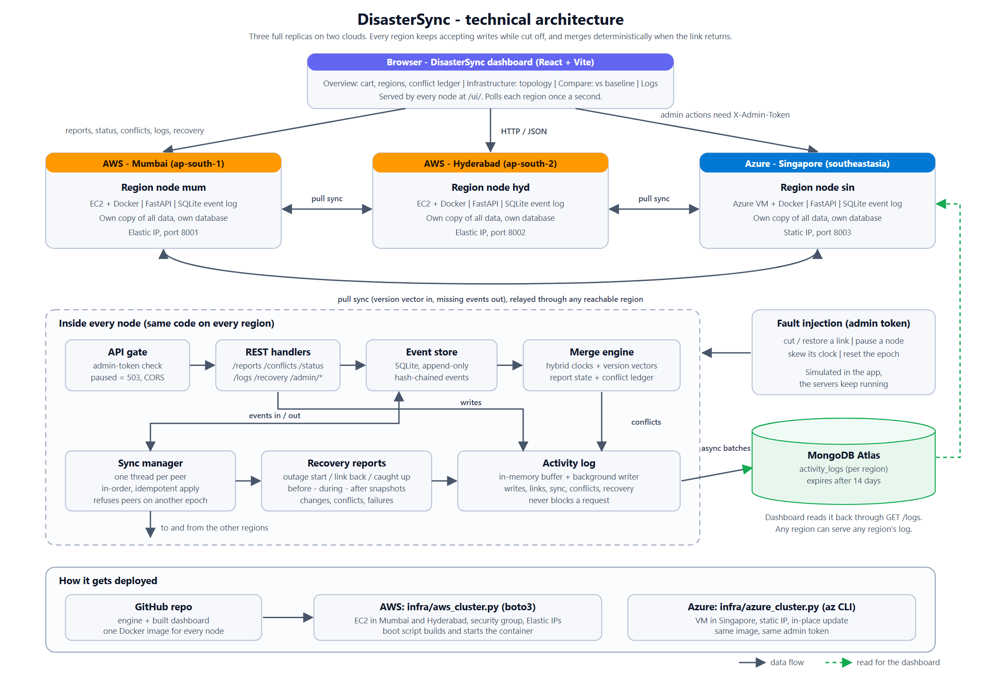
Architecture
Notes:
Browser on top, three full replicas in the middle, each with its own database. Inside every node: an API gate, the event store, the merge engine, the sync manager, recovery reports and an activity log. The activity log ships to MongoDB Atlas in the background and never blocks a request. Everything deploys from one Docker image.

Slide 6
Documented rules decide every conflict
Field | Rule | Why
Severity | Highest wins | A downgrade must be a human decision
Status | Most advanced wins | A resolved record never reopens by accident
Location | Latest wins within 500 m, else operator | Small corrections are safe, big jumps are not
Description | Both kept, operator chooses | Free text cannot be merged safely
Cart quantity | Both kept, higher quantity on Auto resolve | Never lose what a customer asked for
Every conflict stays in the ledger after it is resolved, with who decided and why.
Notes:
Each rule is written in the contract document and covered by a test. The point is not that these exact rules are universal, it is that they are explicit and deterministic, so any two regions holding the same events compute the same answer.

Slide 7
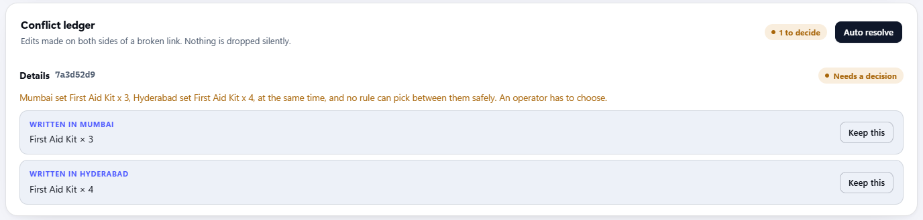
Both versions are kept and the decision is explained
Mumbai set First Aid Kit × 3 and Hyderabad set First Aid Kit × 4 at the same time. No rule can pick safely, so a person decides, or Auto resolve keeps the higher quantity.
Nothing is dropped silently.
Notes:
Live demo cue: cut Mumbai's links, press plus once on the First Aid Kit row in Mumbai, press plus twice in Hyderabad, restore. The ledger shows both versions and the engine's own sentence. Press Auto resolve and the higher quantity is kept with the reason shown.

Slide 8
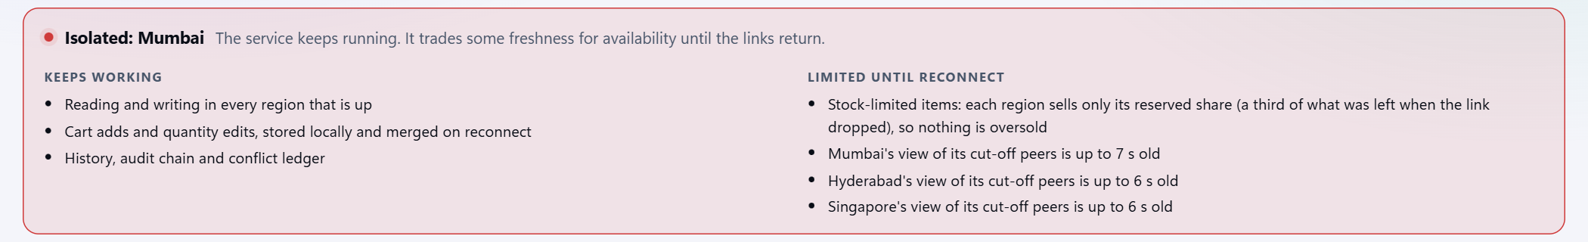
It says it is degraded, and what still works
Normal
Degraded
Isolated
Every region reaches every peer. Writes replicate within a second.
Some links are down. Everything still works and each region shows how stale its view is.
A region reaches nobody. It keeps working alone and merges when a link returns.
Notes:
Graceful degradation is not just not crashing. The system states its own level, what keeps working, and what is limited until reconnect, including how stale each region's view of its cut-off peers is. Demo cue: cut Mumbai's two links and the banner turns red.

Slide 9
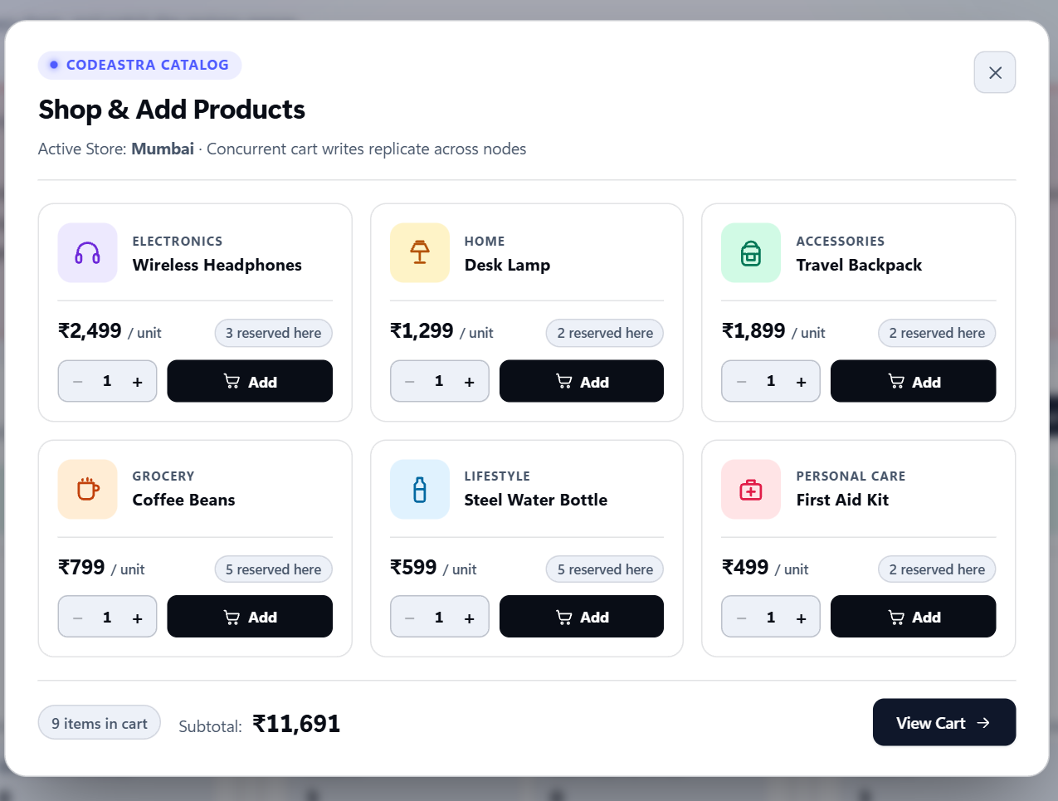
A cut-off region cannot oversell
Prevent, do not repair
When a region loses a link it may only sell its reserved share: a third of what was left when the link dropped.
The shares add up to at most the stock, so regions cannot oversell between them.
After reconnect there is nothing to fix.
Trade-off: a region may refuse a sale it could have made, until the links return.
Notes:
This is conflict avoidance, the same idea as bounded counters in the research literature. Be upfront about two things: it is enforced in the application layer, not by the database engine, and a region may turn down a sale it could have made. That is the deliberate price of never overselling.

Slide 10
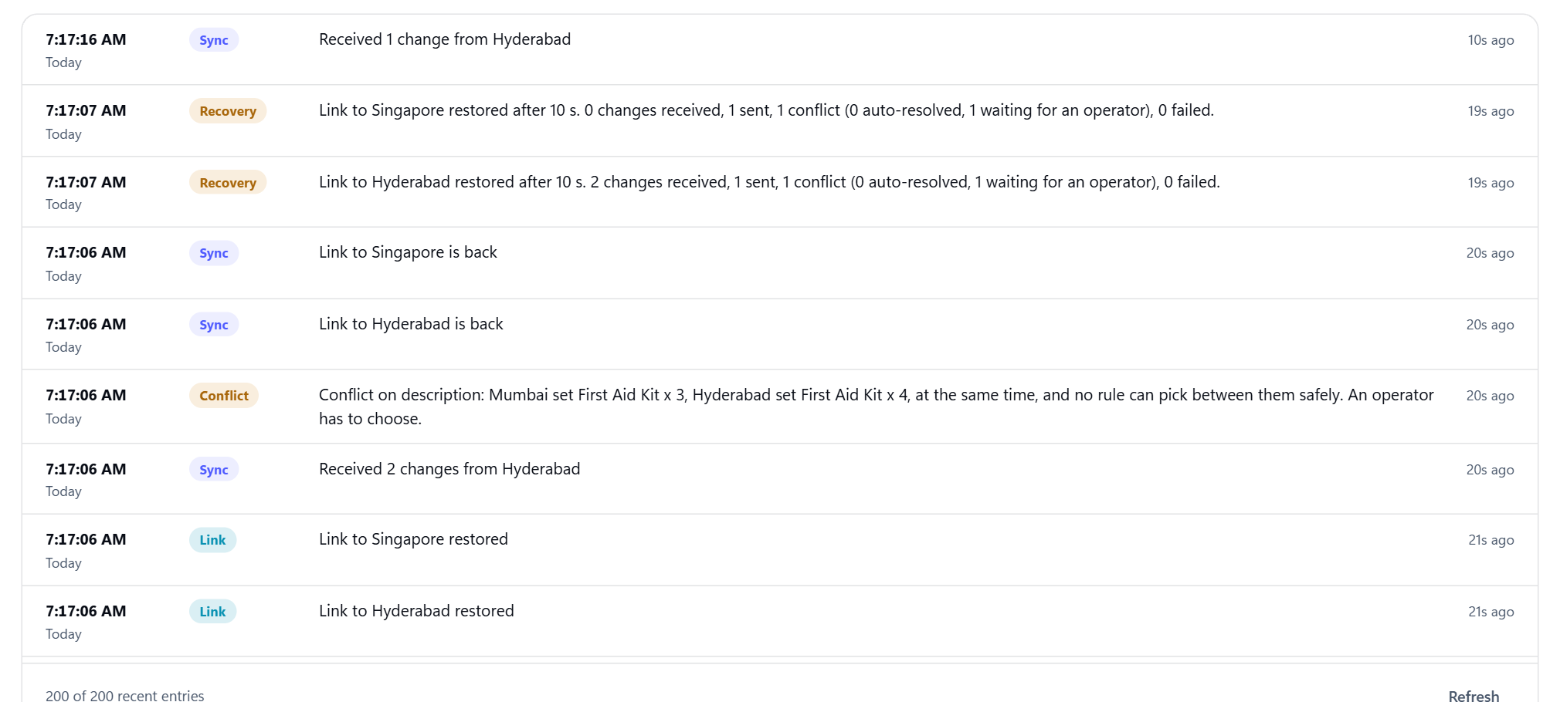
Every outage leaves a report
Each region's log is saved to MongoDB Atlas, so a crashed region's history stays readable from any other region.
Notes:
Recovery reports state what the reconnect actually did: how long the outage was, changes received and sent, conflicts found and how many were auto-resolved, and failures. Logs are written to Atlas in the background. If Atlas is unreachable the node keeps working and falls back to an in-memory log.

Slide 11
Measured over 100 randomised failures per system
Failure scenario | DisasterSync | Baseline
Partition edit | 20 of 20 | 0 of 20
Pairwise partition | 20 of 20 | 0 of 20
Flapping link | 20 of 20 | 5 of 20
Crash and recover | 20 of 20 | 4 of 20
Clock skew | 20 of 20 | 0 of 20
Same failures, same workload, local three-node clusters.
Notes:
This is the headline measurement. The baseline is a plain last-writer-wins replica set with the same API. Under identical failures it silently loses 42.2 percent of acknowledged edits. Ours loses none, and it passes every scenario in every trial.

Slide 12
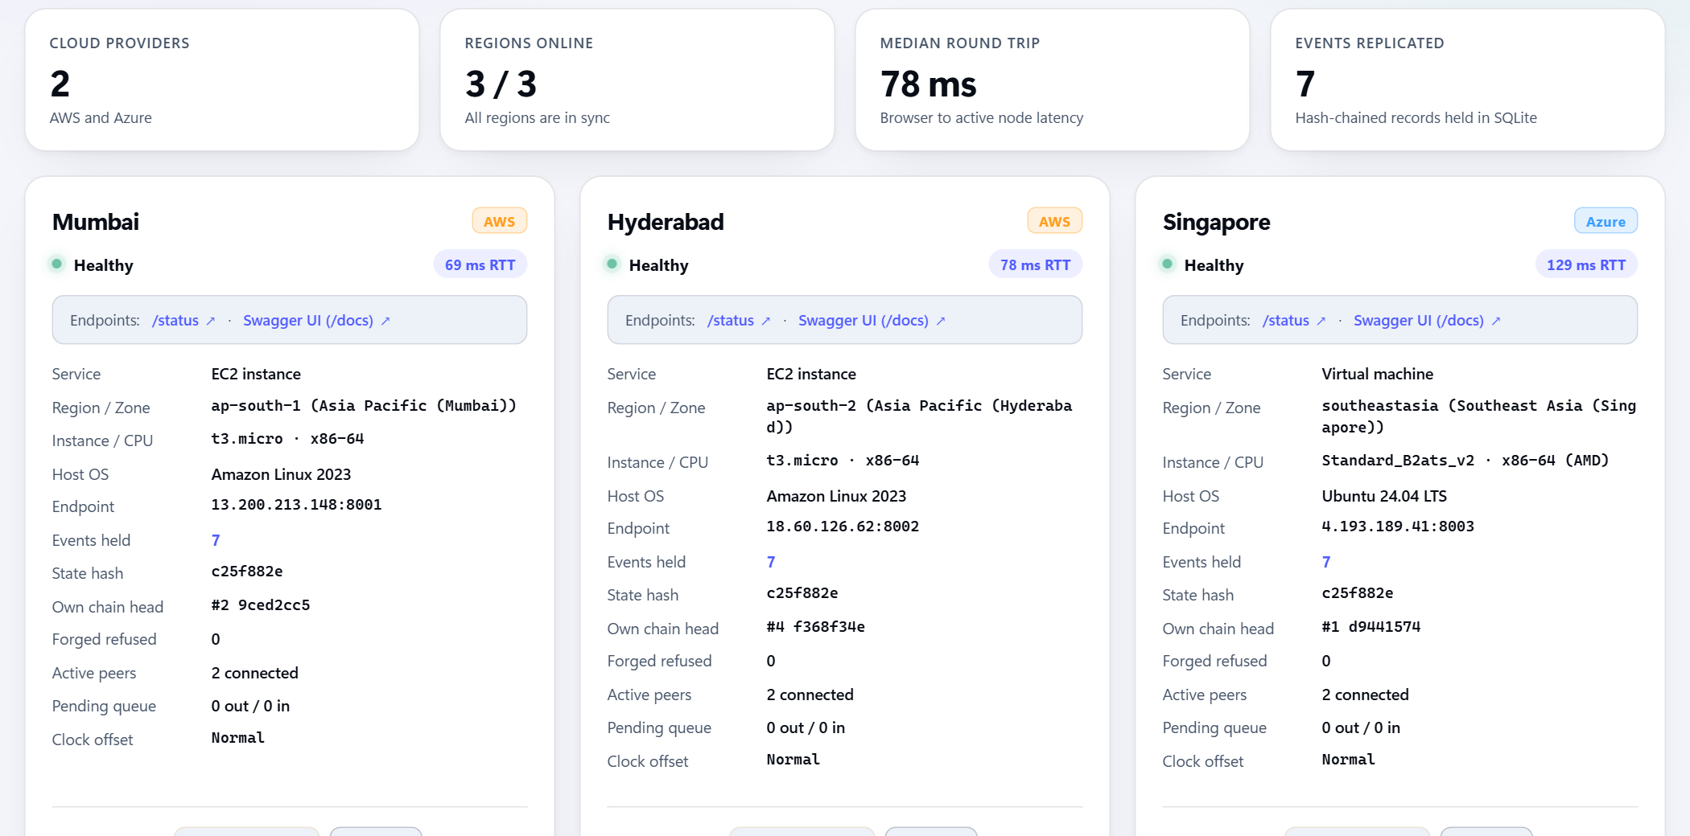
Running on two real clouds
3
regions on 2 cloud providers
87
automated engine tests passing
31
browser checks passing on AWS and Azure
Notes:
Mumbai and Hyderabad run on AWS EC2, Singapore on an Azure VM, all from the same Docker image. The browser test drives the real dashboard: it buys through the store, cuts links, makes a concurrent edit, resolves it, and checks every region's state hash.

Slide 13
What it does not do yet
Honest limits
Next
Reservations are enforced in the application layer, not the engine
Access control is a shared admin token, not per-user permissions
The partition is simulated in the app; servers stay reachable
Enforce stock reservations inside the engine
Data residency rules: keep tagged records inside a country
Time travel: scrub an outage and see each region's state
Notes:
Say the limits before a judge asks. Reservations are an application-layer rule today. Access control is a shared token. The partition is simulated in the app layer, which is exactly what lets us cut and restore links on demand without touching the network.

Slide 14
Nothing is dropped silently.
Regions keep working through a partition, merge by documented rules, and explain every decision.
github.com/Shadab7621/CodeAstra
Notes:
Close on the one-line promise. Then offer to run the live demo: cut a link, edit both sides, restore, and show the ledger.

