Slide 1

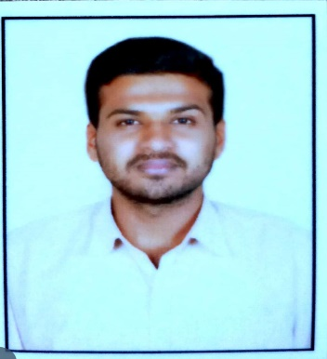


Shadakshari C U
Analyst/Software Engineer
Education and certificates Bachelor of Engineer,
Electronics and communication Engineer:2017-2021
Skills
Base Location: Bangalore
Email ID: shadakshari.c-u@capgemini.com
Mobile No: +919902882398
Grade: A4
Java | Java Basics,OOPS,Generics, Collections, Array, Loops
React | Components, Hooks, Virtual DOM, Routing, Forms & Validation
Database | MongoDB, Oracal SQL Server
UI Tech | HTML 5 & CSS 3,JavaScript
Tools | Git, PostMan, Swagger, Eclipse, Visual Studio Code
Strengths
Full Stack Developer
Hands on experience on core Java, SpringBoot Framework.
Proficient in creating Single page Web Application in React with Authentication with routing
Hands on experience in developing web pages using HTML5, CSS, ReactJs, Good understanding of Document Object Model (DOM) and DOM Functions
Ready to learn new technologies and implement them for the Future Knowledge improvement.
Achievement
Asset Management System
Case study of Online Asset Management System along with API , Swagger, responsive UI with HTML5, CSS, Bootstrap and React used as User Interface.
Degreed : Successfully completed the degreed training in git, mongoDB.
Presentation Title | Author | Date © Capgemini 2017. All rights reserved | 1

