Slide 1


Problem Statement:
Exoplanet Detection
............ Venturing the Cosmos ............
Team Members:
Shadan Ahmad
Project Domain: Machine Learning

Slide 2



Exoplanet Detection
02
Idea
ABSTRACT
TECHNOLOGY USED
This project presents AI-ML model to automate the process of exoplanets detection, evaluating different features, while encompassing methodologies like exoplanet characterization and AI-driven observational strategies, in order to avoid intensive man labour, and human error, with max accuracy and precision.
Python
SKLearn
Pandas
Numpy
TensorFlow
GoogleColab

Slide 3



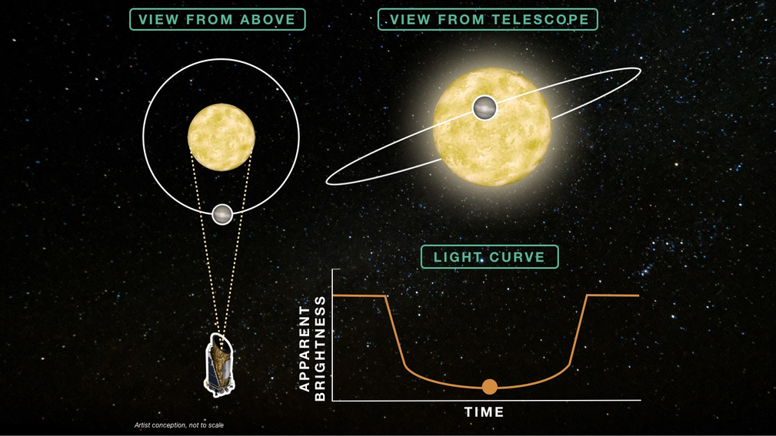
Exoplanet Detection
03
Approach
USE CASES
Targeted search for specific planets/ stars, for eg. gas giant or rocky planets, red giant stars, etc.
Automating data analysis tasks, such as data cleaning, feature extraction, and initial filtering.
Filtering out false positives caused by stellar variability, instrumental effects, or other astrophysical phenomena.
Identifying patterns and anomalies, improving sensitivy and accuracy.

Slide 4
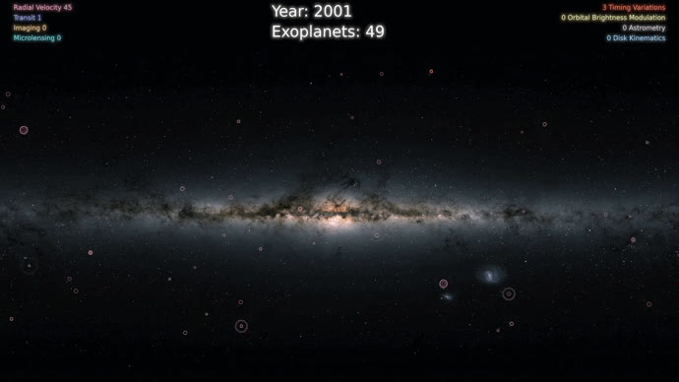
Exoplanet Detection
04
Approach
IDEOLOGY
Methods for exoplanet detection:
Transit Method (using Box Least Squares Analysis)
Radial Velocity
Filtering out false positives caused by stellar variability, instrumental effects, or other astrophysical phenomena, using Background flux, or LATTE (Lightkurve AnalysisTool for Transiting Exoplanet).

Slide 5



Exoplanet Detection
05
Solution
TRANSIT METHOD:
Monitored the flux, which represents the light intensity emitted by a star, and observed for periodic dips in flux as an exoplanet passes in front of its host star, causing a temporary decrease in the observed light.
Dataset Description:
The data describe the change in flux (light intensity) of several thousand stars. Each star has a binary label of 2 or 1. 2 indicated that that the star is confirmed to have at least one exoplanet in orbit; some observations are in fact multi-planet systems.
Dataset:
5087 rows or observations.
37 confirmed exoplanet-stars and 5050 non-exoplanet-stars.
To remove the high imbalance in dataset we used SMOTE

Slide 6
Exoplanet Detection
06
Results
Machine Learning Models:
Traditional machine learning models did not perform as well as the model that we build using Fully Connected Neural Network in the exoplanet detection task. These models may have struggled to capture the complex relationships and patterns present in the dataset, resulting in low performance compared to our Fully Connected Neural Network. However, they still provide valuable insights and serve as benchmarks for performance evaluation.
As the data were highly imbalance using SMOTE helped in achieving good results.
KNN performed better than Decision Tree as knn captured similarities between data points, since knn relies on distance matrix, whereas Decision Tree may have been prone to overfitting.

Slide 7

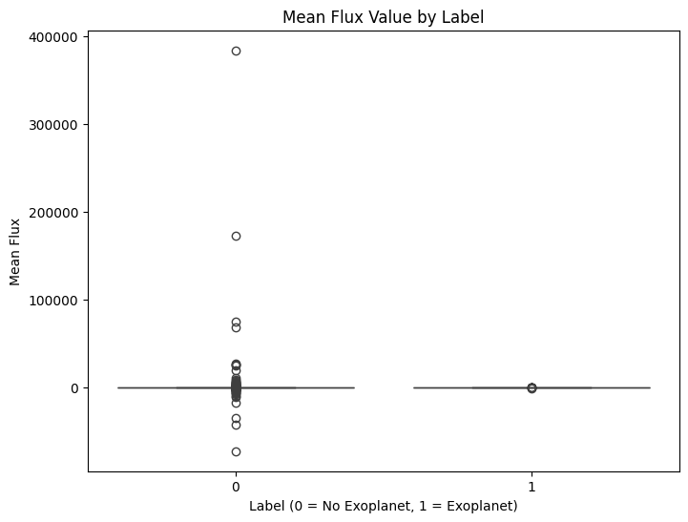

Exoplanet Detection
07
Data Preprocessing & Flux Visualization

Slide 8

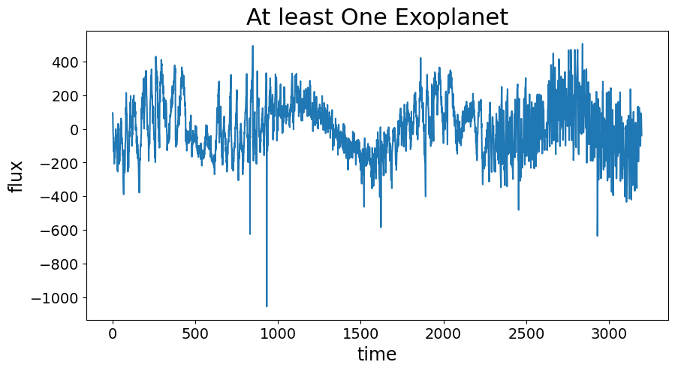

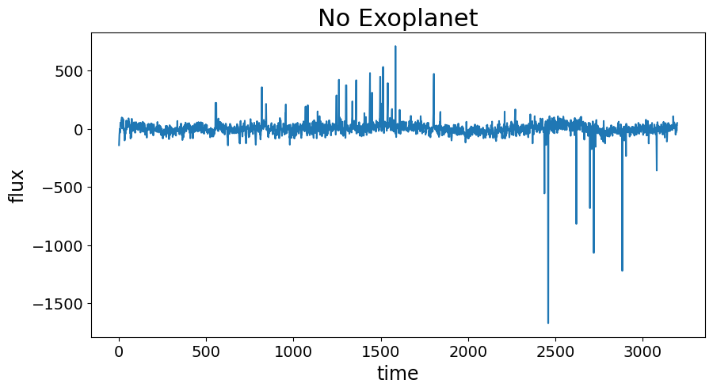
Exoplanet Detection
08

Slide 9
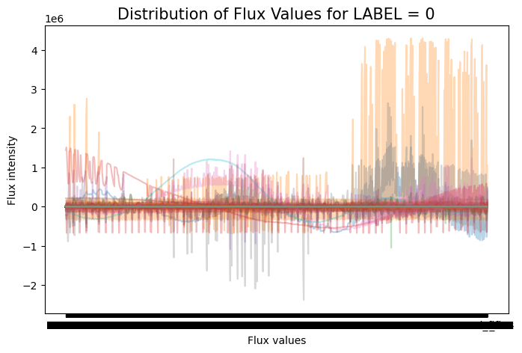
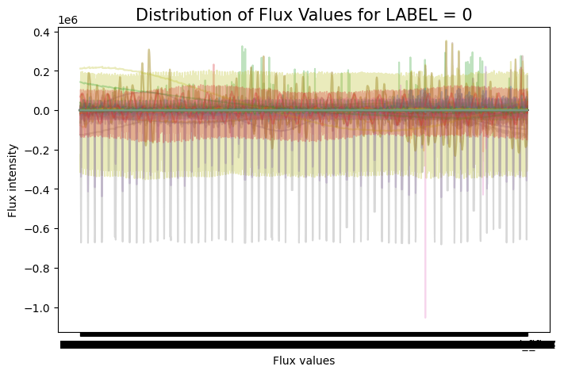
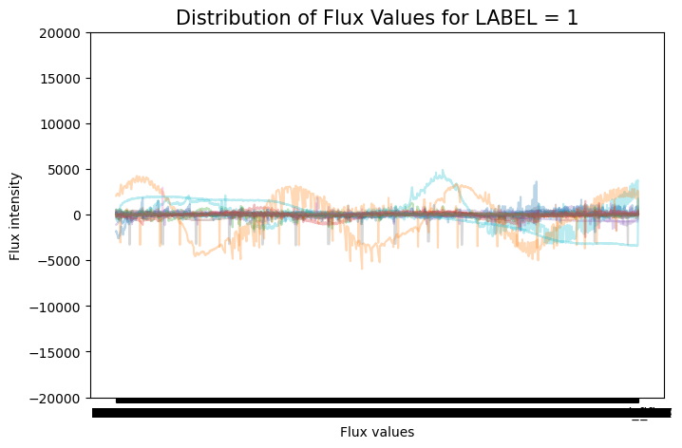
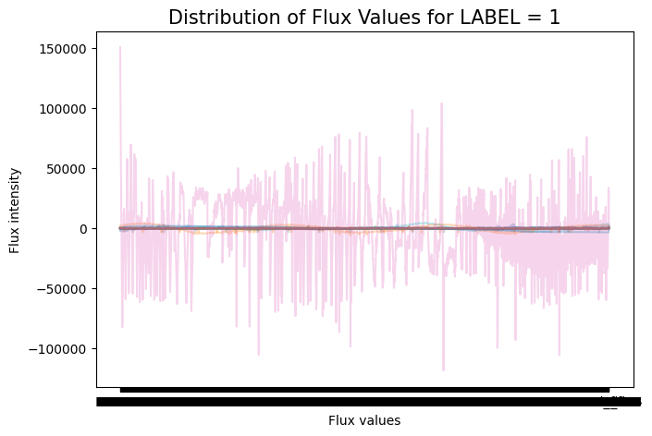
09
Exoplanet Detection
Plot between different flux values and its intensity before removing outliers
Plot between different flux values and its intensity before removing outliers

Slide 10
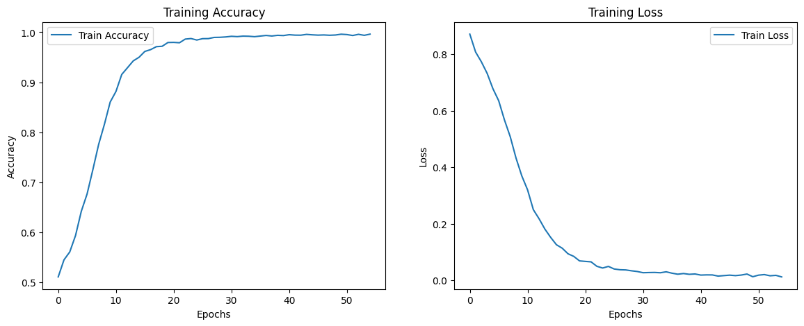
Exoplanet Detection
10
Training Accuracy vs Training Loss:

Slide 11
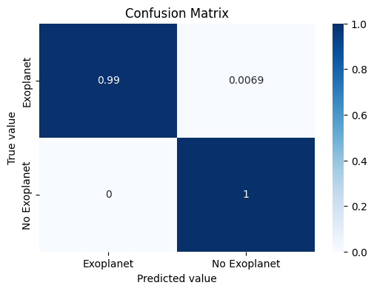
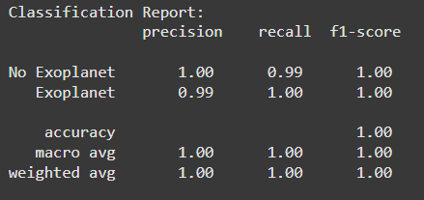
Exoplanet Detection
11
Confusion Matrix and Classification Report:

Slide 12


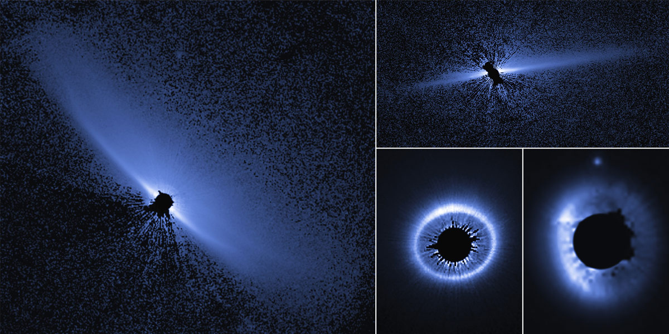

Exoplanet Detection
12
Applications
Identifying faint and small exoplanets with high precision.
Enhanced data analysis and prioritization, for researchers to focus on promising candidates for further studies.
Expanding the model to detect other space objects and classify.
Optimizing real-time telescope analysis.

Slide 13
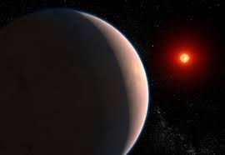
Exoplanet Detection
13
Dependencies/Show stoppers
Scarcity of data, i.e. limited to no data availibility for specific or in general all exoplanets.
Incomplete and Noisy data with complex structure.
Efficient and reliable data processing and interpreting model while maintaining accuracy is crucial for successful exoplanet detection.
Algorithmic Biasness and Black box problem in decision making using deep learning methods, i.e the lack of transparency can create a significant challenge for decision-making, as the process that led to a particular outcome is not clear, and there is a risk of bias or errors.

Slide 14

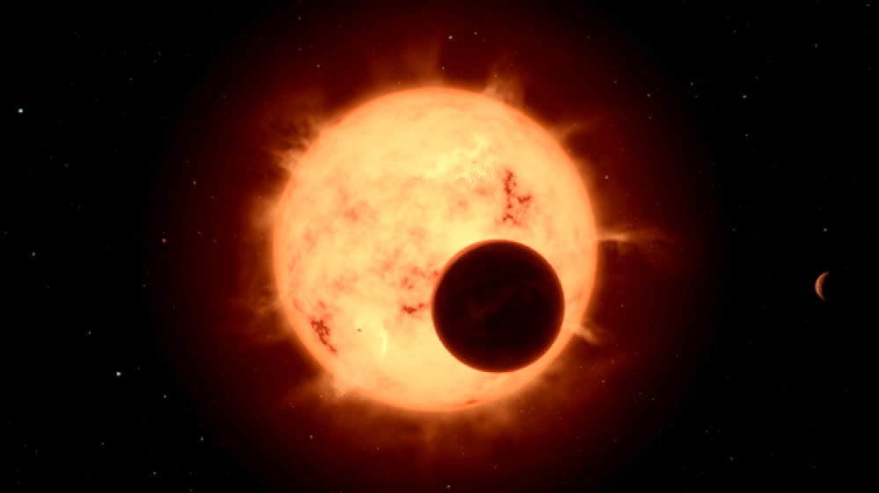
EXOPLANET DETECTION
14
Future Scope
Deployment on website or application.
Characterizing exoplanets using image recognition.
Implementing ExoSolar Planet Model for other features.(for eg human life support system,, etc.)
Checking for Habitable ExoSolar planets.
Other Space object Detection and Classification (eg. Asteroids, stars, galaxies, their ages etc.)

Slide 15



13
Exoplanet Detection
THANK
YOU !.
Discovering life,
beyond our eyes,
and our reach ..!

