Slide 1
Social Media Network Analysis

Slide 2
About the two news agencies
USA Today
USA Today is an American daily newspaper founded on September 15, 1982
At 1.8 million copies as of March 2012, it remains the most widely circulated print newspaper in the world
USA Today’s twitter account has around 730,285 subscribers
LA Times
The Los Angeles Times was first published on December 4, 1881
The Times is the largest metropolitan newspaper in the country
The LA Times twitter account has around 625,550 subscribers

Slide 3
Overall Steps followed in the project
Data Collection
Collected tweets of USA Today and LA Times
Stored the tweets in flat file format
Data cleansing and storage
Cleansed the data using custom Java Program and loaded the tweets in MySQL databse
Non- Network and Network analysis
Performed non- network as well as network analysis
Used Gephi and other visualization tools
Results and Recommendations
Compare the two news agencies and make recommendations

Slide 4
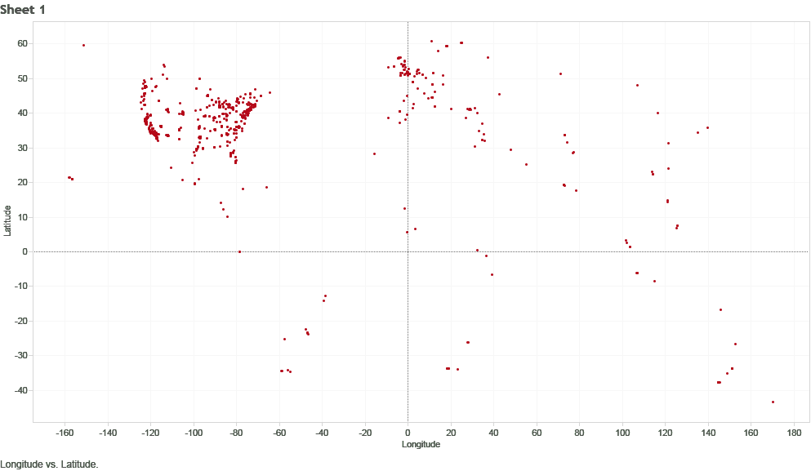
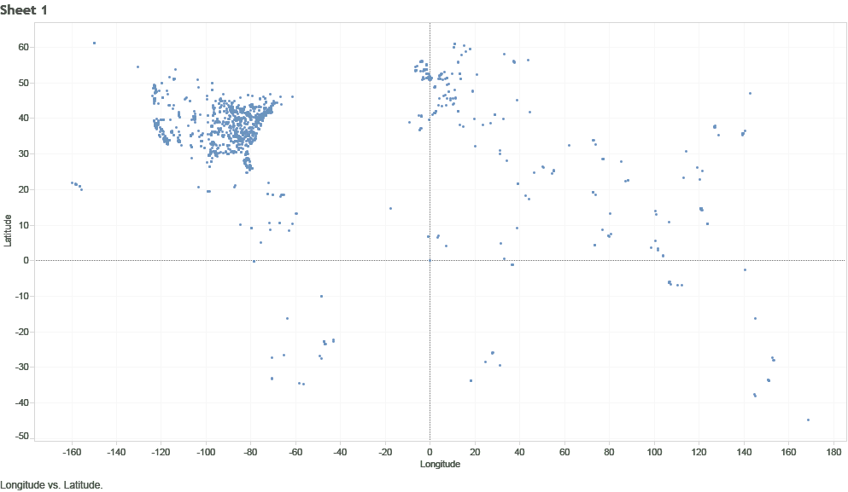
Comparative Analysis
Geographic spread of Users
LA Times USA Today

Slide 5
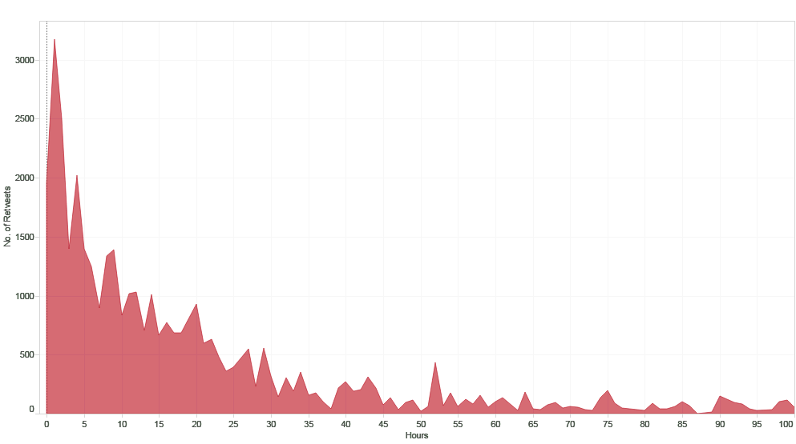
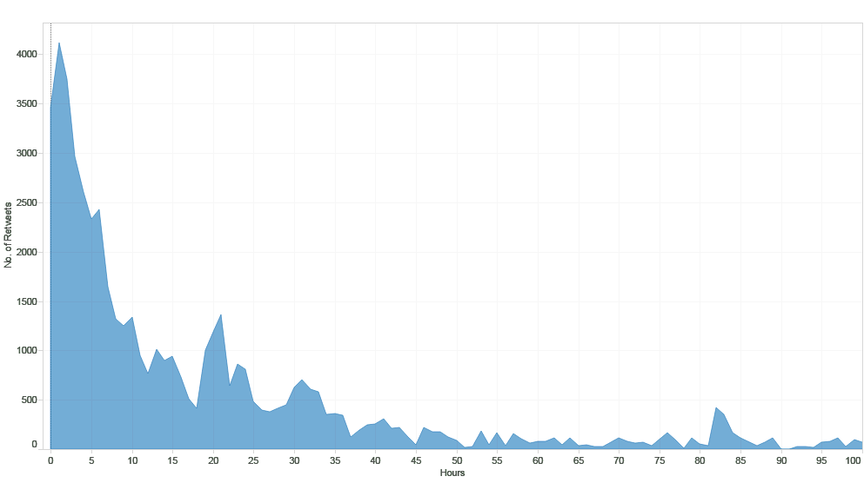
Lifetime Analysis
LA Times USA Today

Slide 6
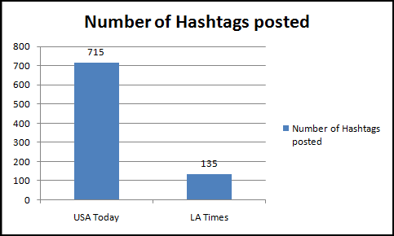
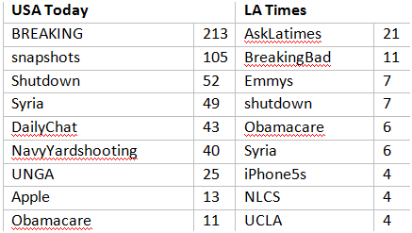
Hastag usage

Slide 7
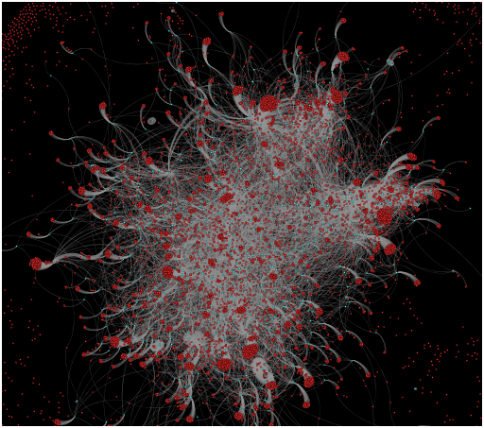

User- Hashtag Analysis
LA Times USA Today
Nodes: 14333 Nodes: 20002
Edges: 18125 Edges: 20593
Modularity: 0.744 Modularity: 0.853
Number of WCC: 2930 Number of WCC: 4647

Slide 8
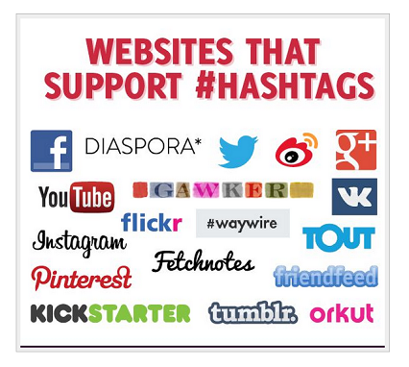
“###” Not just for Twitter anymore

Slide 9
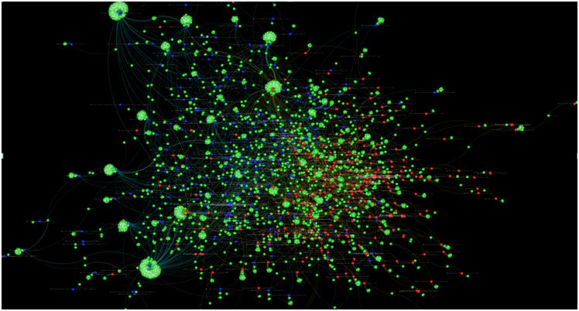
Comparative analysis based on specific news: Syria
The blue dots represent USA Today news articles and red ones LA Times. Green dots are users who re-tweet these articles.

Slide 10
Conclusion
LA Times has less influence on the east coast as compared to USA Today. LA Times should focus on increasing its outreach
Even on topics of national and international relevance like Obama Care and Syria, LA Times lags behind USA Today in audience
LA Times can increase its Twitter popularity by using more hashtags
Based on Hashtags- LA Times covers more local topics like USC, CA etc as compared to USA Today which cover global topics

Slide 11
THANK YOU

