Slide 1

Centralized Server Management with

Slide 2
Use Cases
Manage services: start/stop/check status of all windows and linux apps from same centralized tool.
LB control: Add/remove servers from the load balancer using a unique tool for windows and linux apps.
Manage and deploy cloud services and on premise hosted apps using the same tool.
https://docs.ansible.com/ansible/guide_azure.html
Perform playbook runs / maintenance / troubleshooting tasks from web UI (just pushing a button) or by scheduling these activities.
Run remote command without the need of logging into the actual server.
View and track the results of the activities above and also create dashboards and graphs that show the status of the servers by running application audits.
And everything can be done by defining a roled-based access control strategy (Prod streams would even have access to view production status and App Support Teams perform change or delegate)
Configuration Management across platforms and environments (cloud/on-premise and lower/DR/Prod)

Slide 3
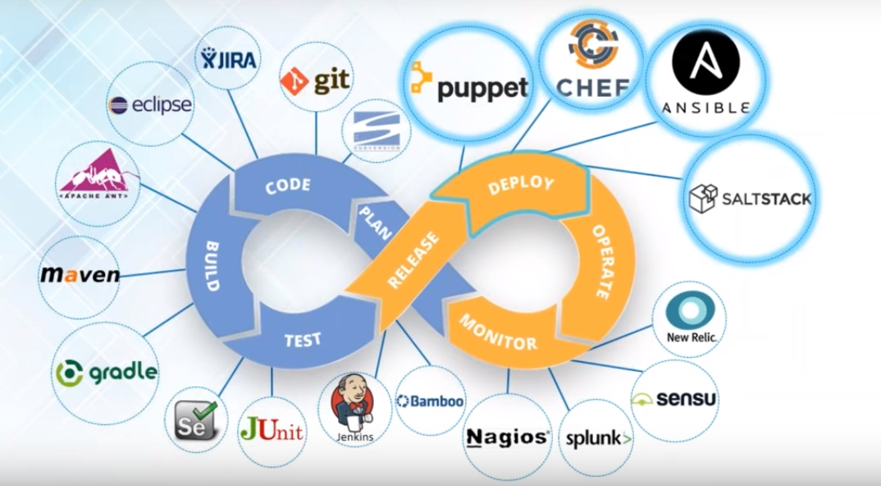
DevOps LifeCycle

Slide 4
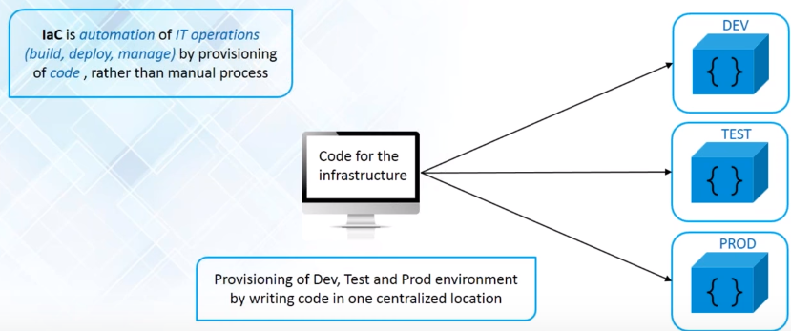
Infrastructure as Code (IaC)

Slide 5
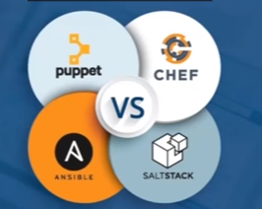
Tools Comparison

Slide 6


Puppet + Chef + SaltStack + Ansible
 | Puppet | Chef | SaltStack | Ansible
Scalability | Highly Scalable | Highly Scalable | Highly Scalable | Highly Scalable
Ease of Setup | Puppet Master Puppet Clients on each client as agents | Chef Server Chef clients as agents on each client | Master Server Minions as agents on each server | Only Master on server machine (ssh)
Availability | Multi-master architecture (active - passive) | Chef server and backup server that becomes primary server in case of failure (Active-Passive) | Multiple masters (active - active) | Primary and Secondary Instance (active-passive)
Management | Own language: Puppet DSL Pull based | Ruby Pull based | Python Push based | Python Push based
Interoperability | Master only Linux/Unix Agents Windows and Linux/Unix | Chef Server on Linux/Unix Chef Clients and Workstation on Windows and Linux/Unix | Salt Master on Linux/ Unix Salt minions on Windows and Linux /Unix | Ansible server on Linux/Unix Supports Windows and Linux/Unix

Slide 7
Configuration Language
 | Puppet: Puppet DSL | Chef: Ruby DSL | SaltStack: YAML (Python) | Ansible: YAML (Pyhon)
Learning curve | Not easy to learn Admin oriented | Developer oriented | Easy to learn Admin oriented Python inbuilt into Linux/Unix | Easy to learn Admin oriented Python inbuilt into Linux/Unix
GitHub Activity | Contributors: 355 Commits: 19,595 Branches: 9 Release: 291 | Contributors: 369 Commits: 12,089 Branches: 177 Release: 231 | Contributors: 1,041 Commits: 49,193 Branches: 11 Release: 82 | Contributors: 1,003 Commits: 13,527 Branches: 33 Release: 57
Enterprise Cost | Puppet Enterprise: $12,000 | Chef Enterprise: $7,200 | SaltStack Enterprise: $15,000 | Ansible Tower Enterprise: $10,000 - $14,000

Slide 8
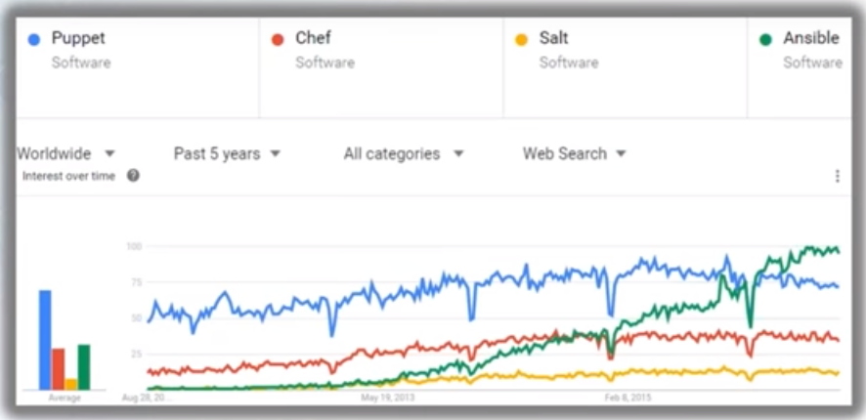
Popularity

Slide 9
Why now?
Manage and run the same playbook against a physical machine, a VM or container
Docker container plugin, don’t run ssh inside a container
Shell scripts aren’t good enough
A Dockerfile is not much more than a script with hand-crafted shell commands
Ansible playbooks are designed to be reusable across many different environments
Ansible can be a great bridge to larger-scale container orchestration
Allows users to describe, in ambiguous terms, the differences between environments
One command to deploy or run playbook directly to specific environments

Slide 10
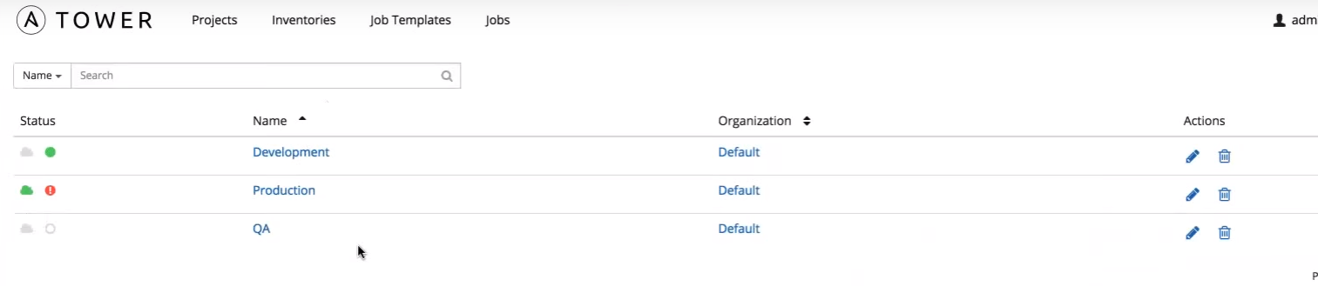
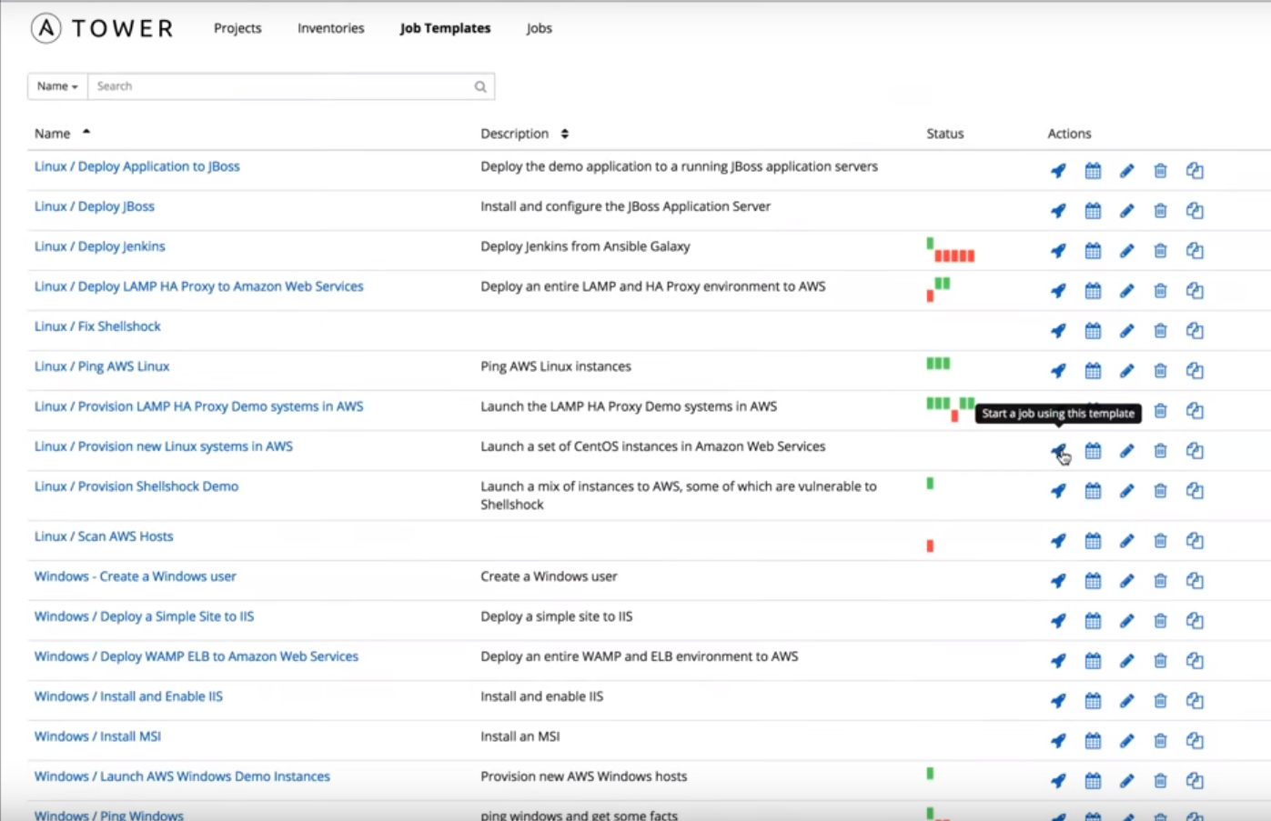
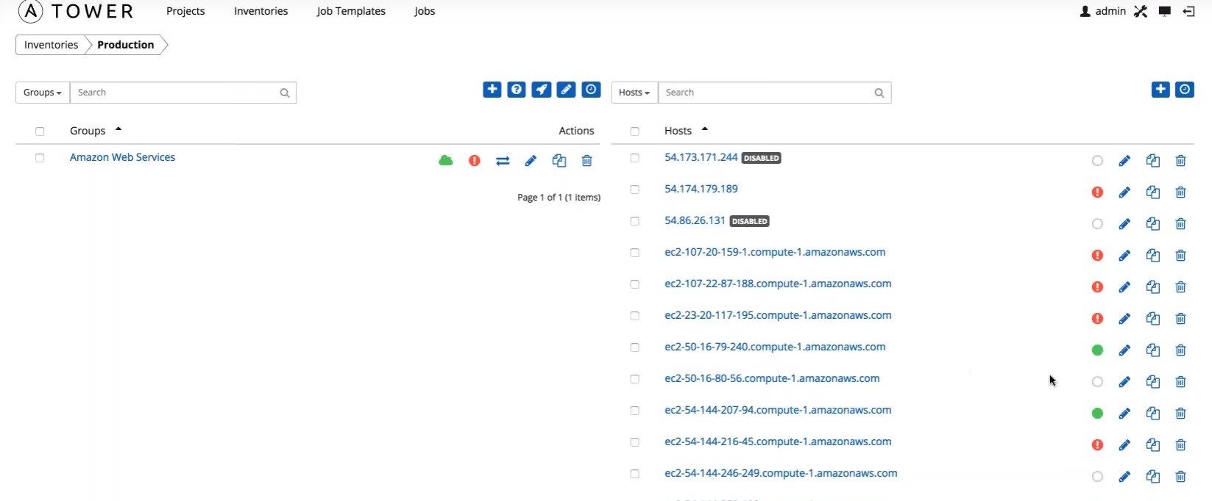
https://www.youtube.com/watch?v=SsiZPAYTaO4

Slide 11
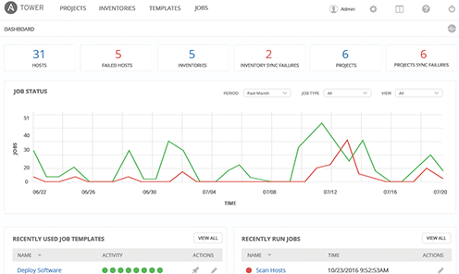
Demo

