Slide 1
AUTOMATION FOR EVERYONE

Slide 2
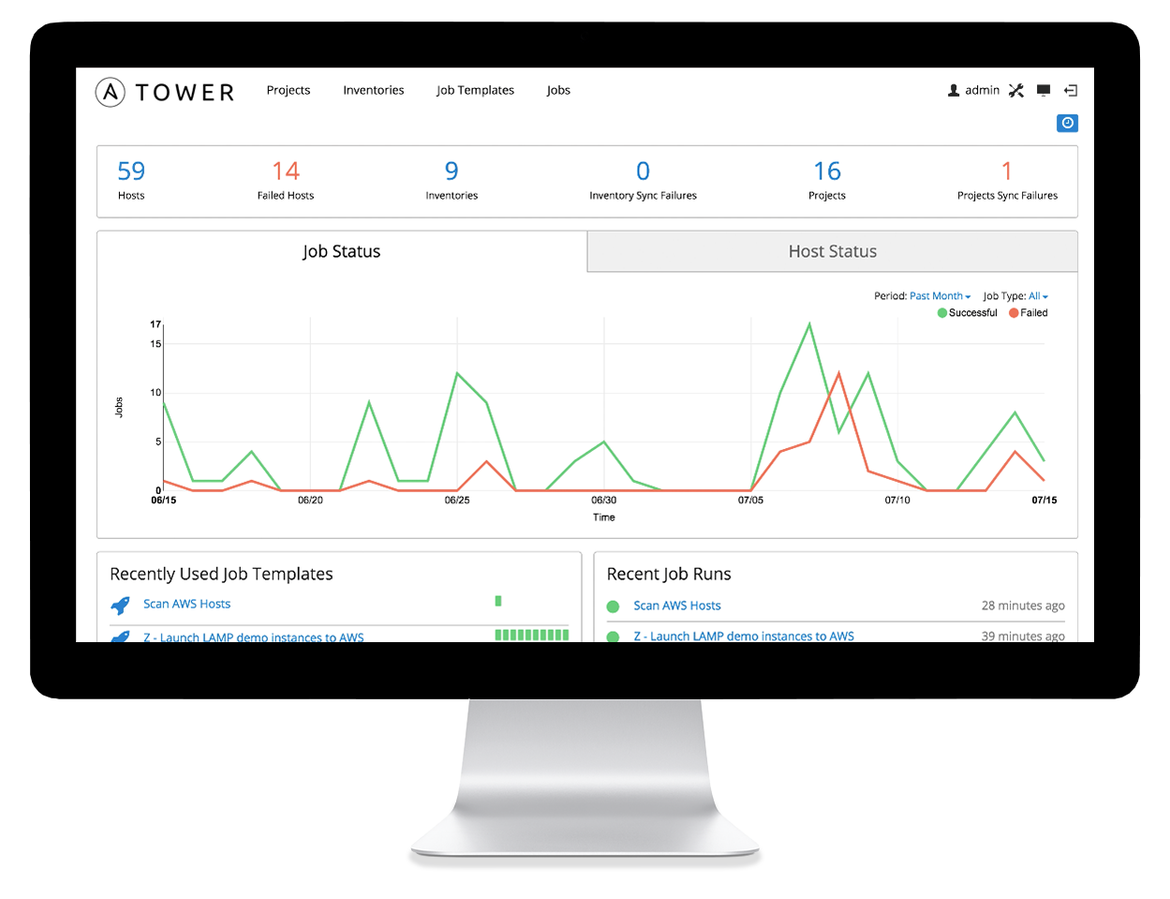
WHAT IS ANSIBLE?
It’s a simple automation language that can perfectly describe an IT application infrastructure in Ansible Playbooks. It’s an automation engine that runs Ansible Playbooks.
Ansible Tower is an enterprise framework for controlling, securing and managing your Ansible automation with a UI and restful API.
Confidential
<number>

Slide 3
SIMPLE
POWERFUL
AGENTLESS
Human readable automation
No special coding skills needed
Tasks executed in order
Get productive quickly
App deployment
Configuration management
Workflow orchestration
Orchestrate the app lifecycle
Agentless architecture
Uses OpenSSH & WinRM
No agents to exploit or update
More efficient & more secure
Confidential
<number>

Slide 4
HOW ANSIBLE WORKS
CMDB
PUBLIC / PRIVATE CLOUD
ANSIBLE’S AUTOMATION ENGINE
USERS
INVENTORY
API
HOSTS
MODULES
PLUGINS
NETWORKING
ANSIBLE PLAYBOOK
Confidential
<number>

Slide 5
HOW ANSIBLE WORKS
CMDB
PUBLIC / PRIVATE CLOUD
ANSIBLE’S AUTOMATION ENGINE
PLAYBOOKS ARE WRITTEN IN YAML
Tasks are executed sequentially Invokes Ansible modules
USERS
INVENTORY
API
HOSTS
MODULES
PLUGINS
NETWORKING
ANSIBLE PLAYBOOK
Confidential
<number>

Slide 6
HOW ANSIBLE WORKS
CMDB
PUBLIC / PRIVATE CLOUD
ANSIBLE’S AUTOMATION ENGINE
MODULES ARE “TOOLS IN THE TOOLKIT”
Python, Powershell, or any language Extend Ansible simplicity to entire stack
USERS
INVENTORY
API
HOSTS
MODULES
PLUGINS
NETWORKING
ANSIBLE PLAYBOOK
Confidential
<number>

Slide 7
HOW ANSIBLE WORKS
CMDB
[web] webserver1.example.com webserver2.example.com
[db] dbserver1.example.com
PUBLIC / PRIVATE CLOUD
ANSIBLE’S AUTOMATION ENGINE
USERS
INVENTORY
API
HOSTS
MODULES
PLUGINS
NETWORKING
ANSIBLE PLAYBOOK
Confidential
<number>

Slide 8
HOW ANSIBLE WORKS
CMDB
PUBLIC / PRIVATE CLOUD
CLOUD:
ANSIBLE’S AUTOMATION ENGINE
OpenStack, VMware, EC2, Rackspace, GCE,
Azure, Spacewalk, Hanlon, Cobbler
USERS
CUSTOM CMDB
INVENTORY
API
HOSTS
MODULES
PLUGINS
NETWORKING
ANSIBLE PLAYBOOK
Confidential
<number>

Slide 9
PLAYBOOK EXAMPLE
---
- name: install and start apache
hosts: all
vars:
http_port: 80
max_clients: 200
remote_user: root
tasks:
- name: install httpd
yum: pkg=httpd state=latest
- name: write the apache config file
template: src=/srv/httpd.j2 dest=/etc/httpd.conf
- name: start httpd
service: name=httpd state=running
Confidential
<number>

Slide 10
PLAYBOOK EXAMPLE
---
- name: install and start apache
hosts: all
vars:
http_port: 80
max_clients: 200
remote_user: root
tasks:
- name: install httpd
yum: pkg=httpd state=latest
- name: write the apache config file
template: src=/srv/httpd.j2 dest=/etc/httpd.conf
- name: start httpd
service: name=httpd state=running
Confidential
<number>
Notes:
The name fields are human-readable comments. Optional, but useful as comments to the playbook. These strings also show up in Tower, so it is easy to correlate any failures in a long running playbook.
<number>

Slide 11
PLAYBOOK EXAMPLE
---
- name: install and start apache
hosts: all
vars:
http_port: 80
max_clients: 200
remote_user: root
tasks:
- name: install httpd
yum: pkg=httpd state=latest
- name: write the apache config file
template: src=/srv/httpd.j2 dest=/etc/httpd.conf
- name: start httpd
service: name=httpd state=running
Confidential
<number>
Notes:
Inventory call-out
<number>

Slide 12
PLAYBOOK EXAMPLE
---
- name: install and start apache
hosts: all
vars:
http_port: 80
max_clients: 200
remote_user: root
tasks:
- name: install httpd
yum: pkg=httpd state=latest
- name: write the apache config file
template: src=/srv/httpd.j2 dest=/etc/httpd.conf
- name: start httpd
service: name=httpd state=running
Confidential
<number>
Notes:
Variables can be handled in several different ways:
Directly in the playbook
As part of a separate vars file
Via the command line
As output from a previous play
Via Tower
<number>

Slide 13
PLAYBOOK EXAMPLE
---
- name: install and start apache
hosts: all
vars:
http_port: 80
max_clients: 200
remote_user: root
tasks:
- name: install httpd
yum: pkg=httpd state=latest
- name: write the apache config file
template: src=/srv/httpd.j2 dest=/etc/httpd.conf
- name: start httpd
service: name=httpd state=running
Confidential
<number>
Notes:
You are not required to use root as the remote user. You can have Ansible connect and run the playbook as any user or even multiple users – as long as that user has the permission to perform the tasks in the playbook. You can even use multiple users and specify different users for different plays or tasks.
Ansible supports sudo, su, powerbroker, and other privilege escalation mechanisms.
<number>

Slide 14
PLAYBOOK EXAMPLE
---
- name: install and start apache
hosts: all
vars:
http_port: 80
max_clients: 200
remote_user: root
tasks:
- name: install httpd
yum: pkg=httpd state=latest
- name: write the apache config file
template: src=/srv/httpd.j2 dest=/etc/httpd.conf
- name: start httpd
service: name=httpd state=running
Confidential
<number>
Notes:
The real work. General format:
<<module>>: key=value
<number>

Slide 15
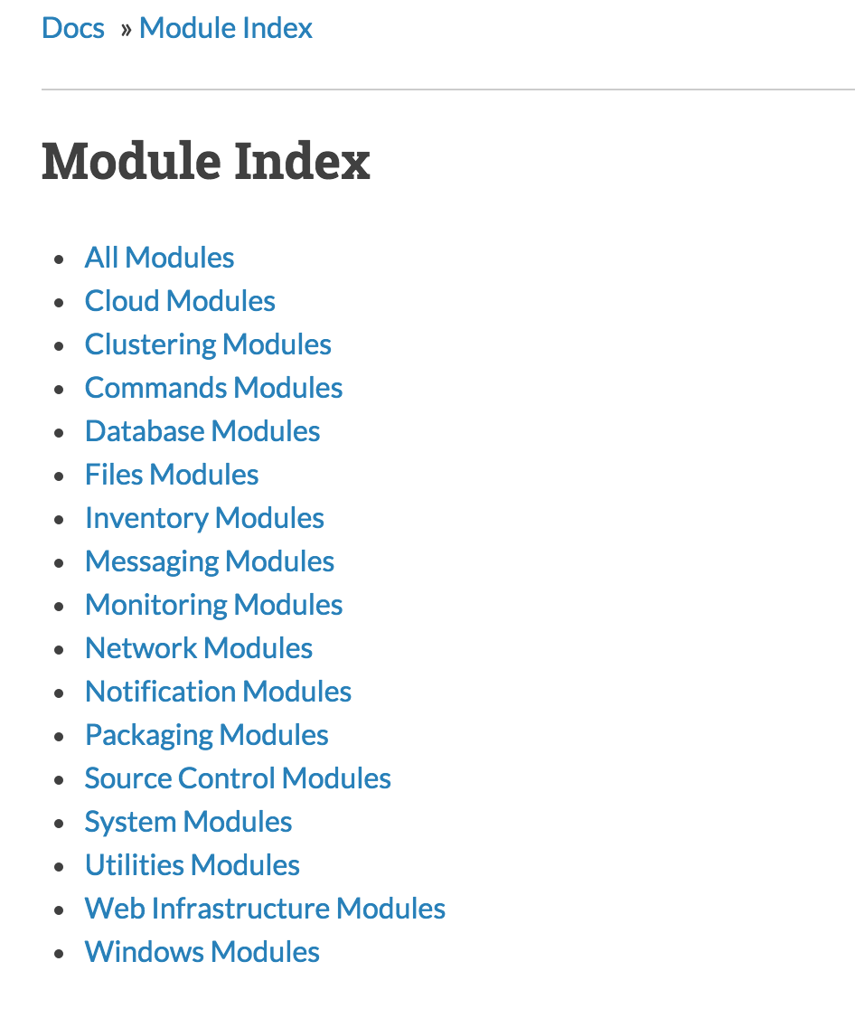
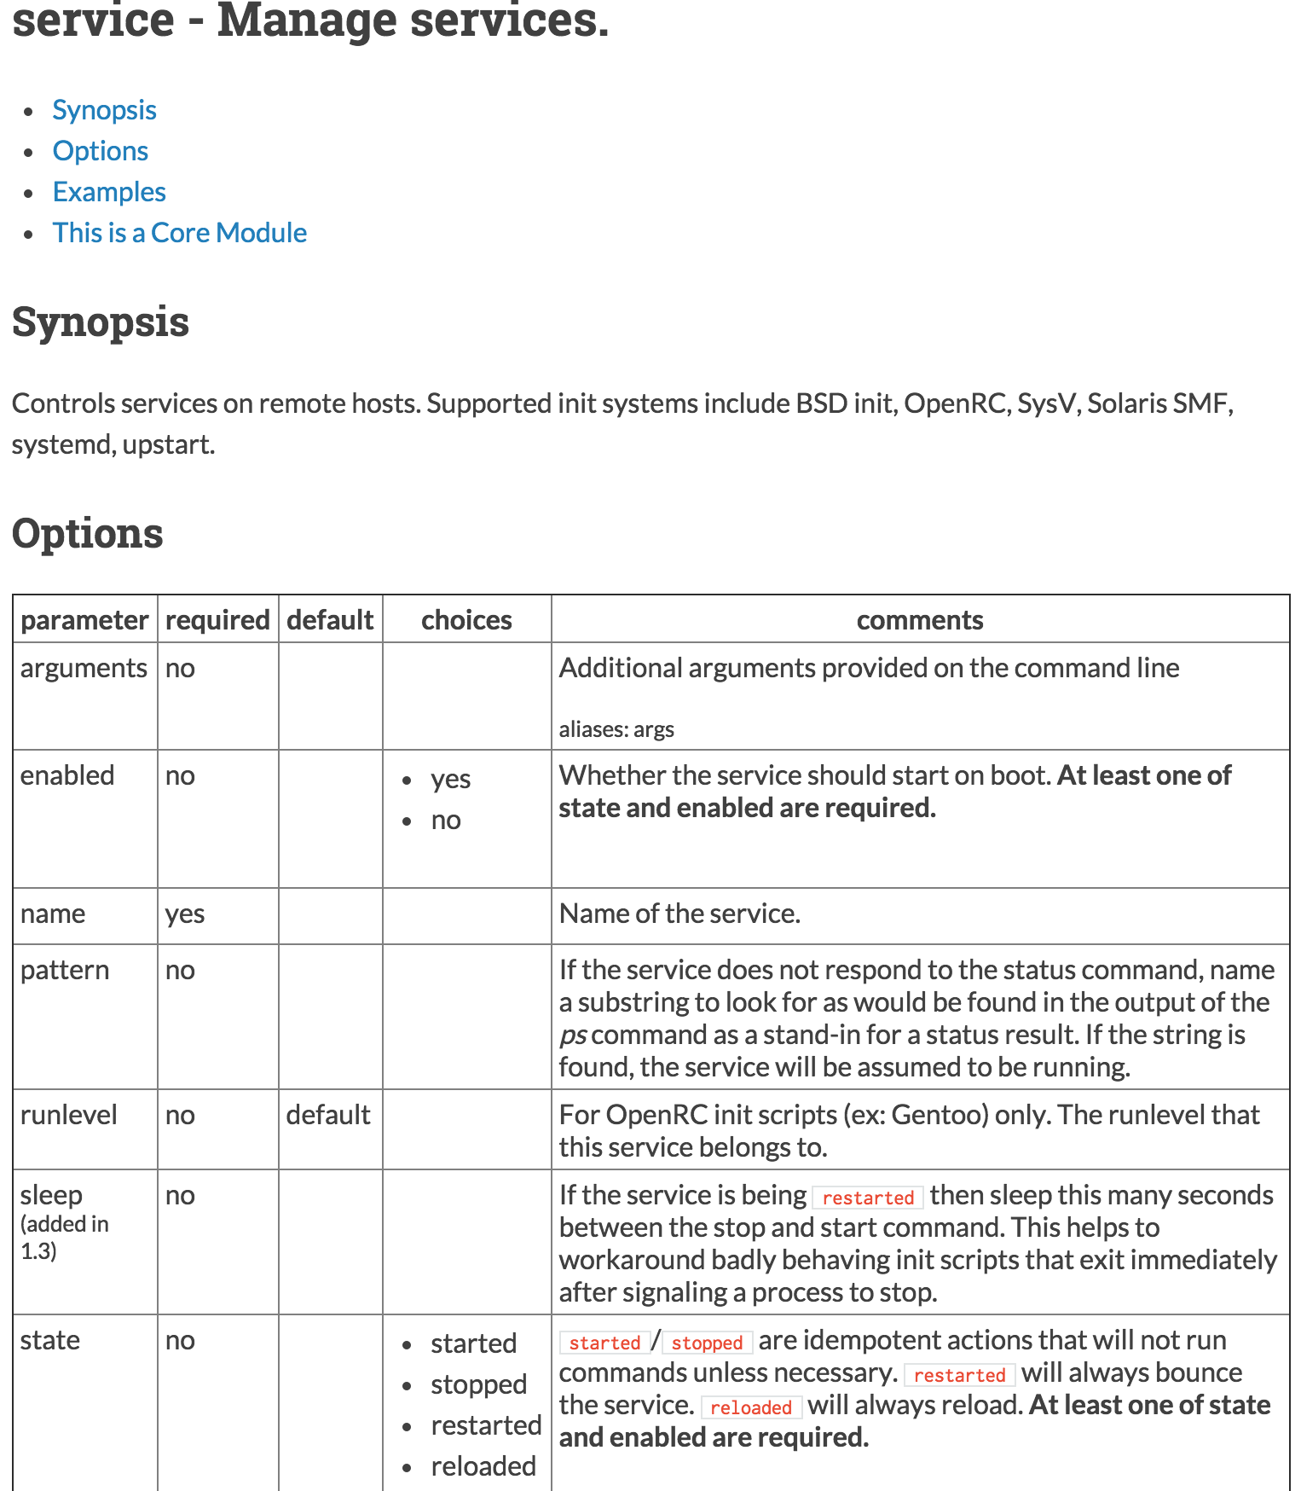
MODULES
Confidential
<number>

Slide 16
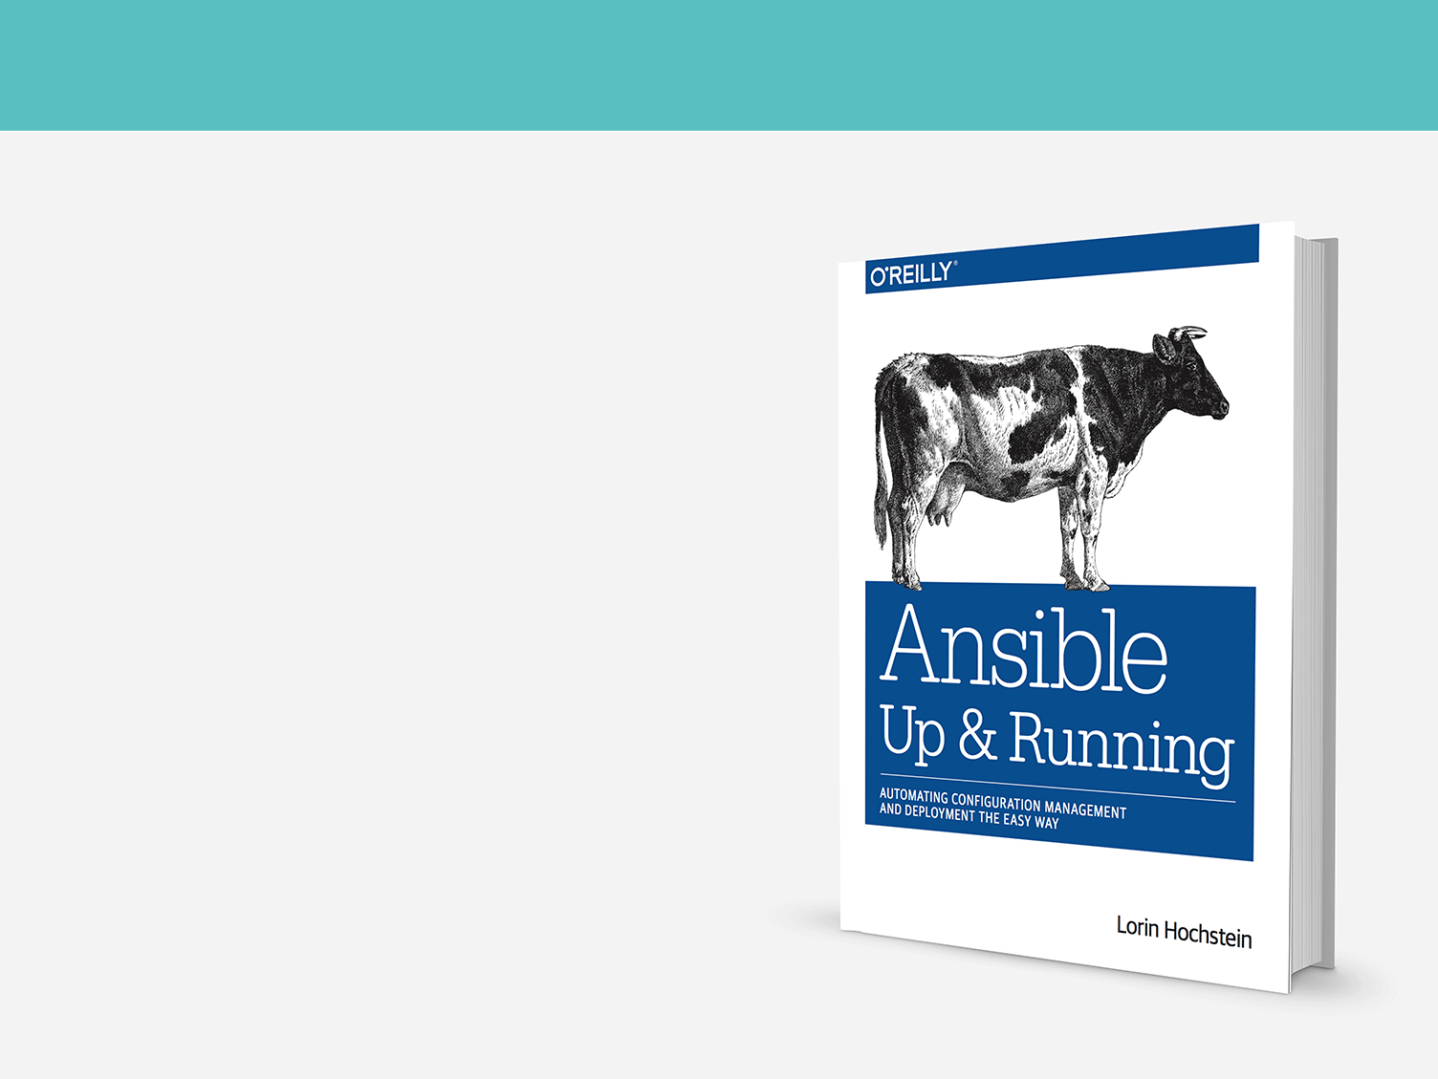
COMMUNITY
THE MOST POPULAR OPEN-SOURCE AUTOMATION COMMUNITY ON GITHUB
13,000+ stars & 4,000+ forks on GitHub
2000+ GitHub Contributors
Over 550 modules shipped with Ansible
New contributors added every day
1200+ users on IRC channel
Top 10 open source projects in 2014
World-wide meetups taking place every week
Ansible Galaxy: over 18,000 subscribers
250,000+ downloads a month
AnsibleFests in NYC, SF, London
Confidential
<number>
Notes:
Lots of contributions come from Vendors in our community, e.g. Microsoft, Rackspace, Google
<number>

Slide 17
THE ANSIBLE WAY
CROSS PLATFORM – Linux, Windows, UNIX
Agentless support for all major OS variants, physical, virtual, cloud and network
HUMAN READABLE – YAML
Perfectly describe and document every aspect of your application environment
PERFECT DESCRIPTION OF APPLICATION
Every change can be made by playbooks, ensuring everyone is on the same page
VERSION CONTROLLED
Playbooks are plain-text. Treat them like code in your existing version control.
DYNAMIC INVENTORIES
Capture all the servers 100% of the time, regardless of infrastructure, location, etc.
ORCHESTRATION THAT PLAYS WELL WITH OTHERS – HP SA, Puppet, Jenkins, RHNSS, etc.
Homogenize existing environments by leveraging current toolsets and update mechanisms.
Confidential
<number>

Slide 18
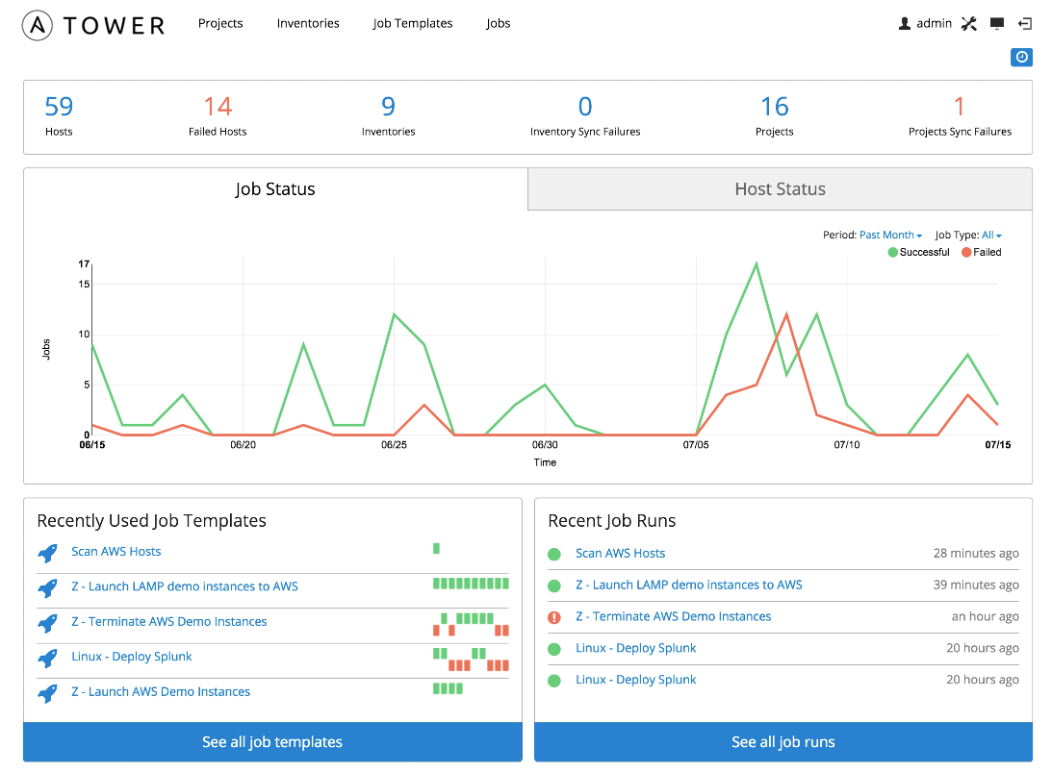
WHAT IS ANSIBLE TOWER?
Ansible tower is an enterprise framework for controlling, securing and managing your Ansible automation – with a UI and restful API.
Role-based access control keeps environments secure, and teams efficient.
Non-privileged users can safely deploy entire applications with push-button deployment access.
All Ansible automations are centrally logged, ensuring complete auditability and compliance.
Confidential
<number>
Notes:
RBAC
Push button deployment (Delegation)
Centralized logging (auditing, compliance)
RESTful API
<number>

Slide 19
ANSIBLE TOWER
TOWER EXPANDS AUTOMATION TO YOUR ENTERPRISE.
CONTROL
KNOWLEDGE
DELEGATION
Scheduled and centralized jobs
Visibility and compliance
Role-based access and self-service
SIMPLE
POWERFUL
AGENTLESS
Everyone speaks the same language
Designed for multi-tier deployments
Predictable, reliable, and secure
AT ANSIBLE’S CORE IS AN OPEN-SOURCE AUTOMATION ENGINE.
Confidential
<number>

Slide 20




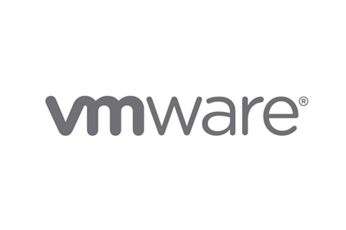























SELECTED ANSIBLE TOWER CUSTOMERS
Confidential
<number>
Notes:
<number>

Slide 21

AUTOMATION = ACCELERATION
“With Ansible Tower, we just click a button and deploy to production in 5 minutes. It used to take us 5 hours with 6 people sitting in a room, making sure we didn’t do anything wrong (and we usually still had errors). We now deploy to production every other day instead of every 2 weeks, and nobody has to be up at 4am making sure it was done right.”
“By using Ansible Tower Surveys, we have created a self-service capability that allows our IT guys to provision new cloud customers quickly. Our first 3 customers each took 2 weeks to provision. With Ansible, our next 500 customers took 10 minutes each to provision.”
“We use Ansible to deploy the network configurations to new datacenters for our games. Previously, it would take 4 days worth of work, onsite, to make sure that our networks were configured correctly. With Ansible, I can now configure a datacenter in 4 minutes, remotely.”
Confidential
<number>

Slide 22
USE CASE
CHALLENGE
Rapidly migrate 65 applications to Amazon Web Services
RESULTS
Primary app updates dropped to 5 minutes from 1 hour
Web stack deployment now takes 10 minutes vs. 2 hours
Systems are continuously patched
TECHNOLOGIES
Red Hat Enterprise Linux
Windows Server 2012r2
AWS
VMware vCenter
Nagios
TrendMicro
Splunk
Confidential – Internal Use Only
<number>
Notes:
<number>

Slide 23
USE CASE
CHALLENGE
Operations wanted to provide easy-to-access self-service to developers
RESULTS
With Ansible Tower, the time required to deploy a stack was reduced from 5 hours to minutes
Near real-time provisioning and management
TECHNOLOGIES
AWS
CentOS
Splunk (Naturally!)
Confidential – Internal Use Only
<number>
Notes:
<number>

Slide 24

USE CASE
CHALLENGE
Streamline instance provisioning and reduce error rates
RESULTS
Provision consistent images 100% of the time
Increased productivity, no time wasted repeating manual tasks
TECHNOLOGIES
VMware vCenter
Red Hat Enterprise Linux
CentOS
Windows
Ubuntu
Confidential – Internal Use Only
<number>
Notes:
<number>

Slide 25

DIFFERENTIATORS
Ruby based
Has client agents
Requires a developer
No development skills required
Agentless
Simple enough for everyone in IT
Configuration, deployment, and orchestration
Application environment focused (network, servers, clouds, etc.)
Configuration
Server-focused
Confidential – Internal Use Only
<number>

Slide 26
Red Hat Product Integration
CloudForms, Satellite, and Tower, Oh My!
Confidential
<number>

Slide 27
Ansible Tower + CloudForms
Deployment and management MADE SIMPLE
CloudForms service catalog items are back-ended by Ansible Tower Job Templates
Ansible Tower deploys software, and manages instances in an ongoing basis
Ansible Tower imports server inventory lists from CloudForms for ongoing management
Confidential
<number>

Slide 28
Ansible Tower + Satellite
TOGETHER, THE BEST RHEL MANAGEMENT
Satellite provisions RHEL from bare-metal, and Ansible orchestrates versioning and application deployment
Ansible deploys Satellite agents, and works with Satellite to manage subscriptions
Satellite and Puppet manages RHEL config, and Ansible orchestrates config deployment, and manages non-RHEL environments
Confidential
<number>

Slide 29

DIFFERENTIATORS
Uses own Ruby-based puppet script language
Uses specialized SSL certificates for client agent auth
Steep learning curve
Configuration
Server-focused
No development skills required
Agentless
Simple enough for everyone in IT
Configuration, deployment, and orchestration
Application environment focused (network, servers, clouds, etc.)
Confidential – Internal Use Only
<number>

Slide 30

DIFFERENTIATORS
Client agents required for full functionality
Persistent connections to master servers
Uncertified crypto
Server-focused
Unproven, small company
No development skills required
Agentless
Battle-tested security using SSH
Can automate anything (network, servers, clouds, etc.)
Backed by the largest open-source company in the world
Confidential – Internal Use Only
<number>

Slide 31
ANSIBLE SALES
WHERE TO FIND ANSIBLE ASSETS
Sales enablement materials including Templates, Decks, Whitepapers, One Sheets available on Google Drive:
Google Drive > Ansible Marketing > Sales Enablement
https://drive.google.com/open?id=0B618R6NtqiRNNGVZZ1dkUTB0cXc
Confidential – Internal Use Only
<number>

Slide 32
ANSIBLE SALES
ANSIBLE ASSETS ON MOJO + PNT
Share Ansible Assets with Red Hat Associates through the Ansible Group on Mojo:
https://mojo.redhat.com/groups/ansible
The Mojo group includes an internal only Sales Resources deck, Sales/Services Rules of Engagement, and links to sales assets on PNT.
Confidential – Internal Use Only
<number>

Slide 33
ANSIBLE: THE LANGUAGE OF DEVOPS
ANSIBLE PLAYBOOK
From development…
…to production.
DEV/TEST
Q/A
OPERATIONS
MANAGEMENT
OUTSOURCERS
COMMUNICATION IS THE KEY TO DEVOPS.
Ansible is the first automation language that can be read and written across IT.
Ansible is the only automation engine that can automate the entire application lifecycle and continuous delivery pipeline.
Confidential
<number>

Slide 34
ANSIBLE: ENTERPRISE IMPACT
TEAM IMPACT
ENTERPRISE IMPACT
+
Save time and be more productive
+
Overcome complexity
+
Eliminate repetitive tasks
+
More resources for innovation
+
Fewer mistakes & errors
+
Increase accountability and compliance
+
Improve collaboration
and job satisfaction
+
A culture of success
Confidential
<number>

Slide 35
MODERNIZE
MIGRATION
Automate existing processes
Manage legacy like DevOps
Define applications once
Re-deploy anywhere
DEVOPS
Model everything Deploy continuously
Confidential
<number>

Slide 36
PLAYBOOK EXAMPLES
LAMP + HA Proxy + Nagios: https://github.com/ansible/ansible-examples/tree/master/lamp_haproxy
JBoss Application Server: https://github.com/ansible/ansible-examples/tree/master/jboss-standalone
RHEL DISA STIG Compliance: http://www.ansible.com/security-stig
Many more examples at:
http://galaxy.ansible.com
https://github.com/ansible/ansible-examples
Confidential
<number>
Notes:
<number>

Slide 37
GETTING STARTED
Have you used Ansible already? Try Tower for free:
ansible.com/tower-trial
Would you like to learn Ansible? It’s easy to get started:
ansible.com/get-started
Want to learn more?
ansible.com/whitepapers
Confidential

