Slide 1



ANSIBLE TOWER
Shadd Gallegos
Senior Solution Architect, Automation Tiger Team
Red Hat

Slide 2

AUTOMATE REPEAT IT
Notes:
Nothing routine should ever be done manually.

Slide 3
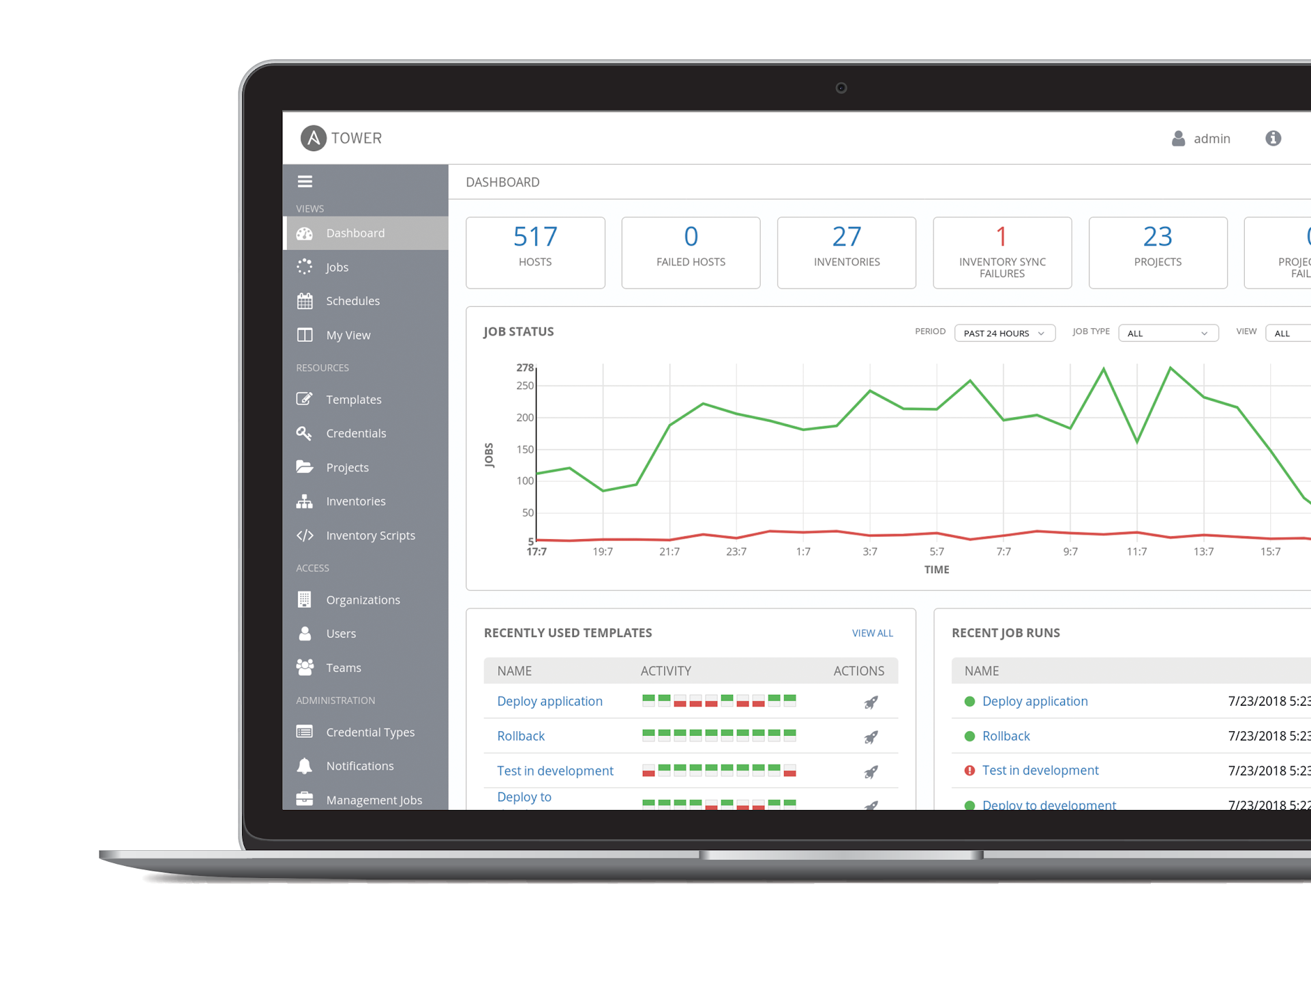
WHAT IS ANSIBLE AUTOMATION?
Ansible is an open source community project sponsored by Red Hat. It’s a simple automation language that can perfectly describe IT application environments in Ansible Playbooks.
Ansible Tower is an enterprise framework for controlling, securing and managing your Ansible automation with a UI and RESTful API.

Slide 4
THE ANSIBLE WAY
CROSS PLATFORM
HUMAN READABLE
PERFECT DESCRIPTION OF APPLICATION
Agentless support for all major OS variants, physical, virtual, cloud and network devices.
Perfectly describe and document every aspect of your application environment.
Every change can be made by Playbooks, ensuring everyone is on the same page.
VERSION CONTROLLED
DYNAMIC INVENTORIES
ORCHESTRATION PLAYS WELL WITH OTHERS
Every change can be made by Playbooks, ensuring everyone is on the same page.
Playbooks are plain-text. Treat them like code in your existing version control.
Capture all the servers 100% of the time, regardless of infrastructure, location, etc.
Notes:
Cross platform: Linux, Windows, UNIX, Networks, Clouds
Human readable: YAML
Orchestration plays well with others: HP SA, Puppet, Jenkins, RHNSS, etc.

Slide 5



WHY ANSIBLE?
POWERFUL
AGENTLESS
SIMPLE
Human readable automation
No special coding skills needed
Tasks executed in order
Usable by every team
Get productive quickly
App deployment
Configuration management
Workflow orchestration
Network automation
Orchestrate the app lifecycle
Agentless architecture
Uses OpenSSH & WinRM
No agents to exploit or update
Get started immediately
More efficient & more secure

Slide 6
WHAT CAN I DO WITH ANSIBLE?
Automate the deployment and management of your entire IT footprint.
Do this...
Orchestration
Configuration Management
Application Deployment
Provisioning
Continuous Delivery
Security and Compliance
On these...
Firewalls
Load Balancers
Applications
Containers
Clouds
Servers
Infrastructure
Storage
Network Devices
And more...

Slide 7
PLAYBOOK EXAMPLE: Linux
---
- name: Enable repos depending RHEL Distro
hosts: all
become: root
tasks:
- name: Enabling RHEL 6 needed repos on nodes
command: subscription-manager repos --enable rhel-6-server-rpms
when: (ansible_distribution == "RedHat" and ansible_distribution_major_version == "6")
- name: Enabling RHEL 7 needed repos on nodes
command: subscription-manager repos --enable rhel-7-server-rh-common-rpms --enable rhel-7-server-extras-rpms --enable rhel-7-server-optional-rpms --enable rhel-7-server-supplementary-rpms --enable rhel-server-rhscl-7-rpms --enable rhel-7-server-rpms --enable rhel-7-server-ansible-2.9-rpms
when: (ansible_distribution == "RedHat" and ansible_distribution_major_version == "7")

Slide 8
ANSIBLE
THE LANGUAGE OF DEVOPS

Slide 9


COMMUNICATION IS THE KEY TO DEVOPS
ANSIBLE PLAYBOOK
From development…
…to production.
DEV/TEST
Q/A
OPERATIONS
MANAGEMENT
OUTSOURCERS
Ansible is the first automation language that can be read and written across IT.
Ansible is the only automation engine that can automate the entire application lifecycle and continuous delivery pipeline.

Slide 10
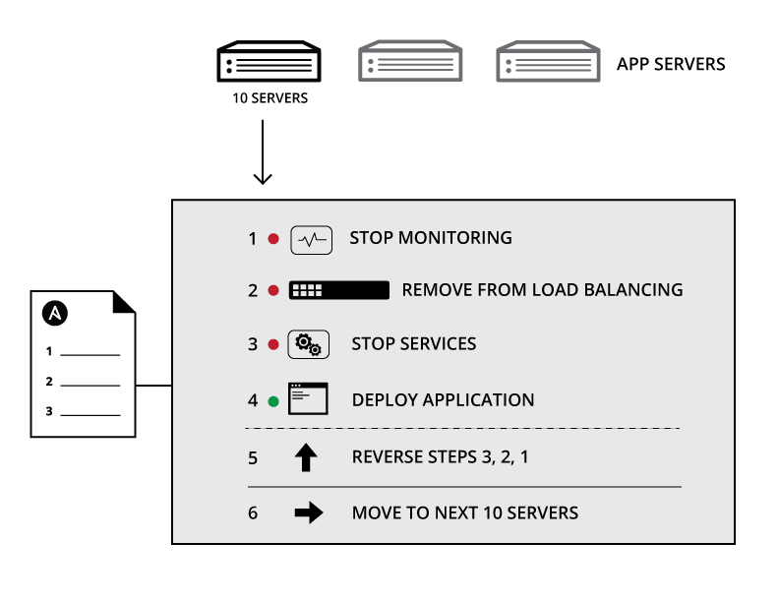
WHY IS AUTOMATION IMPORTANT?
Your applications and systems are more than just collections of configurations. They’re a finely tuned and ordered list of tasks and processes that result in your working application.
Ansible can do it all:
• Provisioning
• App Deployment
• Configuration Management
• Multi-tier Orchestration
Notes:
Combination of configuration and order
Configuration Management alone is not sufficient for app deployment
Allows you to automate entire sets of process

Slide 11
ANSIBLE AUTOMATES TECHNOLOGIES YOU USE Time to automate is measured in minutes
CLOUD
VIRT & CONTAINER
WINDOWS
NETWORK
DEVOPS
MONITORING
AWS
Azure
Digital Ocean
Google
OpenStack
Rackspace
+more
Docker
VMware
RHV
OpenStack
OpenShift
+more
ACLs
Files
Packages
IIS
Regedits
Shares
Services
Configs
Users
Domains
+more
Arista
A10
Cumulus
Bigswitch
Cisco
Cumulus
Dell
F5
Juniper
Palo Alto
OpenSwitch
+more
Jira
GitHub
Vagrant
Jenkins
Bamboo
Atlassian
Subversion
Slack
Hipchat
+more
Dynatrace
Airbrake
BigPanda
Datadog
LogicMonitor
Nagios
New Relic
PagerDuty
Sensu
StackDriver
Zabbix
+more
OPERATING SYSTEMS
RHEL and Linux
UNIX
Windows
+more
STORAGE
NetApp
Red Hat Storage
Infinidat
+more
Notes:
Agentless architecture
Uses OpenSSH and WinRM
No agents to exploit or update
Predictable, reliable and secure
Ansible automates technologies you already use
With the power of a community behind it generating more integrations every day
----------------------------------------------------------------
Points Tim Yeaton added here in his delivery:
Communities of partners building around our language
Tremendous adoption to date - realization in order to scale you have to automate

Slide 12
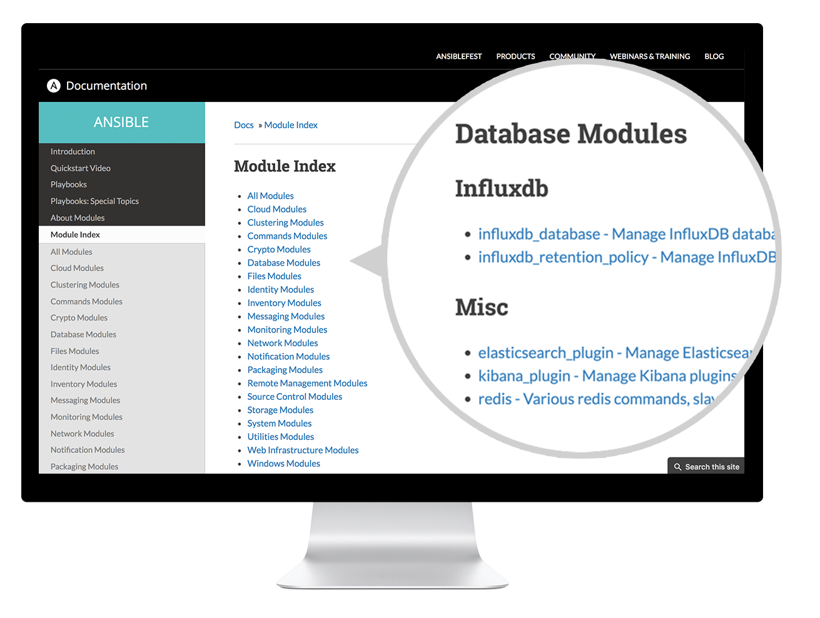
docs.ansible.com

Slide 13
PLAYBOOK EXAMPLES
LAMP + HAPROXY + NAGIOS github.com/ansible/ansible-examples/tree/master/lamp_haproxy
WINDOWS github.com/ansible/ansible-examples/tree/master/windows
SECURITY COMPLIANCE github.com/ansible/ansible-lockdown
NETWORK
github.com/privateip/network-demo
MORE...
galaxy.ansible.com
github.com/ansible/ansible-examples

Slide 14


AUTOMATION FOR TEAMS
Ansible Tower technical introduction and overview

Slide 15

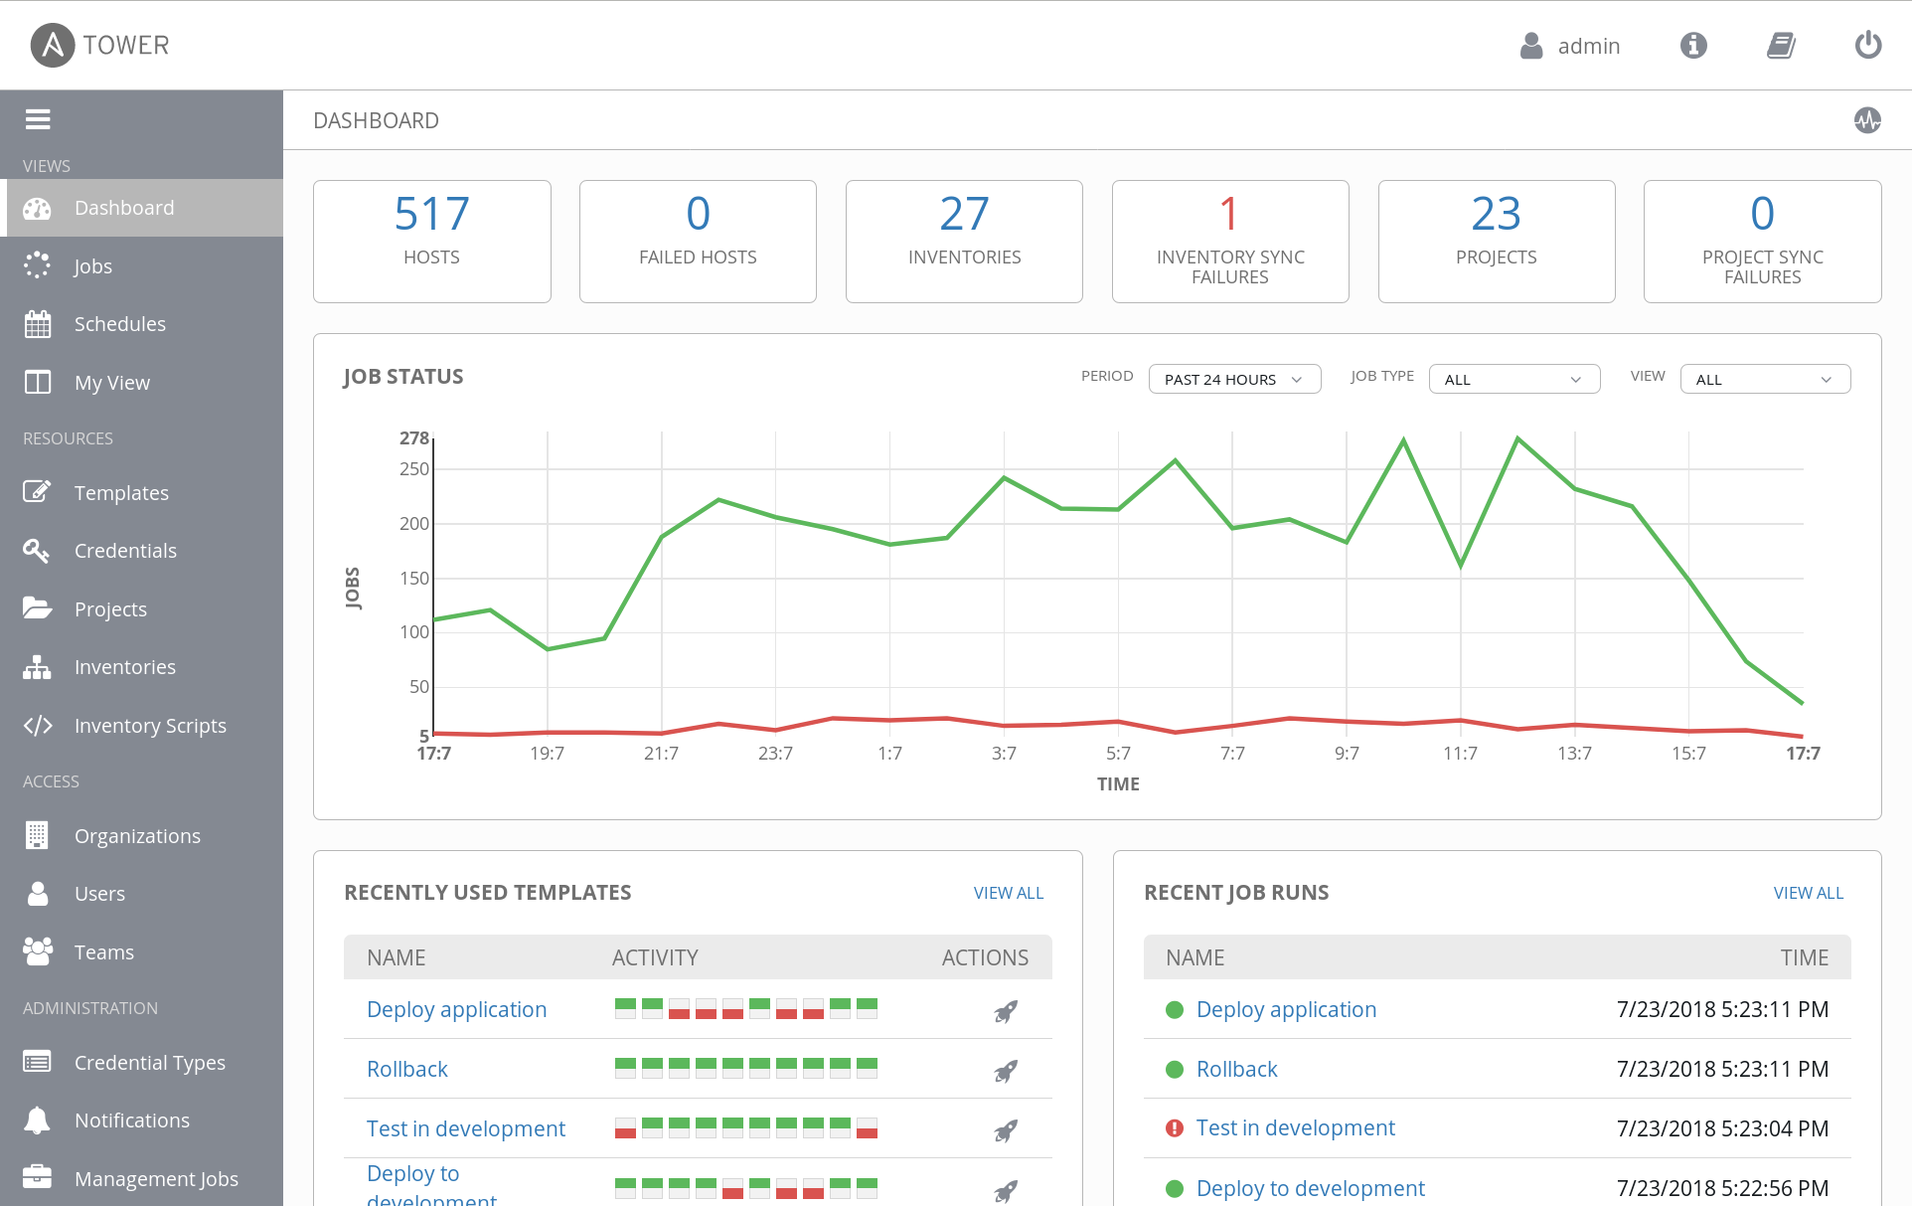
WHAT IS ANSIBLE TOWER?
Ansible Tower is an enterprise framework for controlling, securing and managing your Ansible automation – with a UI and RESTful API.
• Role-based access control
• Deploy entire applications with push-button deployment access
• All automations are centrally logged
Notes:
Control, Knowledge, Delegation
RBAC
Push button deployment (Delegation)
Centralized logging (auditing, compliance)
RESTful API
Role-based access control keeps environments secure, and teams efficient
Non-privileged users can safely deploy entire applications with push-button deployment access
All Ansible automations are centrally logged, ensuring complete auditability and compliance

Slide 16
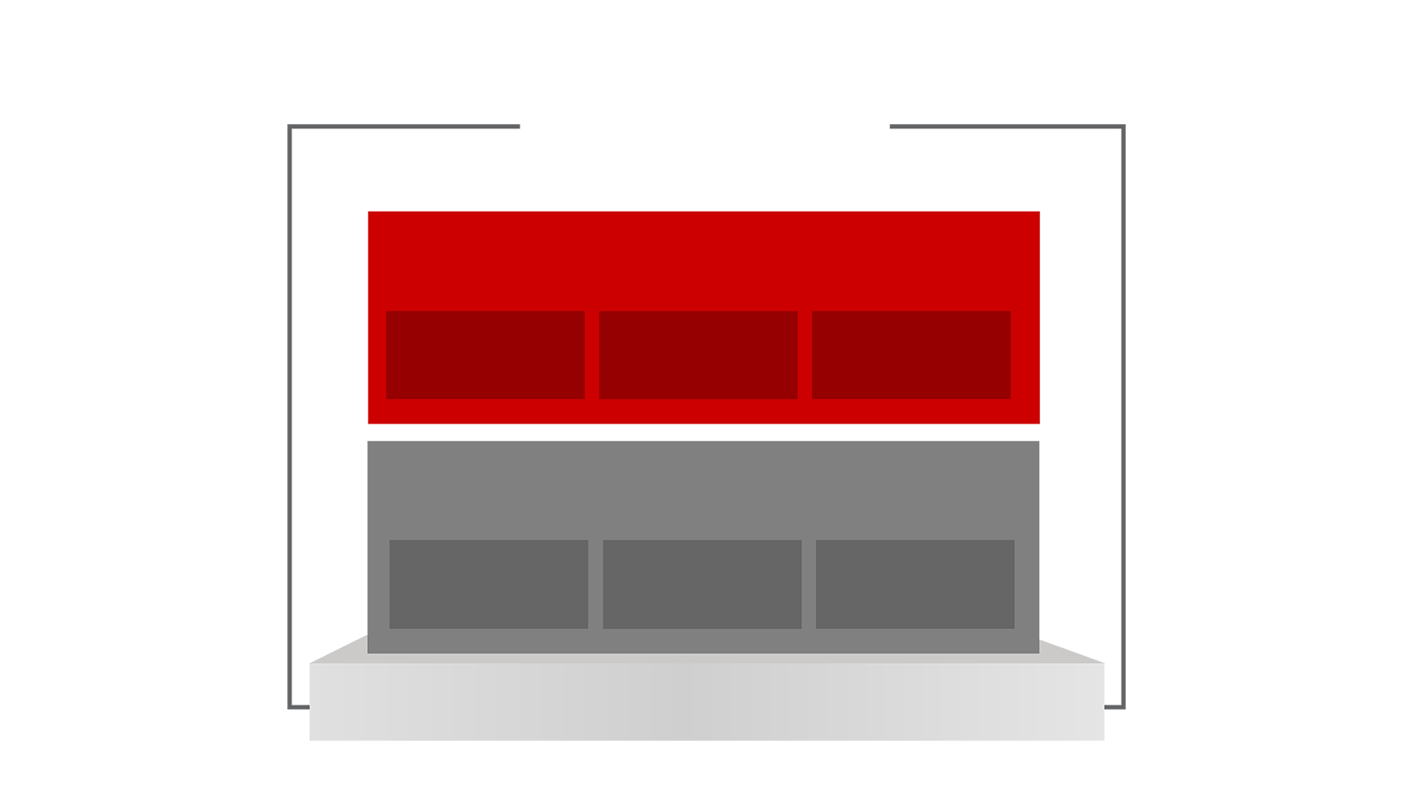

RED HAT ANSIBLE TOWER
Scale + operationalize your automation
CONTROL
KNOWLEDGE
DELEGATION
RED HAT ANSIBLE ENGINE
Support for your Ansible automation
SIMPLE
POWERFUL
AGENTLESS
FUELED BY AN INNOVATIVE OPEN SOURCE COMMUNITY
Notes:
Control: scheduled and centralized jobs
Knowledge: Visibility and compliance
Delegation: Role-based access and self service
Simple: Everyone speaks the same language
Powerful: Designed for multi-tier deployments
Agentless: Predictable, reliable and secure

Slide 17
GETTING STARTED
Have you used Ansible already? Try Tower for free: ansible.com/tower-trial
Would you like to learn Ansible? It’s easy to get started: ansible.com/get-started
Want to learn more?
Videos, webinars, case studies, whitepapers: ansible.com/resources

Slide 18
Demo - .Net Music Store App with DB
Win2016 + SQL DB
Win2016 + SQL DB
Win2016 + IIS
Win2016 + IIS
VMware - Test
OpenStack - Dev
Load Balancer
Win2016 + SQL DB
Win2016 + IIS
AWS - Prod

