Slide 1
Before we begin
Red Hat Contacts
Follow-up Sessions: John Riccitelli - jriccite@redhat.com
Technical Q&A: Marc Skinner - mskinner@redhat.com
Ansible Monthly Best Practice Session
Ansible Training via Red Hat Learning subscription (12 mos, entire product portfolio)
Ansible Optum Event Part II
September 9th - Ansible Collections
AnsibleFest - October 13-14th
https://www.ansible.com/ansiblefest

Slide 2


Shadd Gallegos
Senior Solutions Architect
Tiger Team - Red Hat

Slide 3
What is it that you are looking for?
A way to automate:
Repetitive activities.
I.T. manual requests.
Ability to run - AD-Hoc, predefined, or scheduled requests.
Real time drift remediation.
Simplify and speed up response to audits or I.T. incidents
Products/developments created that will be reproduced.

Slide 4

Automated Security & HIPAA Compliance
Business Drivers
Industry standards based compliance - OpenSCAP, NIST, and HIPAA
Continuous scanning and remediation to remain in compliance with regulation; prevent cyber threats
Real time configuration and drift management
Simplify and speed up response to audits
AUTOMATED SECURITY & HIPAA COMPLIANCE
Technical Requirements
Consistent and verifiable enforcement policies
Compliance awareness and transparency
Reduced probability of human error and analysis time
Compliance-as-code
Simplified reporting
Automation
Red Hat Technology:
RHEL
Satellite
Insights
Ansible Automation
‹#›

Slide 5
What is the Red Hat Management Portfolio
Ansible
Ansible Tower
Satellite
InSights
Cloud.RedHat.com

Slide 6



Slide 7
What is Ansible?
Simple, agentless automation platform that can improve your current processes, migrate apps for better optimization, and provide a single language for DevOps practices across your organization.
Comprised of
Cross Platform (Windows, Linux, Unix, IoT, ect.)
AD-Hoc, Playbooks, Roles, and Collections
What is Galaxy?
Cloud.RedHat.com

Slide 8
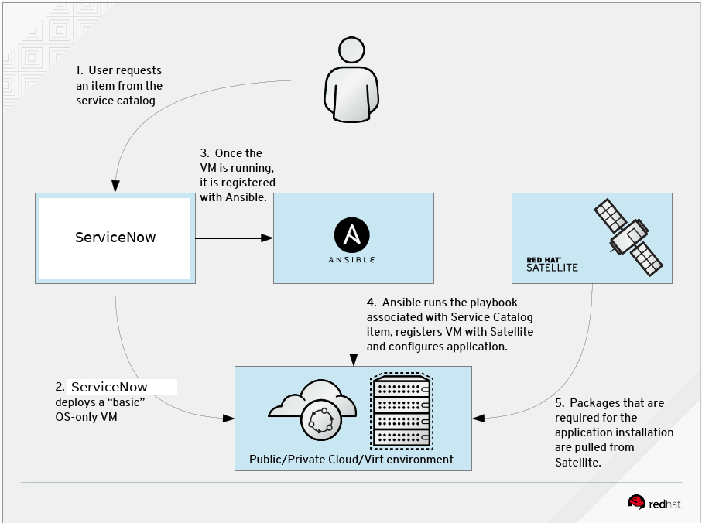
What Does the Environment Look Like

Slide 9
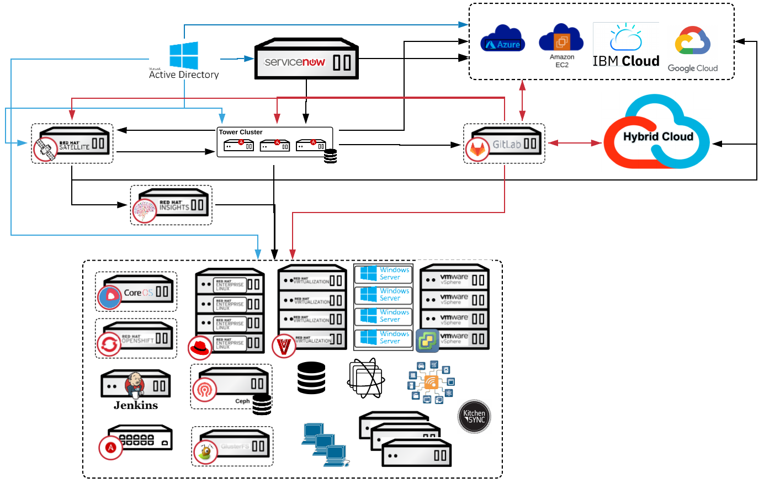
Or Like This

Slide 10

Red Hat Ansible Engine
Cross platform
Human readable
Perfect description of application
Agentless support for all major OS variants, physical, virtual, cloud and network devices.
Perfectly describe and document every aspect of your application environment.
Every change can be made by Playbooks, ensuring everyone is on the same page.
Version controlled
Dynamic inventories (Or Static)
Orchestration plays well with others
Playbooks are plain-text. Treat them like code in your existing version control.
Capture all the servers 100% of the time, regardless of infrastructure, location, etc.
Orchestration plays well with others: ServiceNow, Infoblox, AWS, Terraform, Cisco ACI and more
Notes:
Cross platform: Linux, Windows, UNIX, Networks, Clouds
Human readable: YAML
Orchestration plays well with others: HP SA, Puppet, Jenkins, RHNSS, etc.

Slide 11
Ansible automates technologies you use Time to automate is measured in minutes, 50+ certified platforms
Cloud
Virt & Container
Windows
Network
Security
Monitoring
AWS
Azure
Digital Ocean
Google
OpenStack
Rackspace
+more
Docker
Kubernetes
OpenStack
OpenShift
VMware
+more
ACLs
Files
Packages
IIS
Registry
Shares
Services
Configs
Users
Domains
Updates
+more
Arista
Aruba
Bigswitch
Cisco
Ericsson
F5
FRR
Juniper
Meraki
OpenvSwitch
Ruckus
VyOS
+more
Checkpoint
Cisco
CyberArk
F5
Fortinet
Juniper
IBM
Palo Alto
Snort
+more
Dynatrace
Datadog
LogicMonitor
New Relic
Sensu
+more
Devops
Jira
GitHub
Vagrant
Jenkins
Slack
+more
Red Hat Products
RHEL
OpenShift
Satellite
Insights
PAM/DM
JBoss EAP
+more
Storage
EMC
Netapp
Hitachi
IBM
Infinidat
+more
Systems
IBM (Z,P,I)
Dell
Cisco
HP
Notes:
Ansible’s agentless architecture provides enablement for a wide variety of platforms that make it easy for them to be automated. With the move to Content Collections, it’s now even easier for the partners and community to build, test, and publish content at any time without the wait for it to be included in an actual Ansible release. Ansible Galaxy is the de-facto place for community content, while Automation Hub is the place for Certified content (selected certified platforms in bold, many more available).
Uses OpenSSH and WinRM
No agents to exploit or update
Predictable, reliable and secure
Ansible automates technologies you already use
With the power of a community behind it generating more integrations every day
----------------------------------------------------------------
Points Tim Yeaton added here in his delivery:
Communities of partners building around our language
Tremendous adoption to date - realization in order to scale you have to automate

Slide 12
Ansible Modules
Networking (Cisco ACI, AireOS, IOS, IOS XR, Meraki, NSO, NX-OS, UCS, many more)
Load Balancing (F5, NetScalar)
Storage (Netapp, HP, IBM, Hitachi)
Security (Palo Alto,Cisco)
Windows
RHEL
CICD for App Dev, Testing, Capacity/Performance (EAP & WAS)
Mainframe (P,Z,I)

Slide 13
Ansible Collections
IBM (P,Z,I)
Chocolatey <-- windows application deployment
Cloud, Azure, Amazon
Cisco
F5
IBM
NetApp
Dell EMC
Splunk
Red Hat

Slide 14
---
- name: Linux install and start apache
hosts: web
become: yes
tasks:
- name: httpd package is present
yum:
name: httpd
state: latest
- name: latest index.html file is present
template:
src: files/index.html
dest: /var/www/html/
- name: httpd is started
service:
name: httpd
state: started
Notes:
Playbook example:
The name fields are human-readable comments. Optional, but useful as comments to the Playbook. These strings also show up in Tower, so it is easy to correlate any failures in a long running Playbook.
Inventory call-out
Variables can be handled in several different ways:
Directly in the playbook
As part of a separate vars file
Via the command line
As output from a previous play
Via Tower
You are not required to use root as the remote user. You can have Ansible connect and run the playbook as any user or even multiple users – as long as that user has the permission to perform the tasks in the playbook. You can even use multiple users and specify different users for different plays or tasks.
Ansible supports sudo, su, powerbroker, and other privilege escalation mechanisms.
The real work. General format:
<<module>>: key=value

Slide 15
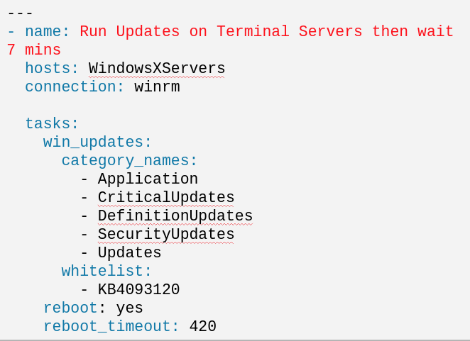
Notes:
Playbook example:
The name fields are human-readable comments. Optional, but useful as comments to the Playbook. These strings also show up in Tower, so it is easy to correlate any failures in a long running Playbook.
Inventory call-out
Variables can be handled in several different ways:
Directly in the playbook
As part of a separate vars file
Via the command line
As output from a previous play
Via Tower
You are not required to use root as the remote user. You can have Ansible connect and run the playbook as any user or even multiple users – as long as that user has the permission to perform the tasks in the playbook. You can even use multiple users and specify different users for different plays or tasks.
Ansible supports sudo, su, powerbroker, and other privilege escalation mechanisms.
The real work. General format:
<<module>>: key=value

Slide 16
What is Ansible Tower?
Ansible Tower by Red Hat is a centralized API for your Ansible automation and a graphical user interface for Ansible.
Simple Web Ui Role Based Access Control Job Scheduling Dynamic Or Static Inventory Management Multi Playbook Workflows Restful Api’s External Logging Integration Real-Time Job Status Virtual Environments | Red Hat Technical Support Red Hat Customer Portal Access Install/Upgrades Are Well Documented And Supported Standard Release Cycles Tested Prior To Release Clustering With Isolated Nodes Stat Reporting Red Hat Certified Content

Slide 17
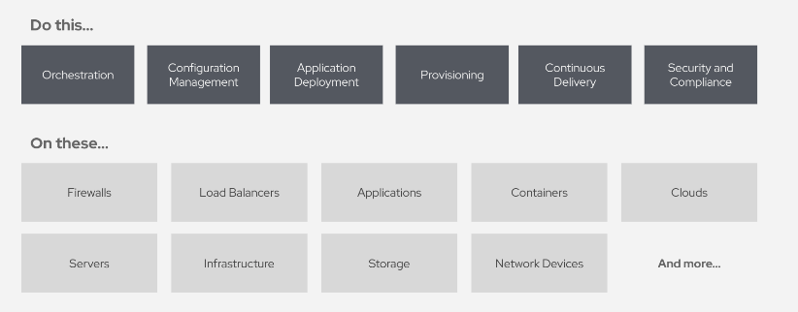
What can I do using Ansible Tower?
Automate the deployment and manage your entire I.T. Footprint

Slide 18
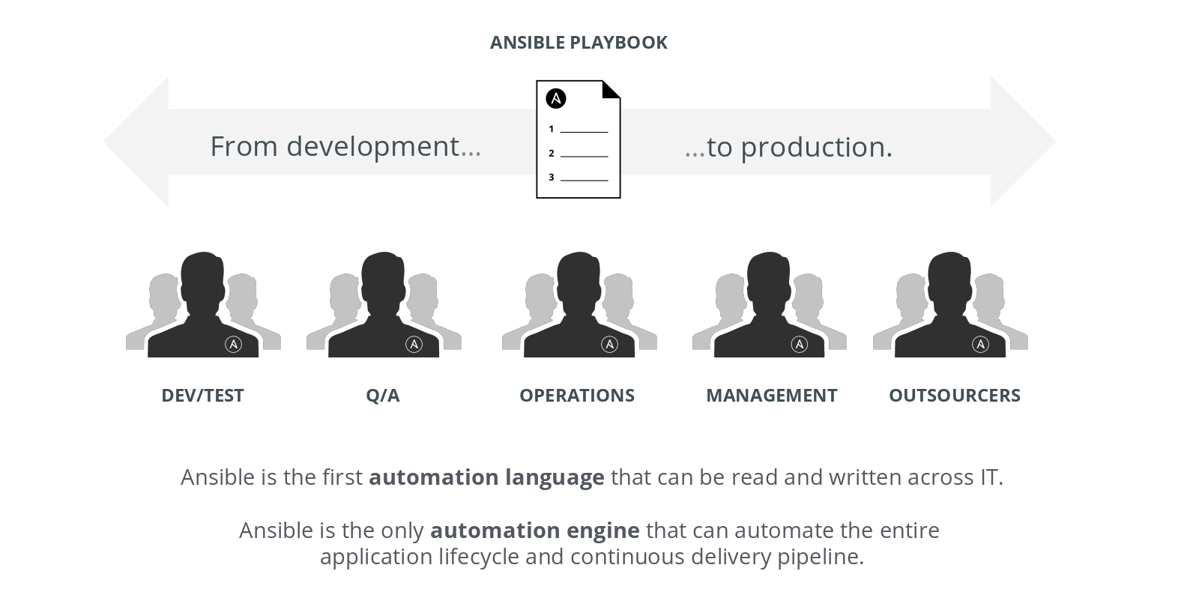
Ansible is the language of DevOps!

Slide 19
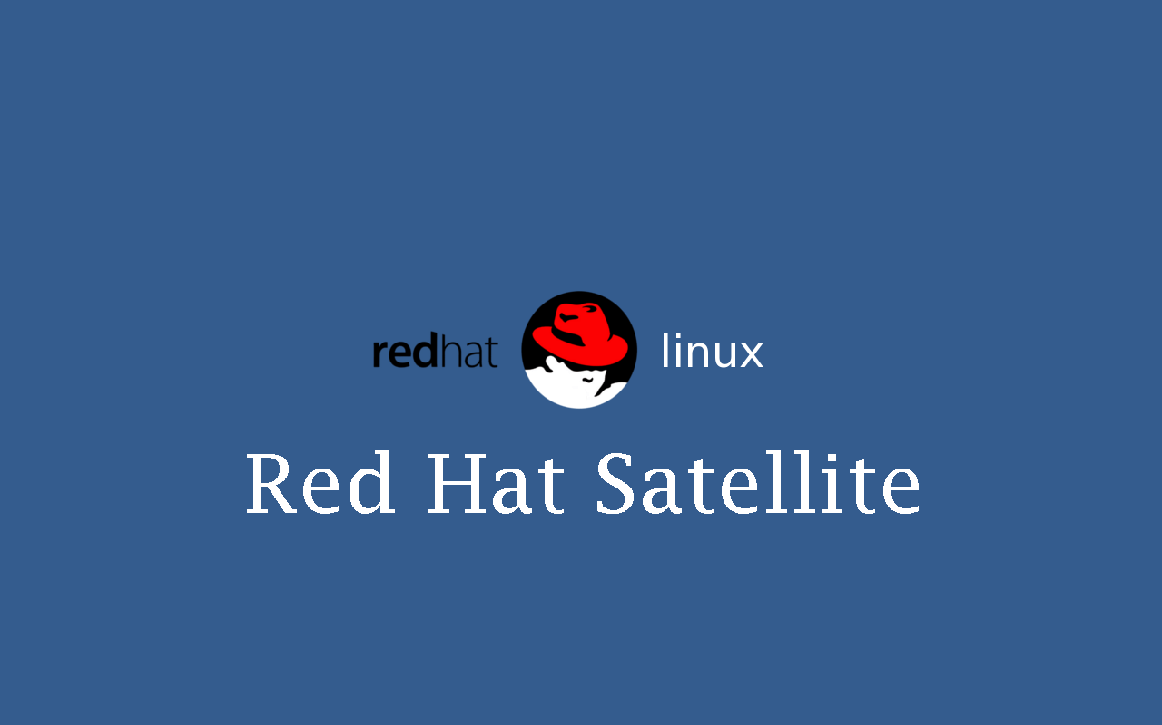

Slide 20

What is Satellite?
The easiest way to manage your Red Hat infrastructure for efficient and compliant IT operations. Establish trusted content repos and processes that help you build a standards-based, secure Red Hat environment.

Slide 21


Slide 22
What is InSights?
A predictive analytic tool with real-time, in-depth analysis of your Red Hat infrastructure, letting you predict and prevent problems before they occur.
https://cloud.redhat.com/

Slide 23

What Happens Next
Use Cases

Slide 24
Automated Security & HIPAA Compliance
Business Drivers
Industry standards based compliance - OpenSCAP, NIST, and HIPAA
Continuous scanning and remediation to remain in compliance with regulation; prevent cyber threats
Real time configuration and drift management
Simplify and speed up response to audits
AUTOMATED SECURITY & HIPAA COMPLIANCE
Technical Requirements
Consistent and verifiable enforcement policies
Compliance awareness and transparency
Reduced probability of human error and analysis time
Compliance as code
Simplified reporting
Automation
Red Hat Technology:
RHEL
Satellite
Insights
Ansible Automation
‹#›

Slide 25
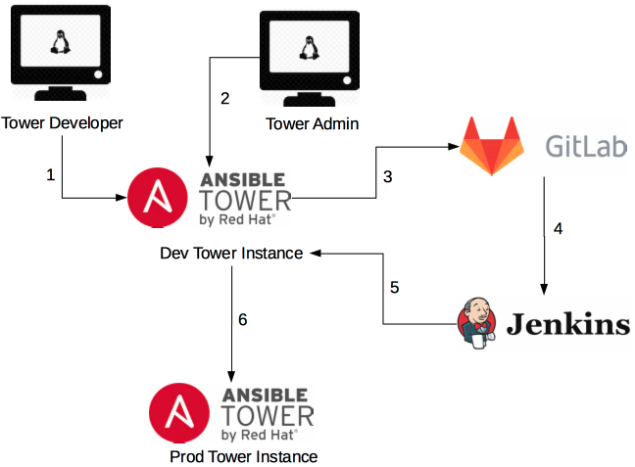
CICD for App Dev, Testing, Capacity/Performance (EAP & WAS)
Notes:
1. A Tower developer builds or modifies an asset in the dev version of Tower.
2. A Tower administrator runs a job telling dev Tower to export its assets.
3. The job commits the files into an SCM
4. The SCM notifies a CI tool (or the CI tool polls the SCM)
5. The CI tool calls to the import job on the Dev Tower instance
6. The job on the Dev Tower instance calls to the Prod Tower instance to update its assets.690317

Slide 26
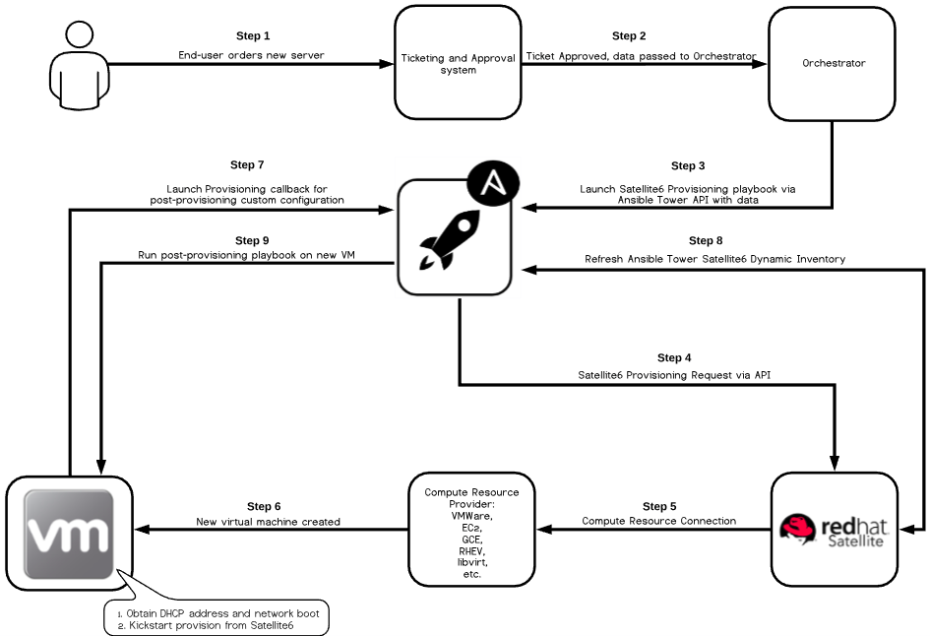
Automated Virtual Host Provisioning
Notes:
1. A Tower developer builds or modifies an asset in the dev version of Tower.
2. A Tower administrator runs a job telling dev Tower to export its assets.
3. The job commits the files into an SCM
4. The SCM notifies a CI tool (or the CI tool polls the SCM)
5. The CI tool calls to the import job on the Dev Tower instance
6. The job on the Dev Tower instance calls to the Prod Tower instance to update its assets.690317

Slide 27

Additional Resources
Red Hat Resources
https://github.com/ansible/workshops
https://www.Ansible.com/
http://docs.Ansible.com/
Microsoft Azure
https://docs.microsoft.com/en-us/azure/developer/ansible/
Redhat Education
http://redhatgov.io/
https://learn.openshift.com
http://lab.redhat.com
https://www.ansible.com/resources/ebooks
https://redhatdemos.com/
GitHub Shadd Gallegos
https://github.com/ShaddGallegos/RHTI
https://github.com/ShaddGallegos/RHTI/raw/master/Ansible_Tower/Ansible_Use_Cases/Ansible%20Use%20Case%20List.xlsx

Slide 28

THANK YOU!

