Slide 1
HOW TO USE THIS DECK
Name | Roadmap - Red Hat Ansible Automation Platform
Purpose | These slides are for discussing road map with existing and prospective customers for the Red Hat Ansible Automation Platform official roadmap for 2021. **Note: Deck contains speaker notes.
Last Updated | Jan 25, 2021
What this deck is for? | This is a technical level roadmap intended for a creator / operator and not a decision maker.
What this deck is not for? | Helping drive decision makers to purchase Red Hat Ansible Automation Platform.
Owner | Ansible MBU, ansible-pmm-tmm@redhat.com
List of all official Ansible content | Red Hat Ansible Automation Platform One Stop (Red Hat Internal | Red Hat Partners)
<number>
Notes:
Google Slides source link (Red Hat internal)
https://docs.google.com/presentation/d/1NY5Xxl3227i1zbGjWp-5r3aWOPPZKmK-i0wlO0tTKno/edit?usp=sharing
(this must be in the speaker notes - internal links are not allowed in the partner hub)

Slide 2
Disclaimer
The content set forth herein is Red Hat confidential information and does not constitute in any way a binding or legal agreement or impose any legal obligation or duty on Red Hat.
This information is provided for discussion purposes only and is subject to change for any or no reason.
DISCLAIMER AND WARNING
<number>

Slide 3

2021 Roadmap
Key Initiatives through Fall 2021
Shadd Gallegos
Staff Architect Ansible
shadd@redhat.com

Slide 4
Agenda
What is Red Hat Ansible Automation Platform?
High Level Timeline
Ansible Platform Components
Ansible Hosted Services
Ansible Content
Summary & Next Steps
Notes:
Ansible Services
-
Ansible Platform Components
-> tooling, operator, EEs, Automation Hub, Explorer
Ansible Content
->
Ansible Tower*
Ansible Explorer
Automation Analytics
Ansible Builder
Automation Hub
Ansible Platform Operator

Slide 5

Ansible Automation
Ansible technologies combined into
a product delivered to customers
Ansible Cloud Services
Ansible hosted platform services
provided via cloud.redhat.com
Ansible Content
Ansible Technology Use Cases Delivered via Automation Hub
Powered by Ansible - The Universal Automation Language fuelled by the Open Source Community

Slide 6
Timeline Overview
Roadmap Timeline 2021
Ansible Automation Platform 2.0 Announcement
Ansible Automation Platform 2.0 General Availability
Automation mesh
Announce at Red Hat Summit 2021
Includes support of Execution Environments, Ansible Builder, and Ansible Explorer
Execution Environments decoupled from control plane for flexibility
Platform Updates
April
June
October

Slide 7
Timeline Overview
Roadmap Timeline 2021
Ansible Automation Platform 2.0 Announcement
Ansible Automation Platform 2.0 General Availability
Automation mesh
Announce at Red Hat Summit 2021
Includes support of Execution Environments, Ansible Builder, and Ansible Explorer
Execution Environments decoupled from control plane for flexibility
Platform Updates
May
July
November
April
June
October
Ansible Network Automation
Ansible Security Automation
Ansible Cloud Automation
Content Updates
Release of Ansible.Network meta collection.
Symantec Endpoint Protection, TrendMicro Deep Security Software, Red Hat StackRox, Aqua Container Security
VMware vSphere, Red Hat Openshift, Amazon AWS
Notes:
A meta collection is a logical “collection of collections.” The ansible.network meta collection is basically just a shell collection with all the supported Ansible Network collections in the requirements.yml file.

Slide 8
Timeline Overview
Roadmap Timeline 2021
Ansible Automation Platform 2.0 Announcement
Ansible Automation Platform 2.0 General Availability
Automation mesh
Announce at Red Hat Summit 2021
Includes support of Execution Environments, Ansible Builder, and Ansible Explorer
Execution Environments decoupled from control plane for flexibility
Platform Updates
Early May
Late May
July
September
November
April
June
October
Ansible Network Automation
Ansible Security Automation
Ansible Cloud Automation
Content Updates
Release of Ansible.Network meta collection.
see previous slide
VMware vSphere, Red Hat Openshift, Amazon AWS
Hosted Services Updates
Automation Analytics
Automation Analytics
Automation Planner
Email / Notifications

Slide 9

2021: Automation Becomes A Business Imperative
https://go.forrester.com/blogs/predictions-2021-automation-becomes-a-business-imperative/
Notes:
BOLD STATEMENT
https://go.forrester.com/blogs/predictions-2021-automation-becomes-a-business-imperative/

Slide 10







Automation and IT modernization
Many organizations have a problem
Too many unintegrated, domain-specific tools
SecOps
Devs/DevOps
Network ops
<number>
IT ops
Notes:
Your organization is probably using automation already, but in pockets.
Different departments may have an automation initiative already, at different maturity levels, using specialized tools or even the same one without knowing.
Maybe other parts of the organization want to introduce automation but don’t know how, or don’t have access to the right technology.
This ends up being extremely inefficient, from many points of view.
It’s harder to have visibility in these initiatives and understand if or how successful they are.
It’s more expensive to maintain multiple tools, and the IT organization may end up with a very ‘sparse’ know-how.
Ultimately it becomes a real challenge to enable multi-domain use cases, such as DevOps or DevSecOps.

Slide 11

Red Hat Ansible Automation - Roadmap 2021
Automation = Mission Critical
Share automation quickly
Adopt automation faster
Management Supported automation tooling creates clear path for building and creating automation content in a reusable fashion, and an easy path to production
Portability Automation can be shared and adopted quickly between automation teams and sites.
Maintenance Usability is increased as automation engineers can focus on what they want to automate rather than maintaining the environments they automate from
Notes:
Automation MUST BE a mission critical imperative.

Slide 12
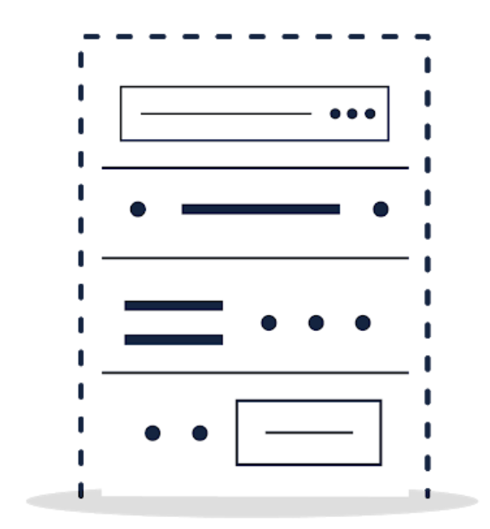

Red Hat Ansible Automation - Roadmap 2021
Leveraging Cloud-native
Physical and Virtual environments
Containerized environments

Slide 13






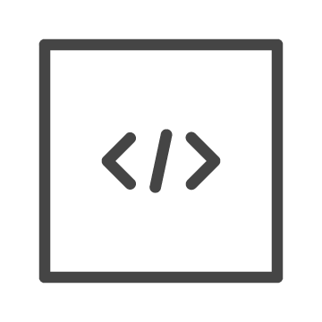




Red Hat Ansible Automation - Roadmap 2021
Current Architecture
Ansible Automation Platform
WebUI
Centralized, monolithic application
Control node contains control plane and execution plane
Poor scalability, rigid architecture
API
RBAC
Workflows
Audit
Execution
virtualenvs
Notes:
Venvs: you have to keep them consistent / in sync on every node in the cluster, for starters. they might require build deps, which get mixed in with your other system deps. they’re just harder to work with, especially in clustered environments. not portable like containers.
Centralized, monolithic application
Control node contains control plane and execution plane
Python virtual environments difficult to admin in production, clustered
Poor scalability, rigid architecture
Operator, Developer, Consumer all relying and using the same host

Slide 14


Red Hat Ansible Automation - Roadmap 2021
Future Architecture
Control Plane
WebUI
Decentralized, modular application
Decouple control plane and execution plane
Containerized execution environments
API
RBAC
Workflows
Audit
Automation Mesh
Execution Environment
Execution Environment
Execution Environment
Notes:
Decentralized, modular application
Control plane and execution plane decoupled
Containerized virtual environments
Scale as needed, on-demand using container orchestrators
Operator, Developer, Consumer have their own “gardens”
Decentralized, modular application
Control plane and execution plane decoupled
Containerized virtual environments
Scale as needed, on-demand using container orchestrators
Operator, Developer, Consumer have their own “gardens”

Slide 15



Red Hat Ansible Automation - Roadmap 2021
Ansible Platform Components
High level view of all components
Updates to Ansible Tower
Updates to Automation Hub
New platform components coming
Deep dive of business solutions for new components
Ansible Automation Platform
Private Automation Hub
Notes:
Ansible Tower*
Ansible Explorer
Ansible Builder
Private Automation Hub
Ansible Platform Operator

Slide 16







Red Hat Ansible Automation - Roadmap 2021
Developer Tools
Automation Execution
Ansible Builder
Ansible Explorer
Ansible Tower
Ansible-test
Core
Molecule & Ansible-lint *
Execution Environments
Content Distribution & Container Registry
Ansible on OpenShift
Private Automation Hub
Platform Operator
* Functionality missing from platform story
Notes:
explorer

Slide 17




Red Hat Ansible Automation - Roadmap 2021
What is Ansible Core?
cli - this includes ansible, ansible-playbook, ansible-doc and numerous other command line utilities for driving and interacting with automation
language - Ansible uses YAML to create a very succinct but powerful set of rules for developing Ansible Playbooks.
framework - this architecture allows pluggability by using collections to be installed and operated from Automation Hub and Ansible Galaxy
functions - this includes conditionals, blocks, includes, loops and other Ansible imperatives
Ansible Core
cli
framework
language
functions

Slide 18




Red Hat Ansible Automation - Roadmap 2021
Why is Ansible Core important?
Red Hat Ansible Automation Platform
Community
Core
Notes:
Ansible core is important because is the fulcrum or common path between community upstream users and Ansible Automation Platform product users. The language of Ansible Automation is the same for both community and customers.

Slide 19




Red Hat Ansible Automation - Roadmap 2021
Limitations of Python Virtual Environments
They don’t work for the enterprise
Tooling
Portability
Maintenance
Python Virtual Environments are not part of the Red Hat Ansible Automation Platform solution. These are Python constructs meant for Python developers.
Python Virtual Environments are unique to a single system and hard to replicate on another system. Its difficult for one person to share their virtual environment with another person to replicate their automation.
Python Virtual Environments may have dozens of Python dependencies per Ansible Automation Project and become increasingly hard to manage and maintain overtime.
<number>

Slide 20



Red Hat Ansible Automation - Roadmap 2021
Ansible Execution Environments
Streamlined development and maintenance of your automation
Challenge
Management of Ansible dependencies, multiple python virtualenvs increases the cost and complexity of automation
Only the packaging of components needed for automation in a cloud-native way. Future ability to directly execute higher-order content such as Ansible Roles with low-code/no-code methods. Scale out capacity on demand with OpenShift.
Solution & Business Value
Bundle together all required Collections, corresponding RPM or PIP3 dependencies, and a minimal Ansible version in a single container.
Technical Implementation

Slide 21


Red Hat Ansible Automation - Roadmap 2021
What’s in an Execution Environment?
Required collections in defined version
Python & needed libraries in defined version
Ansible Core
Universal Base Image (UBI8)
Notes:
ubi8 stands for Red Hat Universal Base Image. The Universal Base Image is designed and engineered to be the base layer for all of your containerized applications, middleware and utilities. This base image is freely redistributable, but Red Hat only supports Red Hat technologies through subscriptions for Red Hat products. This image is maintained by Red Hat and updated regularly. You can view more information about the ubi8 image here: https://catalog.redhat.com/software/containers/ubi8/5c647760bed8bd28d0e38f9f?gti-tabs=unauthenticated

Slide 22


Example Packaging with Execution Environments
amazon.aws Collection
Ansible Execution Environment
ansible.utils Collection
RHEL UBI 8
Ansible Control Node
arista.cvp Collection
Python 3.8
azure.azcollection Collection
Ansible Core 2.11*
ibm.qradar Collection
Collections
redhat.satellite Collection
splunk.es Collection
*includes other Ansible dependencies/packages

Slide 23


Red Hat Ansible Automation - Roadmap 2021
New platform components
Command line tool leveraging podman that builds Ansible environments inside a container.
Ansible Builder*
Command line tool for Execution Environments. Provides enhanced and familiar experience for Ansible creators.
Ansible Explorer*
Ansible Platform Operator
Package, deploy and manage Red Hat Ansible Automation Platform on Openshift Compute Platform (OCP)
* names are subject to change. Ansible Builder is the upstream projects versus the product platform components

Slide 24
Red Hat Ansible Automation - Roadmap 2021
Ansible Builder
Ansible Builder is a tool that aids in the creation of Ansible Execution Environments.
No existing tooling for Ansible Execution Environments or IDE (Integrated Developer Environments) for Ansible Creators. .
Challenge
Ansible Builder allows organizations to customize and build their own Execution Environments with the collections and dependencies they need.
Solution & Business Value
Technical Implementation
Ansible Builder is a python application that will produce a directory that acts as the build context for the container image build, which will contain the Containerfile, along with any other files that need to be added to the image.
https://www.ansible.com/blog/introduction-to-ansible-builder

Slide 25
Red Hat Ansible Automation - Roadmap 2021
Ansible Explorer
Developer environment for navigating, building and executing execution environments
Existing Ansible tooling did not support Execution Environments or easily support navigating multiple installed collections
Challenge
Ansible Explorer uplevels existing Ansible developer experience for native support running Execution Environments. Provides enhanced ability to navigate Ansible Playbook output, documentation, installed plugins and more.
Solution & Business Value
Technical Implementation
Ansible Explorer is a separate python package bundled with Ansible Automation Platform.

Slide 26




Red Hat Ansible Automation - Roadmap 2021
Adapting Certified Execution Environments
create
create
Ansible-Builder
Execution Environments
User
develop
execute
+
Ansible-Explorer
playbook
Execution Environment
✓ Supported Tooling
✓ Portable
✓ Scalable

Slide 27
Red Hat Ansible Automation - Roadmap 2021
Private Automation Hub
Private content repository for sharing automation
Customers have inconsistent way to share trusted content across an increasingly diverse set of technologies and domains
Challenge
Private Automation Hub allows organizational administers to curate which content is available to creators, and reshare internal content across the enterprise.
Solution & Business Value
Technical Implementation
Private Automation Hub is provided as part of the Automation Platform universal installer . This self hosted option can be deployed in a variety of scenarios to host private automation content.

Slide 28
Red Hat Ansible Automation - Roadmap 2021
Ansible Automation Platform Updates
Tower rebranding: Tower name will change, features and capabilities will not
Web UI Updates Updating look and feel to Patternfly 4
Execution Environments: Containerized run-time environments for Ansible Execution
Announce
April 2021
GA
June 2021

Slide 29





Red Hat Ansible Automation - Roadmap 2021
+
Ansible Automation Platform Install Operator
Package, deploy and manage Red Hat Ansible Automation Platform on Openshift
Ansible Automation Platform Resource Operator
Allow Communication between Container Native applications running on OpenShift to Red Hat Ansible Automation Platform
Ansible Automation Integration with ACM
Extend container management and lifecycle through automation

Slide 30
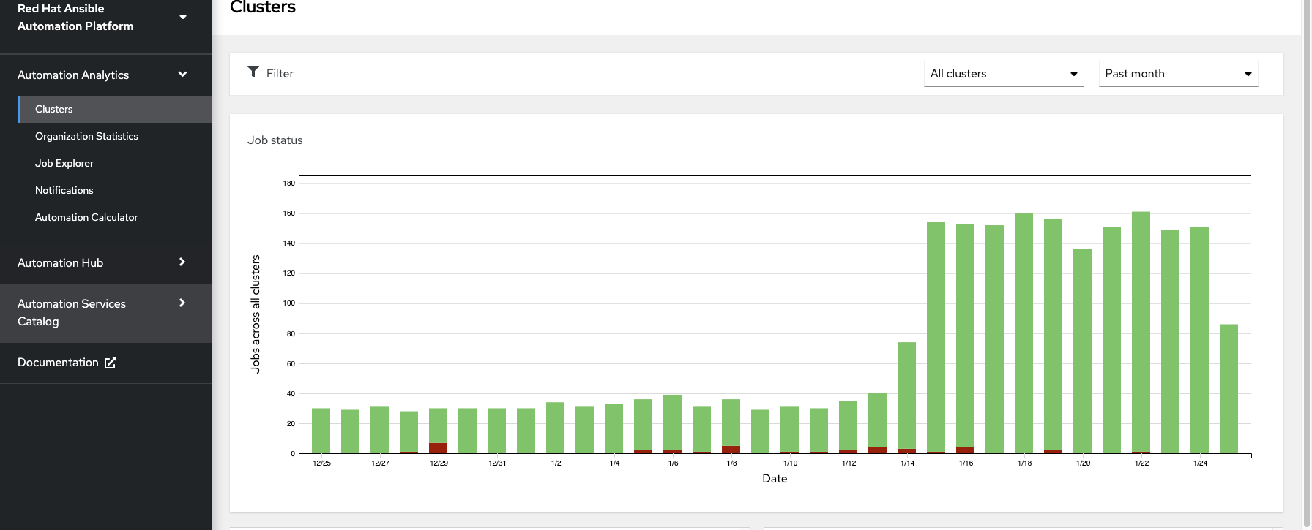
Red Hat Ansible Automation - Roadmap 2021
Ansible Hosted Services
Hosted service available via cloud.redhat.com. Aggregates multiple AAP clusters into one dashboard.
<number>

Slide 31



Red Hat Ansible Automation - Roadmap 2021
Ansible Hosted Services
cloud.redhat.com
Automation Services Catalog
Automation Analytics
Automation Hub
Ansible Automation Platform

Slide 32
Red Hat Ansible Automation - Roadmap 2021
Automation Analytics
Report, resolve, and recognize the value of automation
Customers struggle to understand and measure automation initiatives across an enterprise, making it difficult to capture wins and avoid costly mistakes.
Challenge
Automation Analytics helps customers understand the value of automation through tangible business metrics, resolve issues with AAP more quickly, and receive expert guidance on how to continuously progress their automation initiatives
Solution & Business Value
Technical Implementation
Automation Analytics is provided on cloud.redhat.com as a hosted service. Customers are granted access to via their Red Hat Ansible Automation Platform subscription.

Slide 33
Red Hat Ansible Automation - Roadmap 2021
Ansible Analytics Updates
RBAC Improvements
Control which users can see which content and views
Automation Planner: Help customers plan, track, and report on their automation journey
Email Notifications & Report Exports Provide simple tools to help improve awareness within customer organizations
March
June (MVP)
Notes:
need to figure out SubWatch updates…. info is passed to another team

Slide 34
Red Hat Ansible Automation - Roadmap 2021
Automation Hub
Hosted service on cloud.redhat.com
Customers have inconsistent way to share trusted content across an increasingly diverse set of technologies and domains
Challenge
Automation Hub provides automation content that is certified and supported by Red Hat and our partners. Customers get the assurance they need that they are using supported collections.
Solution & Business Value
Technical Implementation
Automation Hub is provided on cloud.redhat.com as a hosted service. Customers are granted access to Automation Hub via their Red Hat Ansible Automation Platform subscription.

Slide 35




Red Hat Ansible Automation - Roadmap 2021
Creators Experience
DEVELOPER IDE
Custom
Enterprise Content
Infrastructure
Cloud
Automation Hub
cloud.redhat.com
Network
Private Automation Hub
Ansible Automation Platform
CONTENT SDK
Ansible Galaxy
Security
BUILD
PUBLISH
DELIVER
Notes:
Their journey with the Ansible Content Experience starts with a Developer IDE and Content SDK. These tools allow to easily consume trusted content coming from Red Hat and partners [available on Automation Hub on cloud.redhat.com] and the innovation coming from the Ansible community [available on Ansible Galaxy] as it is, or as a base for custom workflows. Once developed, custom content can be tested and, as the second step in the creator journey, published on Private Automation Hub where the organization can apply its own policies and controls. From here, as a final step, all authorized content can be delivered to production, ready to be consumed.

Slide 36
Red Hat Ansible Automation - Roadmap 2021
Automation services catalog
Manage and control the lifecycle of their Ansible content
Challenge
Increase automation adoption to non-creators and operators. Allow the entire enterprise to consume automation in a scalable solution.
Automation Services Catalog allows organizational administers to allow non-technical users to consume automation in a point and click tool to industry standard ITSM tools, all included in their Red Hat subscription.
Solution & Business Value
Technical Implementation
Automation services catalog is a hosted service provided through cloud.redhat.com that allows creation or orderable “products” that can be configured to trigger any automation job on any cluster.

Slide 37
Red Hat Ansible Automation - Roadmap 2021
Automation services catalog
Catalog menu
Decommission subnet / VLAN
onboard user
create developer environment
spin up demonstration environment
Automation Services Catalog
Customer or Consumer
Run audit report
Ansible Automation Platform cluster

Slide 38
In Summary
Create • Scale • Engage

Slide 39
Red Hat Ansible Automation - Roadmap 2021
Ansible Automation Platform 2.0 Components
Ansible Core 2.11
Execution Environments
Ansible Builder
Ansible Explorer
Patternfly 4 User Interface Upgrade
PostgreSQL 12
Container Groups GA
Ansible Automation Platform 2.0 Features
Python virtual environments move to containers
Automation portability between clusters
Enhanced creator experience for playbook authors
Container native support with Openshift Operator
Ansible Automation Platform 2.0 Deployment Notes
Deployable on Red Hat Enterprise Linux 8 and OpenShift 4.x only
No support for isolated nodes (delayed until 2.1)

Slide 40
Red Hat Ansible Automation - Roadmap 2021
Developer Tools
Automation Execution
Ansible Builder
Ansible Explorer
Ansible Tower
Ansible-test
Core
Molecule & Ansible-lint *
Execution Environments
Content Distribution & Container Registry
Ansible on OpenShift
Private Automation Hub
Platform Operator
* Functionality missing from platform story
Notes:
explorer

Slide 41
Red Hat Ansible Automation - Roadmap 2021
Developer Tools
Automation Execution
Ansible Builder
Ansible Explorer
Ansible Tower
Ansible-test
Core
Molecule & Ansible-lint *
Execution Environments
Content Distribution & Container Registry
Ansible on OpenShift
Private Automation Hub
Platform Operator
* Functionality missing from platform story
Notes:
explorer

Slide 42



Red Hat Ansible Automation - Roadmap 2021
Execute
Create
Distribute
Control
Ansible Explorer
Private Automation Hub
Ansible Tower
Ansible-test
Molecule & Ansible-lint *
Platform Operator - Openshift
Ansible Builder
or
Red Hat Enterprise Linux
Developer Tools

Slide 43



Execute
Content & Dependencies
Ansible Core
Universal Base Image 8
Execution Environment
Create
Distribute
Control
Ansible Explorer
Private Automation Hub
Ansible Tower
Ansible-test
Molecule & Ansible-lint *
Platform Operator - Openshift
Ansible Builder
or
Red Hat Enterprise Linux
Developer Tools

Slide 44
Thank you

Slide 45


Execute
Content & Dependencies
Ansible Core
Universal Base Image 8
Execution Environment
Distribute
Control
Create
Private Automation Hub
Ansible Tower
Ansible Explorer
Ansible-test
Molecule & Ansible-lint *
Platform Operator - Openshift
or
Ansible Builder
Red Hat Enterprise Linux
Operations
Developer Tools

Slide 46
Create
Distribute
Control
Ansible Explorer
Private Automation Hub
Ansible Tower
Ansible-test
Molecule & Ansible-lint *
Platform Operator - Openshift
Ansible Builder
or
Red Hat Enterprise Linux
Developer Tools
Execute
Operations
Content & Dependencies
Ansible Core
Universal Base Image 8
Execution Environment

