Slide 1
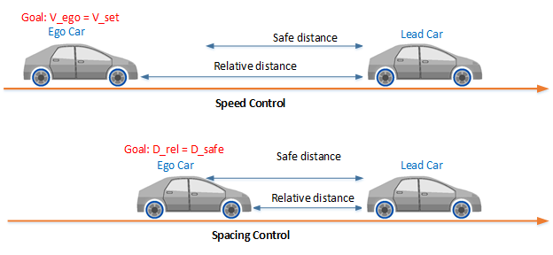
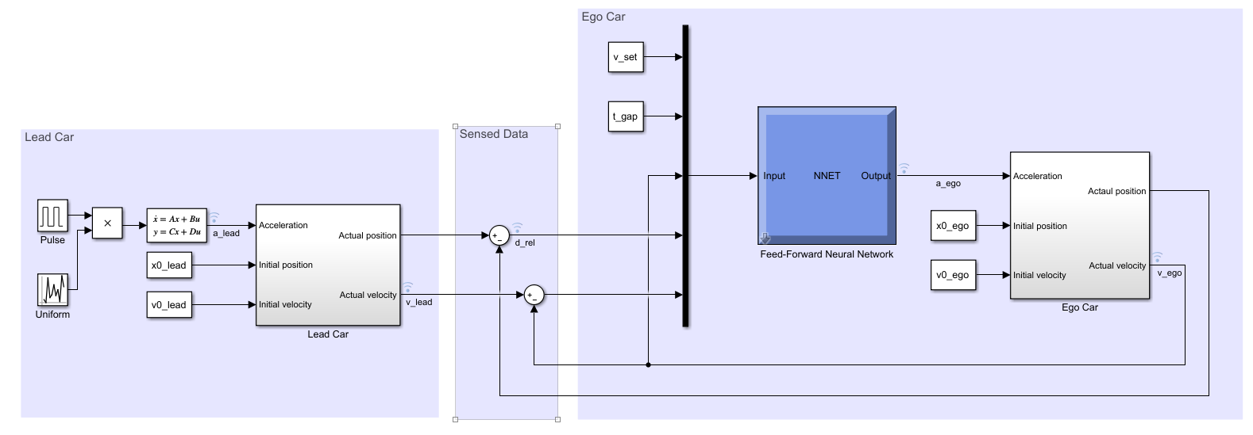
The adaptive cruise control (ACC) system that tracks a set velocity and maintains a safe distance from a lead vehicle by adjusting the longitudinal acceleration of an ego vehicle.

Slide 2
