Slide 1
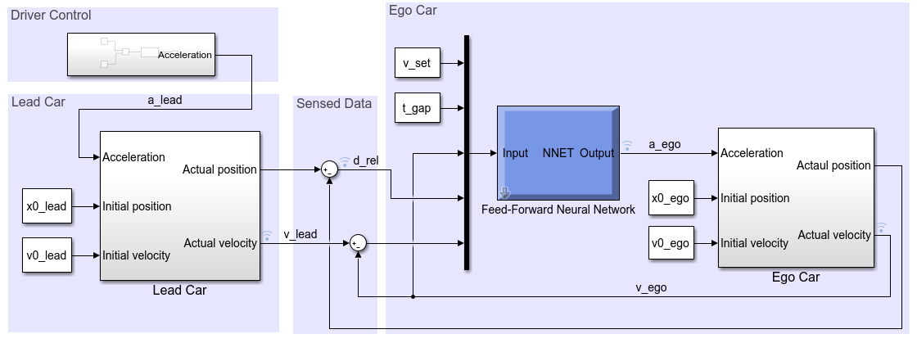
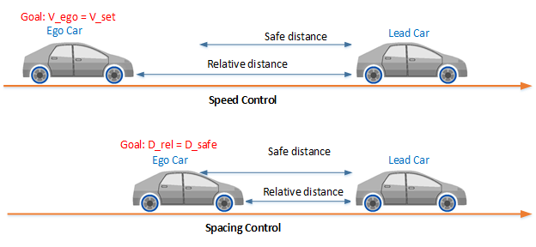
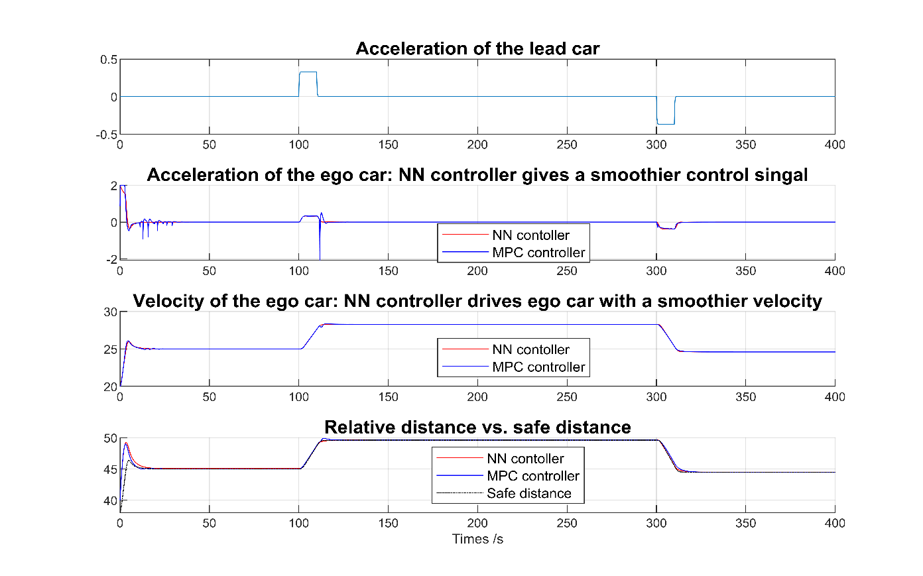
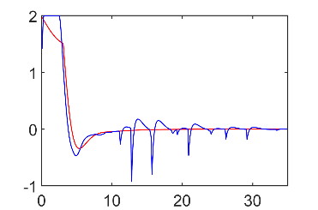
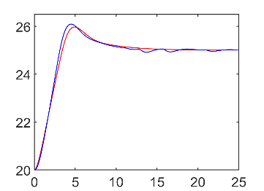
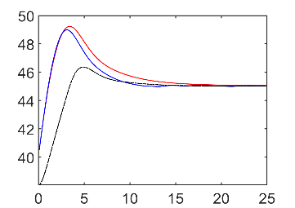
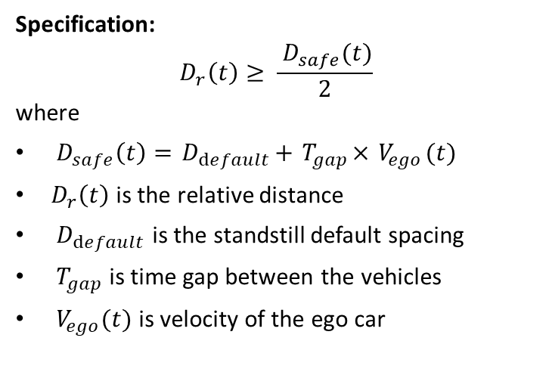
Adaptive Cruise Control System:
tracks a set velocity
maintains a safe distance
Specification:
$$D_{r}\left(t\right)≥ \frac{{ D}_{safe}(t)}{2}$$
where
${ D}_{safe}\left(t\right)={ D}_{default}+{ T}_{gap}×{ V}_{ego}(t)$
$D_{r}\left(t\right)$ is the relative distance
${ D}_{default}$ is the standstill default spacing
${ T}_{gap}$ is time gap between the vehicles
${ V}_{ego}(t)$ is velocity of the ego car

