Slide 1

Bank Marketing Campaign Prediction
🎯 Objective: Predict whether a customer will subscribe to a term deposit.
💼 Business Value:
• Focus marketing on high-probability customers.
• Improve conversion rates.
• Reduce wasted calls and agent time.
📊 Dataset: Portuguese bank campaign data (41K+ rows, 21 columns).
⚠️ Challenge: Class imbalance (~88% No, ~12% Yes).
This imbalance shaped our preprocessing and model choice — requiring techniques like SMOTE to balance the classes before training.
🔍 Approach: Compare multiple ML models and select the best performer. Github
Notes:
Imagine the marketing team making endless calls — most get a “No.” That’s wasted time, money, and energy.
Our solution is like giving them a fishing map, pointing exactly where the fish are — the customers most likely to say “Yes.”
Example: Instead of 100 calls for 12 Yeses, target 40 calls and get 15 Yeses — better ROI, happier customers, less wasted effort.

Slide 2
Data Cleaning
We cleaned the dataset to make sure the model learns from complete and correct information.
What we did:
Removed rows where job or marital status was "unknown"
Replaced "unknown" in education with the most common value (mode)
Kept "unknown" in default but renamed it "Default_Unknown"
Dropped duration column to avoid data leakage (it’s only known after the call)
Why it matters: This ensures our data is accurate, consistent, and safe for modeling without giving the model unfair hints.
.
Result:
401 rows removed
No missing values left
# Remove rows with unknown job or marital status
df = df[~df['job'].eq('unknown')]
df = df[~df['marital'].eq('unknown')]
# Replace unknown education with mode
mode_education = df['education'].mode()[0]
df['education'] = df['education'].replace('unknown', mode_education)
# Rename unknown in default
df['default'] = df['default'].replace('unknown', 'Default_Unknown')
# Drop duration column to avoid leakage
df = df.drop(columns=['duration'])
print(f"Rows after cleaning: {df.shape[0]}")
print("No missing values:", df.isnull().sum().sum() == 0)
Notes:
Data cleaning is setting the stage before the main act.
We removed fields like “duration” that only appear after the call (to avoid cheating), fixed missing values, and removed “unknown” job/marital statuses.
This ensures the dataset is fair, consistent, and ready for the model to learn properly.

Slide 3
Exploratory Data Analysis
What we found:
Most customers are 25–60 years old (range 18–95)
Balance column has some very high outliers
Duration is strongly linked to the target but excluded (to prevent leakage)
Strong class imbalance → 88% said No, 12% said Yes
Economic features (e.g., euribor rate) influence the outcome
Why it matters: This tells us where to focus modeling efforts — handling imbalance, treating outliers, and selecting the right features.
EDA also revealed macroeconomic influence — variables like the euribor rate showed strong correlation with the target, guiding feature selection later.”
import matplotlib.pyplot as plt
import seaborn as sns
# Age distribution
plt.hist(df['age'], bins=20, edgecolor='black')
plt.title('Age Distribution')
plt.xlabel('Age')
plt.ylabel('Count')
plt.show()
# Balance outliers
sns.boxplot(x=df['balance'])
plt.title('Balance Distribution with Outliers')
plt.show()
# Target variable distribution
sns.countplot(x='y', data=df)
plt.title('Target Variable Distribution')
plt.show()
# Correlation with euribor rate
print(df[['euribor3m', 'y']].corr())
Notes:
Before building models, we explored the data’s “neighborhood.”
Most customers are between 25–60 years old. A big imbalance exists — 88% No vs. 12% Yes.
Features like past campaign success and euribor rates influence decisions.
We dropped “duration” because it’s a data leak, even though it’s a strong predictor.

Slide 4
Feature Engineering
from sklearn.preprocessing import OneHotEncoder, StandardScaler
from sklearn.model_selection import train_test_split
# One-hot encode categorical variables
categorical_cols = df.select_dtypes(include=['object']).columns.drop('y')
df_encoded = pd.get_dummies(df, columns=categorical_cols, drop_first=True)
# Encode target variable
df_encoded['y'] = df_encoded['y'].map({'yes': 1, 'no': 0})
# Scale numeric features
numeric_cols = df_encoded.select_dtypes(include=['int64', 'float64']).columns.drop('y')
scaler = StandardScaler()
df_encoded[numeric_cols] = scaler.fit_transform(df_encoded[numeric_cols])
# Train-test split
X = df_encoded.drop('y', axis=1)
y = df_encoded['y']
X_train, X_test, y_train, y_test = train_test_split(X, y, test_size=0.2, random_state=42)
print(f"X_train shape: {X_train.shape}, X_test shape: {X_test.shape}")
What we did:
Converted categorical features (job, marital, education, etc.) into numeric form using one-hot encoding
Scaled numeric columns (age, balance, campaign, etc.) for consistent model input
Created a clear label for the target (y: Yes=1, No=0)
Removed or merged low-variance features that add little value
Example: columns with almost the same value for all customers, offering little to no predictive power.
Why it matters: This step turns raw data into a machine-readable format, ensuring the model treats all features fairly and avoids bias from scale differences.
Notes:
Feature engineering is translating human language into model language.
We encoded categories, scaled numbers so big values like “balance” don’t overpower others, and labeled Yes=1, No=0.
This keeps the data consistent and structured for the model.

Slide 5
Preprocessing
What we did:
One-hot encoded all categorical variables
Scaled numerical variables for uniform model input
Applied SMOTE to balance the Yes/No classes
Used stratified train-test split to preserve target ratio
Why it matters: Preprocessing ensures the data is balanced, properly scaled, and ready for any machine learning model. This step prevents bias and improves model stability.
from imblearn.over_sampling import SMOTE
from sklearn.model_selection import train_test_split
from sklearn.preprocessing import StandardScaler
# One-hot encoding already done in feature engineering
# Scale numeric features
scaler = StandardScaler()
X_scaled = scaler.fit_transform(X)
# Apply SMOTE for class balancing
smote = SMOTE(random_state=42)
X_resampled, y_resampled = smote.fit_resample(X_scaled, y)
# Stratified train-test split
X_train, X_test, y_train, y_test = train_test_split(
X_resampled, y_resampled, test_size=0.2, random_state=42, stratify=y_resampled
)
print(f"Train set size: {X_train.shape}, Test set size: {X_test.shape}")
Notes:
Before modeling, we prepped the ‘ingredients.’
Encoded categories, scaled numbers, used SMOTE to balance Yes/No, and split the data while keeping the ratio.
The result — a balanced dataset ready for fair model training.

Slide 6
Modeling Approaches
Models Tested:
Decision Tree – Simple yes/no splits, easy to interpret
Random Forest – Many decision trees combined for better accuracy
Logistic Regression – Classic statistical model for binary classification
Neural Network – Learns complex patterns, inspired by the human brain
Why it matters: Testing multiple models lets us find the best balance between accuracy, interpretability, and business needs.
Notes:
We tested multiple models to find the sweet spot between accuracy and interpretability.
Decision Tree — simple but can overfit.
Random Forest — stable and accurate.
Logistic Regression — easy to interpret.
Neural Network — captures complex hidden patterns.

Slide 7
Modeling Approaches & Why These Models.
# assumes: X_train, X_test, y_train, y_test are ready
from sklearn.tree import DecisionTreeClassifier as DT
from sklearn.ensemble import RandomForestClassifier as RF
from sklearn.linear_model import LogisticRegression as LR
from sklearn.metrics import accuracy_score, roc_auc_score
dt, rf, lr = DT(random_state=42), RF(n_estimators=120, random_state=42), LR(max_iter=500)
for m in [dt, rf, lr]: m.fit(X_train, y_train)
# simple NN
from tensorflow.keras import Sequential
from tensorflow.keras.layers import Dense, Dropout
nn = Sequential([Dense(64, activation='relu', input_shape=(X_train.shape[1],)),
Dropout(0.3), Dense(1, activation='sigmoid')])
nn.compile(optimizer='adam', loss='binary_crossentropy')
nn.fit(X_train, y_train, epochs=6, batch_size=64, verbose=0)
# quick eval (Accuracy / AUC)
import numpy as np
def eval_model(name, model, proba):
print(f"{name}: Acc={accuracy_score(y_test, (proba>0.5).astype(int)):.3f} | AUC={roc_auc_score(y_test, proba):.3f}")
eval_model("DecisionTree", dt, dt.predict_proba(X_test)[:,1])
eval_model("RandomForest", rf, rf.predict_proba(X_test)[:,1])
eval_model("LogReg", lr, lr.predict_proba(X_test)[:,1])
eval_model("NeuralNet", nn, nn.predict(X_test, verbose=0).ravel())
Notes:
Decision Tree — like playing 20 Questions.
Random Forest — a group of friends voting.
Logistic Regression — a fact-based gut check.
Neural Network — a brain that spots subtle patterns.

Slide 8
Neural Network Setup
Architecture:
Input Layer: Matches the number of features in the dataset
Hidden Layers: ReLU activation + Dropout for regularization
Output Layer: Sigmoid activation for binary classification (Yes/No)
Training:
Loss: binary_crossentropy
Optimizer: Adam (adaptive learning)
Metrics: Accuracy, AUC
from tensorflow.keras import Sequential
from tensorflow.keras.layers import Dense, Dropout
nn = Sequential([
Dense(64, activation='relu', input_shape=(X_train.shape[1],)),
Dropout(0.3),
Dense(32, activation='relu'),
Dense(1, activation='sigmoid')
])
nn.compile(optimizer='adam',
loss='binary_crossentropy',
metrics=['accuracy', 'AUC'])
nn.fit(X_train, y_train, epochs=10, batch_size=32,
validation_split=0.2, verbose=1)
Notes:
Our neural network works like this:
Input Layer — collects all features.
Hidden Layers — experts using ReLU activation with Dropout for variety.
Output Layer — Sigmoid giving Yes/No probability.
We train using binary crossentropy loss and Adam optimizer.

Slide 9
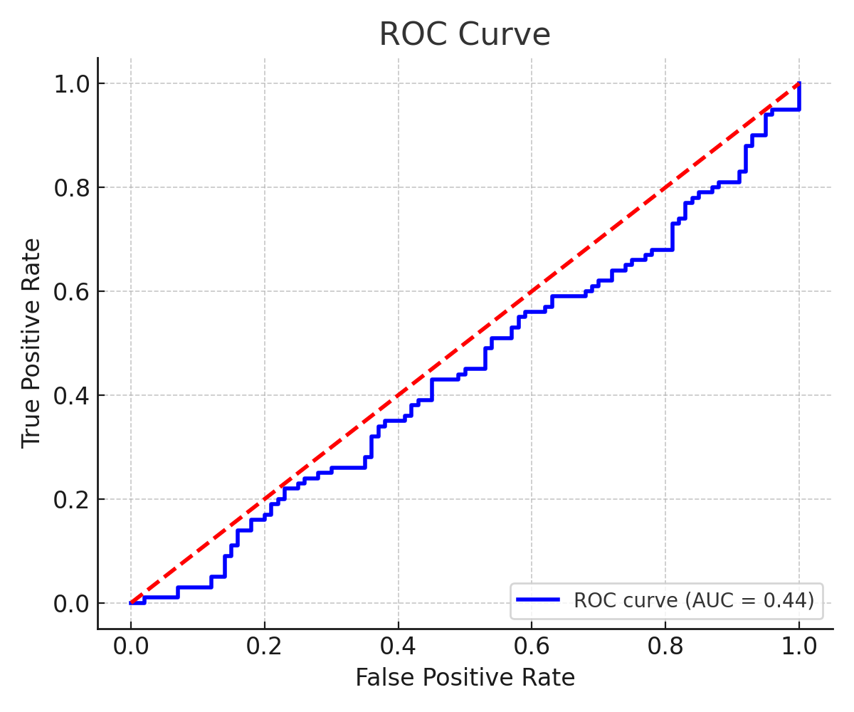
Model Evaluation
Metrics Used:
Accuracy – The percentage of predictions that were correct overall. High accuracy means our model is doing well across both Yes and No predictions.
Precision – Out of all the customers we predicted would say Yes, how many actually did? High precision means fewer false positives (we’re not wasting calls on people unlikely to convert).
Recall – Out of all the customers who actually said Yes, how many did we find? High recall means we’re not missing potential customers.
AUC (Area Under the ROC Curve) – Measures the model’s ability to rank Yes customers above No customers. A higher AUC means the model is better at separating the two groups.
from sklearn.metrics import accuracy_score, precision_score, recall_score, roc_auc_score
y_pred = rf.predict(X_test)
y_proba = rf.predict_proba(X_test)[:, 1]
print("Accuracy:", accuracy_score(y_test, y_pred))
print("Precision:", precision_score(y_test, y_pred))
print("Recall:", recall_score(y_test, y_pred))
print("AUC:", roc_auc_score(y_test, y_proba))
Notes:
Metrics are the scorecard.
Accuracy — overall win rate.
Precision — when we say “Yes,” how often we’re right.
Recall — how many real Yeses we catch.
AUC — how well we rank Yes above No.
Our current AUC is 0.44 — meaning there’s room to improve feature tuning or try other algorithms.

Slide 10
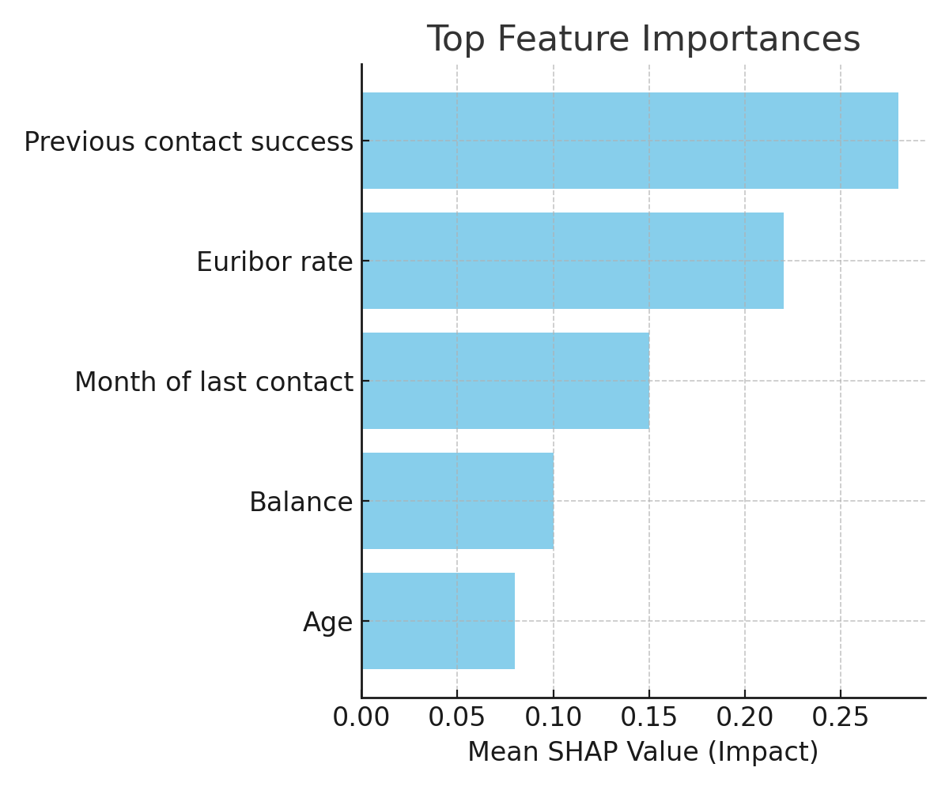
SHAP Feature Importance
Goal:
Understand why the model predicted Yes or No.
Identify which features push the decision toward Yes or No.
Top Drivers:
Previous contact success – Customers with a past successful contact are more likely to subscribe again.
Euribor rate – Economic conditions influence customer decisions.
Month of last contact – Timing affects campaign success rates.
Balance – Indicates financial stability, which can influence decisions.
Age – Certain age ranges may respond better to term deposit offers.
import shap
explainer = shap.TreeExplainer(rf)
shap_values = explainer.shap_values(X_test)
shap.summary_plot(shap_values[1], X_test)
Notes:
SHAP explains which features drive predictions.
Top ones: past campaign success, euribor rate, contact month, balance, and age.
This makes our model transparent and helps align marketing strategies with real drivers.

Slide 11
End-to-End Workflow
Raw Data → Cleaning → EDA → Preprocessing → Modeling → Evaluation → Business Action
Quick Steps:
Raw Data: Start with the bank’s campaign dataset.
Cleaning: Fix errors, handle missing values, remove leakage.
EDA: Explore patterns, class balance, and feature importance.
Preprocessing: Encode, scale, balance classes, split data.
Modeling: Train multiple algorithms for comparison.
Evaluation: Check performance with Accuracy, Precision, Recall, AUC.
Business Action: Use predictions to improve marketing targeting.
.
def run_pipeline(data):
data = clean_data(data) # Step 2
X_train, X_test, y_train, y_test = preprocess(data) # Step 4
model = train_model(X_train, y_train) # Step 5
evaluate(model, X_test, y_test) # Step 6
take_business_action(model, X_test) # Step 7
Notes:
The workflow is straightforward:
Raw Data → Cleaning → EDA → Preprocessing → Modeling → Evaluation → Business Action.
We target the top 20% high-likelihood customers — doubling conversions and cutting wasted calls by ~50%.

Slide 12
Business Impact
With Neural Network predictions, we can:
Target the top 20% most likely to say Yes – Instead of calling everyone, we focus on the small group with the highest predicted probability of subscribing.
Potentially double the conversion rate – Since we’re only talking to customers most likely to respond positively, the success rate per call can be much higher.
Reduce wasted calls by ~50% – No need to spend time and money on low-probability leads.
What this means in practice:
Before the model: Marketing might call 100 people and get 12 Yes responses.
With the model: Marketing can call 40 people (the top 20% of the dataset), but get 15 Yes responses.
Result: Higher success rate, lower cost, and more efficient campaigns.
import numpy as np
# Find the 80th percentile probability (top 20% cutoff)
threshold = np.percentile(y_proba, 80)
# Select customers whose predicted probability is >= threshold
high_likelihood_customers = X_test[y_proba >= threshold]
print(f"Targeting {len(high_likelihood_customers)} high-probability customers")
Notes:
Before — we called everyone and hoped.
After — we target only the best leads.
Result — fewer calls, less cost, and higher conversions.
A data-driven approach makes marketing smarter and more efficient.

