Slide 1

WELCOME
Testing 1
Heap Memory Manager
Testing 2
Errors and thread-safety
HMM Library
Allocation
How it works?
Solution
Tracking Strategy
Agenda
Shadi Bahaa

Slide 2
I am going to talk about…
Tracking strategy
Fast Allocation
Fast Deallocation
Fragmentation handling, coalescing
Testing 1
Agenda
Testing 2
Errors and thread-safety
HMM Library
Allocation
How it works?
Solution
Tracking Strategy
Thread safety
Error Handling
Testing Methodology

Slide 3
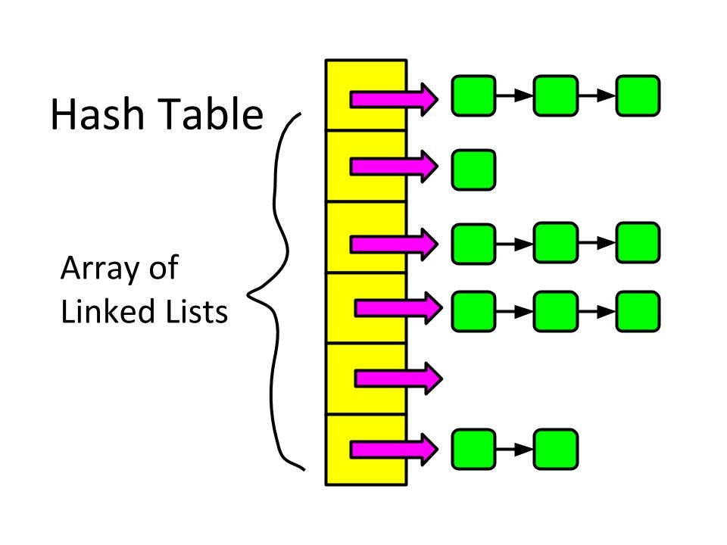
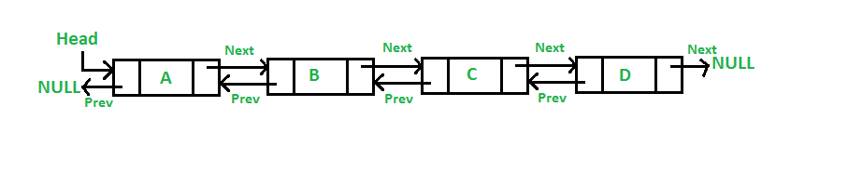
Need fast lookup for free blocks to
reduce
fragmentation
Testing 1
Agenda
Testing 2
Tracking Strategy
Errors and thread-safety
HMM Library
Allocation
How it works?
Solution
Need to free neighbor blocks when attempting to decrease program break or coalesce

Slide 4

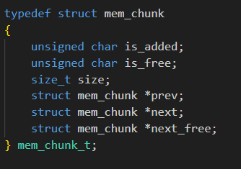
What should I do?
Testing 1
Agenda
Solution
Testing 2
Tracking Strategy
Errors and thread-safety
HMM Library
Allocation
How it works?
prev, next: doubly linked list
next_free: hash table

Slide 5
NULL
head
NULL
8
free
16
free
8
free
NULL
tail
NULL
How it works?
Testing 1
Agenda
Solution
Testing 2
Tracking Strategy
Errors and thread-safety
HMM Library
Allocation
 |  | NULL
Hash_table[0] Holds sizes = (0+1) * 8 = 9 | Hash_table[1] Holds sizes = (1+1) * 8 = 16 | Hash_table[2] Holds sizes = (2+1) * 8 = 24

Slide 6
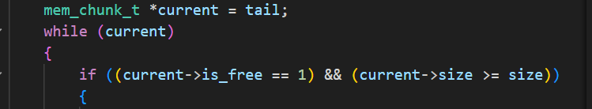

HMMget_free_chunk(size_t size)
1- Trying to get a block with size = size from the hash table: O(1), fragmentation handling
2- If failed, try to get enough chunk from doubly linked list starting from tail: almost O(1), fragmentation handling
3- If failed, try to allocate new space using sbrk, and take a part of it and let the remaining free: O(1), splitting
Testing 1
How it works?
Allocation
Solution
Testing 2
Tracking Strategy
Errors and thread-safety
HMM Library
Agenda

Slide 7
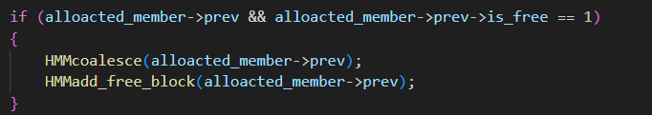
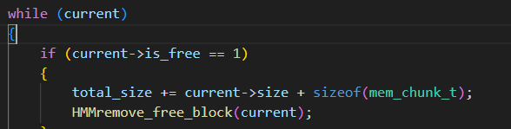
HMMmalloc: uses HMMget_free_chunk(size_t size)
HMMcalloc: uses HMMmalloc besides memset for initializing all members with zero O(n)
HMMrealloc: uses HMMmalloc besides memcpy for copying old pointer data O(n)
HMMfree: almost O(1) time
How?
1- If ptr is freed before or NULL, the function returns: O(1)
2- If ptr freed, it coalesces it with the neighboring chunks: O(1), fragmentation handling
3- If total freed area overcame certain threshold, the free lowers the program break: almost O(1)
HMM Library
How it works?
Testing 1
Agenda
Allocation
Solution
Testing 2
Tracking Strategy
Errors and thread-safety

Slide 8
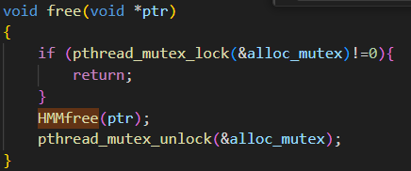
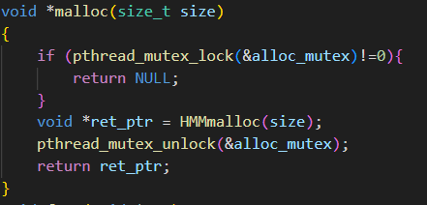
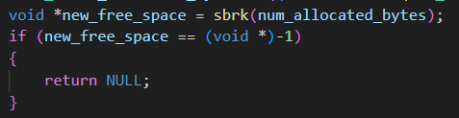
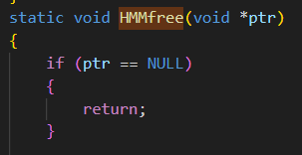
Is it thread-safe?
HMM Library
How it works?
Testing 1
Errors and thread-safety
Agenda
Allocation
Solution
Testing 2
Tracking Strategy
Does handle errors?

Slide 9
Testing methodology:
Random everything – Repeat testing – Let it work in real application
NUM_OPERATIONS = 100000
MAX_SIZE | Average runtime after 50 runs in ms
10 | 52
100 | 62
1000 | 323
10000 | 2603
100000 | 22250
HMM Library
How it works?
Testing 1
Agenda
Errors and thread-safety
Allocation
Solution
Testing 2
Tracking Strategy

Slide 10
MAX_SIZE = 100000
NUM_OPERATIONS | Average runtime after 50 runs in ms
10 | 13
100 | 21
1000 | 58
10000 | 382
100000 | 26217
Testing 2
HMM Library
How it works?
Testing 1
Agenda
Errors and thread-safety
Allocation
Solution
Tracking Strategy

