Slide 1

MERN stack
  Building A React CRUD Application

Slide 2
Steps….First, Front-End
Adding Bootstrap To The React Project
$ npm install bootstrap
import "bootstrap/dist/css/bootstrap.min.css"; /APP.js
Setting Up React Router
^{$ npm install react-router-dom}

Slide 3
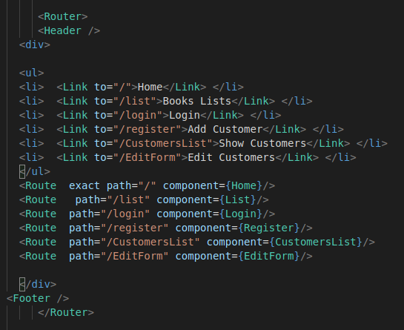

Slide 4
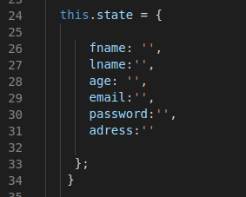
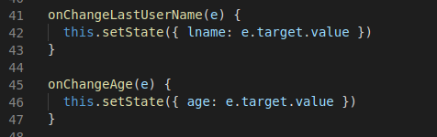
Steps...
Implementing Customers Component Then Add Methods...

Slide 5
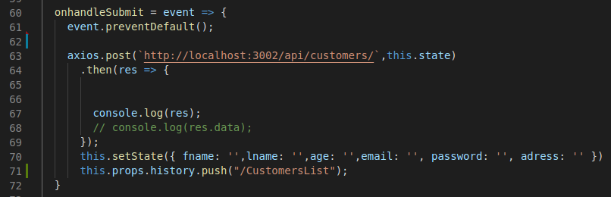
Another method needed

Slide 6
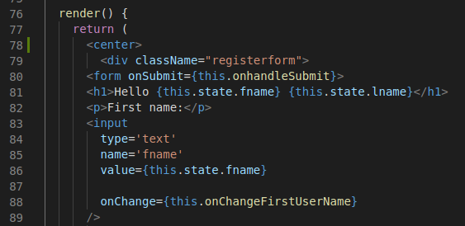
Add the JSX code to display the form

Slide 7
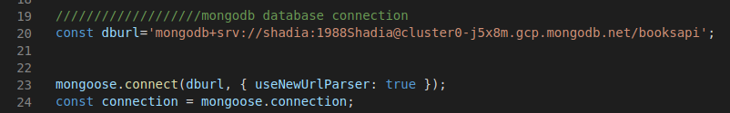
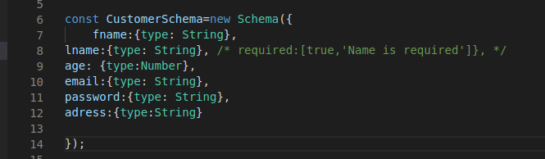
Steps...Second, The back-end
Connecting To MongoDB By Using Mongoose library
And create the
Mongoose schema

Slide 8
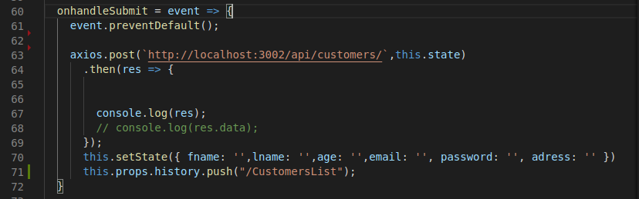
Last Step..Connecting Front-End To Back-End
$ npm install axios
axios is in the handelsubmit

Slide 9
Show the result

