Slide 1
Khmer Braille Machine Translation
Shadia Baroud

Slide 2
The problem to be addressed
Limited Access: Visually impaired individuals in Cambodia have limited access to educational resources.
Challenges in Schools: Teachers and students at the National Institute of Special Education and other special education schools struggle to access Braille translation software to convert Khmer to Braille.
Software Issues: Existing Braille translation software for Khmer is error-prone, expensive, and difficult to customize for special signs and formulas required in subjects like Math, Physics, and Chemistry.

Slide 3





The problem to be addressed
SDG Focus:

Slide 4
Addressing Accessibility Challenges for Khmer Braille
Commercial Braille translation software options, such as the Duxbury Braille Translator, are prohibitively expensive in Cambodia, limiting accessibility for visually impaired individuals.
Our goal is to bridge the gap between visually impaired individuals and others in Cambodia by developing an open-source machine translation system for Khmer Braille, thereby contributing to the community.

Slide 5
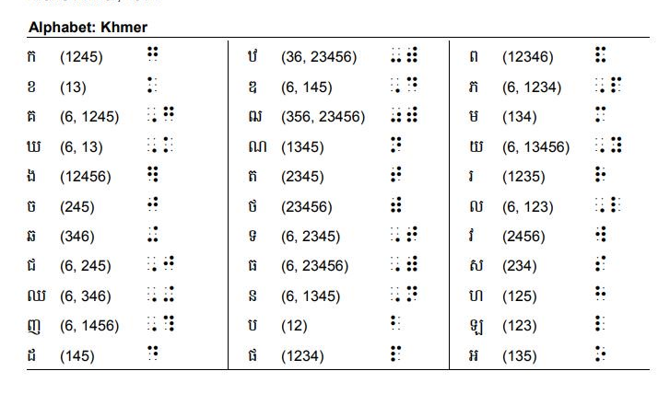
Example of Khmer Braille
Source: Krousar Thmey

Slide 6
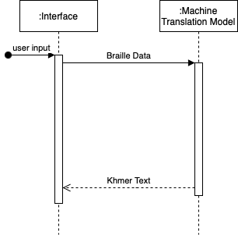
Our solution
Sequence Diagram
We developed a baseline machine translation system utilizing a statistical model.
Achieved BLEU scores:
85% for Khmer to Braille translation.
70% for Braille to Khmer translation (using the Operation Sequence Model).

Slide 7
Example of Khmer to Braille Translation
Khmer
Braille
▁គេ បាន បញ្ច ាក់ថាសេះពូជ ▁បេណាំង ទាំង ▁៨ ▁នៅទី▁លាន
បេណាំងសេះរង់វីក ▁ទី▁កេុង ▁សុីដនី▁បា ▁ឆ្លង ▁រោគ ផ្តេសាយធំ
▁របស់▁សត្វ▁សេះ។▁
▁f , g ▁b *, n ▁b ,? vj * g 9 ▁)* ▁su ▁&3, j ▁vrbnz RB ▁, tz RB ▁# h
▁, n _ ▁, te ▁, l *, n ▁vrbnz RB ▁su ▁r RB9 weg ▁, te ▁vrgc RB ▁s -
ed , ne ▁b *, n ▁+ v , l RB ▁r :, g ▁pvt * s *, y ▁,) y ▁rbs 9 ▁stvw
▁su ▁=

Slide 8





IMPROVEMENT
Future
Work
CONDUCT WORKSHOP
SYSTEM
ADAPTATION
OPEN-SOURCE APP

Slide 9
References
[1] Yann, K., Veng, P., Thu, Y.K, Ly, R.: Statistical vs Neural Machine Translations for Khmer Braille. In: The 13th Conference on Information Technology and Its Applications (2024).
[2] Thu, Y.K., Chea, V., Finch, A.M., Utiyama, M., Sumita, E.: A large-scale study of statistical machine translation methods for khmer language. In: Pacific Asia Conference on Language, Information and Computation (2015), https://api.semanticscholar.org/CorpusID:13622925
[3] Chea, V., Thu, Y.K., Ding, C., Utiyama, M., Finch, A.M., Sumita, E.: Khmer word segmentation using conditional random fields (2015), https://api.semanticscholar.org/CorpusID:49269483
[4] Krousar Thmey Organization: Khmer Braille Book For Blind People (2021), https://github.com/liblouis/braille-specs/blob/master/khmer/Khmer.Braille.Signs.pdf

Slide 10
Thank You!

