Slide 1


Real Estate Industry Analysis For the City Of Toronto
Presented by :
Syed Shadman Sakeeb
Charles Liu

Slide 2
Introduction
One of Canada's most popular national real estate marketplaces and listing site.
Over 10 million home shoppers use Zolo to buy, sell, rent, finance, and learn about real estate per month.
With over 750 active real estate agents, Zolo serves home buyers, renters, and sellers in British Columbia, Alberta, Ontario, and Saskatchewan.
Zolo brings home shoppers, renters and sellers authoritative news, views and trends that touch on personal finance issues and help explain Canada’s real estate marketplace

Slide 3







Tools
Jupyter Notebook
Python
Selenium
BeautifulSoup
Pandas
Numpy
Matplotlib
Seaborn

Slide 4
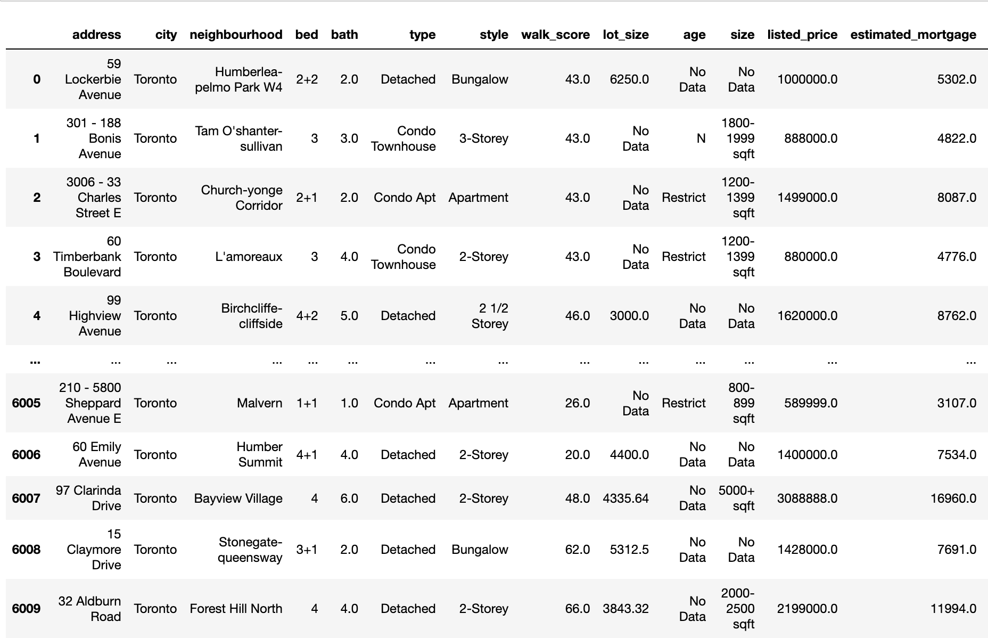
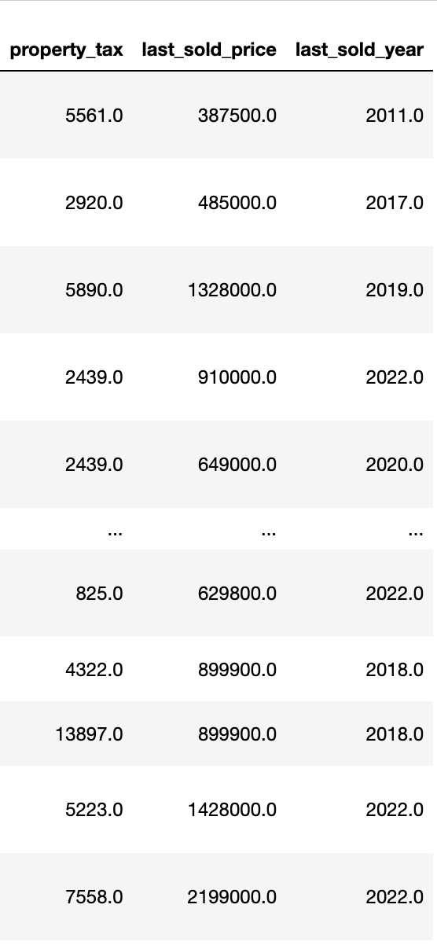
Dataframe from Scraped Data

Slide 5
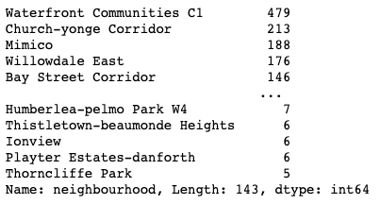

EDA: Types of Properties
Total Number of Properties : 6038
Number of Neighbourhoods in Toronto
Top 4 types of properties by Number of Listing

Slide 6
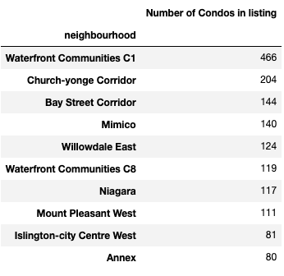
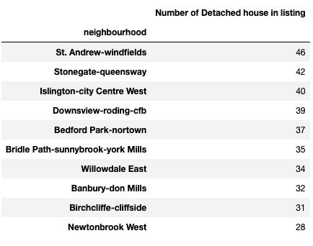
EDA: Types of Properties listing in Neighbourhoods
10 neighbourhoods having highest number of Condominiums and Detached house listings

Slide 7
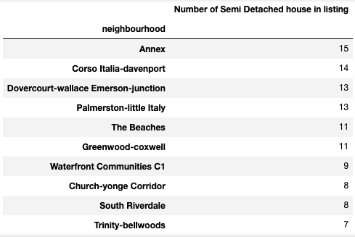
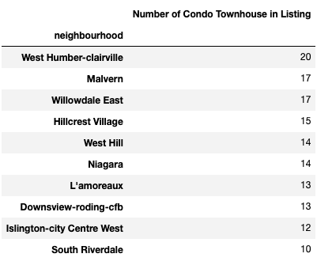
EDA: Types of Properties listing in Neighbourhoods
10 neighbourhoods having highest number of Semi-Detached and Condo Townhouse house listings

Slide 8
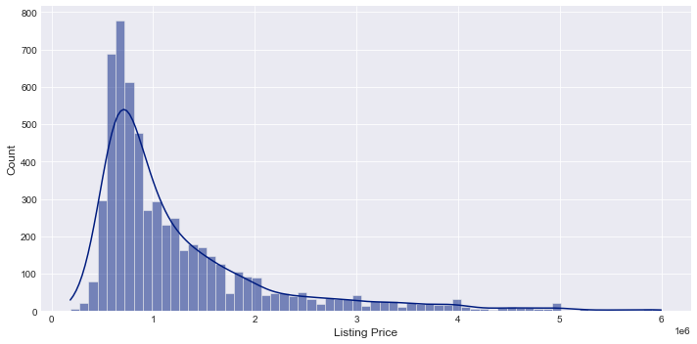
Overall Distribution of Price of Active Listings
City of Toronto

Slide 9
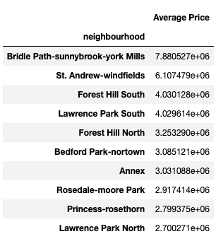
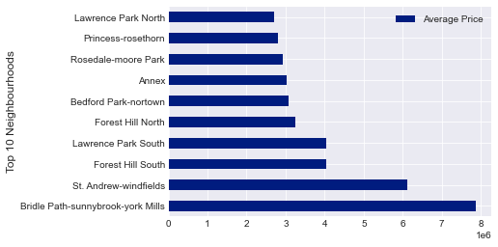
Top 10 Neighbourhoods with Highest Average Price

Slide 10
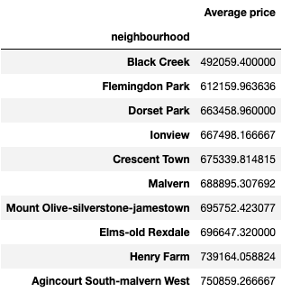
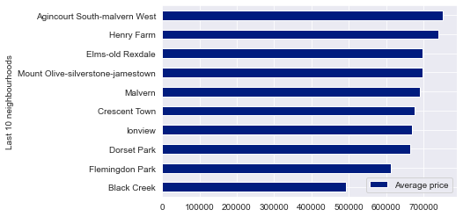
Last 10 Neighbourhoods with Lowest Average Price

Slide 11
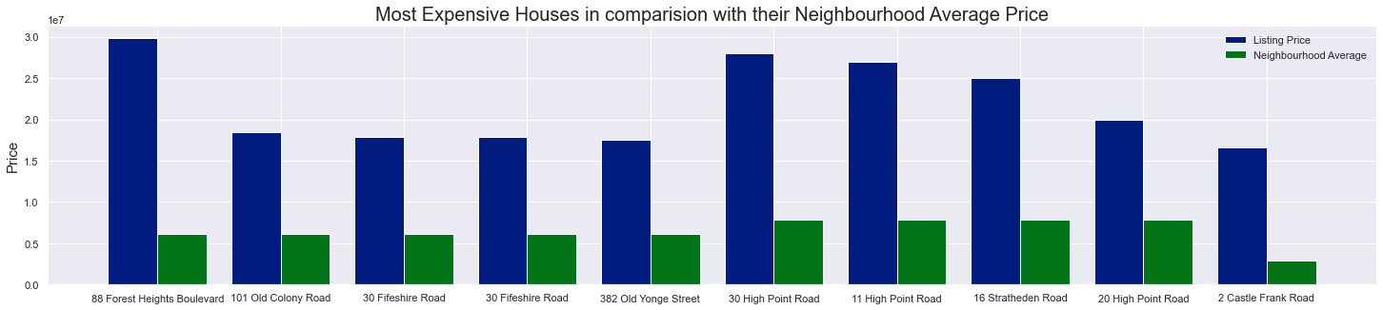
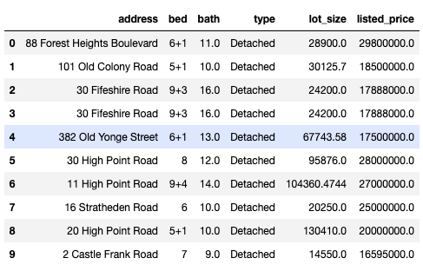
Most Expensive Properties(Comparison with Respective Neighbourhood Average)

Slide 12
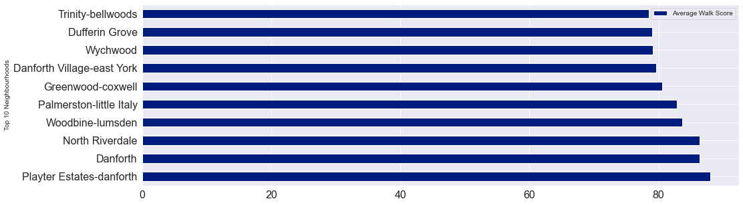
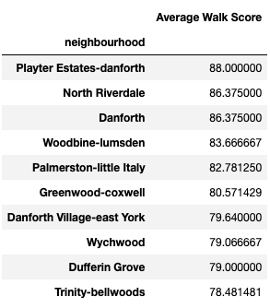
Walk Score Analysis : Top 10 Neighbourhoods

Slide 13
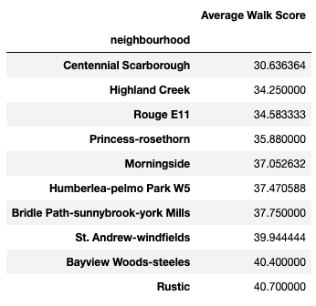
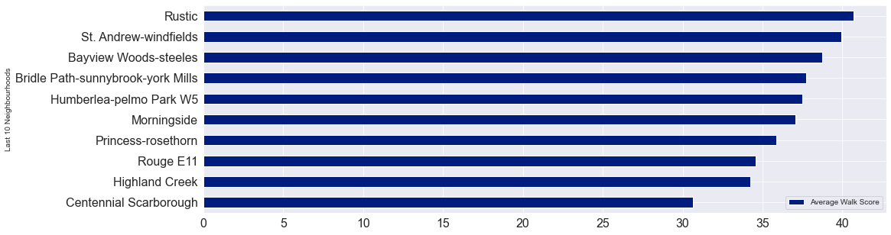
Walk Score Analysis : Last 10 Neighbourhoods

Slide 14
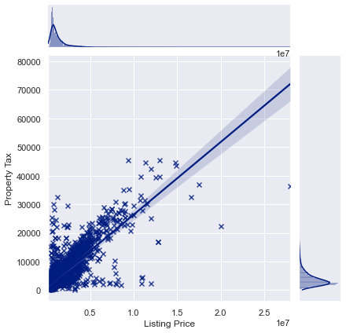
Property Tax Analysis : Correlation with Listing Price

Slide 15
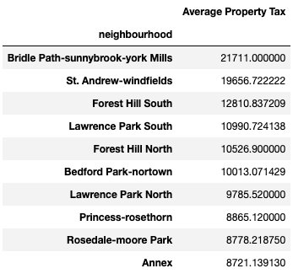
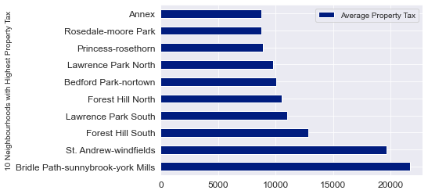
10 Neighbourhoods with Highest Average Property Tax

Slide 16
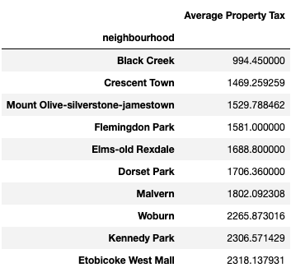
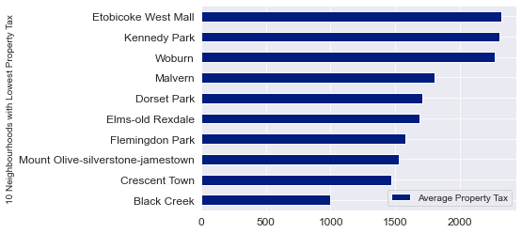
10 Neighbourhoods with Lowest Average Property Tax

Slide 17
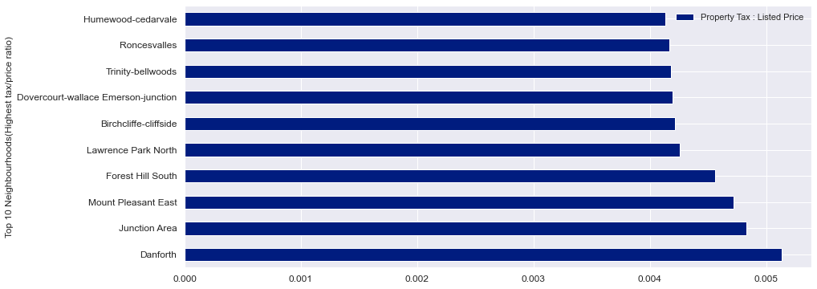
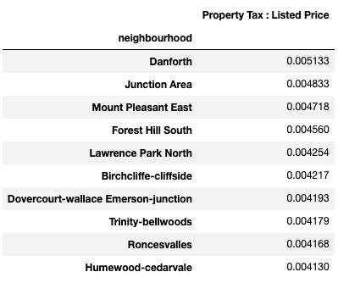
Highest Ratio between Property tax and Listing price
Top 10

Slide 18
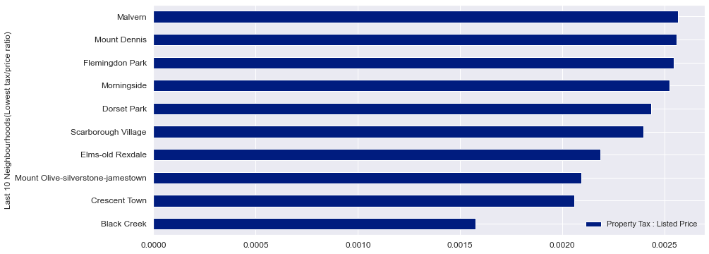
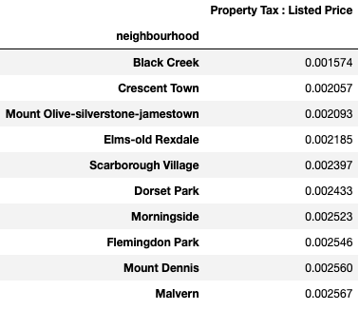
Lowest Ratio between Property tax and Listing price
Last 10

Slide 19
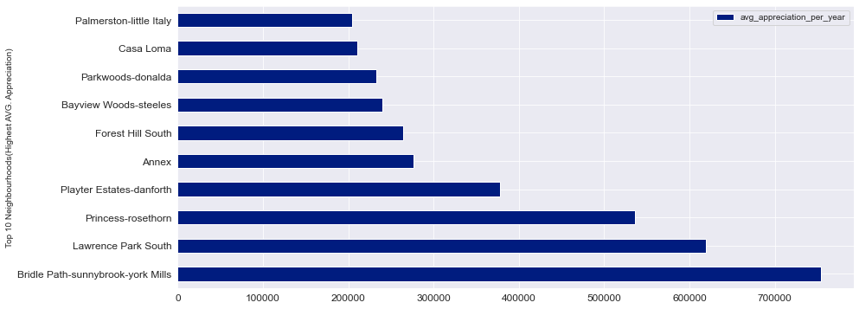
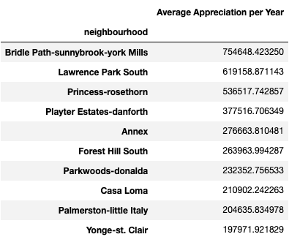
Analysis on Appreciation of the Properties
Top 10 neighbourhoods with Highest Average Appreciation per year

Slide 20
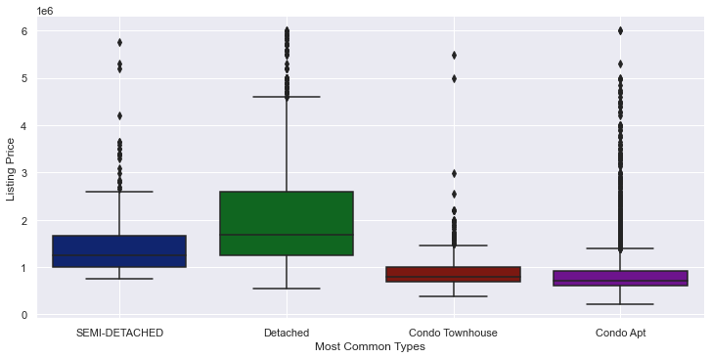
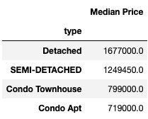
Pattern of Distribution by Property Types

Slide 21
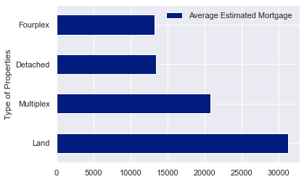
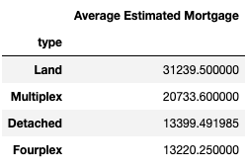
Estimated Mortgage Analysis
Average Estimated Mortgage by Types of Properties (Top 4)

Slide 22
Challenges
Inconsistencies of HTML elements and XPATH for different Listings
Typos and Inconsistent information from the publishers
Broken Links of listings
Huge amount of Missing information
Breaking of Web crawler due to errors after certain time

Slide 23
Next Steps/Future Possibilities
Scraping of Already sold data over last few years for analysis
Combination of new and sold data to make a predictive analytics model
The Predictive model can predict:
Property tax
Listing Price
Mortgage
Predictive analytics on demands for each neighbourhoods
Deployment such models for usage by Real Estate Stakeholders

Slide 24


