Slide 1




Bangladesh University of Engineering andTechnology
ME 174 (CSE):
Lecture 2: Dimensioning
Course Teachers:
Shahriar Alam, Assistant Professor
Taslima Hossain Sanjana, Adj. Lecturer
Sakil Hossen, Drafting Instructor
Department of Mechanical Engineering, BUET

Slide 2
Meaning of Lines
Visible lines represent features that can be seen in the current view
Hidden lines represent features that can not be seen in the current view
Center line represents symmetry, path of motion, centers of circles, axis of axi-symmetrical parts
Dimension and Extension lines indicate the sizes and location of features on a drawing

Slide 3
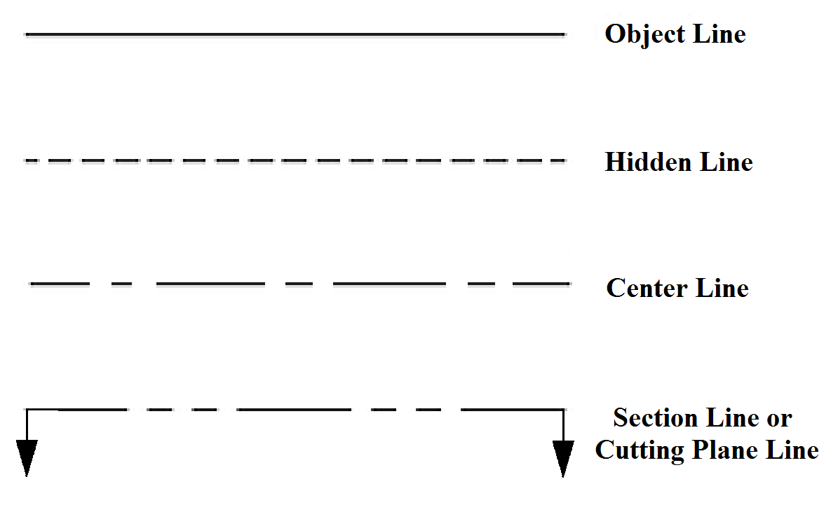
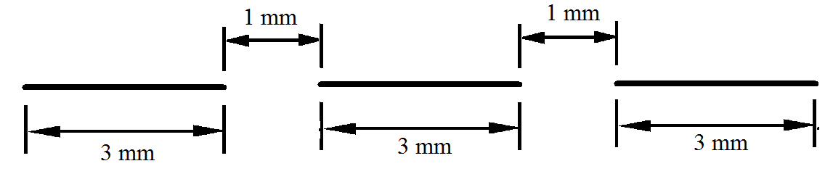
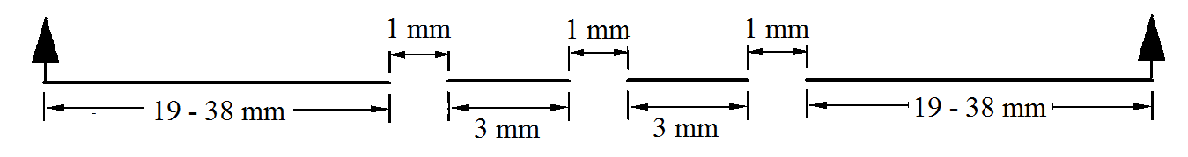
Thickness: 100 %
Thickness: 50 %
Thickness: 50 %

Slide 4

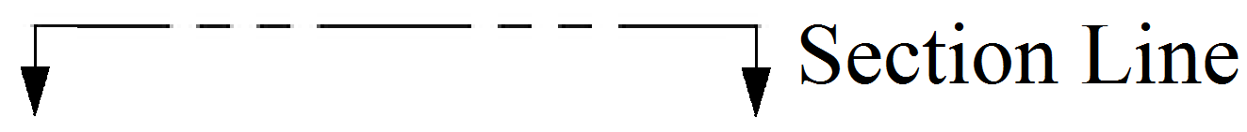
Thickness: 25 %
Thickness: 125 %
N.B.: All Percentages are with respect to the object line

Slide 5
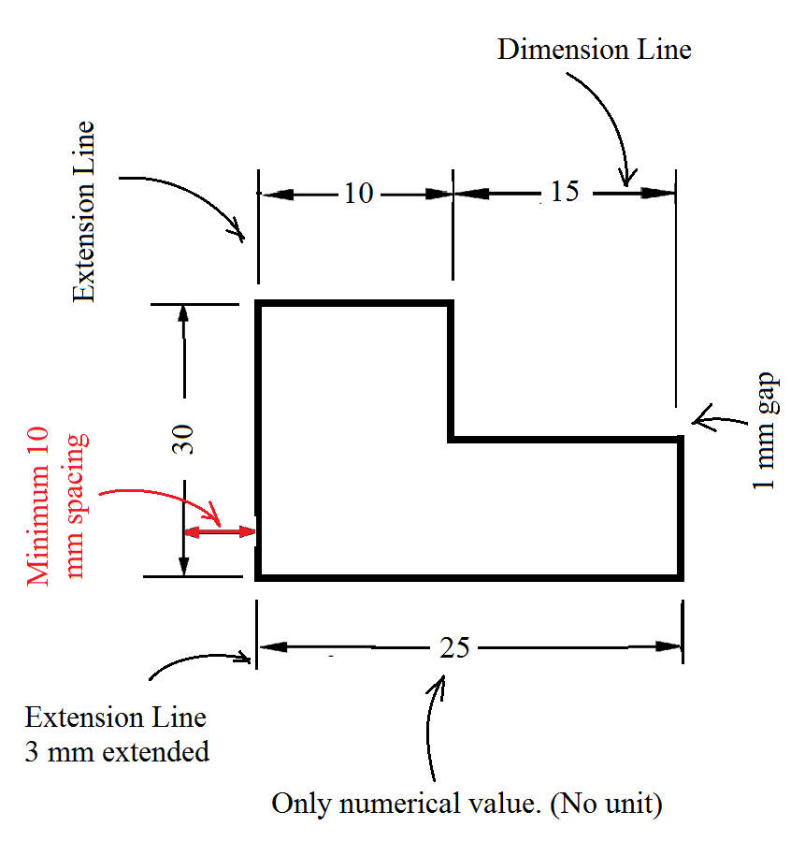
Dimensioning Guidelines
Dimension and extension lines must be either horizontal or vertical.
No dimension/extension line can cross over another dimension/extension line.
There must be one arrowhead at each end of dimension line.
The thickness of both extension and dimension line is 25%.
No dimensioning is allowed inside the object.

Slide 6
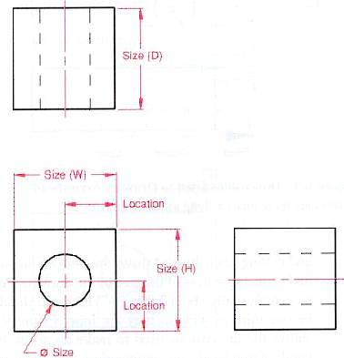
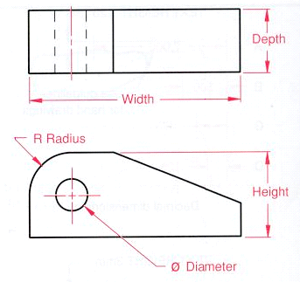
Important elements of dimensioning
Two types of dimensioning: (1) Size and location dimensions and (2) Detail dimensioning

Slide 7
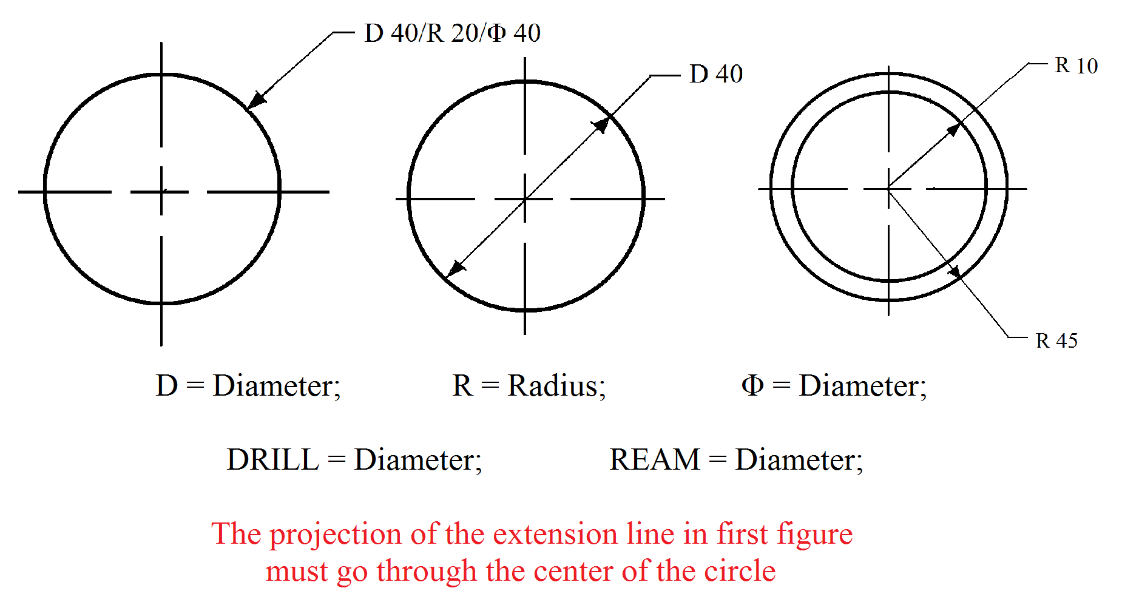
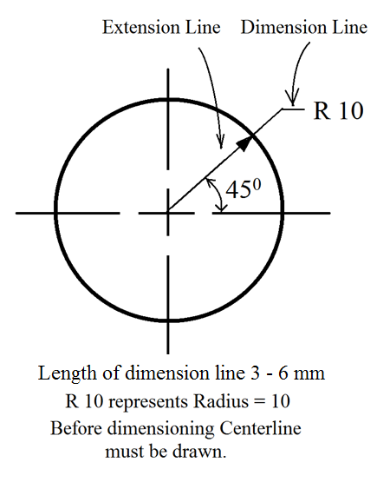
Circular Dimensioning
The arrowhead must touch the circle whose dimension is being shown.

Slide 8
Dimensioning of Circles
Dimensioning of Angles

Slide 9
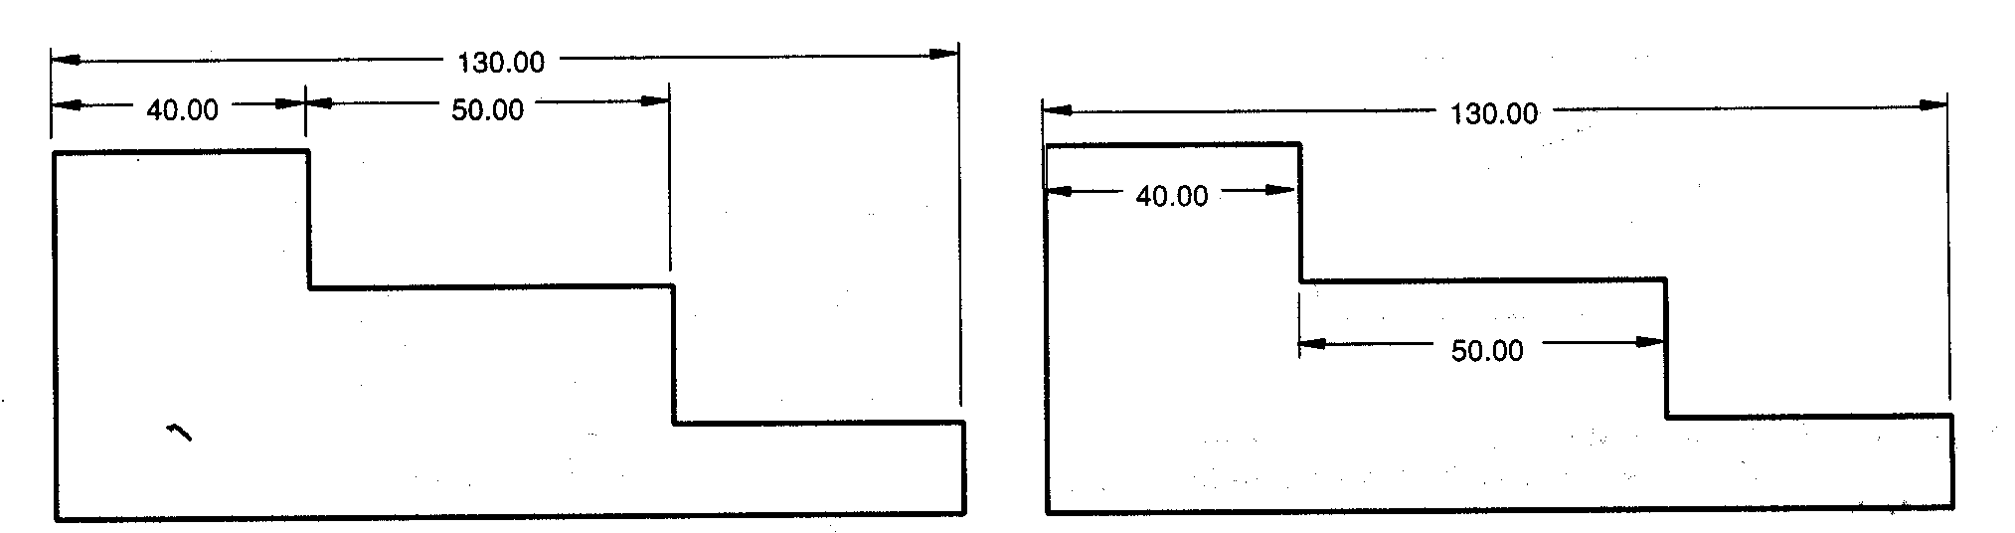
Grouping Dimensions
Dimensions should always be placed outside the part
Yes
No
Notes:
Instructor:
The figure on the left is dimensioned correctly but the horizontal dimensions on the steps could have been done with any two of the three steps. Here the left and center steps were dimensioned. Another important point to make here is the spacing between sets of dimensions. You do not want the dimensions to be crowded.

Slide 10
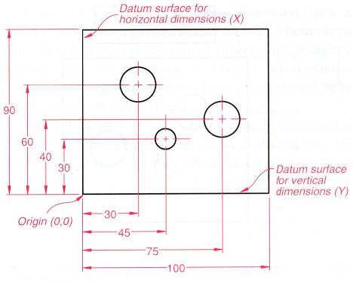
Where and how should we place dimensions when we have many dimensions? (cont.)

Slide 11
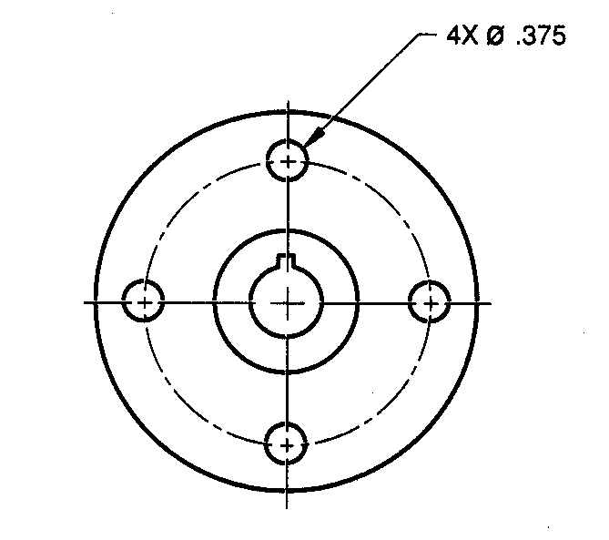
Repetitive Features
Use the Symbol ‘x’ to Dimension Repetitive Features
Notes:
Instructor:
We looked at the location of holes on a circle in a prior slide. Here we use the number of holes X size of the hole to complete the dimensioning.

Slide 12
Reference Books
The most common book to follow:
Mechanical Engineering Drawing
-Dr. Amalesh Chandra Mandal
-Dr. Md. Quamrul Islam
You may also look for resources online.

Slide 13
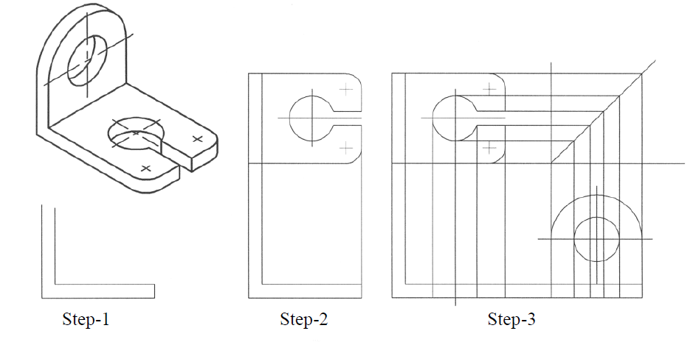
How to Start Drawing???
Front View

Slide 14
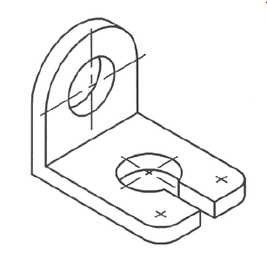
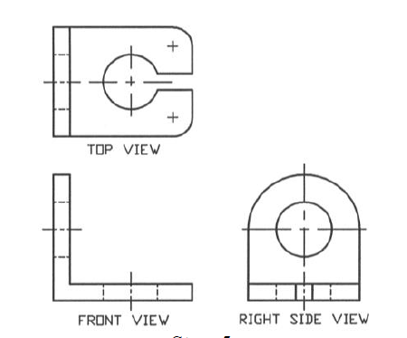
How to Start Drawing???
Its Done. Simple, right???

Slide 15
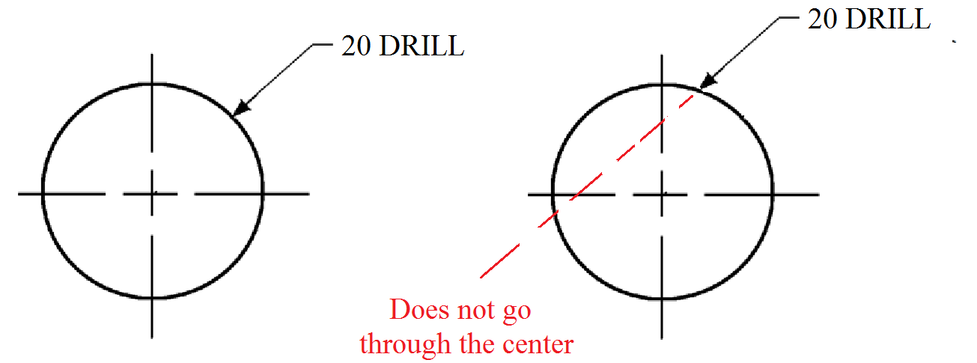
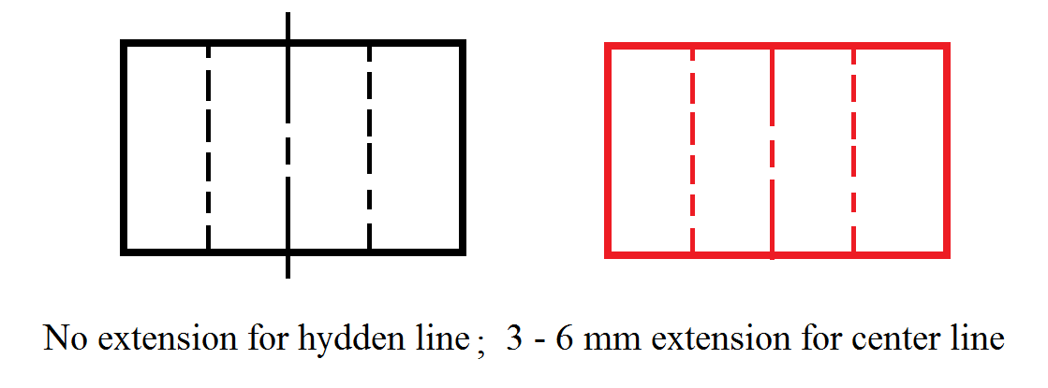
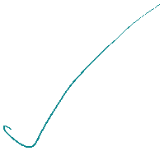
Some Common Mistakes

Slide 16
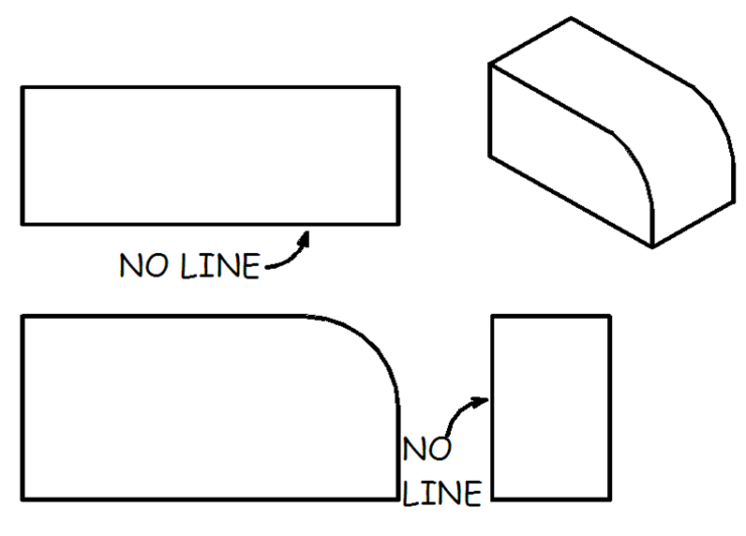
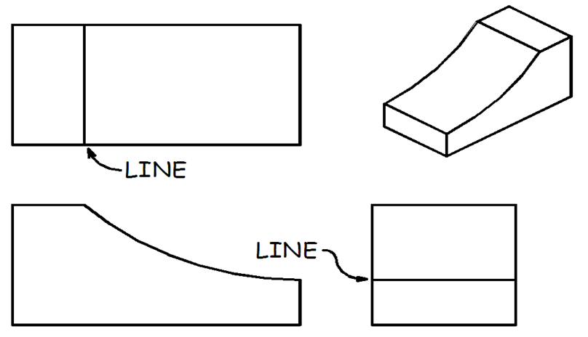
Sharp Edge vs Curved Edge
If a curved surface is tangent to a plane surface, no edge is formed. So, there will be no line.
But if a curved surface intersects with a plane surface, an edge is formed.
So, there should be a line in the views.

Slide 17
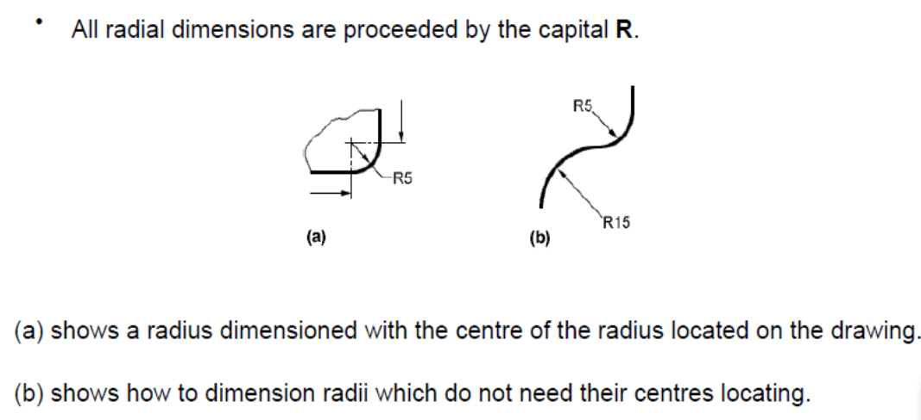
Dimensioning of Arc

Slide 18
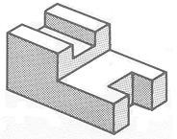
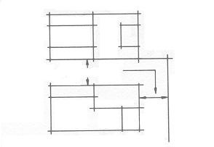

Drawing the Views
To complete an orthographic projection drawing follow these steps.
Step 2:
Space the top view 25-40 mm above the front view. Lightly construct the top view directly over the front view. Extend the lower side of the top view to intersect a vertical line drawn to the right of the front view.
Step 1:
Lightly construct the front view.
25-40 mm

Slide 19
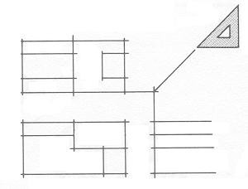
Drawing the Views
Step 3:
Project the features of the front view to the right of the vertical line. Draw a line at 45º from the point of intersection as shown.
The use of a 45º miter line helps to project features from the top view to the side view.

Slide 20
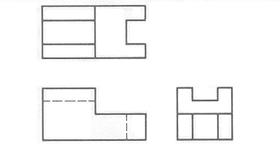
Drawing the Views
Step 5:
Erase all unnecessary lines. Complete the finished linework to complete the required orthographic views. Add the necessary information into the title block.

Slide 21
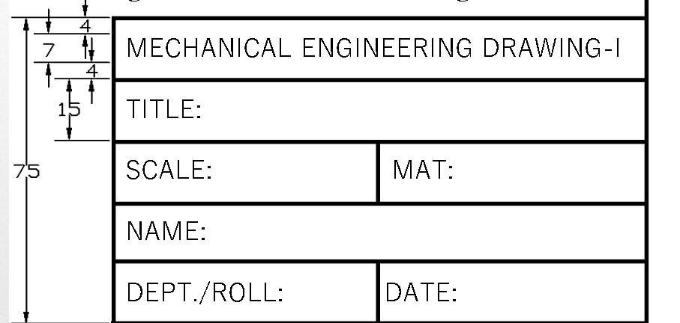
Daily Task
•Before the class starts:
Draw margins on your drawing sheet. Margins should be 10mm at all of four sides of the sheet.
At bottom right corner, sketch the following

Slide 22

THANK YOU

