Slide 1
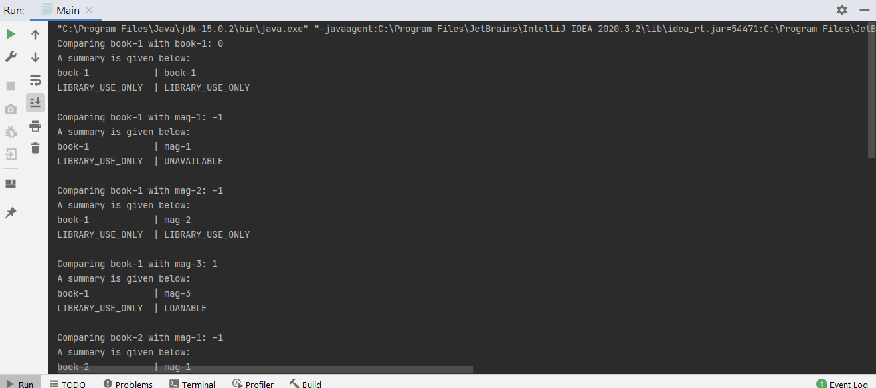
Part-1
ID-2014310

Slide 2

Part-2
ID-2014310

Slide 3
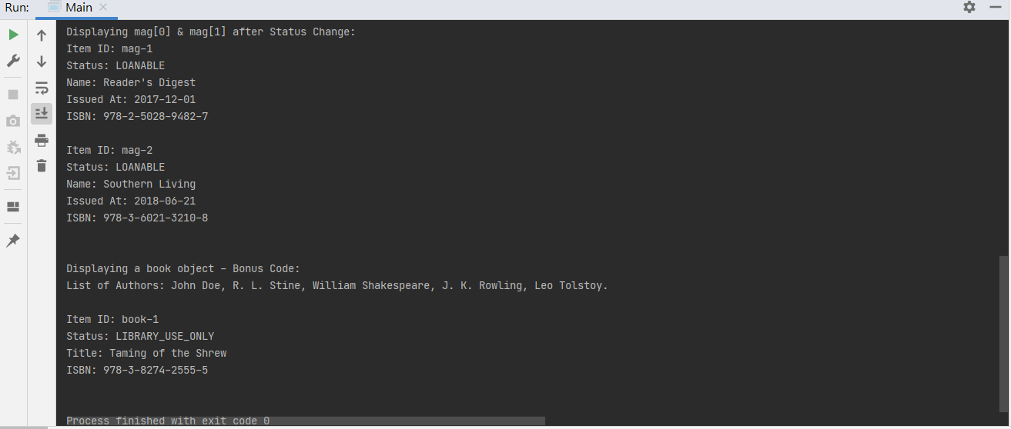
Part-3
ID-2014310

