Slide 1
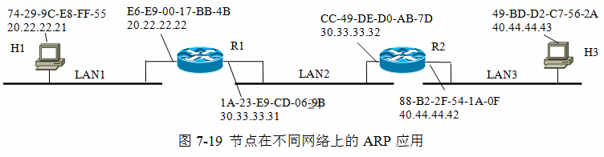


Mac:74-29-9C-E8-FF-55
IP:20.22.22.21
Mac:49-BD-D2-C7-56-2A
IP:40.44.44.43
Mac:E6-E9-00-17-BB-4B
IP:20.22.22.22
Mac:CC-49-DE-D0-AB-7D
IP:30.33.33.32
H3
H1
R1
R2
LAN1
LAN2
LAN3
Mac:34-19-9B-E5-FB-E5
IP:70.77.77.71
Mac:1A-23-E9-CD-06-9B
IP:30.33.33.31
Mac:88-B2-2F-54-1A-0F
IP:40.44.44.42
Mac:73-2A-9C-E8-FE-B5
IP:80.88.88.82
Mac:3A-23-E9-8D-00-93
IP:70.77.77.72
Mac:4D-2D-DC-47-5D-2C
IP:50.55.55.52
H2
LAN4
Mac:CB-39-2E-D5-AA-ED
IP:60.66.66.62
H4
R3
R4
LAN5
LAN6
LAN7
Mac:73-22-6C-F8-3F-53
IP:80.88.88.81
Mac:1C-25-B9-DD-04-3B
IP:60.66.66.61
Mac:8F-32-2C-44-1F-0C
IP:50.55.55.51

