Slide 1


MEDSCOPE:
INTELLIGENT MEDICAL INSIGHTS
Aryan Gahlot- S24CSEU0701
Himanshu Kumar Singh-S24CSEU0721
Harshit Gupta-S24CSEU0735

Slide 2

Problem Statement
Adverse Drug Reactions (ADRs) or side effects are a major challenge in healthcare. Standard medical information provides a generic list of potential side effect for a drug. This approach fails for the higher degree of variability in patient response, as an individual’s risk is unique and heavily influenced by factors like age, gender, location and drug info.

Slide 3
PROPOSED SOLUTION
Our solution is designed to directly address the problem of generic medical advice by delivering health answers based on a person's specific details.
Personalized Side Effect Prediction: Instead of relying on generic lists, our project provides an personalized side effect.
Intelligent Drug Alternatives Engine: For people who face a high predicted risk or are already experiencing side effects, our solution provides alternatives for drug.

Slide 4




GOALS AND OBJECTIVES
Empowering Users
Diverse Categories
Incorporating AI
Move beyond generic side effect lists and deliver the personalized risk and side effect predication.
Offer practical solution when a drug risk’s is too high and provide actionable medication alternatives.
Make complex medical data easy for anyone to access and understand to ensure accessibility through an intelligent assistant.

Slide 5


TECHNOLOGY USED
Backend – FastApi, Uvicorn,
Frontend – HTML, CSS, JavaScript, Jinja2
Database & Auth – Firebase Auth, Cloud FireStore
AI/ML – Scikit-learn, Pandas, Joblib, Matplotlib

Slide 6
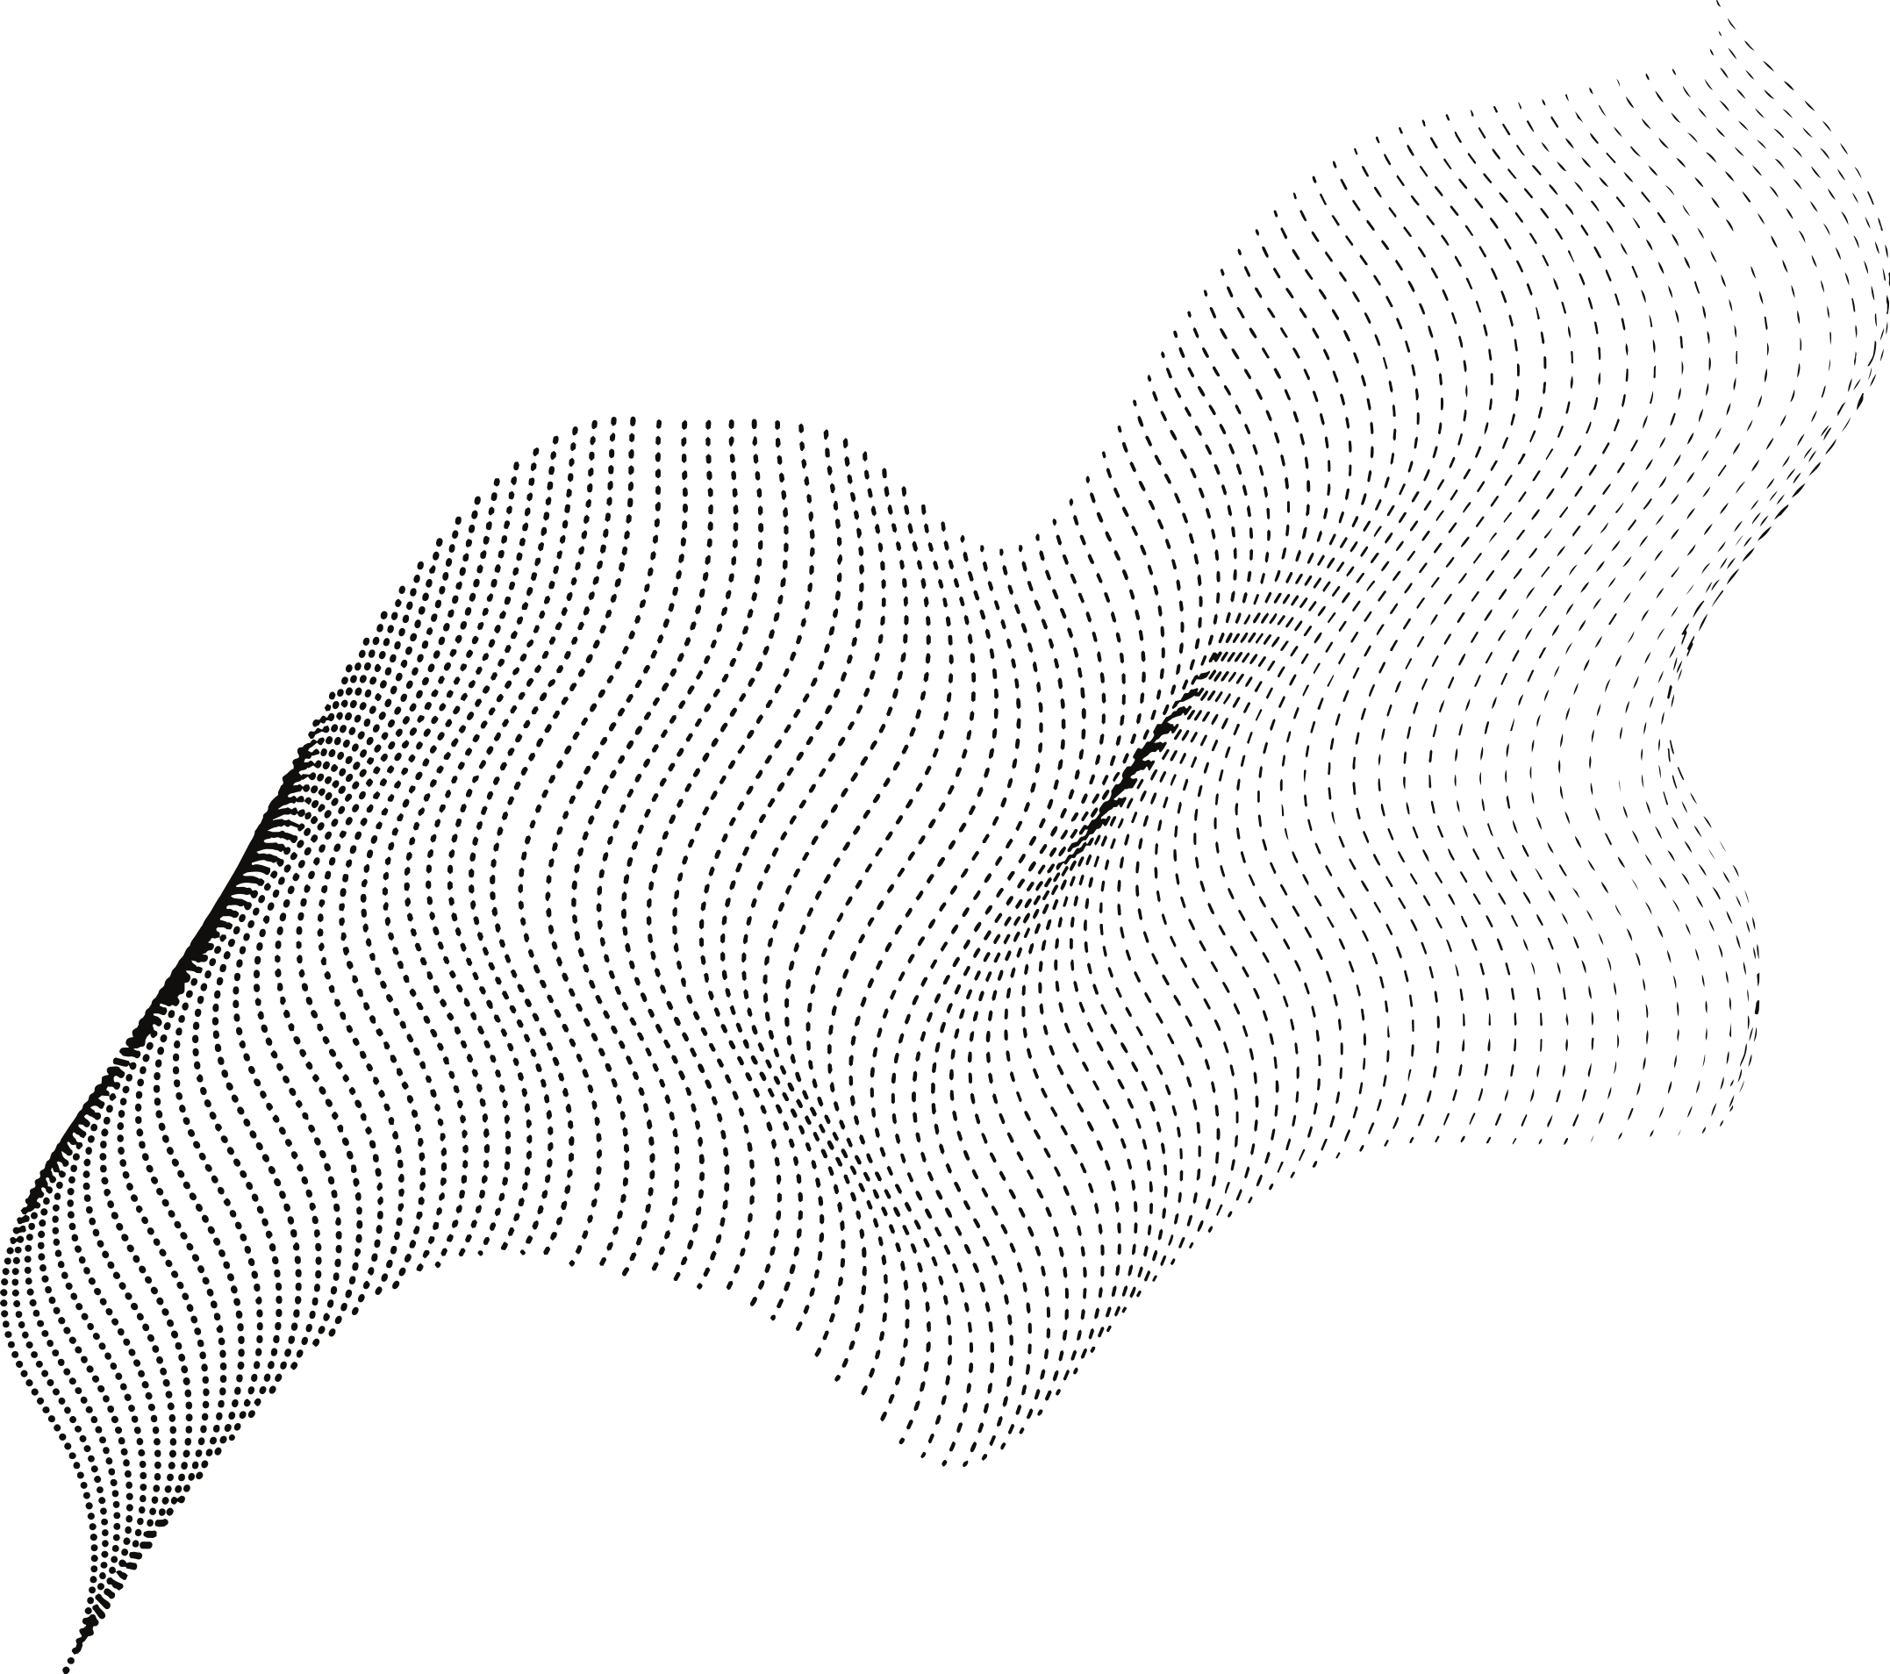
ML Side Effect Prediction:
It uses pre-trained scikit-learn
models to predict potential drug risk profiles and side effects for a user based on their specific
demographic and drug
Details.
Drug alternatives
Engine:
It includes a tool to find alternative medications for a given medical indications.
KEY FEATURES
OF MEDSCOPE
Intelligent Tool
Integration:
The chatbot is built to intelligently decide when it needs to call the internal ‘predict_side_effect’ or ‘find_alternatives’ tools to get data for its response.
AI Medical Assistant:
The project features a conversational chatbot endpoint ‘/chat’ that is powered by Google’s
Gemini AI.
Secure User Management:
The system handles secure user creation and login using firebase auth and saves user data to cloud firebase.

Slide 7
Future Prospects
Integrate Drug-Drug Interaction (DDI) Prediction: Introduce a new model (HODDI dataset) to warn users if their new medication interacts negatively with other drugs they might be taking. This adds a critical layer of safety analysis
Expand and Diversify Datasets: Improve the performance and accuracy of the core ML models by training them on larger, more diverse patient datasets. This will make predictions more reliable across different populations.
Incorporate User Medical History: Enhance the "ML Side Effect Prediction" feature by allowing users to (securely) add their medical history (eg- allergies, pre-existing conditions).

Slide 8
Thank You!

