Slide 1


Pose-Guided Predictive Ballistics
for Body Part–Targeted Football Training
MSc Thesis Defense
School of Engineering & Digital Sciences · Nazarbayev University
Arlen Smagulov
Supervisor: Prof. Sultangali Arzykulov · Co-supervisor: Prof. Mohammad Hashmi · March 2026
1
Arlen Smagulov · MSc ECE · Nazarbayev University
Notes:
Good afternoon, committee. The title of the thesis is Pose-Guided Predictive Ballistics for Body Part–Targeted Football Training. I am Arlen Smagulov, MSc ECE. I will speak for about seventeen minutes and leave a three minute buffer inside our fifteen to twenty minute slot. I would ask that questions be held until the end so the argument can land as a whole. Transition cue: let me start with why this problem matters before we open any code or geometry.

Slide 2

Motivation
SEDS · NU
Commercial launchers are blind.
Professional MoCap is unaffordable.
Football coaches need joint-specific delivery for reception, reaction, and rehab drills.
Open-loop launchers cannot react to athlete position.
OptiTrack or Vicon cost USD 50k to 200k and require markers.
This thesis delivers USD ~200 perception, closed-loop, markerless.
[ADD ON WINDOWS: split-card image — left panel a commercial ball launcher, right panel a MoCap studio]
Takeaway: there is a real, affordable gap to close.
2
Notes:
Frame the panel's attention on the adaptive delivery problem before touching any CV content. Coaches cannot order a training machine that reacts to the athlete; the only thing that does is a full motion capture lab at fifty to two hundred thousand dollars with markers. We are democratizing that capability at around two hundred dollars in perception hardware. Transition cue: having set the gap, let me now state exactly what success looks like in measurable terms.

Slide 3
Problem Statement & Objectives
SEDS · NU
Current implementation targets three joints with measurable accuracy and safety goals.
O1
Ball GT
O2
Joint GT
Mean 3D ball error below 120 mm in the garage arena.
Mean 3D joint error below 180 mm for right knee, right hip, and left shoulder.
O3
Safe integration
O4
Practicality
Six-stage validation, E-STOP latch, and controlled single-shot tests.
Commodity cameras, open-source stack, and about USD 200 perception hardware.
Takeaway: the thesis is judged by accuracy, safety, and practical deployability.
3
Notes:
Frame the thesis around the committee’s decision criteria. I am not just claiming that the system works; I am claiming that it achieves four measurable goals in a realistic garage arena. The three body joints are right knee, right hip, and left shoulder. The current implementation detail that matters most is that the live stack is YOLO-Pose-based, while the evaluation criteria remain ball accuracy, joint accuracy, safety, and practical low-cost deployment.

Slide 4
Background & Related Work
SEDS · NU
Gap: low-cost joint-level targeting with physical actuation. Prior NU work (Orynbay 2025) delivered an omnidirectional launcher but no joint-level vision guidance.
Table 1. Existing categories and the gap this thesis fills.
Approach
Cost
Accuracy
Markerless
Closed-loop
Optical MoCap (OptiTrack, Vicon)
USD 50k–200k
High
No
No
Monocular pose (OpenPose, MediaPipe, YOLO-Pose)
Low
Medium
Yes
Partial
Multi-view triangulation (Hartley & Zisserman, SVD-DLT)
Low
High
Yes
Rare
This work (MVT + YOLO-Pose + FSM)
~USD 200
High
Yes
Yes
Takeaway: no prior low-cost system combines 3D joint localisation and physical ballistic targeting in a domestic arena.
4
Notes:
Use this slide to position the work cleanly. Commercial launchers are cheap but blind. Motion-capture labs are accurate but expensive and passive. Research launchers usually target zones or balls, not named human joints. The key gap is the combination of commodity multi-camera reconstruction, joint localisation, and physical actuation in a domestic environment. This is the framing the assessors should retain before they see the implementation details.

Slide 5
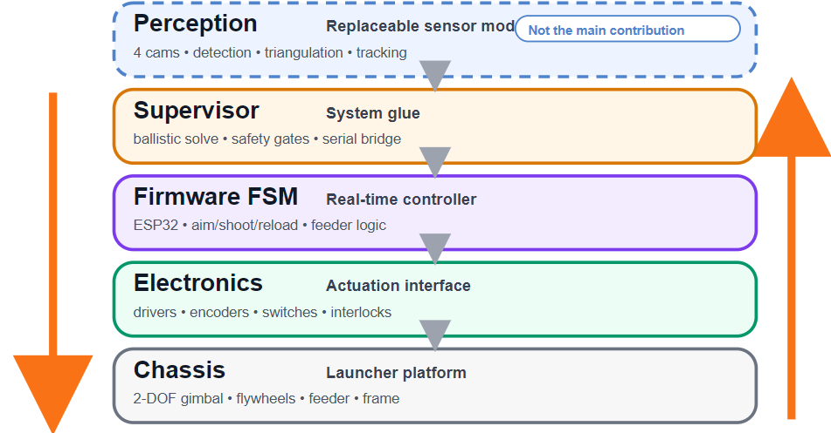
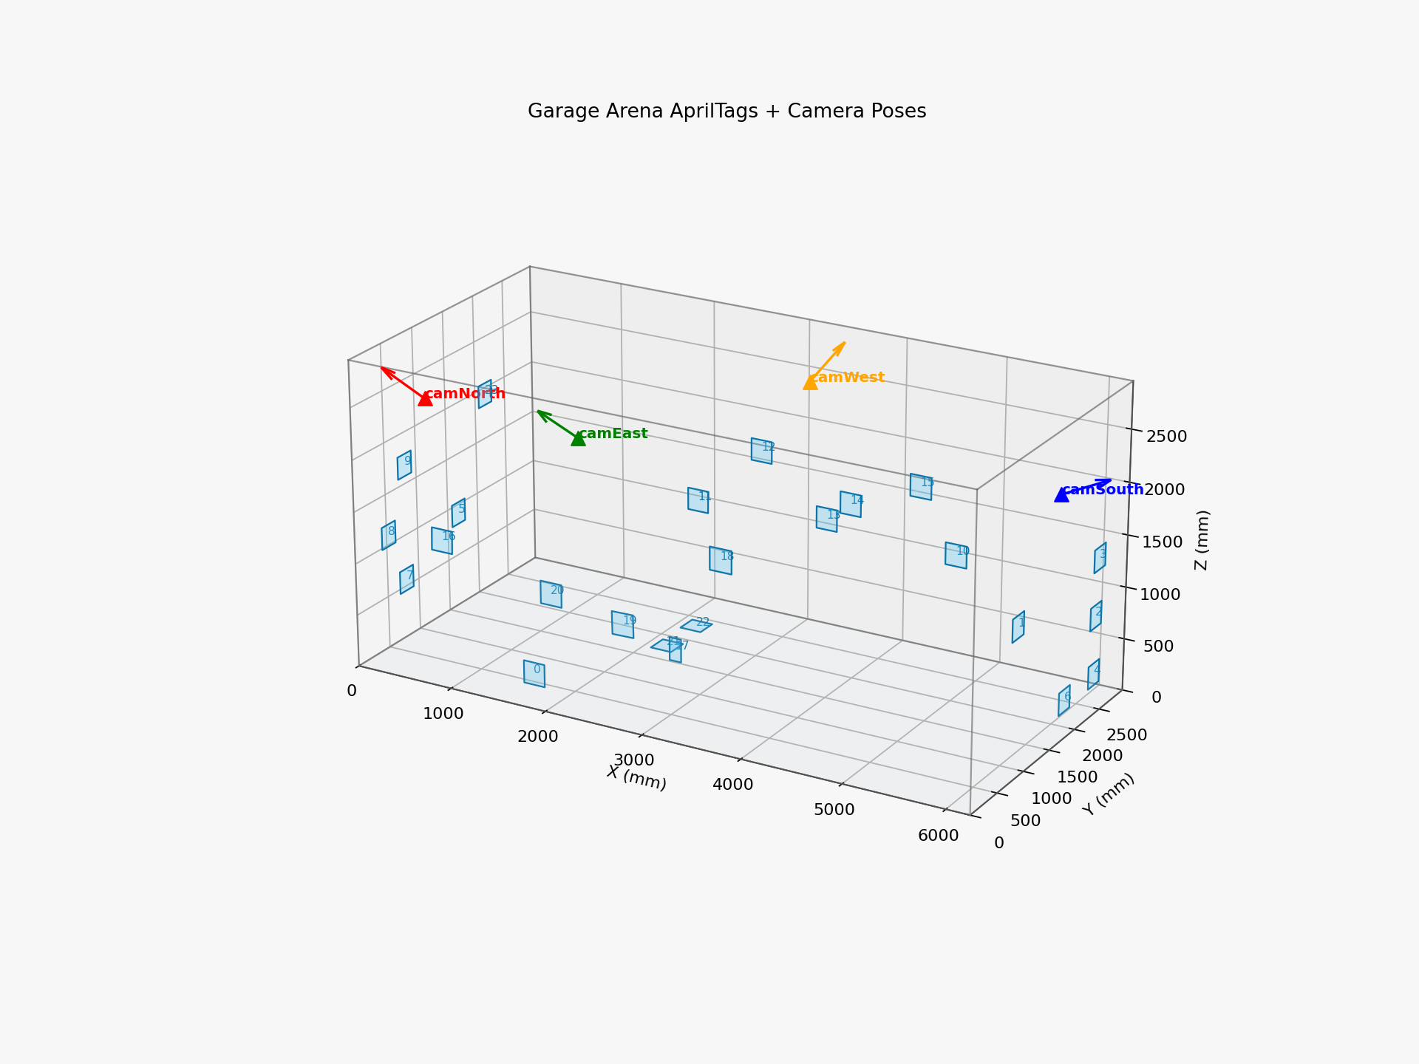
Proposed System — Engineering First
SEDS · NU
What was inherited, what this thesis adds, and what runs today.
Inherited (NU lab BLM)
This thesis (contribution)
Latest implementation (live)
• 2-DOF pan / tilt (NEMA-23 + worm gear)
• Counter-rotating flywheels + ESC drive
• ESP32 + DRV8825 pusher
• Aluminium-profile chassis (Orynbay 2025)
• 4-camera ChArUco + AprilTag calibration
• Multi-view 3D joint triangulation in mm
• Ballistic solver for right_knee / right_hip / left_shoulder
• Six-stage safety protocol + JSONL decision log
• YOLO-Pose TRT FP16, 6.2 ms / image
• YOLO-26m ball TRT FP16, 8 ms / image
• Robust ball triangulation + single-cam fallback
• Voice UDP + blm_follow.py auto-reload training mode
Takeaway: the thesis contribution is the pose-to-launch loop and the safety-gated integration, on top of an inherited launcher.
5
Notes:
This slide is where I clearly separate inherited hardware from my thesis contribution. The launcher platform did not start from zero, but the thesis contribution is not mechanical duplication. It is the integration of perception, triangulation, ballistic computation, safety gating, and evaluation into one working autonomous loop. Saying this early helps the committee attribute the right novelty to the thesis rather than to the entire machine history.

Slide 6
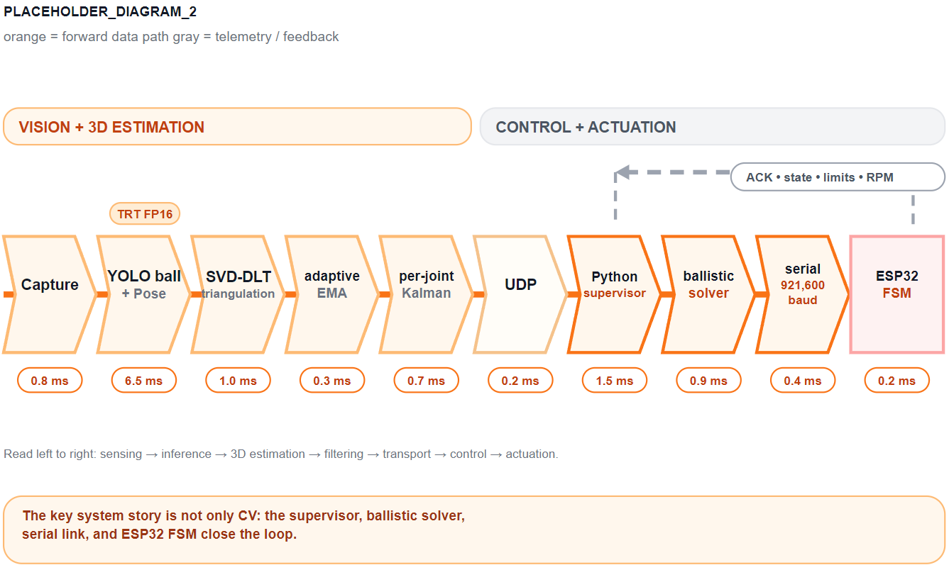
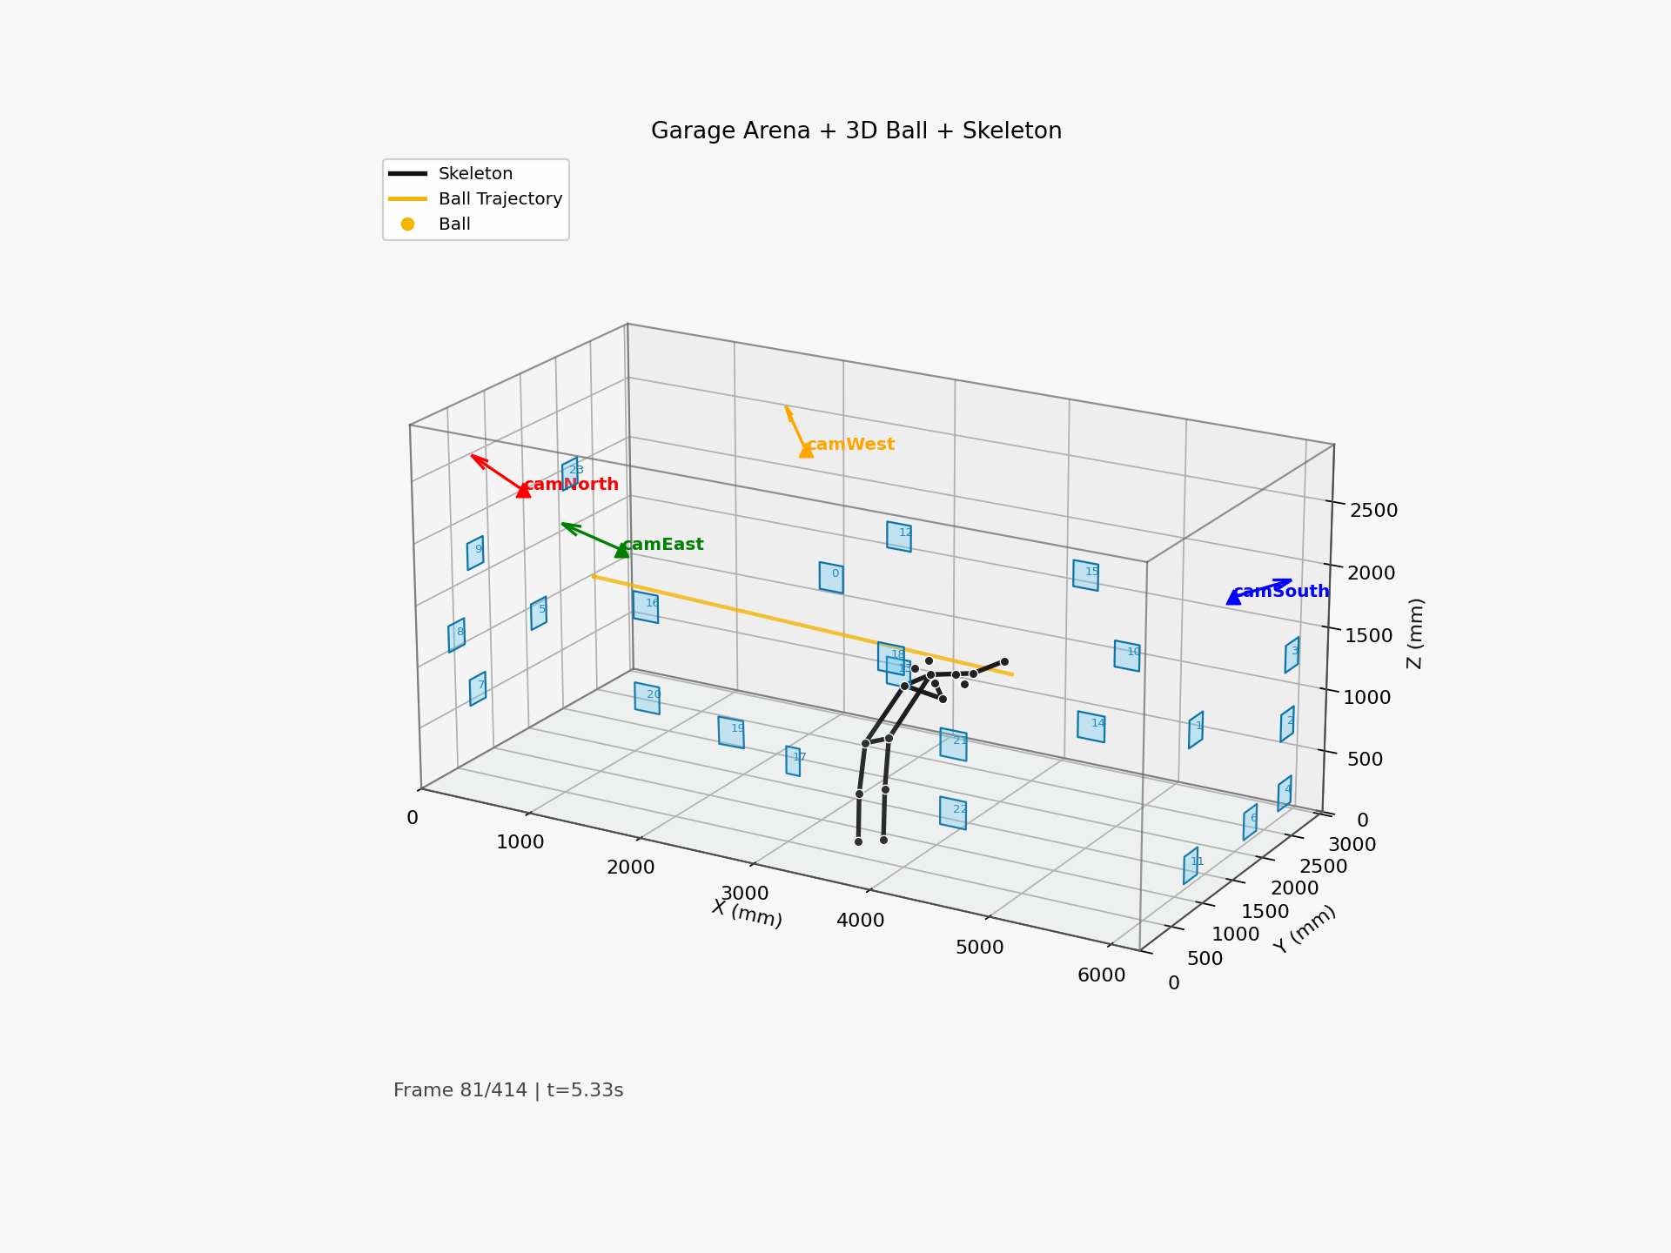
Architecture & Pipeline
SEDS · NU
Live pipeline is YOLO-Pose-first; MMPose is retained only as the GT-evaluation backend.
Figure 1. Live run snapshot of the end-to-end YOLO-Pose pipeline (4-camera arena + 3D overlay).
Perception + command remain inside the real-time budget.
Current code path is YOLO-Pose-based for live body-joint targeting.
Takeaway: the current implementation is YOLO-Pose-first, end to end.
6
Notes:
I am deliberately showing the current implementation order here, not an older thesis-only wording. The committee should understand that the live stack begins with ball detection and YOLO-Pose, then lifts those 2D observations into a 3D world frame, then computes the launch command and checks safety gates before actuation. This is also where I make clear that the pipeline is real-time, rather than an offline reconstruction workflow.

Slide 7
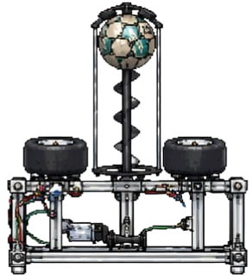
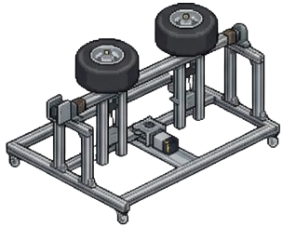
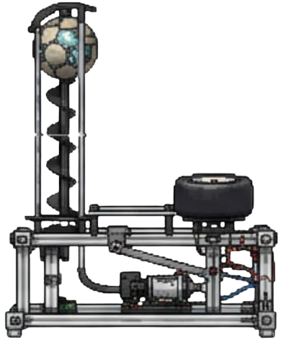
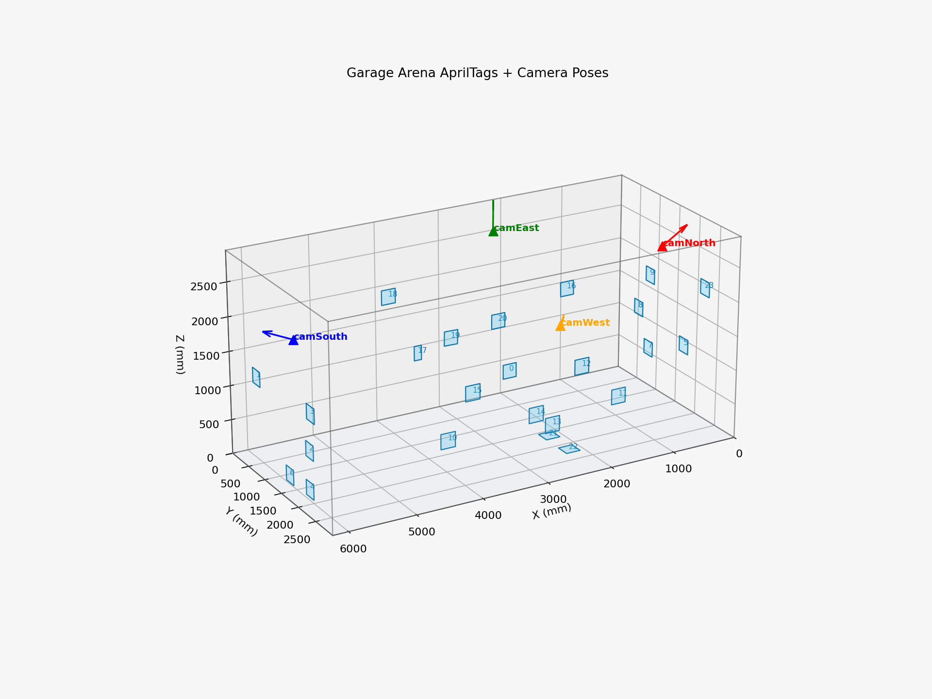
Hardware Implementation
SEDS · NU
Inherited machine hardware plus low-cost sensing
makes the system practical.
4× Hikvision DS-E12 USB cameras, 1280×720, about USD 30 each.
Inherited BLM: flywheels, feed mechanism, NEMA-23 pan/tilt, and worm gears.
ESP32 executes set, shoot, reload, center, and stop commands from the host PC.
24 V fused rail, normally-closed E-STOP, and guarded single-shot validation.
Table 2. Indicative bill of materials (perception + actuation).
Item
Cost
Cameras (4×)
~USD 120
ESP32
~USD 8
Steppers + drivers
~USD 90
Flywheel motors + ESCs
~USD 60
Chassis + wiring
~USD 80
Perception PC (recycled)
-
Takeaway: the platform is practical because inherited actuation is paired with low-cost sensing.
7
Notes:
Keep this slide practical. The committee does not need every bolt; they need to understand that the actuation platform exists, that it is driven by an ESP32, and that the sensing side stays inexpensive. This is where I emphasise that the perception BOM is around two hundred dollars and that the inherited launcher becomes useful only because the sensing and control loop now provide joint-aware targeting.

Slide 8
Software Implementation
SEDS · NU
Current implementation is YOLO-Pose-first; the rest of the stack consumes its 3D outputs.
Layer
Module / Tool
Perception
YOLO-Pose (17 kpts) + custom YOLO ball
Inference
TensorRT FP16
Geometry
triangulate_multi() SVD-DLT
Robust ball
robust_triangulate_ball() iterative
Filter
adaptive EMA + optional CV Kalman predictor
Supervisor
Python + pyserial + safety gates + ballistic solve
Firmware
control_12_full.ino (cooperative FSM, 921 600 baud)
Takeaway: the live stack is YOLO-Pose primary; MMPose is the offline GT / ablation backend.
8
Notes:
This slide should remove any ambiguity about the live software stack. The key message is that the committee should think in terms of a YOLO-Pose-first implementation whose outputs are triangulated and filtered before command generation. I keep the Kalman model as an optional prediction layer instead of the main story, because the core value of the system is accurate 3D joint targeting from the current code path, not a backend comparison with older pose frameworks.

Slide 9
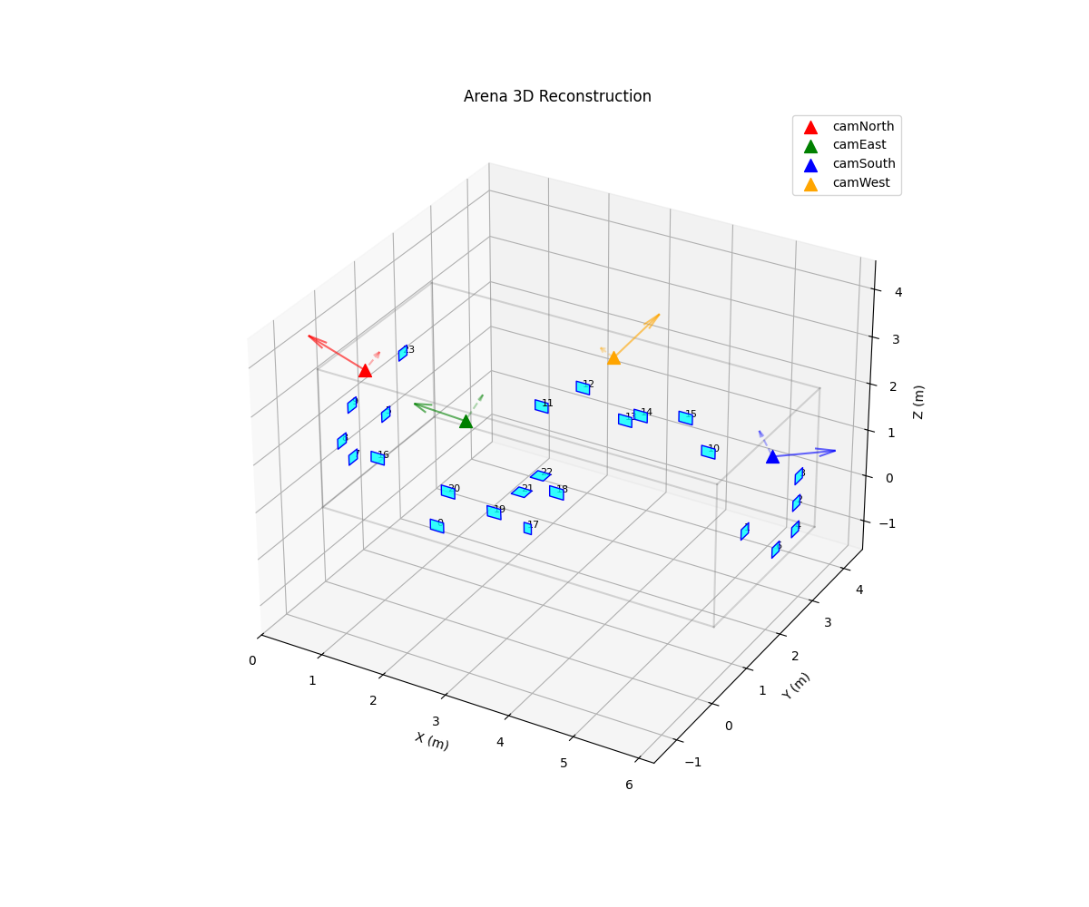
Calibration & Geometry
SEDS · NU
Four cameras are unified into one millimetre world frame.
Intrinsics: ChArUco at 1280×720; per-camera K and distortion coefficients.
Extrinsics: 24 AprilTags + robust PnP into one shared arena frame.
World frame: X depth, Y width, Z up; all coordinates in millimetres.
Triangulation is strongest with 3–4 views and degrades with poorer visibility.
Takeaway: calibration is what turns pixels into targetable millimetres.
9
Notes:
This slide is the geometric contract of the thesis. Once the committee accepts that the four cameras share one world frame, the rest of the system becomes much easier to trust. I should stress that calibration is not a cosmetic step. It is the step that allows two-dimensional detections from multiple cameras to become a single three-dimensional target point in millimetres for the ballistic solver.

Slide 10
Methodology & Experiments
SEDS · NU
Evaluation is organised around ground truth, safety, and reproducibility.
Table 3. Evaluation matrix: experiment type, input, metric, and outcome.
Experiment
Input
Metric
Outcome
Ball GT
36-point static grid
Mean / P95 + bias
Corrected mean 95.17 mm
Joint-touch GT
81 trials, 9 XY × 3 heights
Mean / P95 + per-joint
62 valid trials, mean 143.38 mm
Dynamic clips
ball_slow / ball_fast / ball_fast_ema0.1 / no_ball
Qualitative stability
Live 3D reconstruction verified
Safety checklist
Six-stage integration protocol
Pass / fail + logs
S0–S4 PASSED (aim-only + controlled static single-shot)
Takeaway: the evidence is quantitative, safety-gated, and reproducible.
10
Notes:
This slide matters because it shows that the thesis is not just a demo. The committee should see three things: first, there is quantitative ground truth for both ball and joints; second, safety validation is staged rather than improvised; third, the system logs its own decisions so results are auditable. That combination makes the evaluation credible, especially in a domestic arena where uncontrolled conditions would otherwise be easy to question.

Slide 11
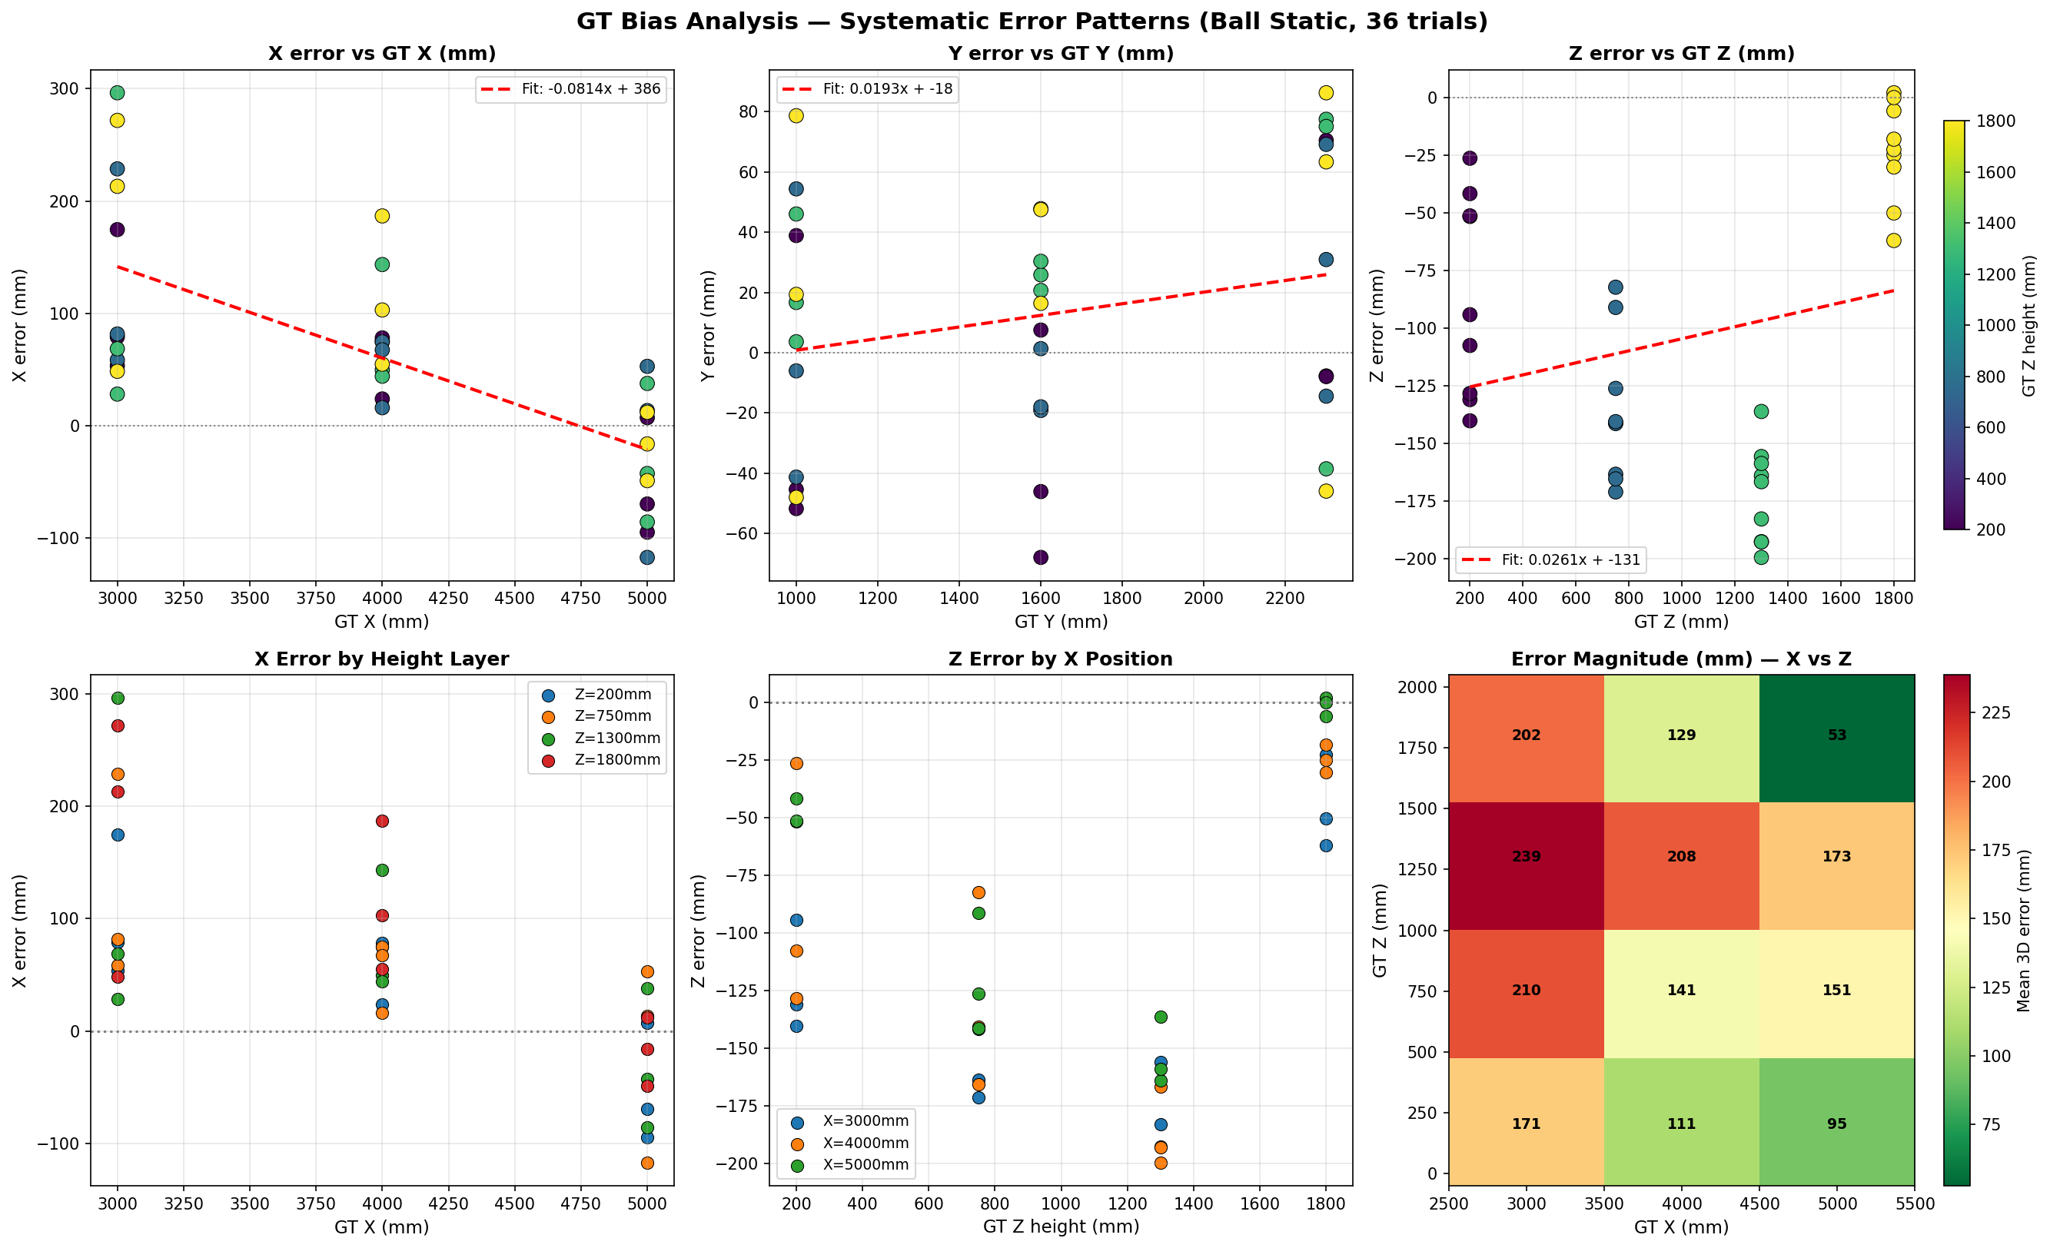
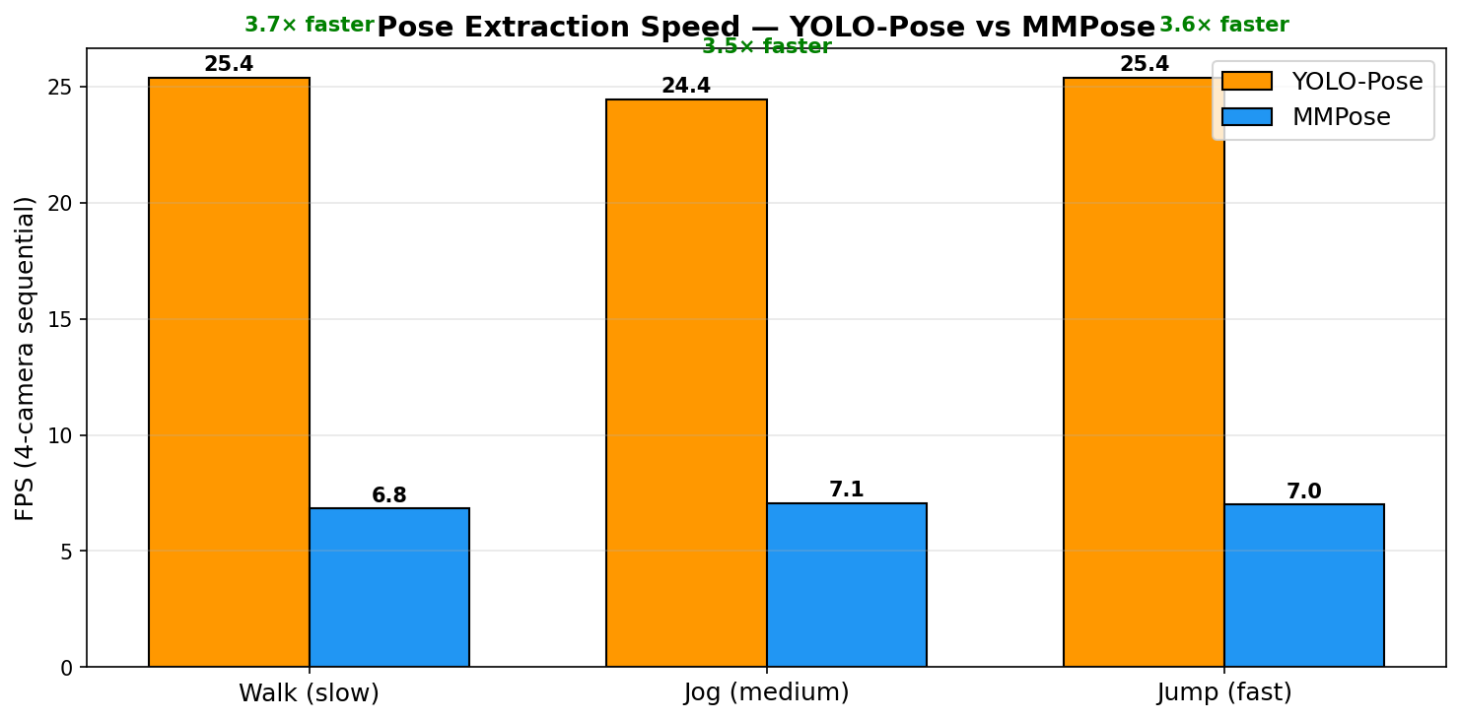
Key Results — Accuracy, Latency, Throughput
SEDS · NU
Committee-level evidence is easiest to read as five headline results.
Headline results
95.17 mm
corrected ball mean
143.38 mm
joint mean (62 valid trials)
Figure 4. Ball static localisation: raw vs bias-corrected 3D error (95.17 mm mean corrected).
110 / 150 / 164 mm
knee / hip / shoulder means
<100 ms
E-STOP latch response
15 FPS
live YOLO-Pose pipeline
Figure 5. Per-backend latency: YOLO-Pose (TRT FP16) is 6.2× faster than MMPose.
Takeaway: the system meets the main ball, joint, and safety targets.
11
Notes:
Present this slide slowly because these are the numbers the committee is most likely to remember. The corrected ball mean supports the first research question. The joint mean and the per-joint breakdown support the second. The emergency-stop response supports the safety claim. The fifteen-frame-per-second line is there to show that the current YOLO-Pose implementation is not only conceptually right but also operationally live.

Slide 12
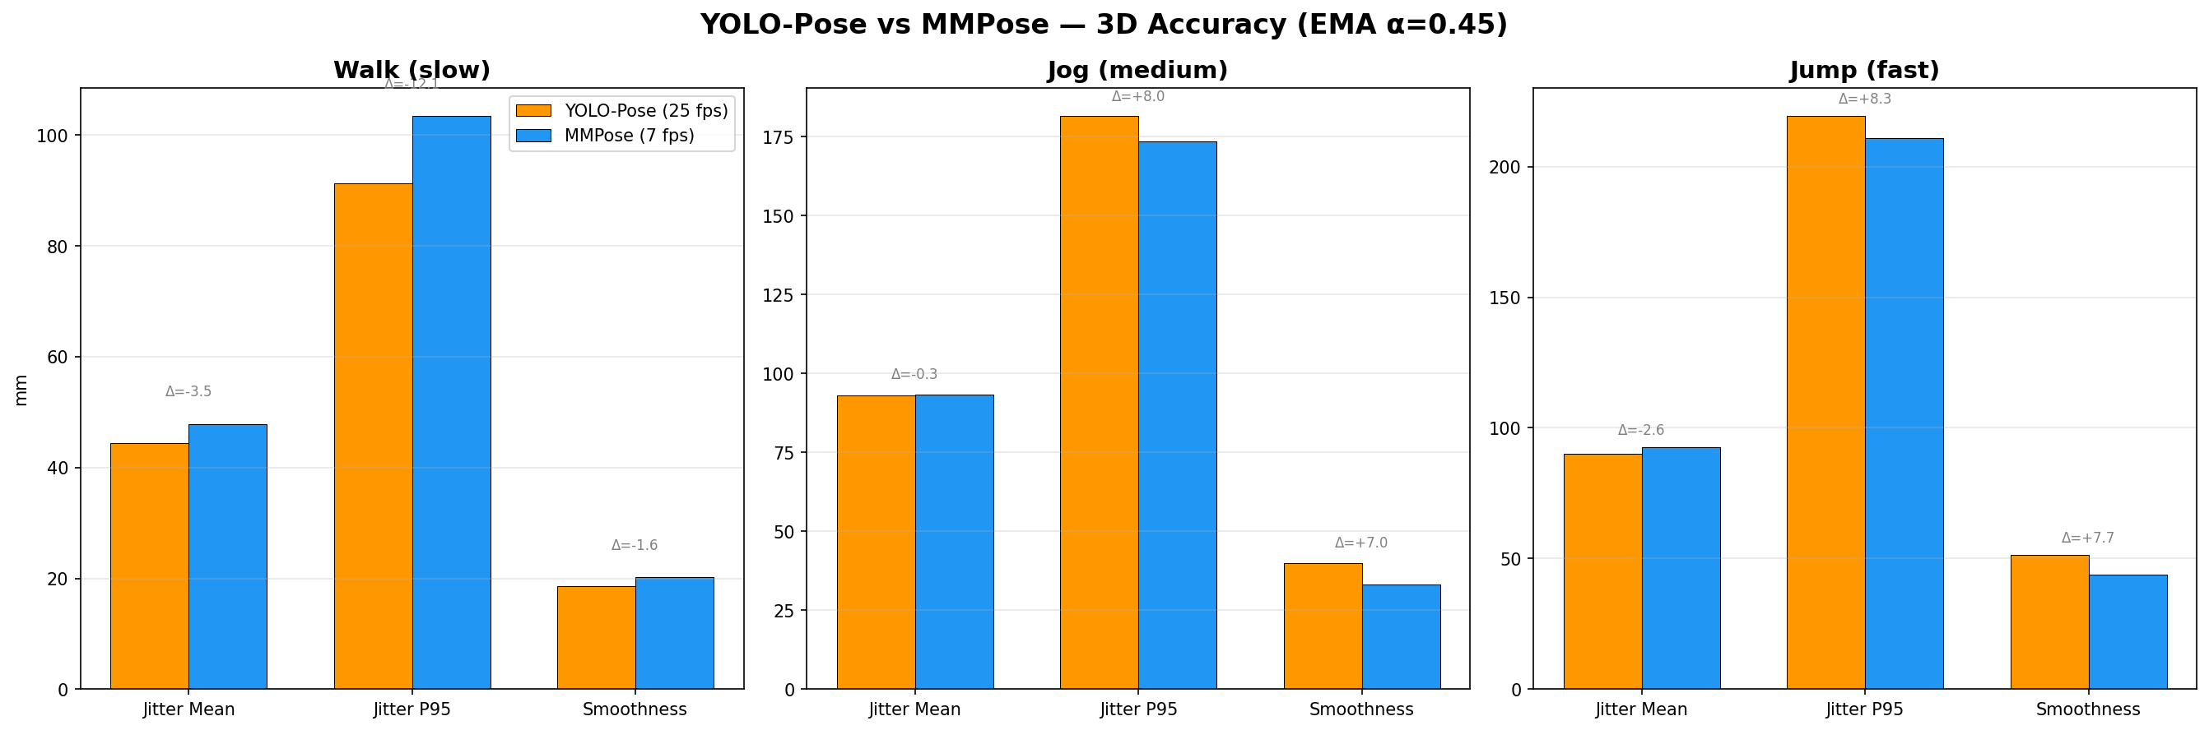
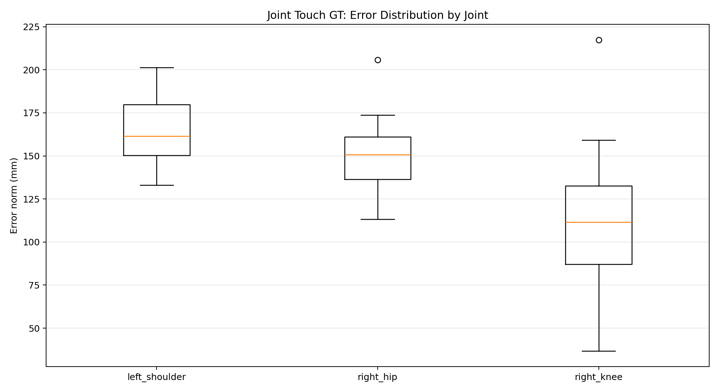
Analysis & Interpretation
SEDS · NU
The practical reading is targetable accuracy, not motion-capture perfection.
RQ1 passed: corrected ball mean is below 120 mm.
RQ2 passed: joint mean is below 180 mm across the three target joints.
Error rises from knee → hip → shoulder as visibility worsens with height.
19 invalid trials are mainly view-count and occlusion failures, not random drift.
Current YOLO-Pose pipeline is now calibration- and visibility-limited.
Figure 6. Backend comparison: YOLO-Pose matches MMPose 3D jitter within 5 mm.
Figure 7. Per-joint 3D error increases with height (knee → hip → shoulder) due to visibility geometry.
Takeaway: accuracy is already useful for joint-targeted delivery in the current arena.
12
Notes:
This interpretation slide is how I stop the committee from over-reading the error numbers as failure. The correct reading is that the system has practical targeting accuracy in a low-cost domestic setting, while the main remaining bottlenecks are calibration quality and visibility. The monotonic increase from knee to shoulder helps explain the error structure physically, which makes the result feel engineering-grounded rather than arbitrary.

Slide 13
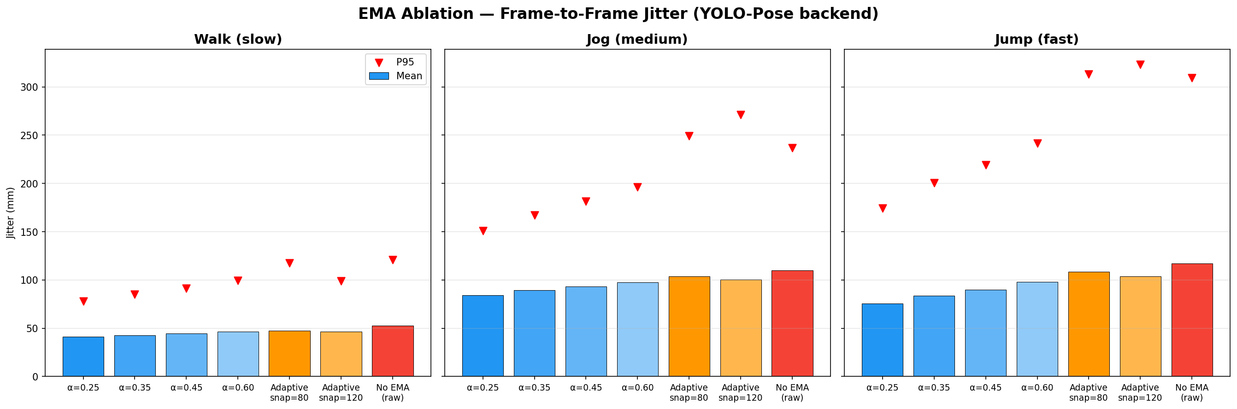
Limitations & Challenges
SEDS · NU
Closed-loop firing on a moving subject remains Stage 5 and is future work.
Full moving-subject autonomous firing is future work; thesis validates aim-only plus static shots.
Single subject, single domestic arena, and controlled indoor lighting only.
19 of 81 joint-touch trials were invalid because fewer than 3 reliable views were available.
Empirical RPM → m/s ballistic map is still missing.
Bias correction fit in-sample on the 36-point ball grid; no held-out calibration set.
Figure 3. Per-joint 3D jitter by smoothing strategy (EMA ablation).
Takeaway: the limitations are clear enough to define the next milestone.
13
Notes:
This slide should sound confident rather than apologetic. The committee expects limitations, and the key is to state them in engineering terms. I should make clear that the thesis does validate the perception-to-actuation chain, but does not yet claim full moving-subject autonomous firing. The most important open items are view robustness, empirical ballistic calibration, and longer-run actuator reliability.

Slide 14
Conclusions & Contributions
SEDS · NU
The three novelty claims the committee should remember (thesis §1.4).
1
2
3
Autonomous aiming machine
Low-cost pose-to-launch pipeline
Safety-gated integration protocol
The launcher autonomously computes pitch, yaw, and wheel RPM from live 3D joint coordinates — a qualitative departure from programmed-trajectory commercial launchers.
USD ~200 of perception hardware (4 commodity USB cameras + open-source detectors) delivers sub-200 mm joint accuracy in a real garage arena.
Six-stage checklist, E-STOP latch < 100 ms, and JSONL decision log make every actuation traceable — reproducible for any vision-guided actuated system.
Takeaway: an autonomous, low-cost, safety-gated pose-to-launch loop — the three claims of this thesis.
14
Notes:
End the technical story by naming the contributions at the right level. I should not get lost in minor implementation details here. The committee should leave with six memorable ideas: autonomous aiming, low-cost 3D targeting, the current YOLO-Pose-based loop, staged safety validation, quantitative ground truth with bias correction, and reproducible logging. That framing makes my thesis contribution easy to separate from the inherited machine platform.

Slide 15
Future Work + Ethics & Standards
SEDS · NU
The roadmap moves from validated aiming to full autonomous training.
Future roadmap
Standards honoured
Closed-loop autonomous firing on moving subjects
Empirical RPM → m/s ballistic calibration map
SLAM-based camera re-localisation and self-recalibration
Multi-person tracking and target assignment
Virtual 3D Goal: camera-only impact detection, no sensors at the goal
ISO 12100
ISO 13849-1
Machinery safety — risk assessment
Cat. 1 stop paths, safety-related control
IEC 60204-1
ISO 10218-1
Control wiring, fusing, emergency stop
Human exclusion during operation
Applicability: sports training, rehabilitation, and adaptive PE instruction.
Takeaway: the next milestone is full moving-target closed-loop firing.
15
Notes:
The future-work story should feel like a concrete roadmap, not a wish list. The next immediate milestone is full closed-loop firing at a moving target. After that, empirical ballistic calibration improves aim quality, SLAM-like relocalisation improves maintainability, and multi-person tracking extends use cases. The Virtual 3D Goal idea is worth naming because it is intuitive and memorable for the committee as a natural next extension of the same perception stack.

Slide 16
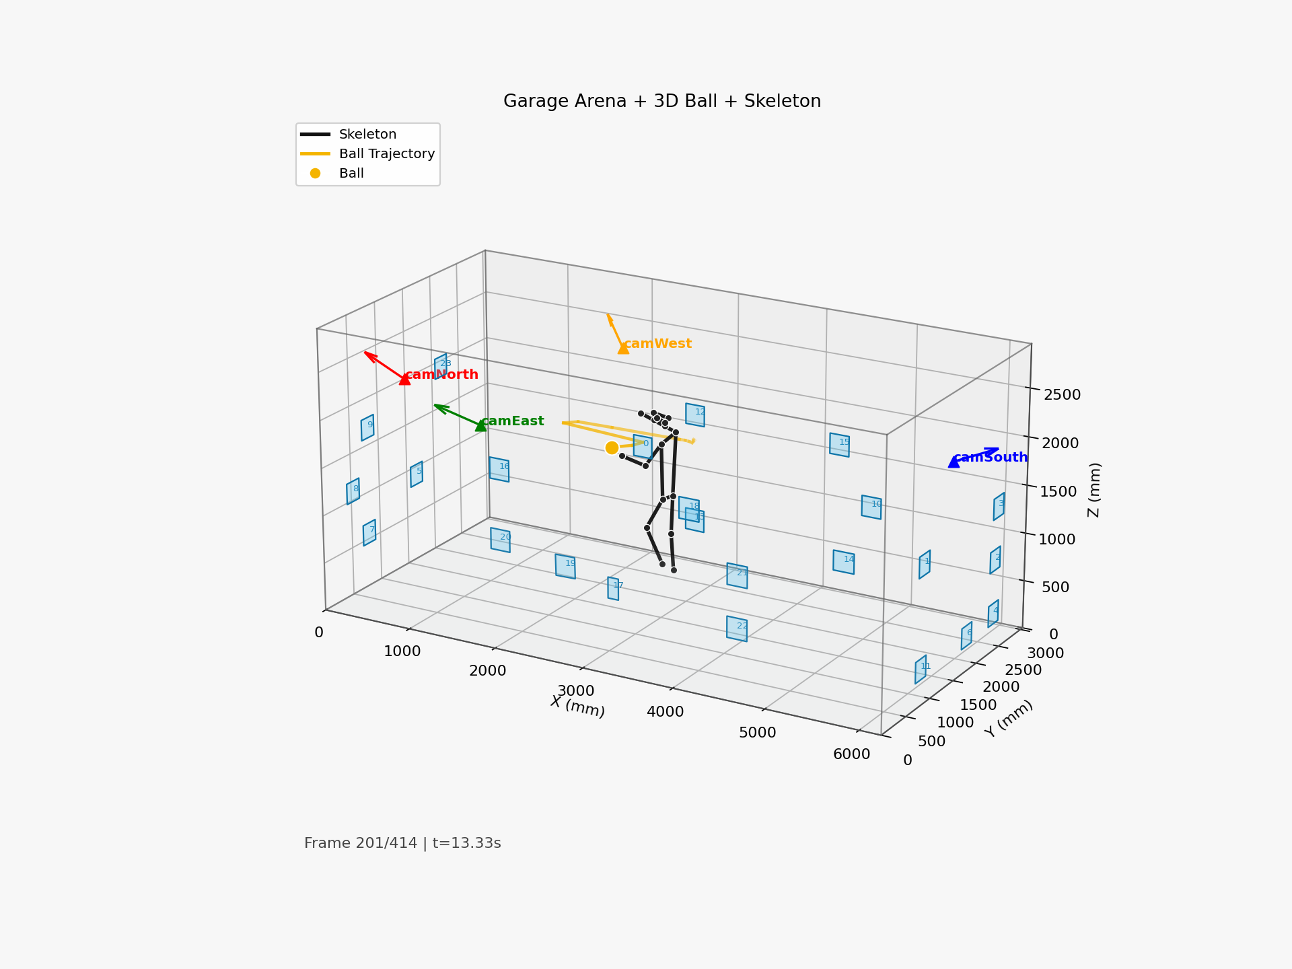
A1 · Live Demo
SEDS · NU
APPENDIX
Arena 3D tracking, trimmed to 20–30 s.
Poster frame shown above. Live demo video on disk: Parallel_working/output/recordings/arena3d_20260417_123348.mp4 (trim to 20–30 s, play on demand).
[Hidden slide — unhide only if panel asks a relevant question]
Unhide only if the panel asks for a demo or a buffer opens.
Notes:
Play if asked for a demo or if a three-to-five-minute buffer opens. Mute audio. Keep the clip to twenty or thirty seconds; longer loops lose the panel. Before pressing play, state what they are looking at: four-camera capture, live triangulation, and Kalman-smoothed joint trace. If the video cannot be embedded inline on the target machine, substitute the mosaic2d fallback from V-02 in the assets checklist and narrate the same framing.

Slide 17
A2 · 10-Layer Safety Stack
SEDS · NU
APPENDIX
Operator on top, hardware at the bottom.
L1
Zone gate — reject targets outside safe arena
L6
RPM gate (Python side)
L2
Confidence gate — per-joint + ball detection score
L7
RPM gate (firmware side)
L3
Stability gate — multi-frame temporal filter
L8
Arm state + typed confirmation
L4
Angle clamp (Python side)
L9
Hardware E-STOP (NC) + link-loss watchdog
L5
Angle clamp (firmware side)
L10
Python exception path — safe shutdown
[Hidden slide — unhide only if panel asks a relevant question]
Use if the panel asks what happens if X fails.
Notes:
Use if the panel asks what happens if X fails. Walk from L1 down: software gates first, then hardware interlocks, then the human authority. Key points to volunteer: the angle clamp and RPM gate are each implemented twice, once in Python and once on the ESP32, so either layer alone is sufficient. The hardware E-STOP is normally-closed so a broken wire stops the machine, not starts it. Close by naming the link-loss watchdog as the answer to network-drop questions.

Slide 18
A3 · End-to-End Latency Budget
SEDS · NU
APPENDIX
Per-stage timings from the live run.
Table 4. Per-stage latency (ms) measured live — mean and P95 from perf_blm_20260417_134210.jsonl.
Stage | Mean (ms) | P95 (ms)
Camera capture (per-frame) | 0.0 | 0.0
YOLO ball detection | 13.9 | 13.2
MMPose / YOLO-Pose | 36.4 | 32.5
SVD-DLT triangulation | 2.2 | 2.6
UDP target broadcast | 0.2 | 0.3
3D render (cv2 backend) | 5.5 | 5.3
2D mosaic render | 3.6 | 3.8
End-to-end perception | 72.8 | 79.9
Total loop (incl. render) | 71.7 | 68.0
[Hidden slide — unhide only if panel asks a relevant question]
Use if the panel asks about real-time guarantees.
Notes:
Use if the panel asks about real-time guarantees. Before pointing at numbers, name the three dominant stages: YOLO inference, triangulation plus Kalman, and mechanical settling. Volunteer that the ninety-fifth percentile for perception stays inside two frame intervals at fifteen FPS, which is why the Kalman predict-step of two hundred to four hundred milliseconds covers worst-case launcher travel. If pushed, note that the latency table is the artifact behind the hundred-and-twenty millisecond claim on slide six.

Slide 19
A4 · ECE Curriculum Mapping
SEDS · NU
APPENDIX
Courses → concepts → evidence in the thesis.
Course
Concept used
Evidence in thesis
Signals & Systems
Kalman filter, EMA, frequency domain
Per-joint CV Kalman; adaptive EMA tuning
Control Systems
Closed-loop feedback, stability
Supervisor → FSM → motor loop; stop paths
Embedded Systems
RTOS-like cooperative FSM, UART
control_12_full.ino at 921,600 baud
Computer Networks
UDP vs TCP, link-loss handling
UDP target broadcast + watchdog timeout
Engineering Ethics
Risk, safety, responsible deployment
ISO 12100 / 13849-1 / IEC 60204-1 alignment
[Hidden slide — unhide only if panel asks a relevant question]
Use only if asked which courses prepared you for this.
Notes:
Use only if asked which courses prepared you for this. Pick two rows to highlight, not five. Signals and Systems maps directly to the Kalman filter and the EMA smoother. Control Systems is the supervisor-to-motor loop. Embedded Systems is the cooperative finite-state machine in control_12_full.ino. Computer Networks covers the UDP link and the watchdog. Engineering Ethics maps to the three ISO standards on slide fifteen. End with one sentence on which course was most directly applied.

