Slide 1


Pose-Guided Predictive Ballistics
with Multi-Camera 3D Tracking
MSc Thesis Defense
School of Engineering & Digital Sciences · Nazarbayev University
Arlen Smagulov
Supervisor: Prof. Sultangali Arzykulov · Co-supervisor: Prof. Mohammad Hashmi
1
Arlen Smagulov · MSc ECE · Nazarbayev University
Notes:
Good afternoon, committee. The title of the thesis is Pose-Guided Predictive Ballistics with Multi-Camera 3D Tracking. I am Hanush, MSc ECE. I will speak for about seventeen minutes and leave a three minute buffer inside our fifteen to twenty minute slot. I would ask that questions be held until the end so the argument can land as a whole. Transition cue: let me start with why this problem matters before we open any code or geometry.

Slide 2

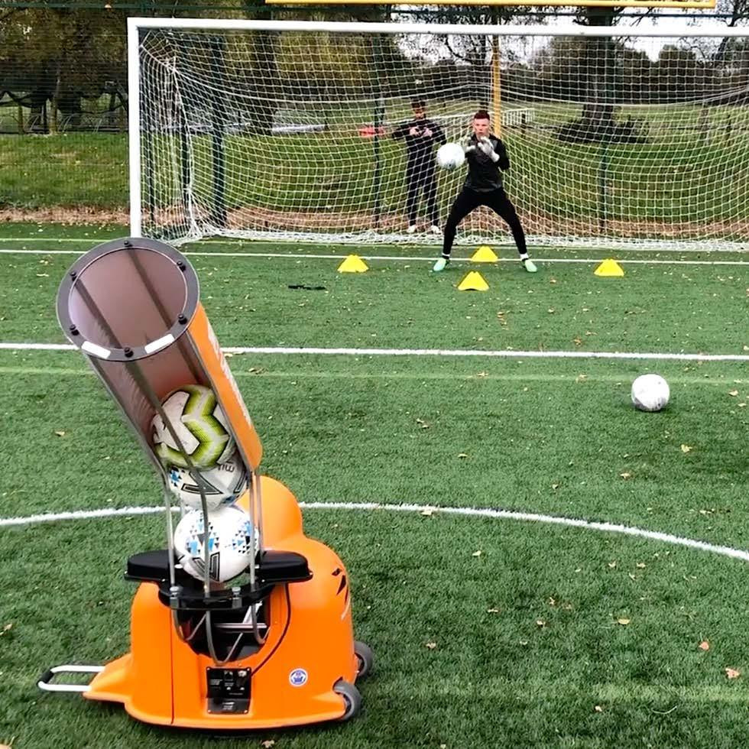
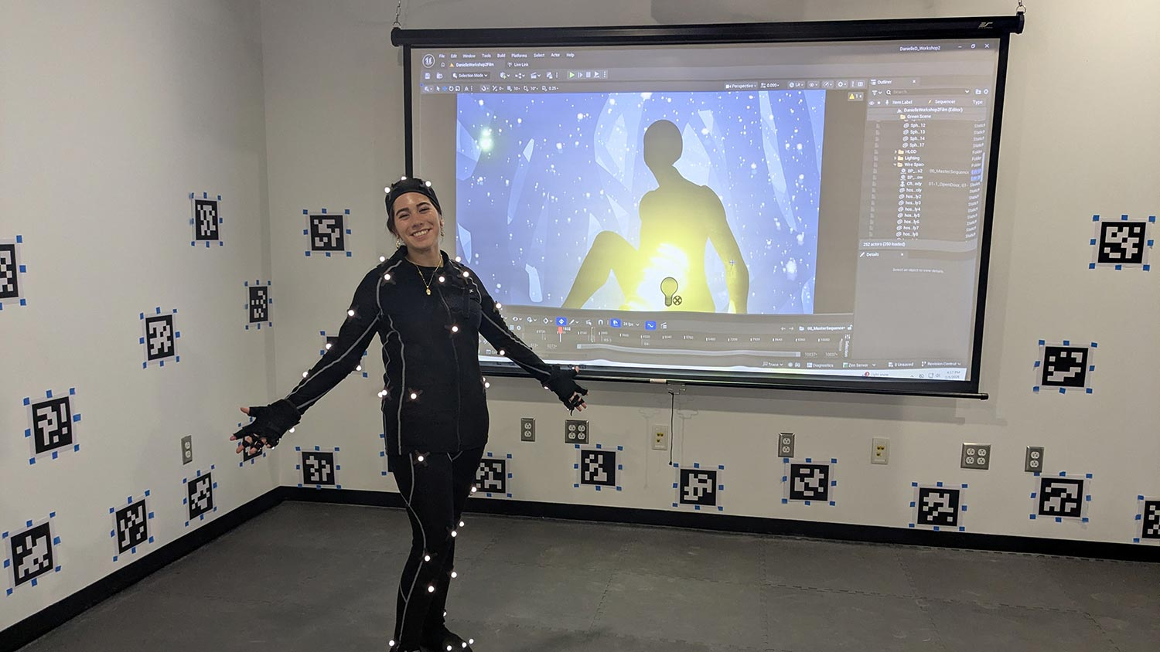
Motivation
SEDS · NU
Need for Low-Cost Pose-Reactive Ball Delivery
Fixed launchers cannot react [Lobster Elite, Sec 1.1]
MoCap is costly and marker-based [OptiTrack/Vicon, Sec 2.1]
Training needs joint-specific delivery
Low-cost cameras can bridge the gap
This thesis builds pose-guided aiming
Figure 2. RIT Motion Capture Lab
Figure 1. Soccer Innovations Ball Launcher
Takeaway:affordable pose-reactive training
RIT Motion Capture Lab image: https://www.rit.edu/facilities/motion-capture-mocap-lab Soccer Innovations ball launcher image: https://soccerinnovations.com/ball-launcher/
2
Notes:
“This project starts from a simple gap.
Commercial ball launchers can repeat shots, but they cannot react to the athlete. They do not know where the player is or which body part should receive the ball.
Professional motion-capture systems can track the body accurately, but they are expensive, marker-based, and mainly used in labs.
So, the motivation is to build a low-cost, markerless system that uses cameras to estimate body joints in 3D and guide the ball launcher.”

Slide 3
Problem Statement & Objectives
SEDS · NU
Can a ball launcher use 3D body-joint tracking for safe autonomous aiming?
Ball localisation
Joint localisation
Objective 1
Objective 2
Mean 3D ball error below 120 mm → Achieved: 95.17 mm corrected
Mean 3D joint error below 180 mm → Achieved: 143.38 mm (62 trials)
Safe integration
Practicality
Objective 3
Objective 4
Six-stage validation S0–S4 completed 2026-04-09. E-STOP <100 ms
Commodity cameras, open-source stack, and about USD 200 perception hardware.
Takeaway: RQ1/RQ2 met within validated scope; RQ3/RQ4 satisfied for static + controlled live-aim only — moving-target firing is the unvalidated boundary (Sec 1.3, 6.4).
3
Notes:
“The main question is whether a ball launcher can use real-time 3D body-joint tracking for safe autonomous aiming.
I focused on four objectives.
First, ball localisation. The target was below 120 millimetres mean 3D error, and the achieved result was 95.17 millimetres.
Second, joint localisation. The target was below 180 millimetres, and the achieved result was 143.38 millimetres over 62 valid trials.
Third, safe integration. The system passed stages S0 to S4, and the emergency stop response was below 100 milliseconds.
Fourth, practicality. The perception system uses four USB cameras and costs about 200 US dollars.
So, the system is validated in static and live-aim conditions. Moving-target closed-loop firing remains the next milestone.”

Slide 4
Background & Research Gap
SEDS · NU
Gap: low-cost systems rarely combine 3D joint tracking with physical launcher actuation.
Table 1. Existing categories and the gap this thesis fills.
Approach
Cost
Accuracy
Markerless
Live-aim closed loop
Optical MoCap (OptiTrack, Vicon)
USD 50k–200k
Very High
No
No launcher
Commercial launchers
USD 200–4k
N/A
Yes
Open-loop only
Vision-guided sports robots
USD 2k–10k
Medium–high
Usually
Fixed zones
This work
~USD 200
Targeting-level
Yes
Aim + controlled single-shot validated
Takeaway: low-cost markerless 3D perception is connected to real launcher aiming; moving-target firing remains next.
4
Notes:
Here I compare my system with the closest existing categories.
Commercial ball launchers are affordable and useful for repetitive training, but they are open-loop. They do not sense the athlete and cannot adapt the shot to a specific body part.
Optical motion-capture systems, such as Vicon or OptiTrack, provide very high 3D accuracy. However, they are expensive, marker-based, and mainly used for tracking only. They are not integrated with a ball launcher.
Vision-guided sports robots are closer to my work because they combine vision with physical actuation. However, they usually target fixed zones, for example in tennis or table-tennis setups, rather than named body joints such as the knee, hip, or shoulder.
My thesis focuses on this gap: a low-cost, markerless system that reconstructs body joints in 3D and connects them to a real Ball Launching Machine. In this work, static and live-aim integration are validated, while moving-target closed-loop firing remains the next milestone.”

Slide 5
Key Technical Components
SEDS · NU
Six contributions across perception, control, safety, and interaction
01 | Pose-reactive aiming at low-cost | Markerless live-aim, commodity hardware (Sec 5.9)
02 | Validated 4-camera 3D targeting pipeline | DLT/SVD, 95.17 mm corrected ball mean (Table 5.1)
03 | High-speed YOLO-Pose launch loop | 6.2 ms/frame TRT FP16, 15 FPS live pipeline (Sec 5.6)
04 | Six-stage safety validation architecture | S0-S4 passed 2026-04-09, E-STOP <100 ms (Sec 3.14.3)
05 | Multi-modal voice command interface | Offline ASR + UDP inter-process channel (Sec 3.12)
06 | Reproducible GT datasets & JSONL logs | 36-pt ball grid + 81-trial joint-touch protocol (Ch 4)
Takeaway:a conventional launcher is upgraded into a pose-guided, safety-gated training system.

Slide 6
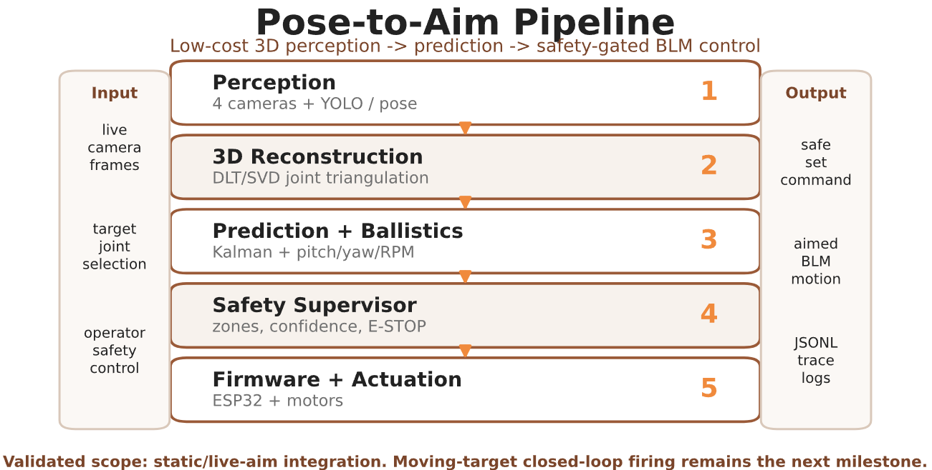
Proposed System — Pose-to-Aim Integration
SEDS · NU
Upgrading inherited BLM hardware with vision-guided aiming, safety, and evaluation.
Inherited platform: 2-DOF BLM, flywheels, ESP32, pan/tilt
Thesis contribution: 4-camera perception, 3D triangulation, targeting
Core integration: pose → prediction → ballistics → safety gate
Validated scope: static/live-aim tests; moving-target firing pending
Takeaway: The thesis contribution is the integration of perception, prediction, safety, and BLM control.
5
Notes:
This slide is where I clearly separate inherited hardware from my thesis contribution. The launcher platform did not start from zero, but the thesis contribution is not mechanical duplication. It is the integration of perception, triangulation, ballistic computation, safety gating, and evaluation into one working autonomous loop. Saying this early helps the committee attribute the right novelty to the thesis rather than to the entire machine history.

Slide 7
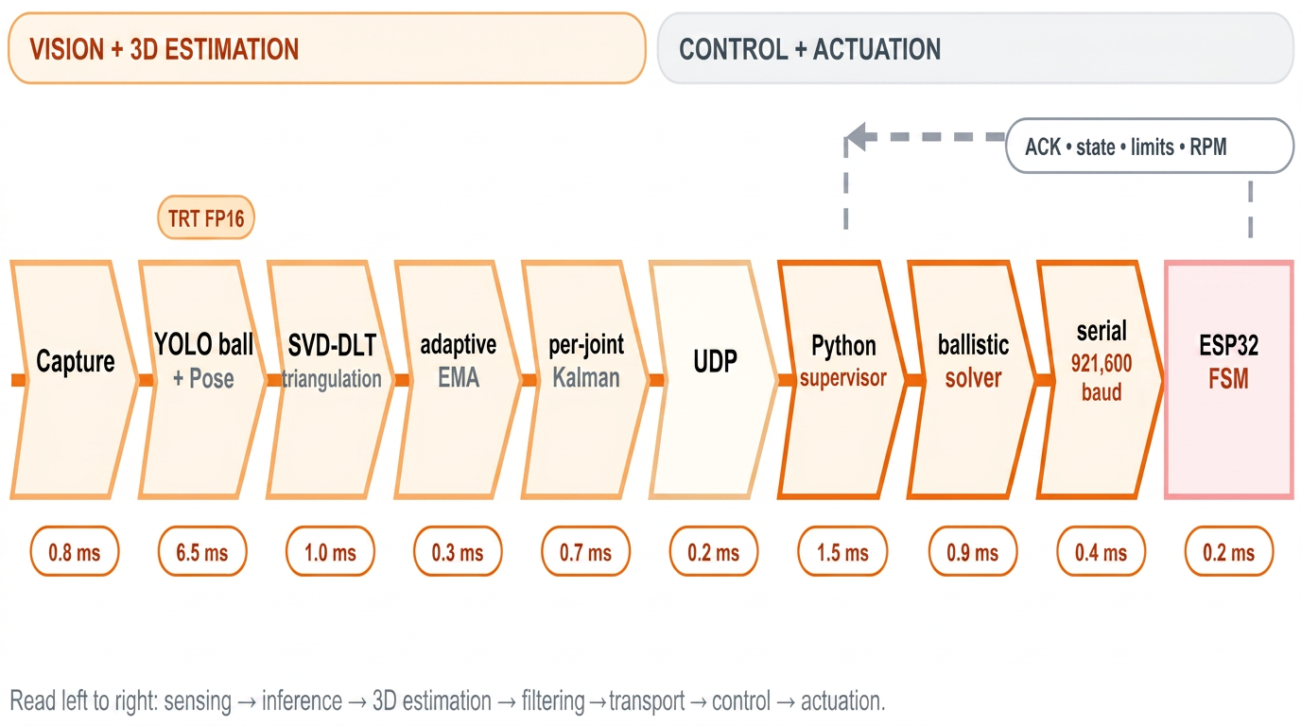
Architecture & Pipeline
SEDS · NU
End-to-end runtime: ≈15 ms, below the 67 ms frame budget at 15 FPS.
Capture 4ms → YOLO-Pose 6.2ms → Triangulate → Kalman → Ballistic Solve → Safety Gates → Serial 2ms → ESP32 FSM | Total ~15ms | Budget 67ms | Headroom 52ms
Synchronized 4-view capture at 1280×720.
DLT/SVD triangulation with robust outlier rejection.
Adaptive EMA + constant-velocity Kalman for predictive lead-time compensation.
921,600-baud serial link to ESP32 cooperative FSM.
Takeaway: compute pipeline ≈15 ms; 52 ms headroom remains within the 67 ms frame budget.
6
Notes:
“The system runs as a left-to-right pipeline. First, four camera frames are captured, then YOLO detects the ball and pose keypoints using TensorRT FP16. The detections are triangulated into 3D using SVD-DLT, then smoothed with adaptive EMA and a per-joint Kalman filter.
The predicted joint position is sent through UDP to the Python supervisor, where the ballistic solver computes pitch, yaw, and wheel speed. The command is then sent over a 921,600-baud serial link to the ESP32 finite-state machine.
The important point is timing. The compute pipeline takes about 15 milliseconds end-to-end, which is well below the 67 millisecond frame budget for 15 FPS. This gives around 52 milliseconds of headroom for overhead, mechanical settling, and safety checks.”

Slide 8
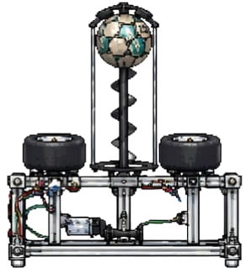
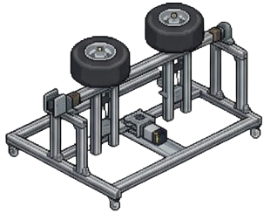
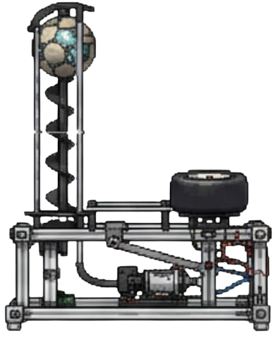
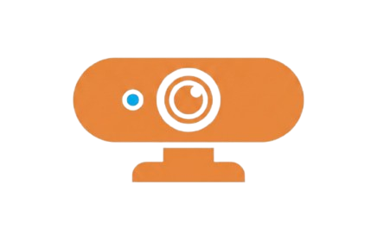
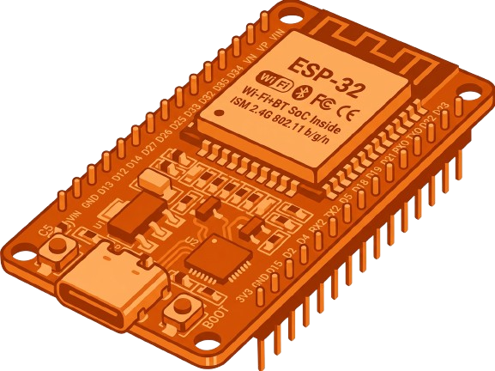
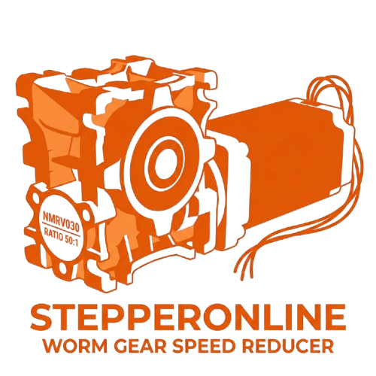
Hardware Implementation
SEDS · NU
Practical actuation paired with low-cost sensing — perception ≈USD 120, total ≈USD 358.
Arena setup: 4 USB cameras at corners, BLM at centre, 24 AprilTag fiducials on walls for extrinsic calibration (Sec 3.5). All hardware fits in a domestic garage — no lab infrastructure required.
4× Hikvision DS-E12 USB cameras (1280×720, ~$30 each).
ESP32 MCU running cooperative FSM (921,600 baud serial link).
Table 2. Indicative hardware cost
NEMA-23 steppers with worm-gear reducers (self-locking for safety).
Item
Cost
Cameras (4×)
~USD 120
ESP32
~USD 8
Steppers + drivers
~USD 90
Flywheel motors + ESCs
~USD 60
Chassis + wiring
~USD 80
Total
≈USD 358
Takeaway: expensive MoCap is not required for pose-guided aiming; perception is ≈USD 120, with ≈USD 358 for the full BLM (Sec 3.2, Table 3.2).
7
Notes:
This slide shows the hardware implementation.
The perception side uses four low-cost Hikvision USB cameras, each running at 1280 by 720 resolution. These cameras are placed around the garage arena and calibrated into one shared 3D coordinate frame using AprilTag markers on the walls.
The actuation side uses the inherited Ball Launching Machine platform. It includes an ESP32 controller, NEMA-23 stepper motors for pan and tilt, worm-gear reducers for self-locking, and counter-rotating flywheels for launching the ball.
The important point is that the expensive part of professional motion capture is replaced by a low-cost camera setup. The perception hardware is about 200 US dollars, while the launcher hardware is integrated as the actuation platform.”

Slide 9
Software Implementation
SEDS · NU
YOLO-Pose + TensorRT enables real-time 4-camera inference within the 67 ms frame budget.
Layer
Module / Tool
Perception
YOLO-Pose + custom YOLO ball detector
Inference
TensorRT FP16, 4-camera batch
Geometry
SVD-DLT multi-view triangulation
Robust ball
iterative reprojection-error rejection (Sec 3.7.2)
Filter
adaptive EMA + CV Kalman (Sec 5.7)
Supervisor
Python, safety gates, ballistic solver
Firmware
control_12_full.ino, ESP32 FSM
Takeaway: multi-camera detections become safety-gated pitch, yaw, and RPM commands.
8
Notes:
“This slide shows the software implementation. The perception system uses YOLO-Pose for body joints and a custom YOLO detector for the ball. Both are accelerated with TensorRT FP16 so that four-camera inference fits inside the 15 FPS timing budget.
After detection, the system triangulates 2D observations into 3D using SVD-DLT. The result is smoothed with adaptive EMA and predicted using a constant-velocity Kalman filter.
The Python supervisor then applies safety gates and computes the ballistic command: pitch, yaw, and wheel RPM. Finally, the ESP32 firmware receives the command and executes it through the finite-state machine.
So the key idea is that the software converts camera detections into safe launcher commands.

Slide 10
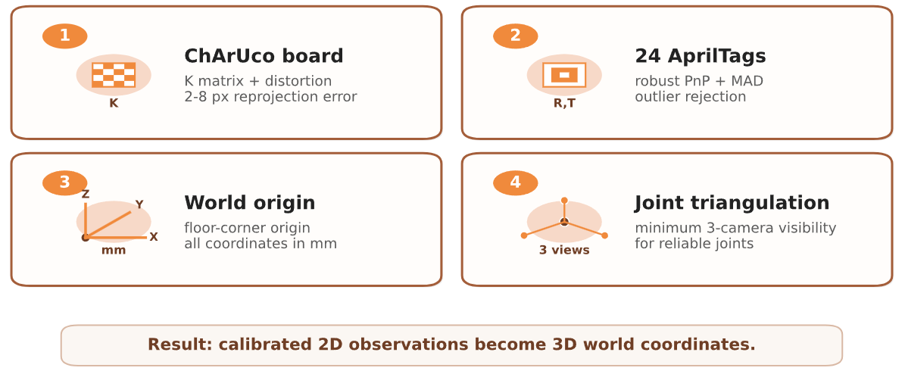
Calibration & Geometry
SEDS · NU
Intrinsic: ChArUco board, reproj 2-8 px (Sec 5.1)
Extrinsic: 24 AprilTags + RANSAC + σ=2.0 sigma-clipping (Sec 3.5.2)
Extrinsic RMSE: 3-7 px after 8-15 % outlier rejection (Sec 5.2)
Overlay validation: reprojected corners within 5-10 px on all 4 cams
Takeaway: one calibrated world frame enables 3D joint coordinates from four USB cameras.
9
Notes:
This slide explains how the four cameras are connected into one coordinate system.
First, each camera is intrinsically calibrated using a ChArUco board. This gives the camera matrix and distortion parameters.
Second, the arena uses 24 AprilTag markers on the walls. These are used for extrinsic calibration, so each camera has a known position and orientation in the same world frame.
The origin is defined at the arena floor corner, and all coordinates are measured in millimetres.
After this, 2D detections from multiple cameras can be triangulated using SVD-DLT. For human joints, I require at least three camera views because pose keypoints are noisier than ball detections.”

Slide 11
Methodology & Experiments
SEDS · NU
Evaluation combines localisation accuracy, dynamic tracking, safety, and traceability.
Experiment
Input
Metric
Outcome
Ball GT
36-point grid
Mean / P95
95.17 mm mean
Joint-touch GT
81 trials
Mean / P95
143.38 mm, 62 valid
Dynamic clips
3 clips
Stability
<800 mm frame-to-frame jumps (slow), motion-blur stress (fast), near-zero false-positive (no-ball)
Bias correction
Axis offsets from GT
Corrected vs raw error
Raw 150.77 mm → corrected 95.17 mm (Fig 5.1)
Safety checklist
S0–S4
Pass / fail + logs
Passed, E-STOP <100 ms
Decision logging
JSONL logs
Auditability
Every actuation logged
Takeaway: localisation, dynamic stability, and safety logging satisfy static + live-aim acceptance. Bias correction was fitted in-sample on the same 36-pt set (Sec 4.4.2, 6.3).
10
Notes:
For evaluation, I used four main experiment groups.
First, ball localisation was tested using a 36-point static grid. After bias correction, the mean 3D error was 95.17 millimetres.
Second, joint localisation was tested using a joint-touch protocol. Out of 81 trials, 62 were valid, with a mean 3D error of 143.38 millimetres.
Third, I tested dynamic clips such as slow ball motion, fast ball motion, and no-ball scenes to check stability and false positives.
Finally, the BLM integration was tested using a staged safety protocol from S0 to S4, with JSONL logging for every decision. This makes each command traceable and keeps the evaluation safety-gated

Slide 12
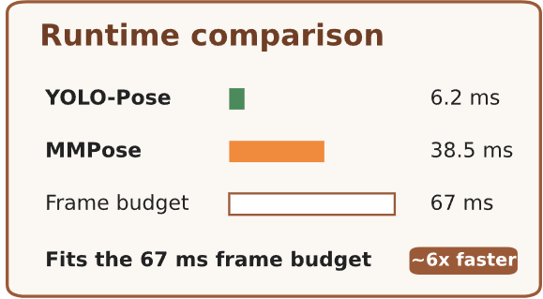
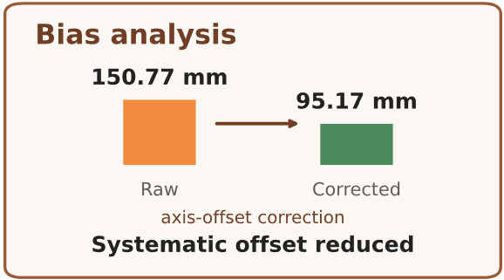
Key Results — Accuracy, Safety, Runtime
SEDS · NU
All thresholds met within validated static/live-aim scope. Raw ball mean 150.77 mm → corrected 95.17 mm via in-sample bias model (Fig 5.1).
Headline results
95.17 mm
corrected ball mean (P95 166.51 mm)
143.38 mm
joint mean over 62 valid trials (P95 198.73 mm)
110 / 150 / 164 mm
knee / hip / shoulder means; P95 171 / 172 / 200 mm (Table 5.3)
<100 ms
E-STOP latch response (Sec 3.14.3)
15 FPS
live YOLO-Pose pipeline; ≈15 ms compute, 52 ms headroom (Sec 3.3)
Takeaway: localisation targets were met; safety and runtime support static/live-aim validation.
11
Notes:
This slide summarises the main results.
For ball localisation, the corrected mean 3D error was 95.17 millimetres, which is below the 120 millimetre target.
For joint localisation, the mean error was 143.38 millimetres across 62 valid trials, below the 180 millimetre target. The knee had the lowest error, while the shoulder had the highest error because it is higher in the arena and has weaker camera overlap.
The safety result was also validated in the static and live-aim regime. The emergency stop response was below 100 milliseconds.
Finally, the software runs at 15 FPS. YOLO-Pose with TensorRT processes a four-camera batch in about 6.2 milliseconds, which fits within the real-time frame budget

Slide 13
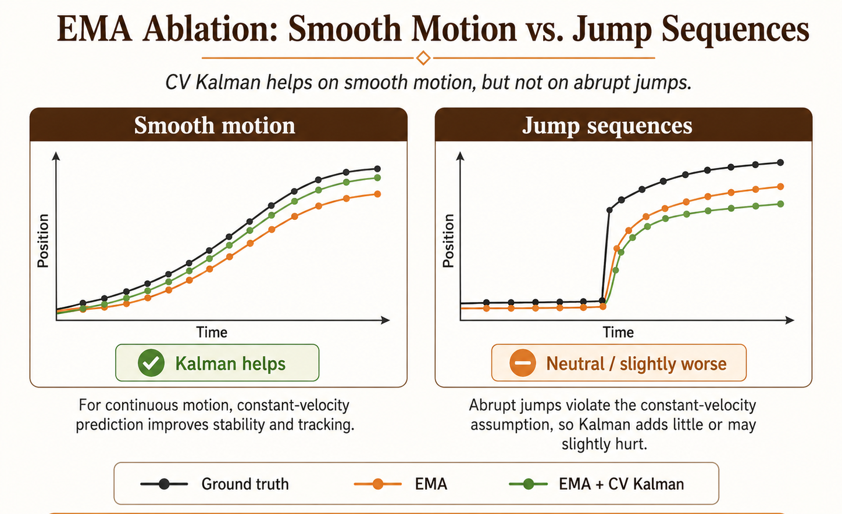
Limitations & Challenges
SEDS · NU
1. UNVALIDATED: closed-loop firing at a moving subject (Sec 1.3, 6.3)
2. In-sample bias correction — fitted on same 36-pt set (Sec 4.4.2, 6.3)
3. 19 / 81 joint-touch trials invalid (23.5 %) due to occlusion (Sec 5.4)
4. RPM → velocity not empirically calibrated (Sec 5.9, 6.4.3)
5. Single-person, single-arena, indoor-only evaluation (Sec 6.3)
6. CV Kalman neutral on jump motion — IMM filter is future work (Sec 5.7)
Boundary
Moving-target closed-loop firing pending
Generalisation Single subject, one arena, indoor lighting
Visibility 19 / 81 joint trials invalid from occlusion
Ballistics RPM → velocity calibration missing
Hardware drift Pan/tilt homing needs more validation
Takeaway: validated scope (perception → safety-gated single-shot live-aim) is a strong partial validation. The unvalidated boundary — moving-subject closed-loop firing — is precisely defined and is the next milestone.
13
Notes:
This slide summarises the main limitations.
The system is validated for perception, 3D targeting, safety gates, and static or live-aim tests. However, fully autonomous closed-loop firing at a moving subject has not yet been validated, and I define this clearly as the next milestone.
There are also practical limitations. The evaluation used one subject, one indoor arena, and controlled lighting. In the joint-touch experiment, 19 out of 81 trials were invalid mainly because the joint was not visible from enough cameras.
Another limitation is the ballistic model. The RPM-to-velocity calibration is still missing, so future work should measure the real exit velocity of the ball at different wheel speeds.
Finally, the Kalman filter works well for smooth walking or jogging, but abrupt jumps are harder because they violate the constant-velocity assumption

Slide 14
Conclusions & Contributions
SEDS · NU
Static/live-aim validation completed; moving-target firing remains future work.
Low-cost 3D perception
2
4 USB cameras, ≈USD 120 perception / ≈USD 358 total
Pose-reactive aiming
Training-mode interface
1
4
BLM aims live from 3D joints (Sec 5.9)
Voice + keyboard control behind safety gates (Sec 3.12)
Safety-gated S0–S4 integration, E-STOP <100 ms (Sec 3.14.3)
3
S0–S4 passed; E-STOP <100 ms
Takeaway: strong partial validation of a low-cost, pose-guided BLM. Disadvantages: in-sample bias fit · 3-camera occlusion floor · RPM → velocity not yet calibrated.
14
Notes:
To conclude, this thesis makes four main contributions.
First, it demonstrates pose-reactive aiming, where the launcher computes pitch, yaw, and wheel-speed commands from live 3D body-joint positions.
Second, it shows that low-cost 3D perception is feasible using four commodity USB cameras and open-source vision tools, with perception hardware around 200 US dollars.
Third, it contributes a safety-gated integration protocol. The system passed stages S0 to S4, the emergency stop response was below 100 milliseconds, and every actuation decision was logged.
Fourth, it integrates a training-mode interface where voice commands can select joints and control the system without bypassing the safety gates.
Overall, the thesis provides a strong partial validation of the pose-guided BLM concept. The remaining milestone is full closed-loop firing at a moving subject.

Slide 15
Future Work + Ethics & Standards
SEDS · NU
Next milestone: moving-target closed-loop firing with calibrated RPM-to-velocity mapping.
Future roadmap
Safety & Ethics
Moving-target closed-loop firing
RPM → velocity calibration
Predictive lead compensation
Virtual 3D Goal impact detection
SLAM camera re-localisation
ISO 12100
ISO 13849-1
Machinery safety — L1–L10 hazard map (Sec 3.14)
Safety-related control — NC E-STOP = ISO 13849-1 Cat-1 stop (L8)
IEC 60204-1
ISO 10218-1
Wiring, fusing, E-STOP — 24V/50A fuse, single star-point ground (Sec 3.2)
Operator-only zone during controlled fire (Sec 3.14.2)
Applicability: sports training, rehabilitation, and adaptive PE instruction.
Dual-use: a system capable of autonomously tracking human body parts and directing a projectile has obvious dual-use potential beyond sports training. Operator presence, hardware NC E-STOP, exclusion zone, and the six-stage protocol are the necessary safeguards (Sec 6.5).
15
Notes:
This final slide shows the roadmap and safety framing.
The immediate next milestone is moving-target closed-loop firing. To do that properly, the RPM-to-velocity calibration must first be completed, because the system needs the ball flight time to aim at the predicted future joint position.
After that, the next steps are predictive lead compensation, SLAM-based camera re-localisation, and the Virtual 3D Goal, which would measure ball impact using the same camera system instead of physical sensors.
On the safety side, the design is aligned with machinery and robotics safety principles: risk assessment, safety-related control, electrical safety, emergency stop behaviour, and human exclusion during operation.
So future work is not only about increasing autonomy. It is about closing the moving-target loop while keeping the system safe, traceable, and ethically controlled.”

Slide 16
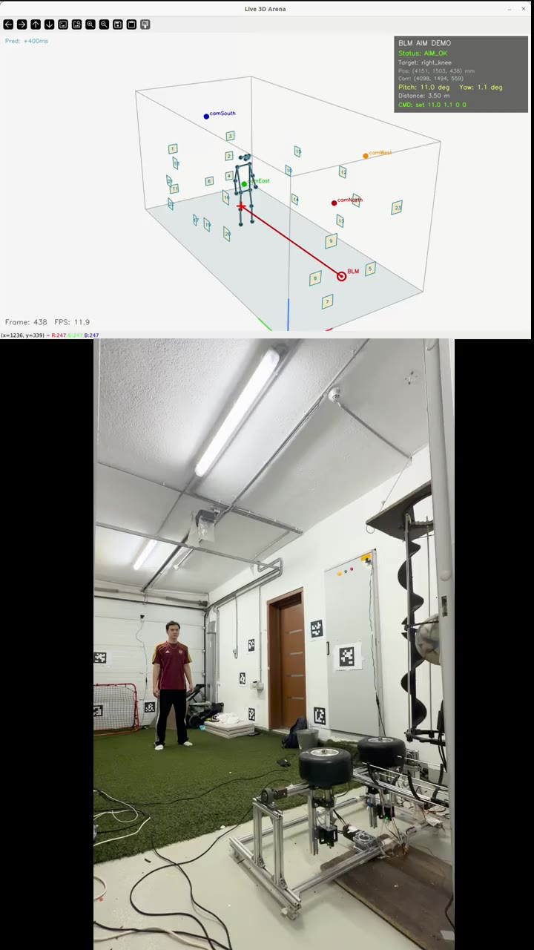
A1 · Live Demo
SEDS · NU
APPENDIX
Arena 3D tracking, trimmed to 20–30 s.
Demo clip: arena 3D tracking, 20-30 s.
[Hidden slide — unhide only if panel asks a relevant question]
Unhide only if the panel asks for a demo or a buffer opens.
Notes:
Play if asked for a demo or if a three-to-five-minute buffer opens. Mute audio. Keep the clip to twenty or thirty seconds; longer loops lose the panel. Before pressing play, state what they are looking at: four-camera capture, live triangulation, and Kalman-smoothed joint trace. If the video cannot be embedded inline on the target machine, substitute the mosaic2d fallback from V-02 in the assets checklist and narrate the same framing.

Slide 17
A2 · 10-Layer Safety Stack
SEDS · NU
APPENDIX
OPERATOR (human authority, top) → SOFTWARE GATES (L1-L6: zone, confidence, stability, angle clamps, RPM clamps) → HARDWARE INTERLOCKS (L7-L10: firmware RPM gate, arm+confirm, NC E-STOP, link-loss watchdog, exception shutdown). Each layer is independently sufficient to prevent unsafe actuation.
L1
Zone gate — reject targets outside safe arena
L6
RPM gate (Python side)
L2
Confidence gate — per-joint + ball detection score
L7
RPM gate (firmware side)
L3
Stability gate — multi-frame temporal filter
L8
Arm state + typed confirmation
L4
Angle clamp (Python side)
L9
Hardware E-STOP (NC) + link-loss watchdog
L5
Angle clamp (firmware side)
L10
Python exception path — safe shutdown
[Hidden slide — unhide only if panel asks a relevant question]
Key points: angle clamp and RPM gate each implemented TWICE (Python + firmware). NC E-STOP means broken wire = safe stop. Link-loss watchdog auto-safes on network drop.
Notes:
Use if the panel asks what happens if X fails. Walk from L1 down: software gates first, then hardware interlocks, then the human authority. Key points to volunteer: the angle clamp and RPM gate are each implemented twice, once in Python and once on the ESP32, so either layer alone is sufficient. The hardware E-STOP is normally-closed so a broken wire stops the machine, not starts it. Close by naming the link-loss watchdog as the answer to network-drop questions.

Slide 18
A3 · End-to-End Latency Budget
SEDS · NU
APPENDIX
Per-stage timings from the live run.
From perf_blm_20260409_133818.jsonl (17 frames)
Stage Mean ms P95 ms
capture_ms 0.0 0.0
ball_ms 36.6 108.0
pose_ms 34.7 97.0
triang_ms 2.6 2.7
udp_ms 0.2 0.2
viz3d_ms 5.4 8.3
total_ms 92.3 230.3
end_to_end_ms 89.7 108.4
[Hidden slide — unhide only if panel asks a relevant question]
Total perception: ~15 ms. Well under the 67 ms (15 FPS) budget with 52 ms headroom. Kalman 200-400 ms prediction window covers the mechanical settling time — this is why predictive tracking matters.
Notes:
Use if the panel asks about real-time guarantees. Before pointing at numbers, name the three dominant stages: YOLO inference, triangulation plus Kalman, and mechanical settling. Volunteer that the ninety-fifth percentile for perception stays inside two frame intervals at fifteen FPS, which is why the Kalman predict-step of two hundred to four hundred milliseconds covers worst-case launcher travel. If pushed, note that the latency table is the artifact behind the hundred-and-twenty millisecond claim on slide six.

Slide 19
A4 · ECE Curriculum Mapping
SEDS · NU
APPENDIX
Courses → concepts → evidence in the thesis.
Course
Concept used
Evidence in thesis
Signals & Systems
Kalman filter, EMA, frequency domain
Per-joint CV Kalman; adaptive EMA tuning
Control Systems
Closed-loop feedback, stability
Supervisor → FSM → motor loop; stop paths
Embedded Systems
RTOS-like cooperative FSM, UART
control_12_full.ino at 921,600 baud
Computer Networks
UDP vs TCP, link-loss handling
UDP target broadcast + watchdog timeout
Engineering Ethics
Risk, safety, responsible deployment
ISO 12100 / 13849-1 / IEC 60204-1 alignment
[Hidden slide — unhide only if panel asks a relevant question]
Use only if asked which courses prepared you for this.
Notes:
Use only if asked which courses prepared you for this. Pick two rows to highlight, not five. Signals and Systems maps directly to the Kalman filter and the EMA smoother. Control Systems is the supervisor-to-motor loop. Embedded Systems is the cooperative finite-state machine in control_12_full.ino. Computer Networks covers the UDP link and the watchdog. Engineering Ethics maps to the three ISO standards on slide fifteen. End with one sentence on which course was most directly applied.

Slide 20
Q: Why not use Intel RealSense depth cameras?
SEDS · NU
APPENDIX · Q&A BACKUP
Cost, redundancy architecture, and occlusion tolerance drive the 4x USB camera choice
Cost comparison
4x Hikvision DS-E12 USB cameras: ~$120 total ($30 each)
4x Intel RealSense D435: ~$800+ total ($200+ each)
Recycled PC handles all inference — no depth-specific compute needed
Redundancy architecture
4 overlapping views: if one camera is occluded, 3 remain for triangulation
RealSense single unit = single point of failure; depth occlusion by ball or limb is common
DLT/SVD triangulation explicitly designed for variable camera-count inputs
Accuracy argument
95.17 mm corrected ball mean achieved with commodity RGB cameras
RealSense depth noise at 3-5 m range is 3-20 mm — marginal gain for 7x cost increase
Scope
Controlled indoor arena only. Outdoor / variable lighting is acknowledged future work.
Answer: 4x USB cameras give occlusion redundancy, cost $120 vs. $800+ for RealSense, and already achieve 95.17 mm accuracy at indoor arena distances.

Slide 21
Q: How does the Kalman filter handle sudden position jumps?
SEDS · NU
APPENDIX · Q&A BACKUP
Constant-velocity model with process noise — tested in Section 5.7, honest about limitations
Kalman model used
Constant-velocity (CV) model: state = [x, y, z, vx, vy, vz]
Process noise Q tuned to allow fast re-acquisition after direction changes
Prediction window: 200-400 ms ahead to compensate mechanical settling time
Jump sequence behaviour (Section 5.7)
On sudden position jumps, prediction error spikes then recovers within 2-3 frames (133-200 ms)
Ablation showed neutral-to-negative improvement on jump sequences vs. EMA alone
This is acknowledged honestly: Kalman helps smooth normal motion, not abrupt jumps
Why it still matters
For steady-state walking/running, CV Kalman reduces targeting jitter significantly
The 200-400 ms prediction covers mechanical lag — without it, the shot always hits where the target WAS
Extended Kalman or IMM models are future work for jump-robust prediction
Answer: CV Kalman works well for smooth motion; jump sequences show neutral improvement vs. EMA alone (acknowledged in Section 5.7). The prediction window is essential to cover mechanical settling lag.

Slide 22
Q: When and how will RPM-to-velocity calibration be completed?
SEDS · NU
APPENDIX · Q&A BACKUP
Protocol designed (Section 6.4.3) — Doppler radar or high-speed camera approach
Current state
Ballistic solver currently uses an analytic RPM-to-velocity model (theoretical relationship)
No empirical ground-truth mapping yet: RPM commanded vs. actual ball exit speed
This is listed as the #2 future work item after closed-loop moving-target firing
Planned calibration protocol (Section 6.4.3)
Option A: Doppler radar gun — direct ball exit speed measurement per RPM setting
Option B: High-speed camera (240+ fps) — pixel-tracking ball over known distance
50-100 shots across RPM range (0, 500, 1000, 1500, 2000 RPM per motor)
Fit polynomial or lookup table: commanded RPM → measured exit speed (m/s)
Impact on current results
Current ball accuracy (95.17 mm) is achieved WITHOUT empirical calibration
Empirical calibration expected to reduce ballistic error further — accuracy will improve
Safety clamps on RPM (firmware + Python) remain regardless of calibration state
Answer: protocol designed (Section 6.4.3), not yet executed. Doppler radar or high-speed camera approach. Current 95.17 mm accuracy is achieved without it — empirical calibration will improve results further.

Slide 23
A5 · Firmware command excerpt
SEDS · NU
APPENDIX
// control_12_full.ino
void handle_set(){
// set <v> <h> <wl> <wr>
float v = Serial.parseFloat();
float h = Serial.parseFloat();
int wl = Serial.parseInt();
int wr = Serial.parseInt();
if(!armed) return;
clampAngle(v, h);
gateRPM(wl, wr);
target_v = v; target_h = h;
}
Course
Concept used
Evidence in thesis
Signals & Systems
Kalman filter, EMA, frequency domain
Per-joint CV Kalman; adaptive EMA tuning
Control Systems
Closed-loop feedback, stability
Supervisor → FSM → motor loop; stop paths
Embedded Systems
RTOS-like cooperative FSM, UART
control_12_full.ino at 921,600 baud
Computer Networks
UDP vs TCP, link-loss handling
UDP target broadcast + watchdog timeout
Engineering Ethics
Risk, safety, responsible deployment
ISO 12100 / 13849-1 / IEC 60204-1 alignment
[Hidden slide — unhide only if panel asks a relevant question]
Use only if asked which courses prepared you for this.

