Slide 1
File Transfer Application
Wu Wei
Stephan Kölker

Slide 2

Technologies
Standard Libraries
No external libraries
Socket: java.net

Slide 3
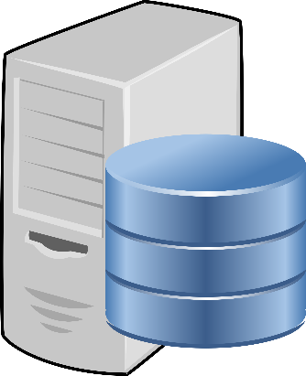

Procedure
Create ZIP
Request
Start
sockets
Number of files
Ready
Huge file
Several normal files
Thousands of tiny files (ZIP)
Unzip tiny files
Notes:
2 threads, 2 simultaneous transmissions
More threads → more overhead
Huge file: Bottleneck
Useless to use more threads for smaller files
Thousands of tiny files: zip (created immediately after server startup)
File transfer: 1. File name, 2. file size, 3. file content

Slide 4
Enhancements
Socket buffer size: 62 KB
Disk buffer size: 1.24 MB
Turn off Nagle’s algorithm
SO Linger Interval: 60
Number of threads: 2
Also possible: Increase MTU
Notes:
Maximize payload of IP package (consider fragmentation)
Disk buffer size = 200 * Socket buffer size (spontaneous value)
Cannot manipulate MTU with Java

Slide 5
Alternatives
java.net or java.nio.channels?
Split huge file into parts
UDP or TCP for certain files
Notes:
java.nio.channels provides more low-level approach (like in C)
Split huge file:
No efficient possibility
always slower
UDP or TCP:
If UDP: how to ensure data consistency?

