Slide 1
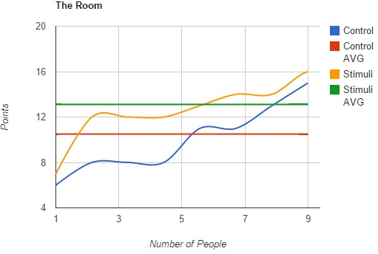
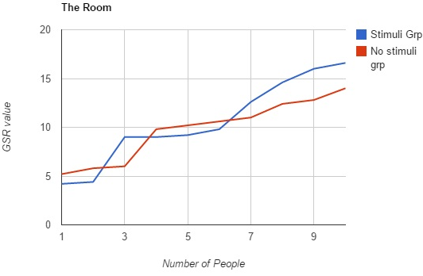
Increasing immersion by touching people
Konstantin Hadzhiev, Tristan Jansen, Joery Verstraeten, Preslav Petkov, Vincent Drent, Rui Wang
Introduction
As a fast growing field in both size and popularity, Virtual Reality is spreading into other fields as well. For example its methods and equipment can be used to create stimulations for several psychophysiological measurements.
For quite a long time now psychologists have been simulating peoples’ phobias to help them encounter them in a safe, controlled environment. Virtual reality takes this method to a whole new level with devices like the Oculus Rift and proper sound effects which make the experience immersive enough. We wanted to take it even further by stimulating as many senses as we could, so that the immersion could be even greater and the brain would be tricked into believing that the situation is real.
Goal of present study
To measure how much physical stimuli, like touching the subjects arm, increases the level of immersion in a virtual environment. If it does enhance immersion, then this type of stimuli could help certain treatments, for example a fear of spiders, because people would be presented with an almost real scenario, but it would be entirely controlled and safe.
20 subjects were divided equally over two experimental conditions: One group receiving tactile stimulation (e.g., touching the arm) on top of experiencing the visual VR world, and the other group only seeing the VR environment without tactile stimulation. For each individual we measured their galvanic skin response(sweatiness of their hands) during the experiment and afterwards we gave them a questionnaire. For our experiment we used household objects to simulate the physical stimuli, for example a toothpick served as a needle.
Results
The above graph shows how immersed the testsubjects felt according to the questionnaire. Points were assigned to the answers in the questionair, meaning the more points a testsubject has, the more immersed he/she felt. The results of the questionnaire show that the testsubjects that received physical stimuli felt more immersed than the testsubjects that did not receive any physical stimuli
Discussion
The results we managed to get were largely influenced by whether the test subject had prior experience with Oculus Rift or not. People who tried on the Rift for the first time had a slightly higher GSR rating than people who had used it before.
It was challenging to time the physical stimuli according to the application as the smallest delay could destroy the immersion of the test subject.
We had hardships to determine the best physical stimuli for each scenario.
The above graph shows how much the GSR value increased from the starting value to the highest measured value. The results show that the values roughly the same, but the peak for some of the physically stimulated subjects was higher than for the control group.
Methods
We had our test-subjects seated in a chair, and had them put on an Oculus Rift and run our application. We designed our application as such that the test subjects experienced 4 different scenes, for example a doctor touching them and injecting them with a needle. The environment was fitting for every scene (e.g. doctor scene contained doctor appliances) in order to increase immersion. As the experiment proceeded the scene shifted to another one.
Conclusion
The level of immersion in a virtual environment is increased by applying physical stimuli during the simulation.
Alternatively , touching people works!

