Slide 1
Increasing immersion by touching people
A psychological virtual reality experiment

Slide 2
Research Question
How much does physical stimuli increase immersion?

Slide 3
Research Method
Tools:
Oculus Rift
Unity3D
Additional hardware
Physical stimuli
GSR measuring tools (e.g.: BioPac)
Method:
20 users, 10 of which in the control group.
Users received physical stimuli in real life, corresponding to what happened in virtual reality.

Slide 4
Research Method
Tools:
Oculus Rift
Unity3D
Additional hardware
Physical stimuli
GSR measuring tools (e.g.: BioPac)
Method:
20 users, 10 of which in the control group.
Users received physical stimuli in real life, corresponding to what happened in virtual reality.

Slide 5
Expectations
General expectations:
Control group will be less immersed than the other group.
GSR results will correspond to this.

Slide 6
Results
Initial thoughts:
Initially, results seemed to be all over the place.
On closer inspection the results are more on par with what we expected.
Users having existing experience with computer games or virtual reality affects the results.
After analysis:
To get usable data out of the questionnaire we assigned a value to each answer.
Higher value means more immersion.
The control group does indeed seem to be less immersed than the other group that received stimuli.

Slide 7
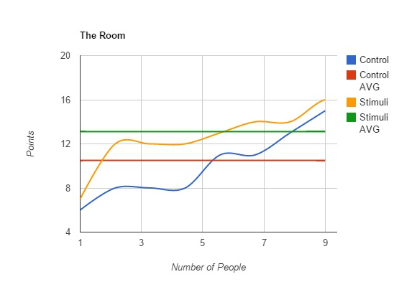
Results
Questionnaire results:
Higher average and overall score for the stimuli group.

Slide 8
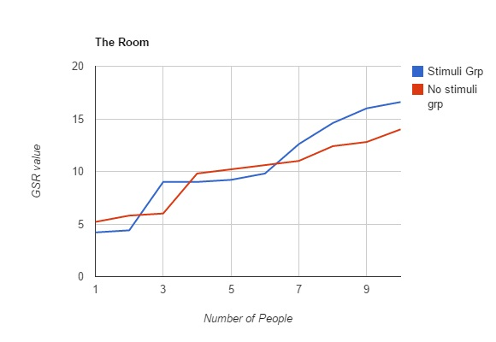
results
GSR results:
Stimuli group has a higher average value.
Not completely decisive; baseline differs per person.

Slide 9
discussion
Observations:
Prior experience with virtual reality influenced the results.
More experienced, often less immersed (no “wow-factor”).
Hardships:
Getting the timing right for the physical stimuli was difficult; it has to correspond with what happens in the virtual environment.
Determining the right way to stimulate the user proved to be difficult.

Slide 10
Conclusion
Overall, the stimuli group seems to be more immersed.
Some results are “clouded” by first time users of the Oculus Rift and maybe even by non-gamers.
If a similar experiment is carried out, it would be recommended to do better screening of the test subjects.

Slide 11
questions
?

