Slide 1


Open data database for reusable waste

Slide 2
The problem
No platform for digitization and inventory of reusable waste.
Even factories that would like to recycle in the production process rarely use recycled material, because it is difficult, they end up using up natural resources.
High impact of the communities being illitirate about how to recycle correctly and what impact have for the environment immature choices about disposing garbage.

Slide 3
The idea
A database completely open to anyone who may be concerned about the environment.
A website that can display the data in a meaningful way that anyone can understand and also have a user-friendly interface for navigation.
Also this website will motivate and educate the local communities to act with a more mature life style that can reduce the non reusable garbage and recycle the reusable ones.
In the future the database can be accessed easily by other applications or websites with an API

Slide 4
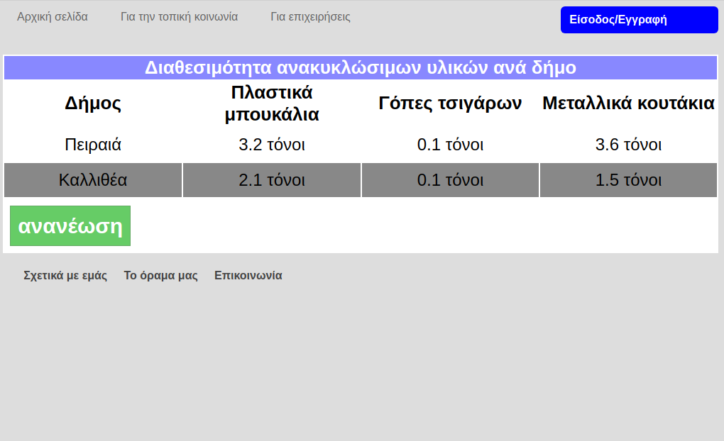
A draft design of the web application

Slide 5
Market size and average cost
This focuses on the secondary raw material market which is rapidly growing, but curbed by the financial crisis. This is going to provide help for this market to overcome the challenges of the financial crisis.
The average cost for a starting data center is 1000 euros and there are additional costs for usage and maintenance and also costs for scaling for the needs of the market(extra servers, extra storage, etc). This can be reduced if local authorities can provide a hosting environment.
The main revenue stream will be ads on the website and a small subscription fee for the businesses and also a fee if the business wants the material delivered.

Slide 6
Stakeholders and targets
Local authorities
Businesses that can use secondary raw materials
Communities
Professionals that work on the field of recycling and garbage collection
Policy-makers
Research centers that work on predicting the impact of mismanaged waste(by combining data from other databases)

Slide 7
How does this help?
Local authorities and the community can collaborate to make a more sustainable economy
Businesses can locate resources from reusable waste that can get with a small charge
High positive impact to environment by reducing the usage of the finite natural resources and reducing harmful activities to the environment by reducing the need for harvesting natural resources

Slide 8
How does this help?
(cont.)
An open data inventory that anyone can use and produce their own data analysis on certain parameters that the database can feed.
For the future:include the supply and demand of secondary raw materials to make a matching between corporations that produce some kind of waste that the other corporation needs for the production process

Slide 9
What effects can this solution have on the environment?
This system will use low power consumption data center, this facility will also use renewable energy as the main supply, like PV cells. And also the programming will be as light to execute as possible.
The waste made by the staff working, or by other processes will be recycled, or disposed as efficiently as possible.
But those two factors are not enough, as it will have a part of their power consumption supplied by burning fossil fuels, but it will be as low as possible by combining low consumption computational units with renewable energy.

Slide 10
Thank you
Thank you for your attention!

