Slide 1


BLOCKCHAIN-BASED CROWDFUNDING PLATFORM
SUBJECT: BLOCK-CHAIN TECHNOLOGY
SUB-CODE: BCS613A
SEMESTER: 6th
SECTION: BHASKARA
PRESENTED BY:
KOUSTAV DUTTA (1VE23CS082)
MAYANK SINGH (1VE23CS100)
MOHIT PAL (1VE23CS106)
NEELOTPAL GHOSH(1VE23CS114)

Slide 2
INTRODUCTION & PROBLEM
  Crowdfunding is widely used for startups, social causes, and innovation
  Traditional platforms (centralized) suffer from:
    Lack of transparency in fund usage
    Risk of fraud and fake campaigns
    High platform fees and control by intermediaries
  Users cannot verify how funds are actually used
Problem: Trust and transparency are missing
01

Slide 3
PROPOSED SOLUTION
  BlockFund uses blockchain technology to solve these issues
  Smart contracts ensure:
  Funds are locked securely
  Rules are enforced automatically
  Every transaction is:
  Transparent
  Immutable (cannot be changed)
  No need for third-party control
02

Slide 4
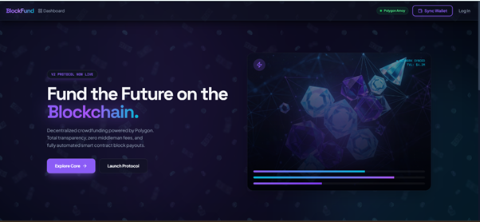
LANDING PAGE
03

Slide 5
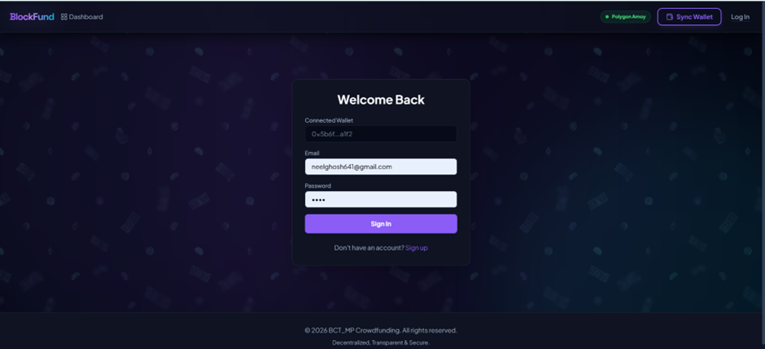
LOGIN PAGE
04

Slide 6
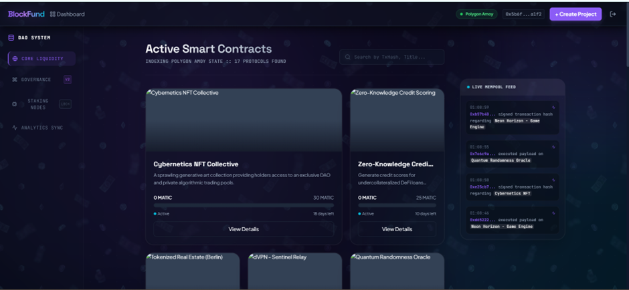
DASHBOARD
05

Slide 7
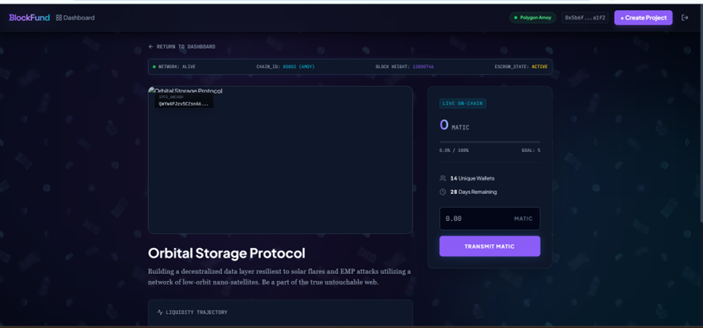
CAMPAIGN DETAILS PAGE
06

Slide 8
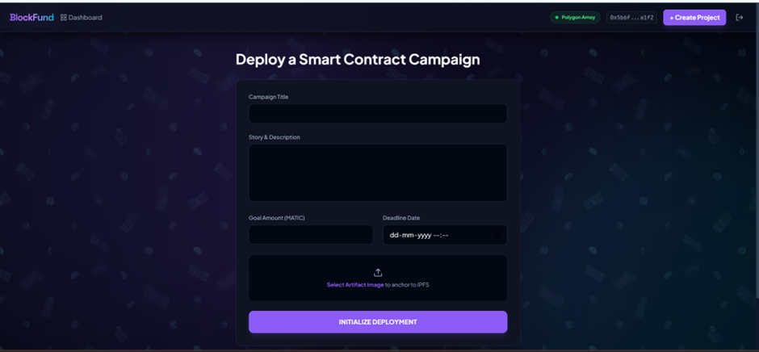
CREATE CAMPAIGN PAGE
07

Slide 9
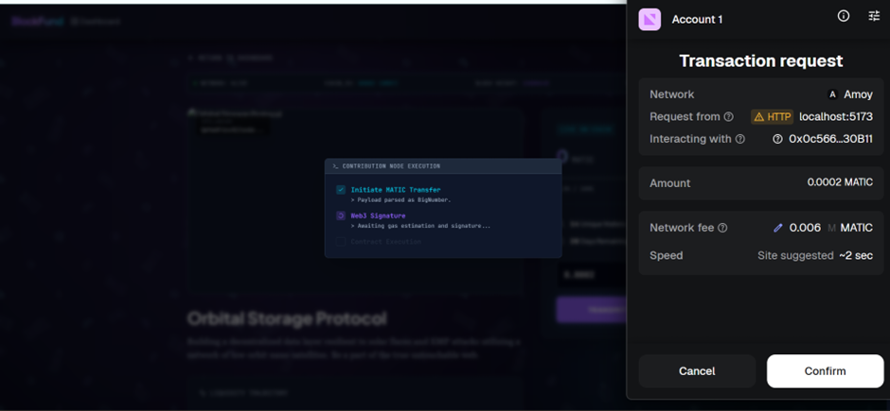
TRANSACTION / CONTRIBUTION PAGE
08

Slide 10
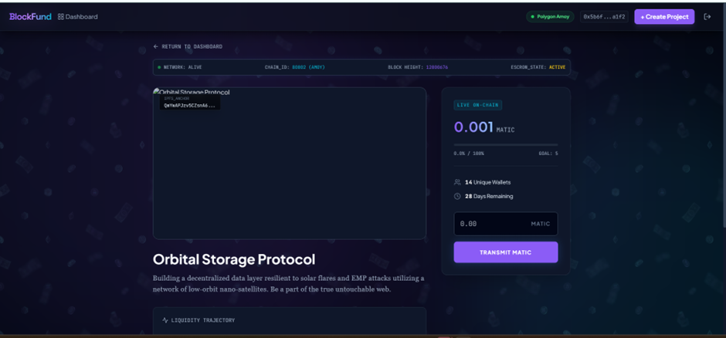
AFTER TRANSACTION PAGE
09

Slide 11
ADVANTAGES & USE CASES
Advantages:
  Eliminates intermediaries
  High security and data integrity
  Transparent and tamper-proof
  Global accessibility
  Trustless environment
Use Cases:
  Startup fundraising
  Charity and donations
  Disaster relief funding
  Community-driven projects
10

Slide 12
CONCLUSION
  BlockFund leverages blockchain to improve crowdfunding
  Smart contracts ensure fairness and automation
  Provides a transparent and secure funding ecosystem
Future Scope:
  Mobile application
  Multi-chain integration
  AI-based fraud detection
11

Slide 13
2nd May, 2030
THANK YOU

